Slide 1
Participant Completion & Certification Strategies
Day 2, Session 4: Nursing Expansion Institute

Slide 2

Moderator/Presenter
Kara Conroy
  Senior Researcher
    Mathematica
      kconroy@mathematica-mpr.com
        734-205-3105

Slide 3
Agenda
Session Objectives & Guiding Questions
Completion & Certification Key Considerations
What is a credential? Why is it important?
Promising Practice
  The Workplace
Small Group Discussion
Q&A

Slide 4
Session Objectives and Guiding questions
Objective
  Define a “credential”
  Explore the benefits of a credential
  Discuss strategies that grantees can use to help participants move from course completion to certification

Slide 5
Guiding questions
Guiding Questions
  What steps should grantees take as participants near course completion to prepare for certification? When should they take these steps?
  What are the benefits of obtaining a credential?
  What counts as a credential?
  What certification challenges have participants faced and what are strategies to address them?

Slide 6
Completion & Certification Components
Outreach & Recruitment | Intake, On-ramps, & Enrollment | Training/ Education Progress | Completion & Certification | Placement | On-the-Job Retention

Slide 7
Key Considerations & Components of Completion and Certification
Last 25% of courses
Academic and career advising
Career trajectory discussions – to employment or additional training/ education
Connection to career opportunities
Course completion
Required exams and assessments
Credential application and attainment
Tracking and reporting of milestones and outcomes

Slide 8
What is a credential? Why is it important?

Slide 9
What is a recognized postsecondary credential?
Section 3(52) of WIOA defines a “recognized postsecondary credential” as:
  a credential consisting of an industry-recognized certificate or certification,
  a certificate of completion of an apprenticeship,
  a license recognized by the State involved or Federal Government, or
  an associate or baccalaureate degree.
4 characteristics strengthen the value of credentials to individuals and businesses: industry-recognition, stackability, portability, and accreditation

Slide 10
The Many Benefits of Credential Attainment
For job seekers, obtaining a credential can…
  Improve their employability by documenting the skills and competencies they bring to an employer
  Lead to higher earnings, greater advancement opportunities, and enhanced job security.
For employers, credentials can assist in…
  Identifying qualified workers,
  Upskilling their current workforce, and
  Helping them better compete in the marketplace.

Slide 11
What “Counts” as a postsecondary credential?
CareerOneStop’s Credential Finder can help you find specific credentials by industry
ETA’s Post Secondary Credential Attainment Tool can help you determine if a credential you are considering would “count” toward your grant’s credential attainment indicator

Slide 12
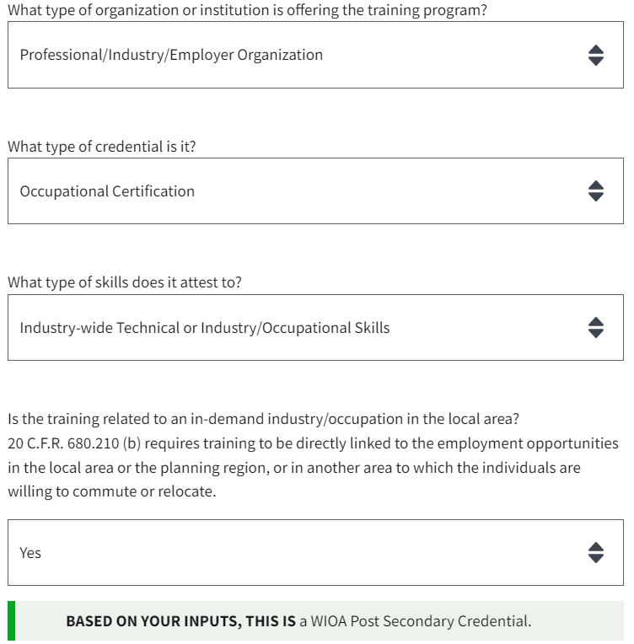
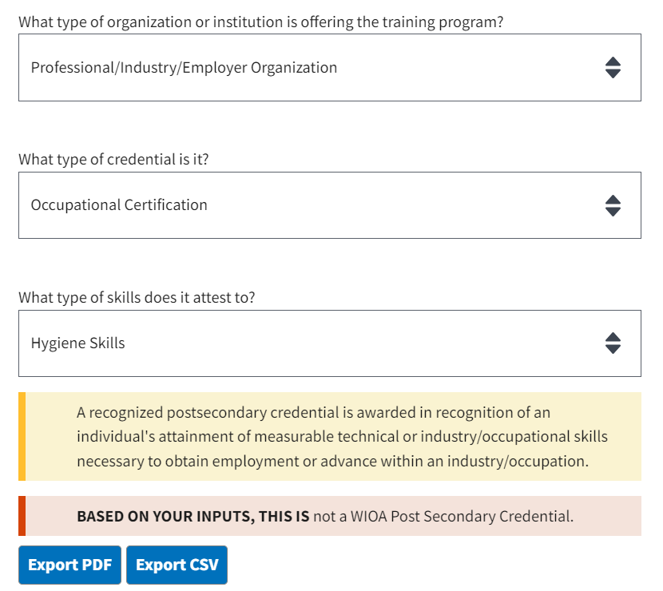
Credential attainment tool examples:
Does THIS CERTIFICATION count?
YES
NO
Source: DOL Credential Attainment Tool

Slide 13
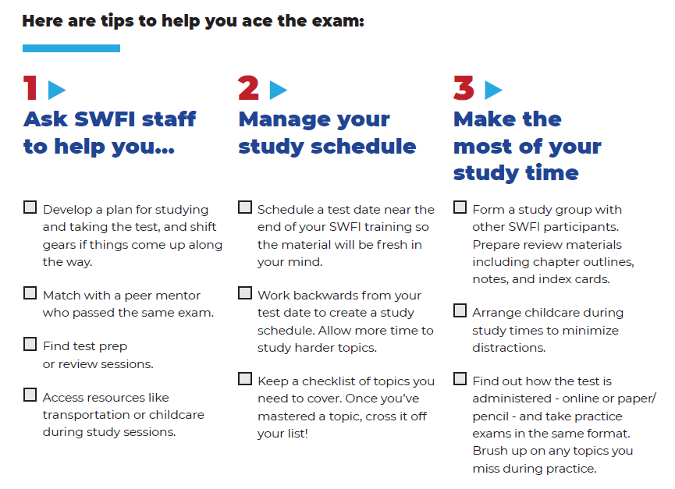
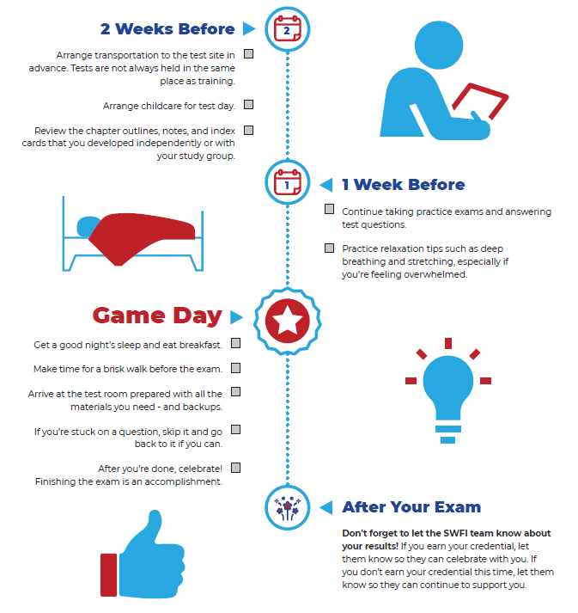
breaking down Exam preparation: A tip sheet from SWFI
Source: SWFI Credential Test Tips

Slide 14
Promising Practice
The Workplace

Slide 15

Presenters
Leigh Roberts
  Vice President, Workforce Development
    The WorkPlace, Inc.

Slide 16
completion and certification: The WorkPlace
Initial Selection of Training Providers/Credentials
  Advisory Committee
    6 major healthcare organizations
    Long-term care facilities
    Evaluation of needs and employment outlook
  RFQ
    Set Qualifications: prior performance, completion rates, placement assistance, populations served
    Create a comprehensive list of educational training providers
    Flexibility to monitor and pivot

Slide 17
completion and certification: The Workplace Cont.
What Does it Look Like for a Participant During Training?
  Relationship Building
  Enrollment and Eligibility
  Case Management
    Academic and Career Counseling
    Needs Assessment
    Pre- and -post program planning
  Supportive Services
  Advocacy

Slide 18
completion and certification: The Workplace
What Does Assessment and Test Prep Look Like?
  Pre-Training Testing
  Pre-Enrollment Program Specific Math Assessments
  Math and Literacy Remedial Drop-In Classes
  Refresher Courses-CT State
  VR Goggles

Slide 19
completion and certification: The WorkPlace
What Do We Do When the Participant is NOT Successful?
  Importance of Relationship Building
  Incomplete Training
    Re-engage (90 days)
    Transition back into programming
    Connection with remedial services
  Failure to Pass Licensure Exams
    Refresher courses/remediation services
    Financial assistance for testing retakes

Slide 20
SMALL GROUP DISCUSSION
Participant Completion/Certification Potential Loss Points & Strategies

Slide 21
Guiding questions for your table to discuss
At your table, consider the following questions. The coach at your table will record your reflections using the sticky notes & easel paper provided:
When/where might we experience (or have you already experienced) participant retention issues during Completion & Certification?
What might be the root causes of these “loss points”?
What solutions might work (or have worked) to prevent them?

Slide 22

Report out and Questions?

Slide 23

Thank you!
The American Institutes for Research® (AIR), completed this project with federal funds, under contract number 1605C2-23-Q-00074 Nursing Expansion Grant TA, from the U.S. Department of Labor, Employment and Training Administration. The contents of this publication do not necessarily reflect the views or policies of the Department of Labor, nor does mention of trade names, commercial products, or organizations imply endorsement by the U.S. Government. AIR is a nonpartisan, not-for-profit organization that conducts behavioral and social science research and delivers technical assistance to solve some of the most urgent challenges in the U.S. and around the world.

