Slide 1
Welcome to the
Peer-to-Peer Virtual Intensive!

Slide 2
Purpose, Agreements, & Introductions
Purpose: Set your project up for success through focused time with your team, peers, and federal partners.
Community Agreements
When you’re presenting, please turn on your camera
Raise your virtual hand when you’d like to speak
Respect your colleagues’ views –especially when you don’t agree
Participate!
Grantee Introductions
Use the chat to introduce your team and note if your project is a Tier 1 (Planning) or Tier 2 (Implementation) grant.

Slide 3
Agenda
12:30 pm - Welcome & Opening Remarks
12:45 - Grantee Spotlight Presentations
1:15 - Job Quality Starter Guide Overview
1:30 - Developing Your Value Proposition
2:20 - Break
2:30 - Grantee Spotlight Presentations
3:00 - Job Quality Canvas Activity
3:50 - Grantee Spotlight Presentations
4:20 – Closing Remarks & Next Steps

Slide 4
Opening Remarks
Jenn Smith
Chief, Division of Strategic Investments
Office of Workforce Investment
Employment and Training Administration
US Department of Labor

Slide 5
Grantee Spotlight Presentations
EDvance
Bay Consortium Workforce Development Board, Inc.
Cincinnati Union Cooperative Initiative
Industrial Development Advantage of East Chicago

Slide 6
EDvance College

Slide 7

EDvance Overview
Critical
Sectors
Tier 1, Planning Grant
Care / Early Care and Education
Top 3 project goals
  Identify Lead Agency Partners to establish a Collaborative Workgroup
  Develop and Administer a Needs Assessment
  Develop Pathway Options through Apprenticeship
Programmatic
Performance
Job
Grant Management
Quality

Slide 8

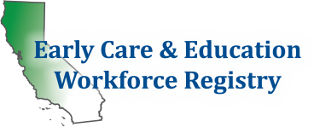








Key Stakeholders
Early Care & Education Workforce Registry
Child Care Providers United (CCPU)
Community Colleges: Los Medanos College, Foothill College, etc. (7)
San Francisco Department of Early Childhood
Employers: YMCA East Bay, Felton Institute, Izzi Early Education Head Start (15 agencies)
Family Child Care Providers & Networks
County Offices of Education (4)
Center for the Study of Child Care Employment

Slide 9
Top Challenge & Asset
Challenge/Pain Point | Asset/Lever
Multiple ECE workforce collaboratives | Strong employer and sector interest in collaborating and planning for BA Earn and Learn Pathway Programs
Establishing partnerships with Workforce Development Boards | High satisfaction with collaborative convening and planning meetings for BA pathway partnerships
Incomplete distribution of Needs Assessments due to limited employer access to accurate data. | High Recognition of EDvance College Model & Curriculum

Slide 10
We’ll know we’ve been successful when….
We have engaged at least 40 agency partners to build our BA Pathway Program across multiple counties
90% of our agency members report a benefit from working collectively and collaboratively to address the needs of the Bay Area ECE Workforce.
We create pathways proposals and plans informed by needs assessment results and employer input.
We have administered a needs assessment to collect insight on worker perspectives.
We create pathway proposals and plans informed by needs assessment results and employer input.
We have begun to create partnership collateral for Pathway Program opportunities.

Slide 11
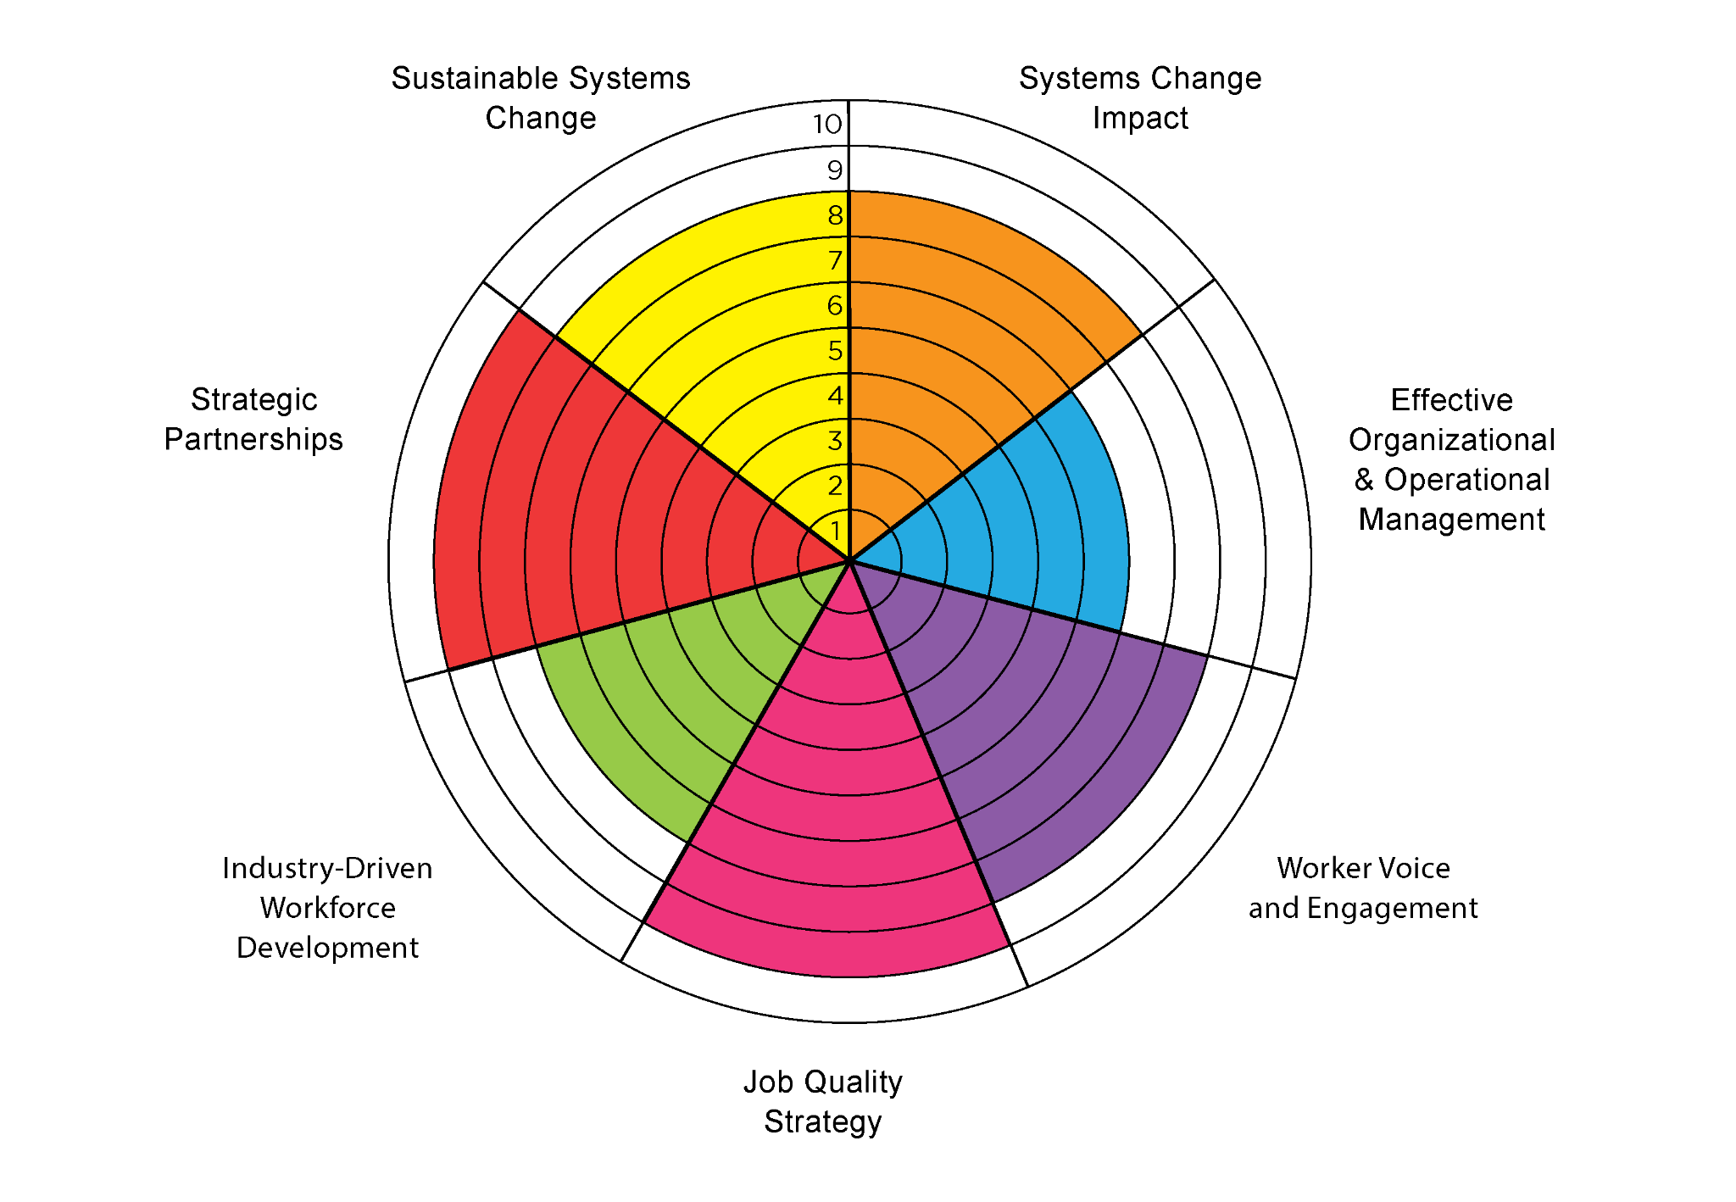
We Are Now Here
Strategic Partnerships/Job Quality Strategy
  Working with multiple employers and partners to understand the ECE workforce needs and inequities to identify job quality strategy
Worker Voice and Engagement
    Increase, Refine, and Expand
  Industry-Driven Workforce Development
    Continuing to strengthen employer feedback and expand our pathway programs

Slide 12
Thank You!
Alicia Osborne
Vice President of Workforce Development & Admissions
EDvance College
Alicia.O@edvance.edu

Slide 13
Bay Consortium
Workforce Development Board

Slide 14
Eastern Shore, Northern Neck, Middle Peninsula Coastal Resiliency Sector Partnership Overview
Tier 1 Planning Grant
Industry Sectors of Focus are:
  Installation, Maintenance, and Repair Workers, All Others
  Emergency Medical Technicians (EMT)
  Electrical, Electronic, and Electromechanical Assemblers
  Heating, Air Conditioning, and Refrigeration Mechanics and Installers
  Geographic area of focus:
  Northern Neck, Middle Peninsula & Eastern Shore of Virginia
Top 3 project goals
  Implement evidence-based sector partnership strategies to understand the landscape of Coastal Resiliency employment and identify barriers to entry and upward mobility.
  Assess employer support needed to improve job quality, including small business and entrepreneurship support.
  Create a plan to implement innovative initiatives designed to integrate community supports, worker voices, educational on-ramps to skills building, and barrier removal for underrepresented and low-income, rural populations

Slide 15





Key Stakeholders 2
Rappahannock Goodwill Industries
Rappahannock Community College
Eastern Shore Community College
Bay Consortium Workforce Development Board
International Union of Operating Engineers, Local 147

Slide 16
Top Challenges & Assets 2
Challenge/Pain Point | Asset/Lever
Employer Voice- Roundtables with local businesses- industry roundtables | Reach out to local business owners and entrepreneurs to attend roundtables, work closely with consulting firm, WorkEd Consulting to conduct discussions
Worker Voice in partnership with Rappahannock Goodwill Industries (RGI)- roundtables (4) and CBOs | Partner with RGI and attend employee roundtables. Employees receive $20 gift cards for participating
Career Pathways with Rappahannock Community College and Eastern Shore Community College | Curriculum enhancements in partnership with college President’s. Hold Leadership meetings once a month for progress

Slide 17
We’ll know we’ve been successful when…2
Implement evidence-based sector partnership strategies to understand the landscape of Coastal Resiliency employment and identify barriers to entry and upward mobility,
Assess employer support needed to improve job quality, including small business and entrepreneurship support.
Create a plan to implement innovative initiatives to integrate community supports, worker voices, educational on-ramps to skills building, and barrier removal for under-represented, low-income, rural populations.

Slide 18
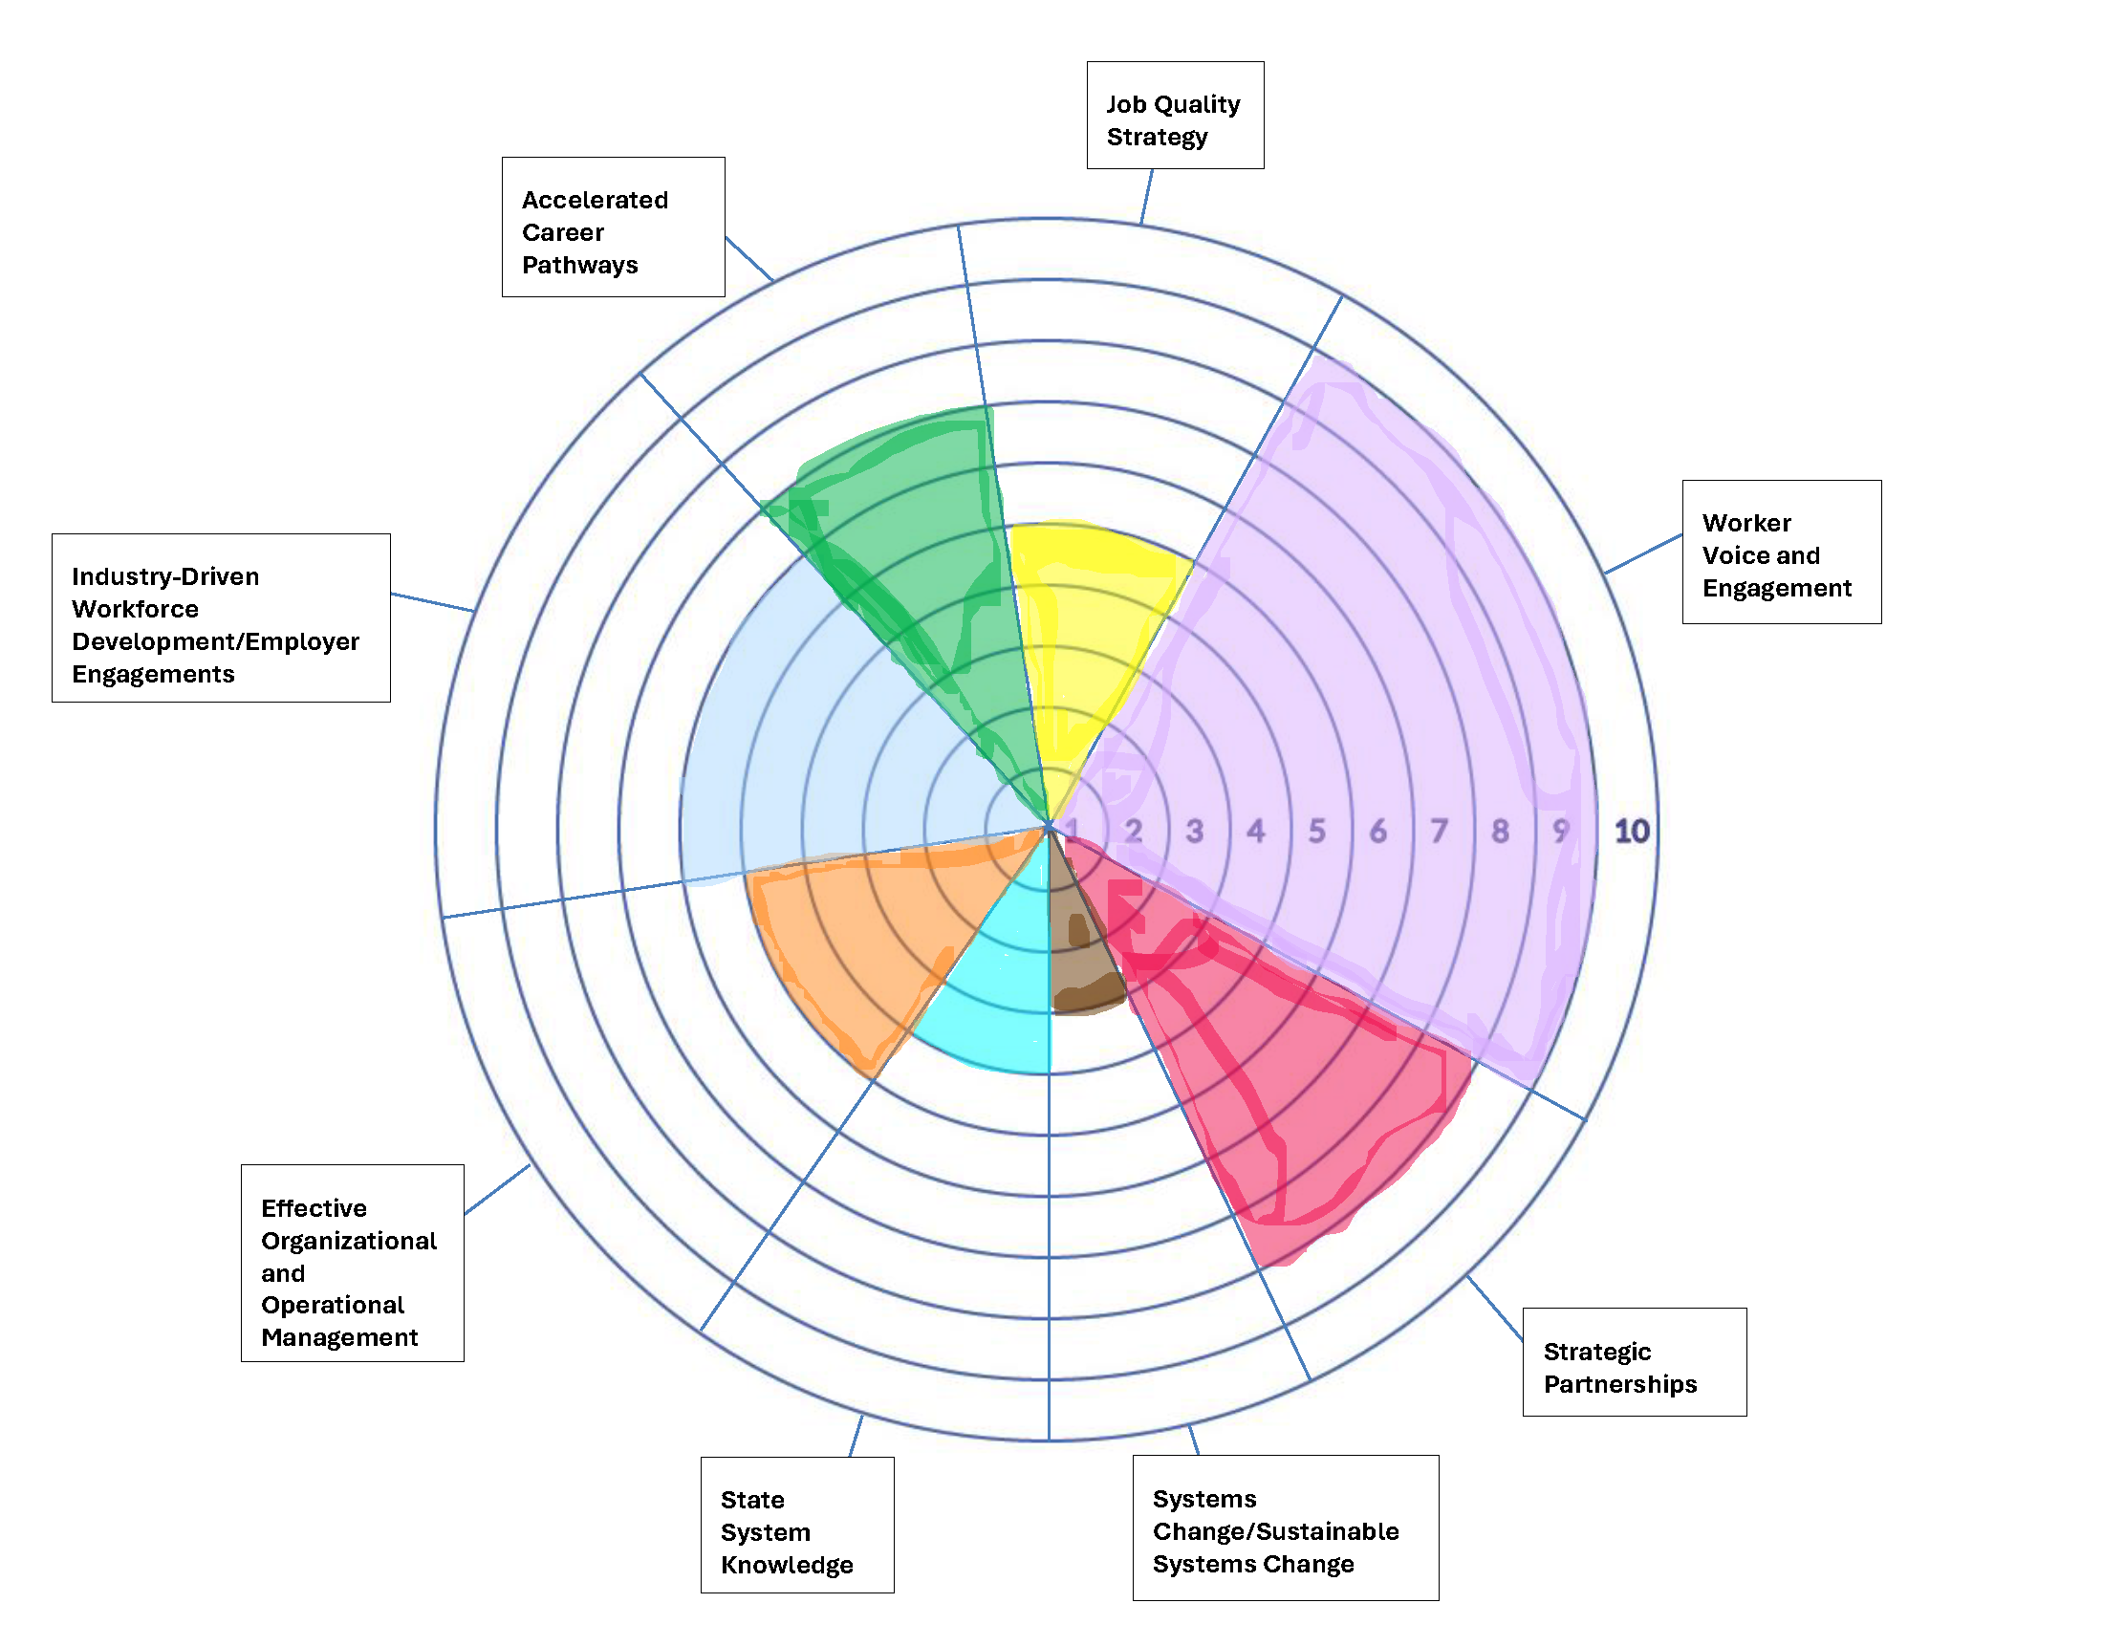
We Are Now Here 2
Worker Voice and Engagement
  RGI to conduct Worker Voice in Roundtables
Strategic Partnerships
RGI, Economic Development, Industry Partnerships, Educational Institutions, RCC and ESCC, Planning Districts, Employer Roundtables
Accelerated Career Pathways
Keeping RCC and ESCC committed and engaged in curriculum enhancements

Slide 19
Thanks!
Makalia Records
Project Director
Bay Consortium Workforce Development Board
mrecords@baywib.org

Slide 20

Co-Op Cincy

Slide 21
Co-Op Cincy Overview
Critical
Tier I Planning Grant
Climate Resiliency
Green Construction Industry in Southwest Ohio
  Greater Cincinnati
  Butler, Clermont, Hamilton, & Warren Counties
Top 3 project goals
    Produce a Strategic Plan to increase Job Quality and Accessibility
    Pilot strategies to increase Job Quality and Accessibility
    Develop Strategic Partnerships for implementation with local industry, government, and community organizations
Sectors
Programmatic
Performance
Job
Grant Management
Quality

Slide 22






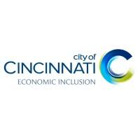



Key Stakeholders 3
Cincinnati AFL-CIO
Greater Cincinnati Apprenticeship Council
City of Cincinnati
  Office of Environment and Sustainability
  Department of Equity & Inclusion
Green Umbrella Regional Climate Collaborative
Sustainergy
Turner Construction
Regional workforce development board
Career Tech
Building Futures Pre- Apprenticeship Program
Faith Communities
Go Green

Slide 23
Top Challenge & Asset 3
Challenge/Pain Point | Asset/Lever
Organize & Facilitate a Steering Committee of 40+ Local Partners | Form working groups to decentralize coordination & weekly leadership team meetings
Incorporate Worker Voice | Leverage partnerships with industry employers & worker advocacy groups
Incorporate Worker Voice | Form roundtable / focus group of industry workers
Build Deeper Buy In with additional Contractors | Relationships with existing contractors and Building Trades Unions

Slide 24
We’ll know we’ve been successful when… 3
We have a robust plan for increasing job quality & accessibility with partner buy-in
Our strategies are showing a tangible positive impact on job quality in the green construction sector
Our industry, government, and community partners are working more collaboratively

Slide 25
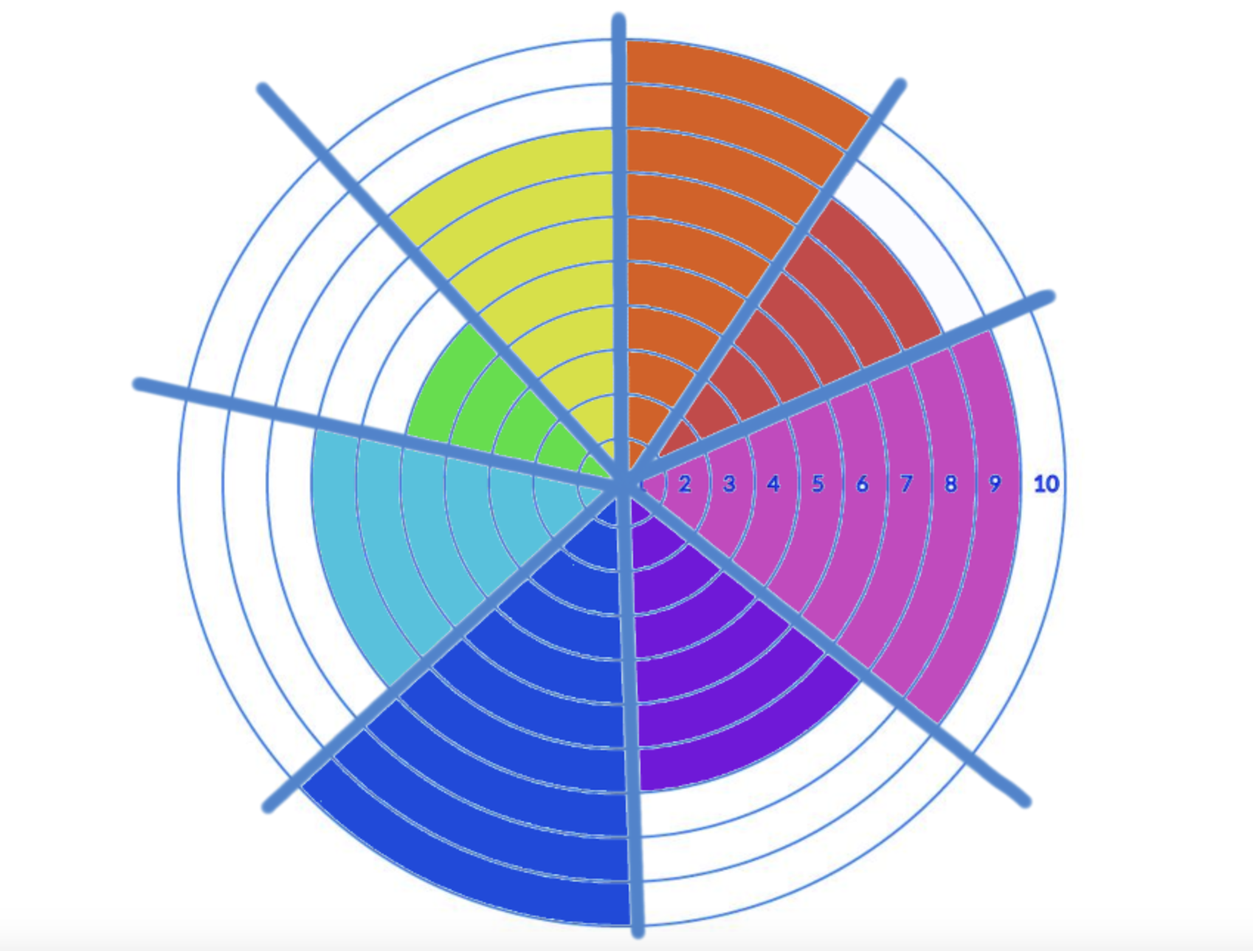
We Are Now Here 3
Effective Training Design (8)
Effective Organizational & Operational Management (10)
Systems Change Impact (8)
Worker Voice & Engagement (5)
Sustainable Systems Change (9)
Industry-Driven Workforce Development (7)
Job Quality Strategy (7)
Strategic Partnerships (10)

Slide 26
Thank You!3
Phil Waller
Special Projects Manager
Co-op Cincy
phil@coopcincy.org

Slide 27
Job Quality Starter Guide
Ben Sommer, Director of Solutions Design and Delivery, Jobs for the Future

Slide 28
Defining your Value Proposition and Engaging with the Job Quality Team Canvas
Job Quality Starter Guide Principles
Value Proposition
Job Quality Team Canvas

Slide 29
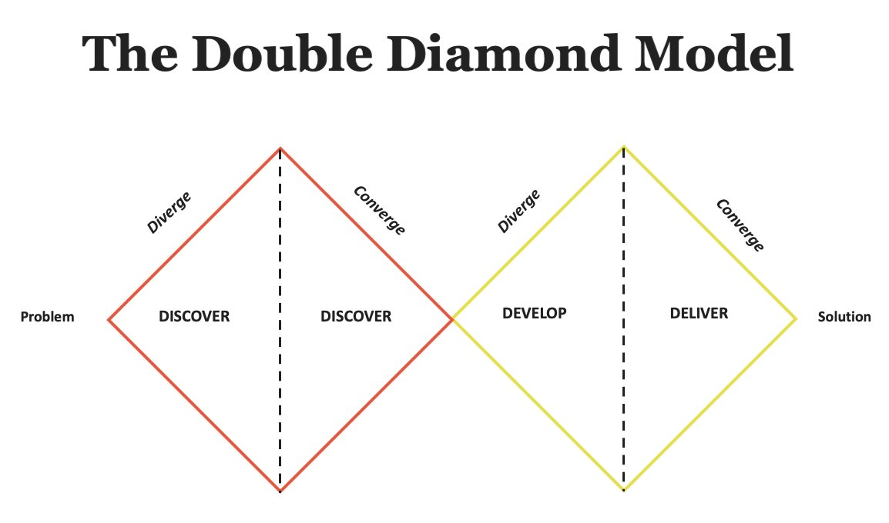
Guiding Principles
How to Use the Starter Guide
Iteration and Prototyping
Stakeholder Engagement

Slide 30
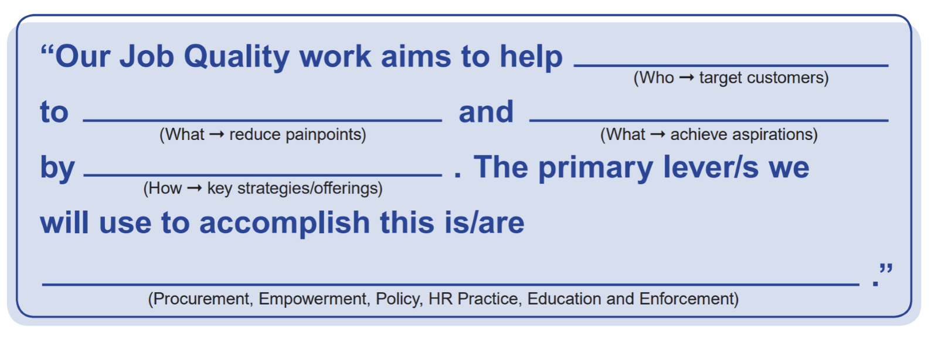
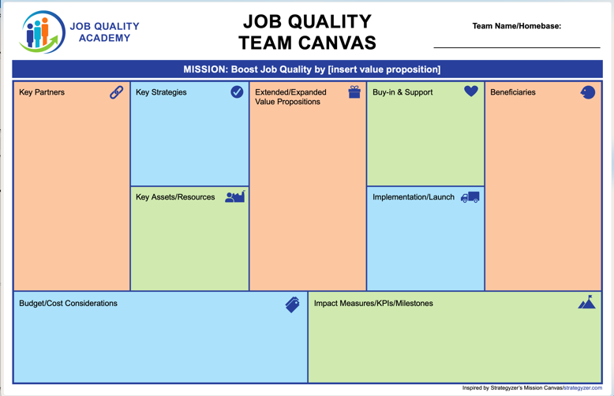
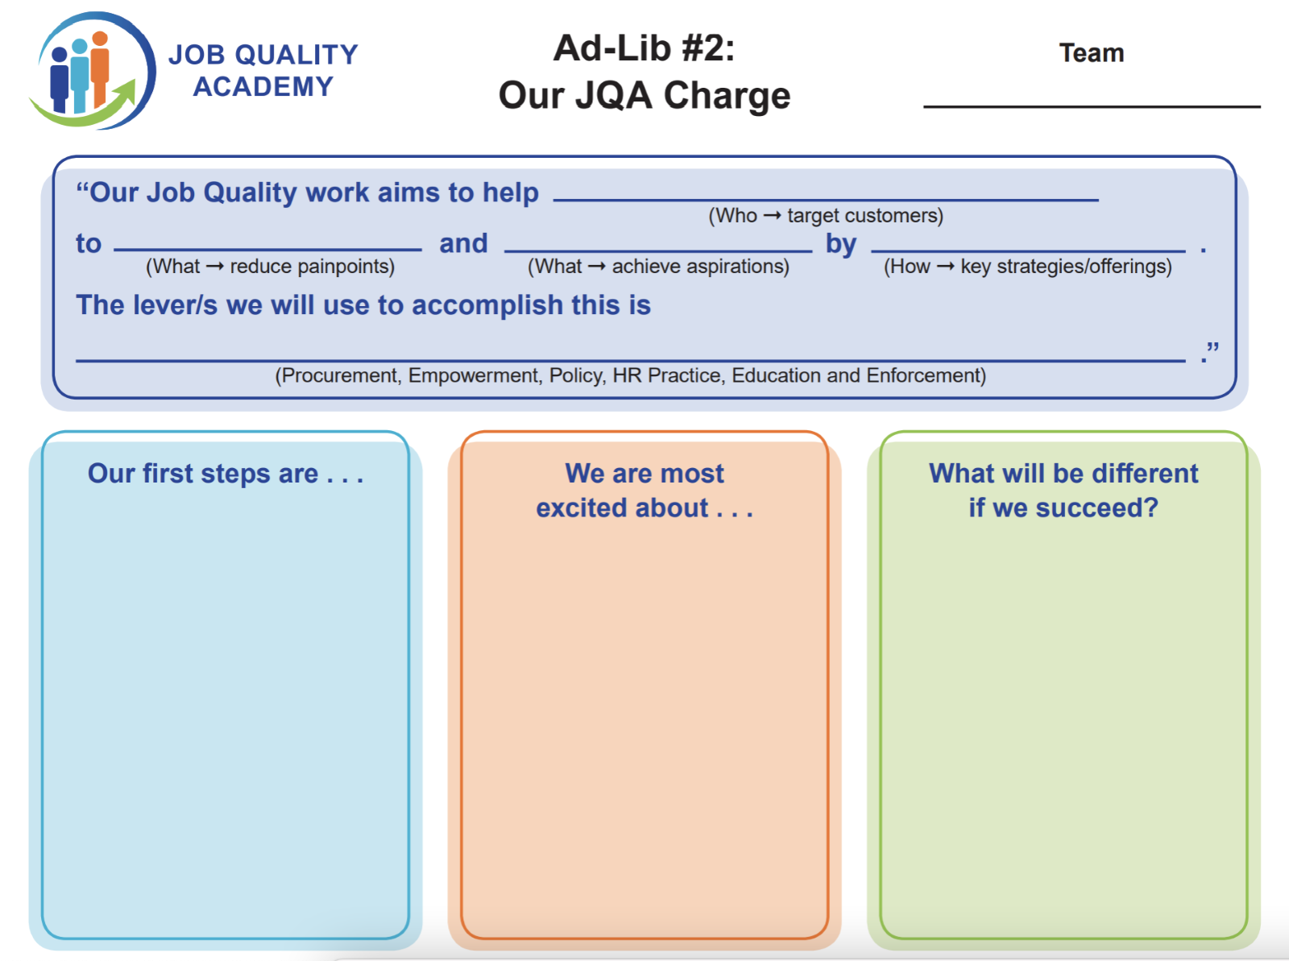
Developing Your Job Quality Action Plan
Action steps | Person(s)/ partners responsible | Resources needed internal/ external | Progress indicators/ milestones | Target completion date | Other
What you’ll need to do to implement the strategy. | Who is responsible for carrying out each action step. | What resources you’ll need to complete each action step. | How you know that you have made progress on each action step. | When you expect to complete each action step. | Additional needs, resources or information

Slide 31

Job Quality Starter Guide
Value Proposition

Slide 32
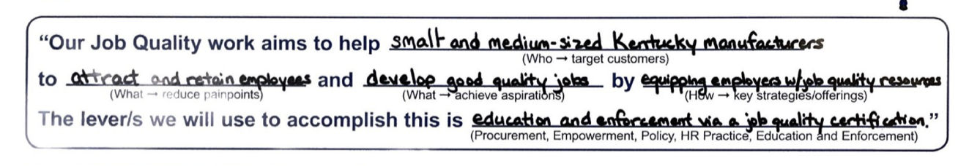
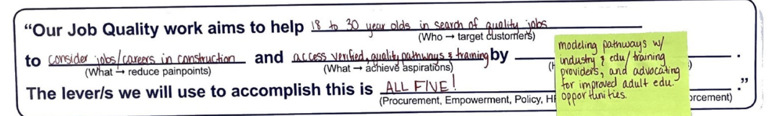
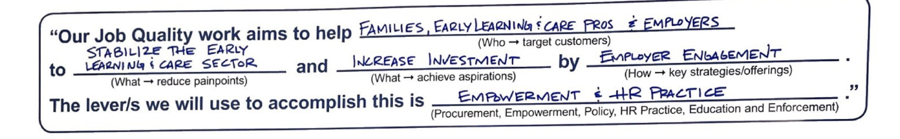
Defining Your Value Proposition (1)

Slide 33
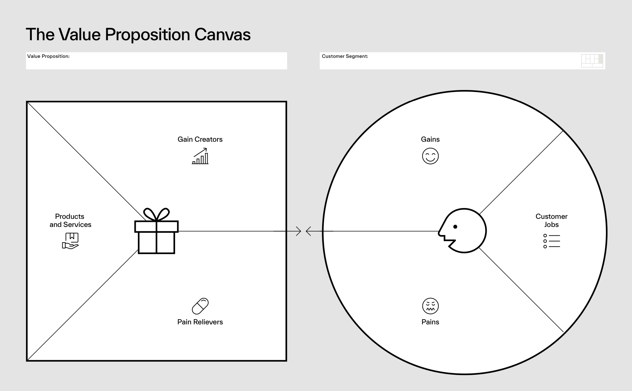
Defining Your Value Proposition (2)
Job-to-be-done: A statement that describes with precision a task, goal that a group of people are trying to accomplish
Gains: Job well done. Positive outcomes, benefits, aspirations
Pains: Annoyances, obstacles, negative outcomes with trying to get the job done

Slide 34
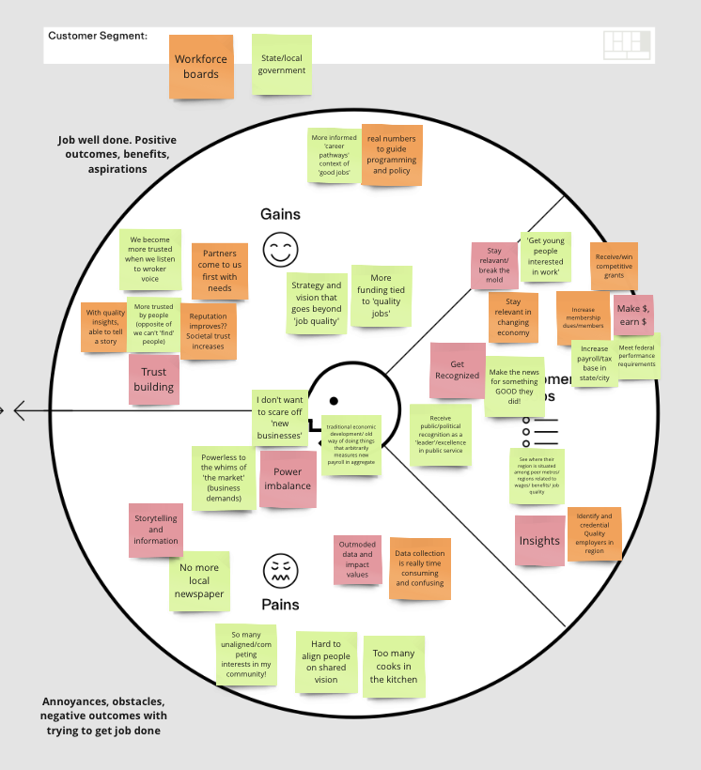
Defining Your Value Proposition (3)

Slide 35
Building Your Job Quality Team Canvas (1)
Mission
Key Partners
Key Strategies
Key Assets/Resources
Extended/Expanded Value Proposition
Buy-in & Support
Implementation/Launch
Beneficiaries
Budget/Cost Considerations
Impact Measures/KPIs/Milestones
35

Slide 36
Building Your Job Quality Team Canvas (2)
Mission
Key Partners
Key Strategies
Key Assets/Resources
Extended/Expanded Value Proposition
Buy-in & Support
Implementation/Launch
Beneficiaries
Budget/Cost Considerations
Impact Measures/KPIs/Milestones

Slide 37
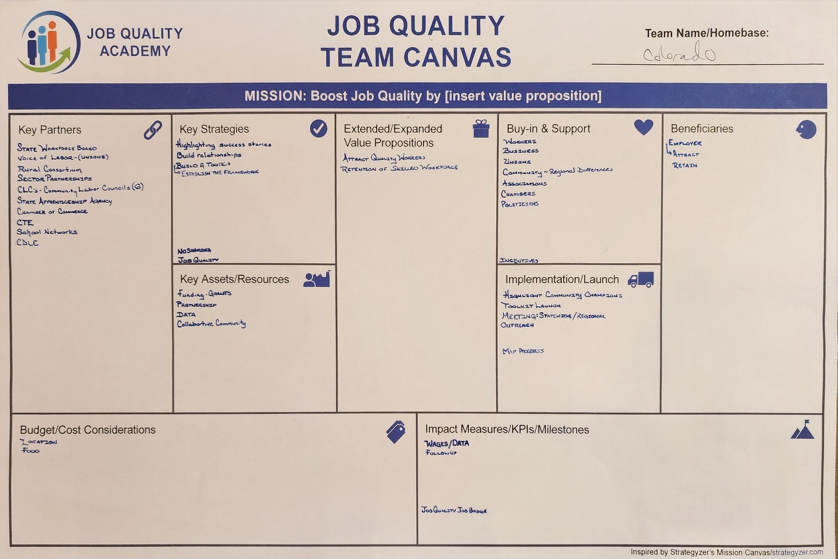
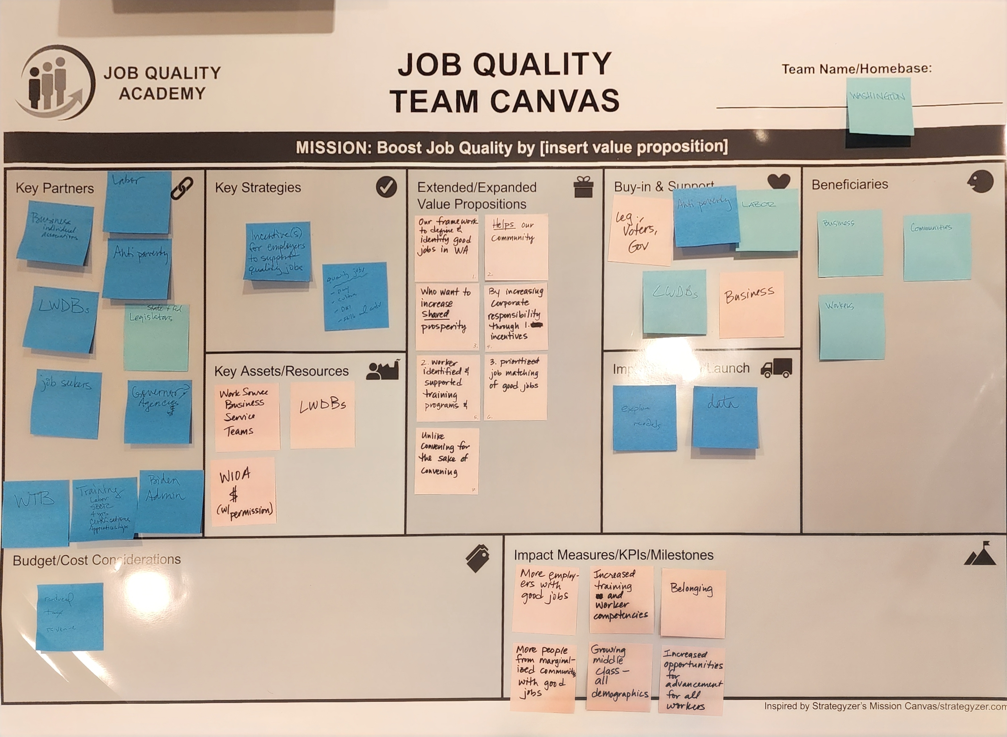
Building Your Job Quality Team Canvas (3)

Slide 38
Defining Your Value Proposition – Activity Breakout Groups
Instructions:
Take about 5 minutes to review the statement
In your breakout groups, spend 7 minutes working on "Customer Segments" and "Jobs to be done."
Share out and discuss for 10 minutes
Spend 7 minutes working on "Pains" and "Gains"
Share out and discuss for 10 minutes
Prepare to report on the following question:
  Share your team’s top three initial reactions to the Value Proposition Activity.
  Do you think your team at home could engage in this?
  What would make it more helpful?

Slide 39

2:20 - Break

Slide 40
Grantee Spotlight Presentations (2)
Civic Works, Inc.
Portland General Electric Company
Resilience Force
Tampa Bay Academy Of Hope

Slide 41
Civic Works

Slide 42

Transforming Job Quality in the Climate Resiliency Sector Overview
Critical
Tier 2
Solar
Baltimore City
Top 3 project goals
  Address critical job quality issues in the Solar Industry.
  Enhance wages, benefits, and working conditions.
  Empower workers within the resiliency climate sector
Sectors
Programmatic
Performance
Job
Grant Management
Quality

Slide 43




Key Stakeholders 4
The Public Justice Center
Mayor’s Office of Employment Development
Sunlight to the Rescue
Chesapeake Solar & Storage Association

Slide 44
Top Challenge & Asset 4
Challenge/Pain Point | Asset/Lever
The key challenge facing the climate resiliency sector in Baltimore is the lack of family-sustaining jobs, especially for underserved communities. Many available positions do not provide living wages, benefits, or stable career paths, limiting economic mobility. | However, Baltimore's increasing investment in renewable energy, green building, and other climate initiatives presents an asset and opportunity to transform job quality in these sectors. By working with employers and stakeholders, we can ensure equitable access to the economic benefits.

Slide 45
We’ll know we’ve been successful when…. 4
Our industry partners have demonstrably improved job quality
We will enroll 90 entry-level workers, graduate 80% of them (72), and place 63% of them (57)
We will enroll 150 incumbent workers, graduate 90% of them (135), and 70% of them will receive career advancement in the form of title promotion or wage increase (94)

Slide 46
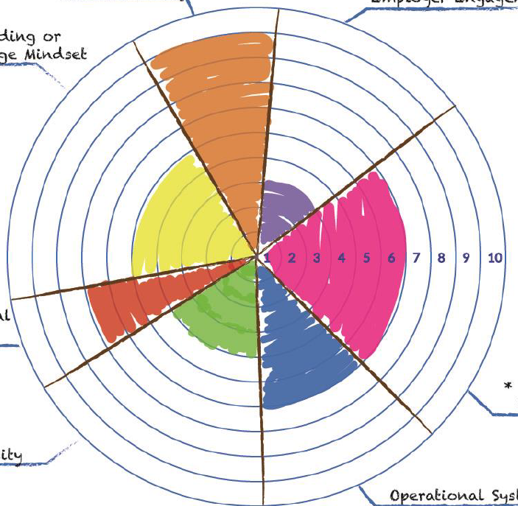
We Are Now Here 4
Effective Organizational & Operational Management
Systems Change Impact/
Sustainable Systems Change
Worker Voice & Engagement
Systems Change Impact/ Sustainable Systems Change
  Sharing outcomes to ensure partner engagement
Job Quality Strategy
Refining, measuring, and monitoring
Industry-Driven Workforce Development
Keeping our industry partners engaged and committed
Strategic Partnerships
Industry-Driven Workforce Development
Job Quality Strategy
Effective Training Design

Slide 47
Thank You! 4
Terrance Clark
Associate Director of Career Pathways Center for Sustainable Careers
Civic Works
tclark@civicworks.com

Slide 48
Oregon Clean Energy Workforce Coalition Portland General Electric (PGE)

Slide 49
Jobs for a Clean Energy Future
Critical
Tier 2
Climate Resilience
Oregon
Top 3 project goals
  Engage with workers and worker organizations on barriers experienced by historically marginalized populations
  Provide Skills Training for Adults in Custody (AIC) and Recruit New Talent to Union Apprenticeship Programs
  Develop career awareness and career learning programs for opportunity youth to gain exposure to the clean energy sector
Sectors
Programmatic
Performance
Job
Grant Management
Quality

Slide 50






Key Stakeholders 5
Union Pre-apprenticeship Construction Training Program (U-PACT): Ironworkers Local 29, Bricklayers Local 1, Cement Masons Local 555
Coffee Creek Correctional Facility
Clackamas Workforce Partnership
East Cascades Works

Slide 51
Top Challenges & Assets 5
Challenge/Pain Point | Asset/Lever
Completion of the program with AIC U-PACT participants. | DOC engagement to build solutions to address competing circumstances.
Data collection for DOL reporting needs. | Building reporting system with partner workforce board infrastructure.

Slide 52
We’ll know we’ve been successful when…. 5
Improvement in representation from women, people of color, and those formally involved with the justice system within each of the three crafts.
Minimum of 25% of youth participants have increased their knowledge of the Good Jobs employers and clean energy career paths.
Live and highly utilized Clean Energy Careers website, co-created and informed by worker voice and industry partners.

Slide 53
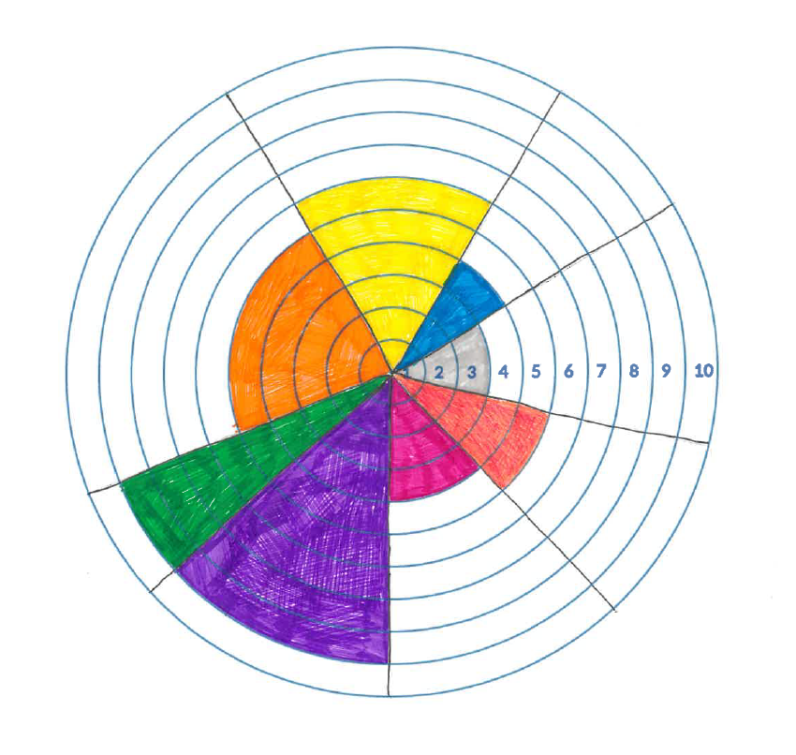
We Are Now Here 5
Job Quality Strategy
Worker Voice & Engagement
Organizational/
Operational Management
Worker Voice & Engagement
  Conducting surveys and focus groups across the state
Organizational Management
  Onboarding of dedicated FTE for grant implementation
  Conducting an audit of internal systems and procedures
Effective Training Design
  Launching career awareness programming for opportunity youth
  Creating new evaluation tools in partnership with the U-PACT program
Sustainable Systems Change
Industry-Driven Workforce Development
Systems Change Impact
Strategic Partnerships
Effective Training Design

Slide 54
Thank You! 5
Brooke Brownlee
Manager of Labor, Workforce & Economic Prosperity
Portland General Electric
brooke.brownlee@pgn.com

Slide 55
Resilience Force

Slide 56
A Good Jobs Blueprint In The Climate Resilience Economy
Tier 2
Climate Resiliency
California, Louisiana, South Florida
Top 3 project goals
  Through this project, Resilience Force will build a Climate Workforce Training and Apprenticeship Program to carry out: decarbonizing, weatherizing, and climate-proofing homes, schools, churches, and cities. Workers who rebuild homes, schools, and cities after hurricanes and fires are being trained on how to weatherize those buildings, install solar panels, and become the backbone of a climate-resilient and clean energy economy. These workers will build year-long careers from decarbonization, weatherization, and climate resilience. These are necessary occupations to improve our country’s resilience to the impacts of climate change, transition to clean energy, and efforts to mitigate further climate change.
  To improve job quality, we are building an industry-wide association of resilient workers.
  To improve workers’ access to quality jobs, we will train workers in relevant professional skills and confer certifications that allow them to enter the fields of disaster restoration and year-round climate resiliency, with special efforts to recruit women, people of color, and the justice-impacted.

Slide 57
Key Stakeholders 6
Climate Resilience Workforce
OIC of South Florida
North Bay Jobs with Justice
Signal Restoration, US Roofing Systems, the International Union of Painters and Allied Trades (IUPAT), and the Minority Builders Coalition (MBC)

Slide 58
Top Challenges & Assets 6
Challenge/Pain Point | Asset/Lever
Changing the culture of safety in the workplace. | Training “Health and Safety Job Stewards” who monitor and report workplace hazards on their worksites. Concerted activity are protected from retaliation and workplace safety committees are formed.
Identifying additional high-road employers. | High-road standards are attached to $250 million in contracts.
Continuous monitoring and tracking of all trainees. | Creating a phone-based app to help track workers.

Slide 59
We’ll know we’ve been successful when... 6
150 trained workers earn industry-recognized credentials, and at least 75% are placed with high-road disaster restoration or climate resiliency employers.
High-road standards are attached to $250 million in contracts.
Our membership has increased by 500 participants from historically marginalized populations.

Slide 60
We Are Now Here 6
Systems Change Impact/ Sustainable Systems Change
Institutionalizing partnership processes through consistent and regularly scheduled communications and workflow commitments.
Strategic Partnerships
Refining, measuring, and monitoring
Grow good job opportunities or adopt good job practices into existing occupations for the target populations
Industry-Driven Workforce Development
Strengthening sector partnerships by identifying common goals

Slide 61
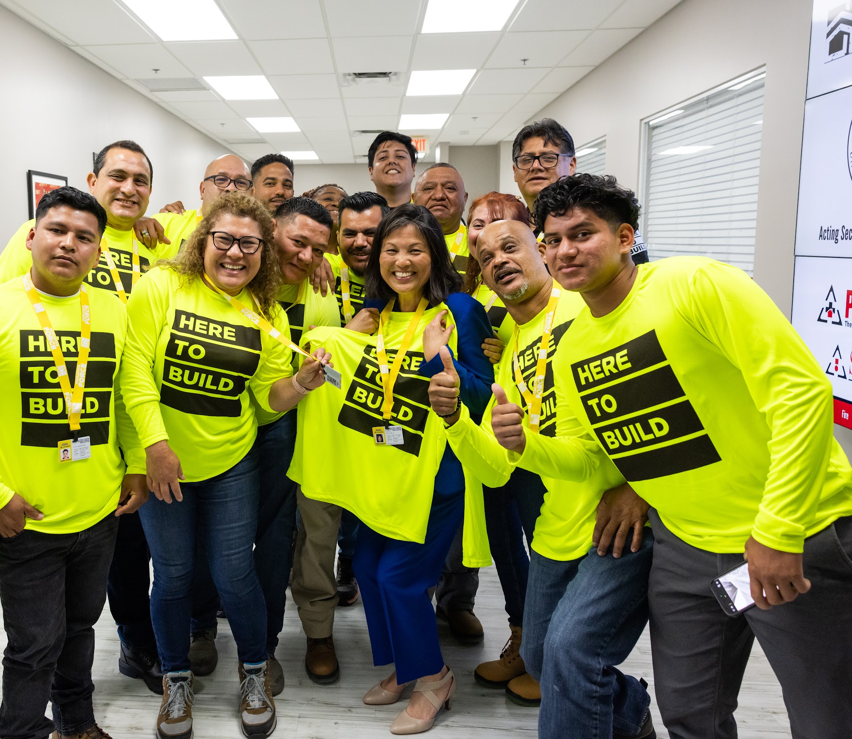
Thank you! 6
Cynthia S. Hernandez
Director of Training
Resilience Force
chernandez@resilienceforce.org

Slide 62
Building Your Job Quality Team Canvas
Activity Breakout Groups
Instructions:
In your breakout groups, spend 5 minutes working on "Key Partners".
Share out and discuss for 10 minutes
Spend 5 minutes working on "Key Assets/Resources"
Share out and discuss for 10 minutes
Time permitting – Spend 5 minutes working on “Buy-in and Support”
Share out and discuss for 10 minutes
Prepare to report out on the following:
  Share your team’s top three initial reactions to the Value Proposition Activity.
  Do you think your team at home could engage in this?
  What would make it more helpful?

Slide 63
Grantee Spotlight Presentations (3)
Cheyney University of Pennsylvania
Lane Workforce Partnership
Employ Milwaukee, Inc.
Hospitality Industry Training & Education Fund

Slide 64
Cheyney University of Pennsylvania

Slide 65
Cheyney University Hospitality Career Advancement Collaborative
Critical
Tier 1 Planning Grant
Hospitality Industry
Phila-Camden-Wilmington region
Top 3 project goals
  Create pathways for career advancement in hospitality
  Increase social capital of entry-level workers who are Black and Latinx persons.
  Align training programs with worker needs so that they are worthwhile and effective in closing skill gaps.
Sectors
Programmatic
Performance
Job
Grant Management
Quality

Slide 66



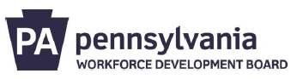

Key Stakeholders 7
Chaddsford Winery
Brandywine Wine Trail Valley
PA Workforce Development Boards

Slide 67
Top Challenges & Assets 7
Challenge/Pain Point | Asset/Lever
Capturing feedback from people of color in our local wine industry. | Broaden our reach to establish strategic partnerships with organizations in other regions.
Haven’t filled the two project positions yet. | Work with the internal stakeholders to make sure they’ve bought in to the significance of this opportunity.

Slide 68
We’ll know we’ve been successful when… 7
Our training programs are worthwhile and effective in closing skill gaps.
There is a career advancement pathway delineated for certificate holders.
The needs and perspectives of Black & Latinx are represented in initiatives to improve job quality in the industry.

Slide 69
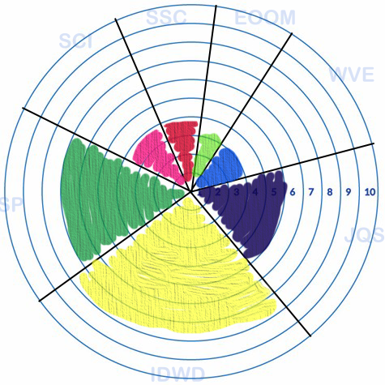
We Are Now Here 7
Sustainable Systems Change
Effective Organizational and Operational Management
Systems Change Impact
Strategic Partnerships
Participation on our Advisory Board from key strategic partners
Industry-Driven Workforce Development
  Aligning with our industry partners to design the training curriculum
Job Quality Strategy
Reviewing the high priority occupations list to ensure our focus is precise
Worker Voice & Engagement
Strategic Partnerships
Job Quality Strategy
Industry-Driven Workforce Development

Slide 70
Thank You! 7
Richard Spencer
Director of Workforce Development/PI
Cheyney University of Pennsylvania
rspencer@cheyney.edu

Slide 71
Lane Workforce Partnership

Slide 72
Oregon Coast Hospitality Sector Partnership
Critical
Sectors
Tier 1 – Planning Grant
Hospitality Industry
Oregon Coastal Communities
Top 3 project goals
  Formation of the Oregon Coast Hospitality Sector Partnership
  Identify Training Needs of the Industry as well as non-traditional career pathways for workers
  Creating definitions and guides for Good Jobs and Career Pathways within the hospitality industry
Programmatic
Performance
Job
Grant Management
Quality

Slide 73

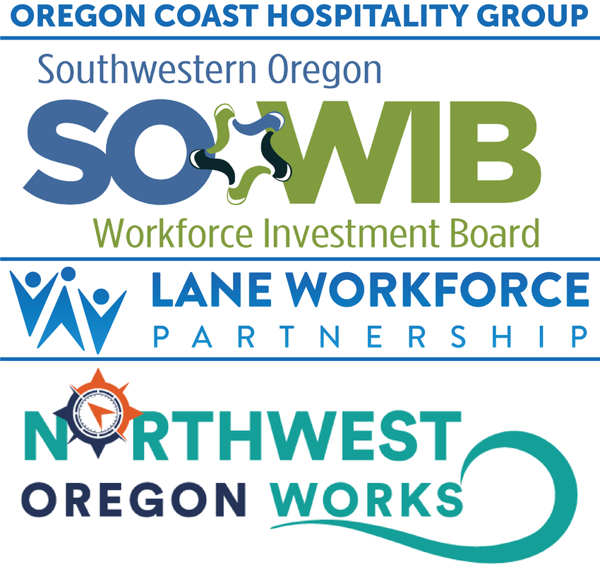

Key Stakeholders 8
Oregon Restaurant and Lodging Association (ORLA)
Oregon Hospitality Foundation
Oregon Coast Visitor Association (OCVA)
Workforce Development Boards
  Southwestern Oregon Workforce Investment Board
  Lane Workforce Partnership
  Northwest Oregon Works
Collaborative Economic Development Oregon

Slide 74
Top Challenges & Assets 8
Challenge/Pain Point | Asset/Lever
Industry Convenings – Bringing Establishment Owners Together for Sector Partnership Kick-off | ORLA and OCVA annual conferences - Time will be dedicated at the conference for Oregon Coast Hospitality Industry Partnership training and communications
Getting worker participants to travel to physical locations for focus group sessions | Major Employers - Leaning on major employers to host sessions – which reduces travel time

Slide 75
We’ll know we’ve been successful when... 8
The Oregon Coast Hospitality Industry Sector Partnership is well-established
60 employers complete our industry survey, and we have heard from a diverse segment of industry workers and job seekers through focus groups and surveys.
Our White Paper is written with workforce development solutions ready to implement

Slide 76
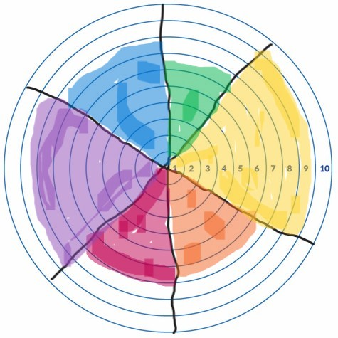
We Are Now Here 8
Industry-Driven Workforce Development
Worker Voice & Engagement
Worker Voice and Engagement
Ensuring that workers are represented in training design and quality jobs pathways
Job Quality Strategy
Developing the strategies and training design needed for Quality Jobs
Systems Change Impact/Sustainable Systems Change
Creating the ecosystem for sustainable support of employers and the workforce
Effective Organizational & Operational Management
Strategic Partnerships
Systems Change Impact/
Sustainable Systems Change
Job Quality Strategy

Slide 77
Thank You! 8
Cindy Perry
Director of Workforce Programs
cindy@laneworkforce.org
Ryan Kounovsky
Manager of Workforce Programs
Ryan@laneworkforce.org

Slide 78
Serve MKE (Milwaukee)

Slide 79
Serve MKE: Quality Jobs for Hospitality Workers Overview
Critical
Sectors
Tier 2 Implementation
Industry sector of focus: Hospitality
  Milwaukee County, WI
Top 3 project goals
  Elevate the standards of job quality within Milwaukee’s hospitality sector.​
  Support 400 participants throughout the project’s duration.​
  Provide participants with valuable industry-recognized training and credentials
Programmatic
Performance
Job
Grant Management
Quality

Slide 80




Key Stakeholders 9
AFL-CIO Workers United 122 and Marcus Hotels & Resorts
Employ Milwaukee’s Hospitality Industry Advisory Board
Milwaukee Area Technical College (MATC)

Slide 81
Top Challenges & Assets 9
Challenge/Pain Point | Asset/Lever
Engagement with worker voice partners. Hard for them to take time to attend meetings. Their own staffing levels. | Member employers receive direct benefits. We reached out to a third union partner to join the Council and share the burden.
Participant Recruiting. We used the first 9 months to plan. June is a vacation time so folks may not be as available. | Generous training and supportive service funds. Dedicated grant staff to provide ser vices.

Slide 82
We’ll know we’ve been successful when… 9
Our industry partners have demonstrably improved job quality
We have engaged at least 300 participants from historically marginalized populations
70% of our participants obtain employment in the hospitality industry.

Slide 83
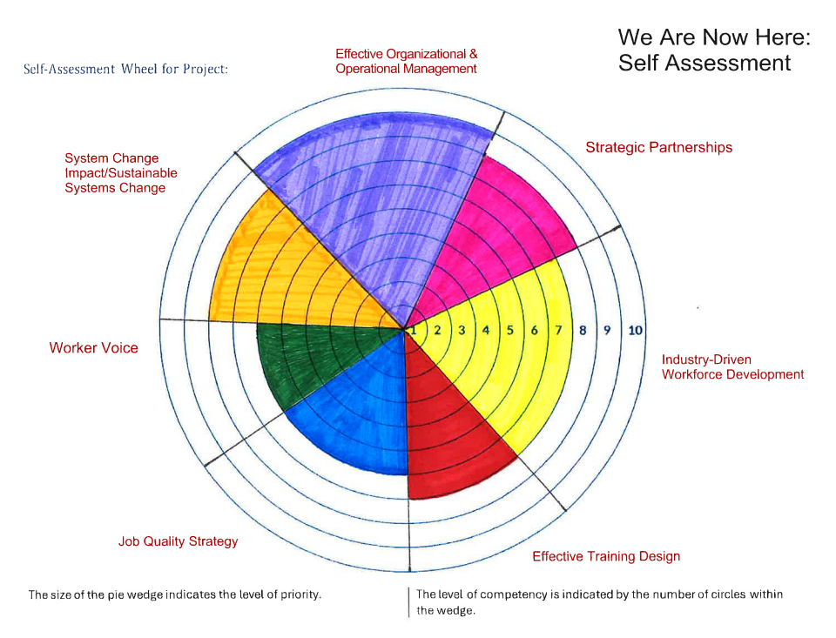
We Are Now Here 9
Systems Change Impact/ Sustainable Systems Change
Communicating results to maintain partner involvement
Job Quality Strategy
Improving, assessing, and tracking
Industry-Driven Workforce Development
Ensuring our industry partners remain involved and dedicated

Slide 84
Thank You!
Cindy Anderson
Project Manager
Employ Milwaukee, Inc.
Cindy.Anderson@employmilwaukee.org
Tashika Coleman
Workforce Specialist
Employ Milwaukee, Inc.
Tashika.Coleman@employmilwaukee.org

Slide 85
Hospitality Training Academy

Slide 86
Hospitality Culinary Registered Apprenticeship Replication Project
Critical
Tier 2 Implementation Grant
Hospitality Industry
Phoenix, Chicago, Baltimore, and Philadelphia
Top 3 project goals
  Improve job quality for Cooks by expanding Chicago’s program and replicating HTA’s program in Phoenix, Baltimore, and Philadelphia
  Train 273 participants in the skills needed to be hired by employers that have entered into Collective Bargaining Agreements (CBA) with local labor unions
  Place participants in good family-sustaining jobs protected by CBAs.
Sectors
Programmatic
Performance
Job
Grant Management
Quality

Slide 87



Key Stakeholders 10
UNITE HERE Local 11
  (Los Angeles, Orange, and San Bernardino Counties in California, and the State of Arizona)
Arizona @ Work Statewide Workforce Development Network
HIRE360 (Chicago)

Slide 88
Top Challenge & Asset 10
Challenge/Pain Point | Asset/Lever
Assessing apprenticeship applicants to ensure they are right for the program and the program is right for them | Knowledge Building and Buy-In: developed 2 new assessments, “Student Readiness” and “Culinary Career Interest” that we are piloting to determine the validity

Slide 89
We’ll know we’ve been successful when…. 10
HTA’s program has been replicated in Phoenix, Baltimore, and Philadelphia
85% of enrollments will be from targeted underrepresented population groups
80% employer satisfaction rate with culinary skills and job readiness of project participants

Slide 90
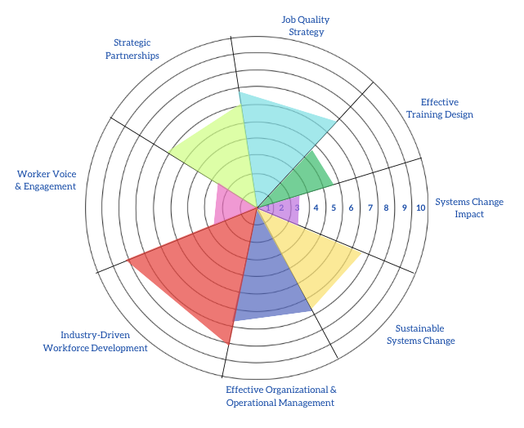
We Are Now Here 10
Systems Change Impact
  Driving enhancements – short-term and long-term barriers and impacts
Worker Voice & Engagement/ Effective Training Design
Worker Voice related to training design
Strategic Partnerships
State and local workforce boards

Slide 91
Thank You! 10
Adrineh Terantonians
Director of Workforce Systems
Hospitality Training Academy
adrineh.terantonians@lahta.org

Slide 92
Next Steps
Share the Job Quality Starter Guide with your Critical Sectors “home team”
Work on the Value Proposition & the Job Quality Canvas activities with your team
Prepare to share your questions, epiphanies, and challenges with these activities at the August 15th Peer-to-Peer Discussion
  Heads up! Future monthly Peer-to-Peer Discussions will continue to focus on the Job Quality Starter Guide.
  Provide Feedback
    Please answer a few brief anonymous poll questions on your experience in today’s Virtual Intensive.

Slide 93
Thank you for participating!
Contact the Critical Sectors Program Office at Criticalsectors@dol.gov
To anonymously ask questions of - or give feedback to the Critical Sectors Program Office team, complete our form.
The Next Office Hour is Thursday, July 11^{th,} at 2 PM ET.
The July 18th Monthly Peer-to-Peer Meet Up will be canceled

