Slide 1
Greater Financial Health & Improved Employment Outcomes: A Growing Partnership between the Disability Employment Initiative, American Job Centers & MyFreeTaxes
Webinar Date: January 20, 2015
Presented by:
Jamie Robinson
Manager, Financial Empowerment and Workforce, National Disability Institute

Slide 2
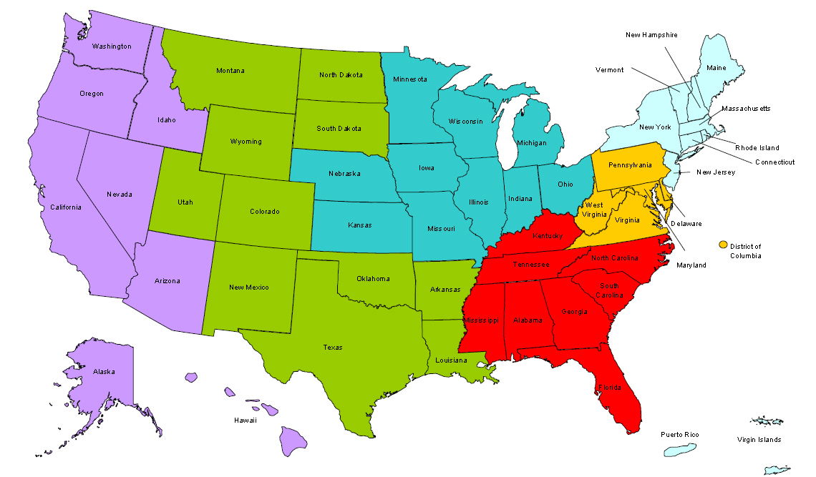
Where are you?
Enter your location in the Chat window – lower left of screen

Slide 3


Moderators
Moderator: Randee Chafkin
Title: Workforce Development Specialist
Organization: Employment and Training Administration
Moderator: Laura Gleneck
Title: Program Manager for DEI, NDI Technical Assistance Team
Organization: National Disability Institute
#
3

Slide 4


Learning Objectives
Participants and partners from the public workforce system will learn about:
Benefits and impact of free tax preparation on employment
Significant increase in awareness and access to free tax preparation by DEI to public workforce system
Critical connections made by DEI and American Job Centers (AJCs) to ensure veterans have access free tax preparation
Experiences and findings of AJCs integrating MyFreeTaxes
How AJCs can expand free tax preparation to help individuals build greater financial stability
#
4
Notes:
4

Slide 5

Presenter
Presenter: Jamie Robinson
Title: Manager, Financial Empowerment and Workforce
Organization: National Disability Institute

Slide 6
Agenda
Key initiatives that led to significant integration of free tax preparation in public workforce system
Benefits and impact of integrating free tax preparation in AJC Network
History, overview and impact of MyFreeTaxes nationwide
Background on how DEI opened doors to integrating MyFreeTaxes in public workforce system
Expansion and impact of MyFreeTaxes in both veterans and disability communities
How AJCs, their partners and employers can get involved in expanding free tax preparation in 2015

Slide 7
National Disability Institute
(NDI)
National Disability Institute (NDI) is the first national nonprofit organization dedicated exclusively to building a better economic future for Americans with disabilities
We envision a world where people with disabilities have equal opportunity to achieve financial stability and independence as people without disabilities
http://www.realeconomicimpact.org/

Slide 8
NDI’s Real Economic Impact
(REI) Network
Alliance of organizations and individuals dedicated to advancing economic empowerment of people with disabilities
Consists of more than 900 partners in more than 100 cities
Includes non-profits, community tax coalitions, asset development groups, financial education initiatives, private-sector businesses, federal/state/local governments and agencies, and individuals & families with disabilities.
All join forces to embrace, promote and pursue access to and inclusion of people with disabilities in economic mainstream
http://www.realeconomicimpact.org/REI-Network.aspx

Slide 9
Meeting NDI’s Mission
NDI’s 6 major areas of focus:
  Financial Education
  Tax Preparation
  Benefits Planning
  Employment
  Asset Building
  Public Policy

Slide 10
Key Initiatives Intersect:
Employment & Taxes
Employment
NDI is national technical assistance provider for US DOL disability employment initiatives for over 10 years
DOL’s DEI first to incorporate asset development to enhance economic stability of individuals with disabilities
Taxes
2005 to 2012 - REI builds more disability-inclusive free tax coalitions across country
  5,316% increase in number of persons with disabilities filing taxes (7,600 to 411,000 pwd)
2009 to 2014 - NDI joins MyFreeTaxes Partnership, increases filers with disabilities 6% to 13% (online 19%)

Slide 11
POLL
  1. How many DEI projects, AJCs, and/or workforce partners on the webinar today are familiar with any free tax preparation options in your community?
  2. Of those who are familiar with free tax preparation resources in your region, how many of you partner with your tax site or coalition in some way?
  3. Finally, of those who are currently partnering with free tax preparation, how many AJCs are integrating free tax resources within your regular core, intensive and/or WIA services?

Slide 12
Why Integrate Free Tax Preparation in the Workforce System?

Slide 13
Who accesses the
Workforce Development System?
Over 20 million individuals tap into key federal programs and resources of public workforce system that help them find jobs and identify training programs
Customer-base is diverse, many of whom are unemployed or remain within low-to moderate income once employed
Co-located partners target underserved/underemployed
More individuals with disabilities are accessing AJCs due to disability-employment initiatives like DPN and DEI that enhance access and opportunities

Slide 14
Business Providing Free Tax Filing to Employees
Boosts employee benefits and business bottom line
Builds employee confidence and retention
Supports positive company morale
Provides no-cost incentive for your workforce
MyFreeTaxes Tax filing software provided by H&R Block® utilizing Secure Transmission Control Protocol, the highest industry standards to safeguard taxpayer information.
Helps employees keep more hard earned money in their pockets!

Slide 15
The MET Center:
Stimulating Economic Self-Sufficiency in St. Louis
The MET Center is a strategic partnership created to stimulate the economic self-sufficiency of individuals living in low-income communities of the St. Louis Region
The Center seeks to accomplish this mission by delivering focused, comprehensive, and accessible job training, placement, assessment, career development services and transportations services
Incorporates financial literacy, on-site tax prep and asset development throughout customer flow

Slide 16
The MET Center – Supportive Services
Financial Education & Asset Building Services
Home Buyers Education & Investment Services
Tax Services Vita Site
Transportation Services
Health and Wellness Education
MET Mobility Center
Dr. J’s Family Weight Loss
Healthy Relationship Education/Responsible Fatherhood
Individual and Group Counseling Services
Teen Pregnancy Prevention Program

Slide 17
The MET Center – Flow of Services
Studies show that bundling and sequencing of work readiness training, financial literacy, tax preparation, and asset building:
  Leads to Long-Term Engagement
  Effectiveness of Services
  Optimize Customers’ Utilization of Services
  Increase in Customer Retention
  Increase in Participants Wages
  https://www.eiseverywhere.com/file_uploads/cc951be7436951cb1200e0eb765c1d8d_CS3_ISD_MET.pdf

Slide 18
POLL
How many people have heard about MyFreeTaxes before today?
Do we have anyone out there who has actually filed on MyFreeTaxes?

Slide 19
MyFreeTaxes Partnership
Funded by the Walmart Foundation, MyFreeTaxes partnership includes United Way, National Disability Institute and Goodwill Industries International
Since 2009, MyFreeTaxes Partnership has helped millions of taxpayers claim more than $10 billion in tax refunds
www.MyFreeTaxes.com is the only FREE online platform for eligible taxpayers that covers all 50 states and the District of Columbia
Emphasis is inclusive tax preparation for ALL taxpayers, including individuals with disabilities

Slide 20
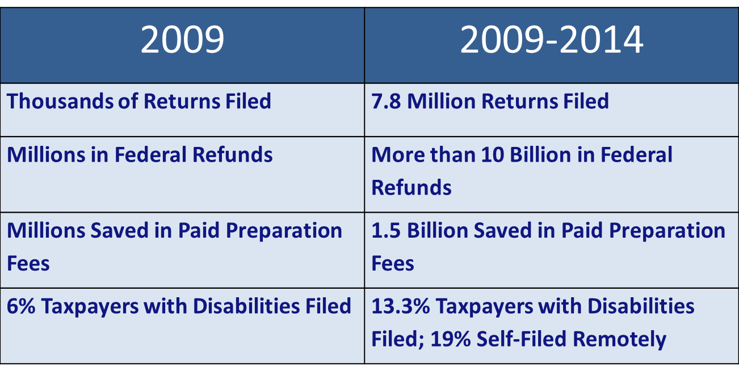
MyFreeTaxes:
Pioneering Inclusive Financial Stability

Slide 21
MyFreeTaxes: The Ideal Customer
Income < $60,000
(*adjusted gross income in 2015)
Functional email address
Valid SSN or ITIN
No foreign income
Computer aware

Slide 22
MyFreeTaxes Hotline
1-855-MY-TX-HELP
All customers using www.myfreetaxes.com are supported by the MyFreeTaxes Helpline
Hours of Operation: 10am – 8pm EST (Monday – Saturday)
Helpline is staffed by select 2-1-1 centers and IRS certified volunteers
Email support is available 24/7 with a 24 hour response time
Chat support is available during hours of operation

Slide 23
Expanding Financial Stability in the Public Workforce System
2013 - NDI selected 10 workforce regions as pilots
Outreached more than 6,000 people
Surveys showed more than 80% of filers felt empowered to file their own taxes next year
20% of MyFreeTaxes workforce online filers reported a disability
2014 - NDI expands to 22 workforce regions across 9 states
Online returns for second year AJC sites doubled or tripled
Over 33,450 individuals were reached during promotion
Expansion into veteran community

Slide 24
Introducing MyFreeTaxes to Veteran Community
Personal and professional experiences of NDI staff served as springboard to approaching veteran community
Site visits to AJC pilots led to collaboration with Disabled Veterans Outreach Program
In 2014, 6 veteran programs serves as MyFreeTaxes pilots
Partnerships formed between IRS, NDI, and Dept. of Veteran Affairs leading to MyFreeTaxes posted on VA.gov
Dept. of Veteran Affairs connected NDI with VA hospitals and Community Resource Referrals Centers and other national partners, including ArmyOneSource

Slide 25
Benefits Of Integrating MyFreeTaxes into Veteran Programs
Easy, cost-effective way to expand veteran services
Gateway to financial education for veterans
Produces benefits such as reduced lengths of stay in transitional housing and long-term stability in employment
Supports veterans who may be target of fraudulent practices
Veterans-centered environment can help overcome challenges with transportation, fear of social settings, identifying reliable resources
Offers veterans feeling of empowerment with computer skills

Slide 26
Findings from AJCs on Integrating MyFreeTaxes
AJCs want resources to help them support low-income workers and vulnerable populations
AJCs need to provide resources that will help people focus on skills re-building and employment
AJCs want resources to bring in new customers to learn about all available workforce services
AJCs report that MyFreeTaxes helps shift the importance of financial stability to the forefront of customer services
AJCs that implement DEI and Employment Networks under Ticket to Work reach more filers with disabilities

Slide 27
More Universal Findings from NDI’s
MyFreeTaxes Pilots
Most customers and partners completely unaware of free tax preparation – untapped systems
MyFreeTaxes supplements partnerships that are already in place with credit unions, financial literacy programs, credit/debt coaching, housing/mortgage counseling, etc.
MyFreeTaxes allows customers to save money and remain focused on training/skills re-building and employment goals
Customers are in-need of free resources; MyFreeTaxes is added benefit for all, especially those most vulnerable

Slide 28
MyFreeTaxes 2015
NDI is expanding MyFreeTaxes using a regional model
Ten AJCs and veteran programs are serving as MyFreeTaxes’ “Anchors” or mentors to broader community
Anchors recruit other diverse partners such as:
  Other workforce centers and veteran organizations
  United Ways and Goodwills
  Disability Agencies
  Community Organizations
  Employers, Chambers, Other Business Associations
Anchors and new partners may choose to collaborate with IRS to recruit volunteer tax coach

Slide 29
2015 MyFreeTaxes (MFT) Workforce Anchors
CDO Workforce - Oneonta, NY
Kathy DeAngelo,
Disability Resource Coordinator
Alaska Department of Labor & Workforce Development – Statewide MFT Project
Nikki Powis,
Disability Employment Initiative Statewide Lead

Slide 30
How Can your AJC get involved this tax season?
There are options and it’s an easy lift with a HUGE impact!
  Register on new MyFreeTaxes Affiliate Portal to partner with MyFreeTaxes https://affiliate.myfreetaxes.com
  Find your nearest VITA and TCE sites generally located at community and neighborhood centers, libraries, schools, shopping malls and other convenient locations across the country http://irs.treasury.gov/freetaxprep/

Slide 31
Join the MyFreeTaxes Network
Join the new Affiliate Portal by registering here:
https://affiliate.myfreetaxes.com/
Access a variety of resources including:
Marketing, digital & PR materials for download
Interactive forum to share best practices with partners
Tools & resources to help promote and use MFT:
        Training videos, newsletters and playbboks
        TaxAccess – supports to effectively serve taxpayers with disabilities

Slide 32
Contact Info
Jamie Robinson
Manager, Financial Empowerment & Workforce
National Disability Institute
MyFreeTaxes Project Manager
Celebrating 10 Years of Real Economic Impact
for People with Disabilities
Boston Office
617.467.4195 (telephone)
jrobinson@ndi-inc.org

Slide 33
Summary
In today’s presentation we covered the following:
  Benefits and impact of integrating free tax prep within the AJC Network
  Significant impact of DEI in expanding free tax prep within AJC Network, specifically to taxpayers with disabilities and veterans
  Ways in which AJCs can get involved this tax season to increase awareness and access to free tax prep for customers and employers
33
Notes:
33

Slide 34

Discussion & Feedback
Your thoughts or questions are welcomed…
#
34
Notes:
34

Slide 35

Please enter your questions in the Chat Room!

Slide 36

Speaker’s Contact Information
Speaker: Jamie Robinson
Title: Manager, Financial Empowerment and Workforce
Organization: National Disability Institute
Email: jrobinson@ndi-inc.org
#
36
Notes:
36

Slide 37
Thank You!
Find resources for workforce system success at:
www.workforce3one.org

