Slide 1
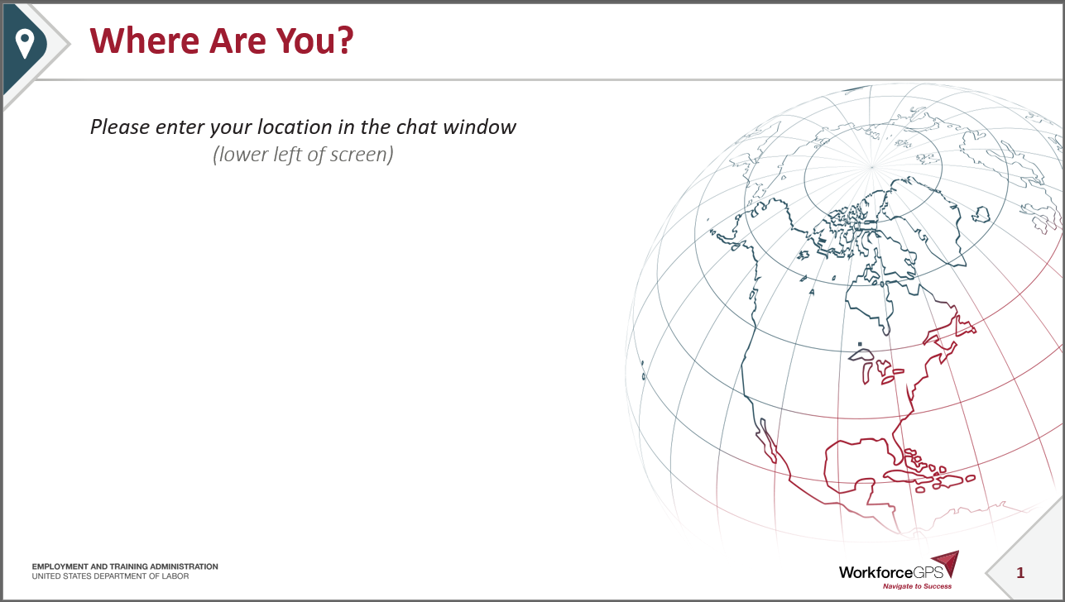

Slide 2
Unemployment Compensation (UC) for Individuals Affected by COVID-19
Unemployment Insurance Program Letter (UIPL) 10-20, released March 12, 2020

Slide 3
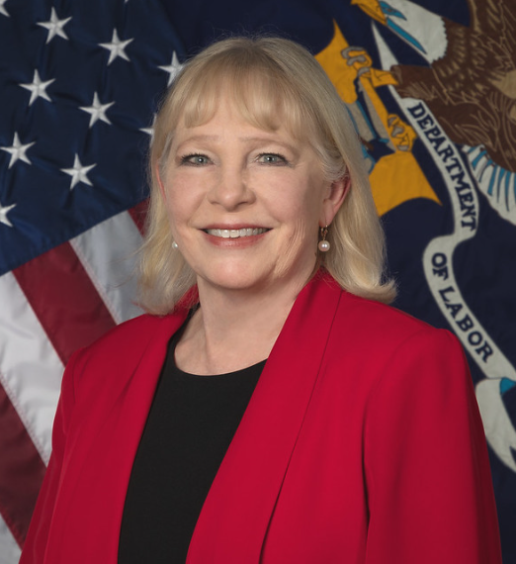
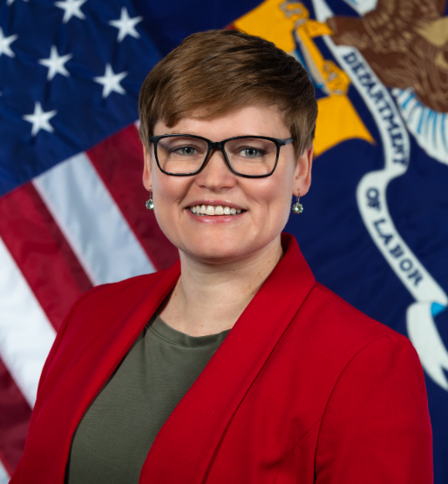
Today’s Speakers
Gay Gilbert
  Administrator
  Office of Unemployment Insurance
    Employment and Training Administration
    US Department of Labor
Michelle Beebe
  Division Chief, Legislation
  Office of Unemployment Insurance
    Employment and Training Administration
    US Department of Labor
Jonathan Hammer
  Counsel for Unemployment Programs
  Employment & Training Legal Services Division
    Office of the Solicitor
    US Department of Labor

Slide 4
Summary and Background
Unemployment Insurance (UI) requires individuals to be able to, available for, and actively seeking suitable work
States have significant flexibility in implementing these requirements
An individual may be quarantined or otherwise affected by COVID-19 but still eligible for UC, depending on state law
The UI program is not intended to be used as paid sick leave

Slide 5
“Unemployed” Status
“Unemployment” includes a reduction of both work hours and earnings
An individual receiving paid sick leave or paid family leave is still receiving pay and would generally not be considered “unemployed” for purposes of collecting UC
Manual of State Employment Security Legislation, 1950
and
UIPL 08-98

Slide 6
“Able/Available/Actively Seeking Work” Requirement
As a condition of eligibility for UC in any week, “a claimant must be able to work, available for work, and actively seeking work”
  “Able and available” requirements were codified in federal regulation at 20 CFR 604.4 in 2007
  “Able, available, and actively seeking work” requirements were inserted into Section 303(a)(12) of the Social Security Act (42 USC 503(a)(12)) in 2012
Federal UC law makes some exceptions, such as for state-approved training or participation in the Short-Time Compensation program

Slide 7
“Able/Available/Actively Seeking Work” Requirement
20 CFR 604.5(a) Application—availability for work
A State may consider an individual to be available for work during the week under any of the following circumstances:
  “(1) The individual is available for any work for all or a portion of the week claimed, provided that any limitation placed by the individual on his or her availability does not constitute a withdrawal from the labor market.”
  “(2) The individual limits his or her availability to work which is suitable for such individual as determined under the State UC law, provided the State law definition of suitable work does not permit the individual to limit his or her availability in such a way that the individual has withdrawn from the labor market.”
  “(3) The individual is on temporary lay-off and is available to work only for the employer that has temporarily laid-off the individual.”

Slide 8
“Able/Available/Actively Seeking Work” Requirement
20 CFR 604.4 Application—ability to work
(b) If an individual has previously demonstrated his or her ability to work and availability for work following the most recent separation from employment, the State may consider the individual able to work during the week of unemployment claimed despite the individual's illness or injury, unless the individual has refused an offer of suitable work due to such illness or injury.

Slide 9
State Flexibility within the Parameters of Federal UC Law
States have flexibility to determine what type of work is suitable for an individual and what it means for that individual to be able, available, and actively seeking work even when quarantined or otherwise affected by COVID-19.
The UIPL provides 3 examples that states may consider when reviewing their laws in light of COVID-19’s effects. Other scenarios than these may arise.
  Scenario #1: Employer temporarily ceases operations
  Scenario #2: Individual is quarantined and will return to employer
  Scenario #3: Individual is not returning to the employer

Slide 10
Example for Assessing UC Eligibility
Scenario #1: Employer temporarily ceases operations
An employer or employing unit temporarily shuts down due to COVID-19 with the expectation that the individual will return when business resumes.
Is the individual “unemployed?” Yes, state law may find that because the individual has reduced hours and pay, they are unemployed.
Is the job separation allowable? Yes, federal law permits states to consider this a temporary layoff as the employer does not currently have suitable work and intends to call the individual back to work.

Slide 11
Example for Assessing UC Eligibility
Scenario #1 (cont’d.): Employer temporarily ceases operations
An employer or employing unit temporarily shuts down due to COVID-19 with the expectation that the individual will return when business resumes.
Is the individual “Able, Available, and Actively Seeking Work?” Yes, as provided under 20 CFR 604.5(a)(3), state law may find the individual meets these requirements if the individual is able & available to work for that employer once suitable work becomes available again and that the individual is taking reasonable steps to preserve contact with the employer.

Slide 12
Example for Assessing UC Eligibility
Scenario #2: Individual is quarantined and will return to employer
An individual is quarantined by a medical professional or under government direction, and the employer has instructed the individual to return to work after the quarantine is over or has not provided clear instruction to do so.
Is the individual “unemployed?” Yes, state law may find that because the individual has reduced hours and pay, they are unemployed.
Is the job separation allowable? Yes, federal law permits states to consider this a temporary layoff as the employer does not currently have suitable work and intends to call the individual back to work.

Slide 13
Example for Assessing UC Eligibility
Scenario #2 (cont’d.): Individual is quarantined and will return
An individual is quarantined by a medical professional or under government direction, and the employer has instructed the individual to return to work after the quarantine is over or has not provided clear instruction to do so.
Is the individual “Able, Available, and Actively Seeking Work?” Yes, as provided under 20 CFR 604.5(a)(3), state law may find the individual meets these requirements if the individual is able & available to work for that employer once suitable work becomes available again and that the individual is taking reasonable steps to preserve contact with the employer.

Slide 14
Example for Assessing UC Eligibility
Scenario #3: Individual is not returning to the employer
An individual is quarantined or leaves employment due to a reasonable risk of exposure or infection (i.e., self-quarantine) or to care for a family member and either does not intend to return to the employer or the employer will not allow the individual to return.
Is the individual “unemployed?” Yes, state law may find that because the individual has reduced hours and pay, they are unemployed.
Is the job separation allowable? Maybe, state law will determine whether the separation here is a quit or discharge and whether the circumstances are allowable under the state’s good cause/just cause provisions.

Slide 15
Example for Assessing UC Eligibility
Scenario #3 (cont’d.): Individual is not returning to the employer
An individual is quarantined or leaves employment due to a reasonable risk of exposure or infection (i.e., self-quarantine) or to care for a family member and either does not intend to return to the employer or the employer will not allow the individual to return.
Is the individual “Able, Available, and Actively Seeking Work?” Maybe, as provided under 20 CFR 604.5(a)(1), state law may find that the individual is still able, available, and actively seeking work that is suitable for an individual with these circumstances and that such a limitation does not constitute a withdrawal from the labor market.

Slide 16
Employer Charging
When determining, in the context of COVID-19, whether certain unemployment benefits should be charged to employers, states should consider how to fairly distribute costs to employers.
If states consider changing their laws to increase availability of UC in the context of COVID-19, they should also consider the impacts on trust fund solvency.
  21 states and jurisdictions are below the recommended solvency standard
  Only 31 states meet the eligibility criteria for interest-free borrowing

Slide 17
Eliminating the Waiting Week
The waiting week is a longstanding practice in the UI program that may give states time to assess eligibility and deter fraud.
In light of the emergent need to cover individuals impacted by COVID-19 and to allow the UI program to act as an economic stimulus, states should consider temporarily waiving such requirements.
If a state triggers onto Extended Benefits (EB) while the waiting week is waived, they will not be reimbursed for the first week of all EB claims
(Section 204(a)(2) of the Federal-State Extended Unemployment Act of 1970)

Slide 18
Promotion of Short-Time Compensation, aka Worksharing
The Short-Time Compensation (STC) program can be an important resource for employers whose business temporarily declines as a result of COVID-19.
What does it do? Employers with a state-approved STC plan reduces the hours of their employees in lieu of layoffs, while permitting these employees to receive payment for partial unemployment.
Advantage for Employees: They do not suffer a complete loss of employment and are paid STC when their hours are reduced.
Advantage for Employers: They are able to reduce labor costs temporarily while still maintaining their skilled workforce.

Slide 19
Resources
Email covid-19@dol.gov with your questions
  CC to your regional office
  If proposing changes to state laws or rules, include your Division of Legislation state team member (Regions 1 and 6 roberson.Nicole@dol.gov; Regions 2 and 5 massey.steve@dol.gov; and Regions 3 and 4 wells.agnes@dol.gov )
UIPL 10-20
  Unemployment Compensation for Individuals Affected by the Coronavirus Disease 2019 (COVID-19)
    https://wdr.doleta.gov/directives/corr_doc.cfm?DOCN=8893
State Unemployment Insurance Trust Fund Solvency Report (Feb. 2020)
  Provides assistance in effectively evaluating a state’s trust fund solvency levels
    https://oui.doleta.gov/unemploy/docs/trustFundSolvReport2020.pdf
Guidance on Short-Time Compensation
  WorkforceGPS Landing Page
    https://stc.workforcegps.org/
  UIPL 22-12, plus Change 1 and Change 2
    https://wdr.doleta.gov/directives/corr_doc.cfm?DOCN=9382

Slide 20
Thank You!
Need help? Email: Support@workforceGPS.org

Slide 21
Any Questions?
Please send your questions to covid-19@dol.gov

