Slide 1
Where Are You?
Please enter your location in the chat window
  (lower left of screen)
Please tell us where you’re listening in from! Also, are any of you in “virtual groups” listening in together?

Slide 2
Staying Connected
Engaging Youth Virtually

Slide 3
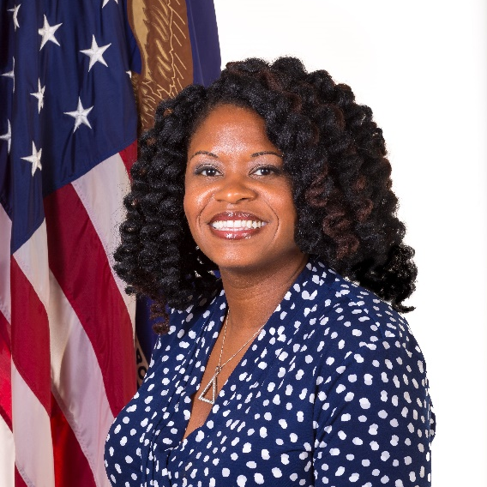
Today’s Moderator
Maisha Meminger
  Manpower Analyst
    Division of Youth Services
    Employment & Training Administration
    U.S. Department of Labor

Slide 4


Today’s Speakers
Keda Dorisca
  Seaford High School Coordinator
    Pathways to Success, Inc.
    Georgetown, DE
Michael Garringer
  Director of Research and Evaluation
    MENTOR: The National Mentoring Partnership

Slide 5

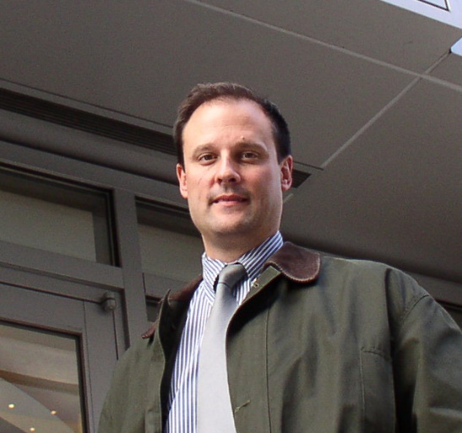
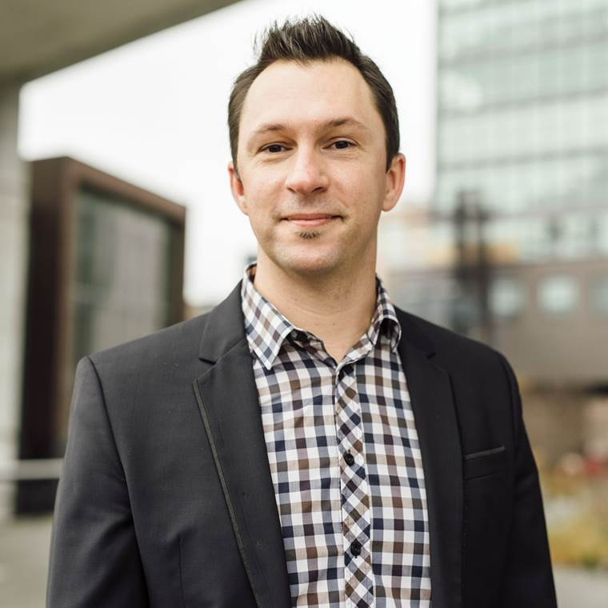
Today’s Speakers
Jacqueline Ivy
  Senior Program Manager
    GetSchooled.com
Charles Hiteshew
  Executive Director
    100KOpportunities Initiative
Jason Rzepka
  Cultural Strategist
    100KOpportunities Initiative

Slide 6

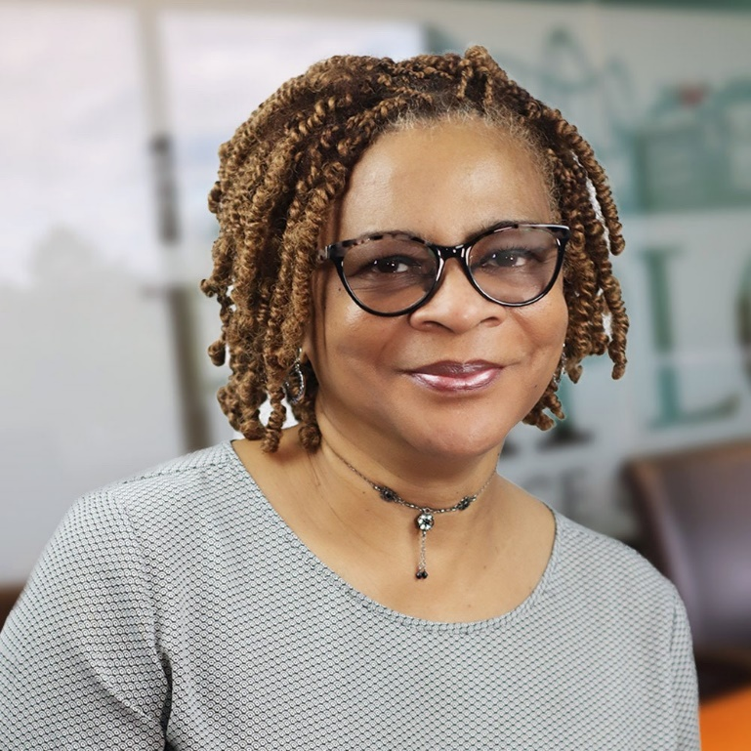
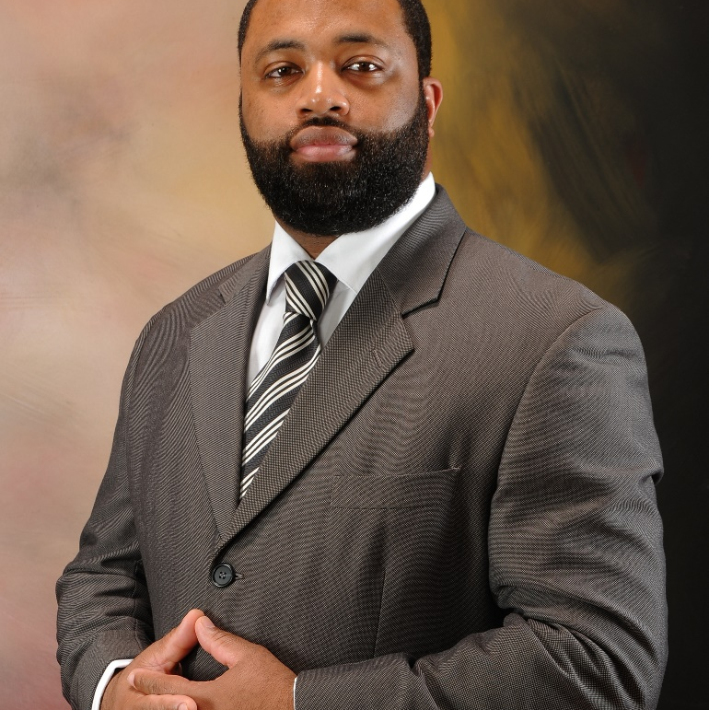
Today’s Speakers
Brian Walker
  Program Manager
    Youth Career Connections
    Employ Prince George's, Inc., MD
Monica Chavis
  Youth Career Consultant
    Youth Career Connections
    Employ Prince George's, Inc., MD
Denise M. Higgs
  Youth Business Consultant
    Youth Career Connections
    Employ Prince George's, Inc., MD

Slide 7
Today’s Objectives
Provide tips on creative ways to use social media, online tools and websites to engage youth in workforce programs
Learn how organizations are reaching out to, and engaging, youth through:
  Virtual Engagement
  Virtual Job Fairs
  Virtual Job Experiences
  Virtual Mentoring

Slide 8
Introduction
What are we learning from the field?

Slide 9
WIOA Youth Program COVID-19 Session May 4, 2020
ETA conducted a "WIOA Youth Program COVID-19 Session" Monday, May 4, 2020 at 2pm (ET). During this event, answers to pre-submitted questions were given as well as resources and best practices were shared.
ETA developed:
  A series of technical assistance resources and frequently asked questions (FAQs)
    https://www.workforcegps.org/resources/2020/03/18/23/35/Coronavirus-COVID-19-Resources.
  “WIOA Youth Program COVID-19 Session Lessons Shared” which highlights attendees shared solutions
    https://youth.workforcegps.org/resources/2020/06/15/18/59/WIOA-Youth-Program-COVID-19-Session-Lessons-Shared
  Region 6: Strategies for Operating the YouthBuild Program in a Virtual Environment Training Series, https://youthbuild.workforcegps.org/resources/2020/05/19/12/29/Region-6-Strategies-for-Operating-the-YouthBuild-Program-In-a-Virtual-Environment
  Resources on Virtual Engagement pages Part One & Two
    https://youth.workforcegps.org/resources/2020/06/18/13/10/Resources-on-Virtual-Engagement
    https://youth.workforcegps.org/resources/2020/06/18/20/00/Resources-on-Virtual-Engagement-part-2
_
_
_
_
_
_

Slide 10
Highlighted lessons learned
Virtual engagement allows programs to implement strategies to keep youth engaged when texts, phone calls, and emails are not enough.
Communication, Communication, Communication
Technology “Check-outs”
Making Internet Accessible
Supportive Services Linkages
Partnerships Strengthened
Participation Improved
Workforce Experiences

Slide 11
Virtual Engagement
Keda Dorisca, Seaford High School Coordinator
  Pathways to Success, Inc.
  Georgetown, DE

Slide 12








Tools to Stay Connected
KEDA DORISCA
PATHWAYS TO SUCCESS INC.
SEAFORD HIGH SCHOOL COORDINATOR
Staying Connected: Engaging Youth Virtually

Slide 13
Communication Methods
  What is your favorite way to communicate with youth participants?
Phone
Email
Social Media
Zoom/WebEx etc..
All of the above
Select your answer

Slide 14
Sharing Information about your Program
  What social media platform do you use the most to share information about your program?
Facebook
Instagram
Twitter
Snapchat
Other (let us know in the chat feature)
Select your answer

Slide 15


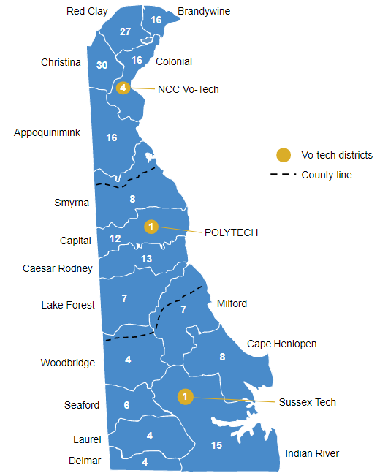



Pathways to Success Inc.
  In-school youth non-profit agency in Sussex County, Delaware (rural)
  4 Schools in Sussex ( Sussex Technical High School, Cape Henlopen High School, Seaford High School, and Milford High School)
  Climate and Culture
  5 years (4 years of High School - 1 year life/career path (4year/2 year College, Trade School, Military, and/or Full Time Employment))

Slide 16




Pathways to Success Inc.
Mission
Pathways to Success mission is to prepare youth, adults, and their families for successful lives. We utilize innovative and creative approaches in mentoring and education to help individuals develop to be healthy, productive, contributing and responsible citizens. Working in service to the at-risk communities in a spirit of offering hope through education and information, creating positive systemic change through empowerment.

Slide 17

Our Goals
What we Offer
  Provide tools for academic success
  Enable individuals to experience a wide range of opportunities
  Encourage and support individuals while they consider their future
  Build competence, confidence, and community
  Engage and support parents as partners
  Academic Mentoring
  Character Education
  Preparatory Experiences
  Work-Based Activities
  Connecting Activities
  Family Involvement
  Career Planning
  College Preparedness
  Business Partnership and
Outreach
Model
Our Success
  C.A.R.E.
  Consistent
  Authentic
  Respectful
  Empowerment
  98% Success Rate - Graduating On Time
  96 % - College, Military, or Full Time Employment
https://www.pathways-2-success.org/

Slide 18




Staying
Connected
Today

Slide 19


Reaching Students...
Pandemic and The
Resurgence of Racial Injustice in the Mainstream Consciousness
BEFORE
DURING
- Daily Interaction in school
- Opportunities to interact before, during, and after school, weekends, and contact for emergencies
- Mentoring
- Academic Support
- Personal Growth and Mental Health
- C.A.R.E. Model
- Adjustments and more Creativeness
- Advocate for students to be met where they are
- More Intentional Contact
(Food, Tech, etc.)
- Broader Accessibility
- Academic Support
(Admin, Teachers, Counselors)
(Lack of Equity and Resources)
- Personal Growth/ Mental Health
(Resilience, Perseverance)

Slide 20



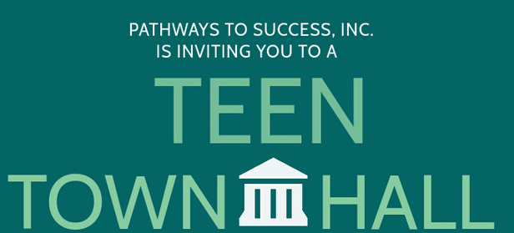

Approaches:
what we do
TEXT/CALLS
RESPONSE RATE:
95%
SOCIAL MEDIA
ENGAGEMENT RATE:
75%
CREATIVE VIRTUAL EVENTS
SUCCESS RATE:
35 -40 %

Slide 21




Challenges
- NEW NORMAL (VIRTUAL WORLD)
- STUDENTS ADAPTING
- ACCESS TO TECHNOLOGY
- MASLOWS HIERARCHY OF NEEDS
(RESOURCES AND SERVICES)
- UNDERSTANDING GRACE ALL AROUND
- INTERNET (Wi-Fi/ BROADBAND)
- STUDENT MOTIVATION
- STUDENT CONSISTENCY

Slide 22
Successes
OUR GOLDEN EGG: RELATIONSHIPS BUILT WITH STUDENTS
- GRADUATING OUR SENIORS (80 STUDENTS)
- HELPING UNDERCLASSMEN ADVANCE TO NEXT GRADE LEVEL
- ADVOCACY
- ENCOURAGING STUDENTS TO COMPLETE WORK
- STUDENT BUY-IN DAY BY DAY INTO THIS VIRTUAL WORLD
- TRYING DIFFERENT APPROACHES
- REIMAGINE EDUCATION AND REACHING STUDENTS

Slide 23
Tips
Rules of Engagement
Conduct
Norms
Why
- Conduct has changed
- Contact has changed
- Be Specific
- Be Direct
- Consider your
Approach
- Attention (Be Realistic)
- Awareness (Video/Audio)
- Respect
- Clearly Defined Roles and Goal
- Growth Mindset
- Explain the Why!
- Make Sure Everyone is on the same page
- Safety of Student(s) and Employer/Employee

Slide 24
Tips
Engagement - Resources
LIVE
APPS
VIRTUAL IDEAS
- ZOOM
-QOOPER
- GOOGLE HANGOUT
- INSTAGRAM
- FACEBOOK
- TWITTER
- TPT
- GOGGLE FORMS
- YOUTUBE
- FLIP GRID
- PADLET
- TOWN HALLS
WEBINARS
- POLLS
- DISCUSSION BOARD
- TED TALKS
- MUSIC/ MOVIES
- POP CULTURE
- PODCASTS
- FIELD TRIPS

Slide 25



What We Learned !!!
- Connection and Consistency is Key
- Continuous Learning and Growth Mindset is Imperative
- Collaboration and Student Ownership
- Importance of Digestible Content and Sharing of Experiences
- Accountability and Grace
- Parent Engagement
- Have fun

Slide 26
Any Questions?
Keda Dorisca, Seaford High School Coordinator- Pathways to Success, Inc.
31 The Circle Suite A and B
Georgetown, DE 19947
Office: 302-858-4861 Cell: 302-259-2504
Fax: 302-858-4864
http://www.pathways-2-success.org/
_
_

Slide 27
Virtual Mentoring
Michael Garringer, Director of Research and Evaluation
    MENTOR: The National Mentoring Partnership

Slide 28
Virtual Mentoring in the
Time of COVID-19 strategies for supporting young people and transitioning mentoring to virtual environments
7/9/20
Michael Garringer
Director of Research and Evaluation
MENTOR: The National Mentoring Partnership

Slide 29
The last four months in the world of mentoring
Programmatic efforts suspended; facing an uncertain future
Program matches struggling to find appropriate and safe forms of contact
Institutions where mentoring happens are also shut down or refocused
Natural mentoring relationships also disrupted
The needs of young people have shifted
Funders shifting priorities

Slide 30

COVID-19’s impact on relationships
Nearly a third of mentors report that the COVID-19 pandemic has had a positive impact on their mentoring relationships.
However, about a quarter of mentors say the pandemic has had a negative impact.
  The biggest negative impact on relationships has been program closure/suspension (29% of respondents).
About two in five say the pandemic has had either no impact or mixed impact on their mentoring relationships.
Positive impact
No impact
Mixed impact
Negative impact
Base: Nationally Representative Sample who mentor (Total Answering n=111).
30
Pacific Market Research

Slide 31
Communication during COVID
How mentors are staying in touch with mentored youth during
COVID-19 pandemic
Half of mentors report using video conferencing to stay in touch with their mentees
Slightly fewer are using phone calls without video
About a third are maintaining in-person visits, while maintaining a safe distance
One in five have not had contact in any way
Base: Nationally Representative Sample who mentor (Total Answering n=106).

Slide 32
For formal mentoring programs…
Programs estimate that only 57% of matches are currently in touch with each other regularly
Only 69% of youth/families in matches are estimated to have access to Wi-Fi and a device to communicate with their mentor, engage in school work, etc.
Programs are working to provide free devices and hot spot access through schools or other locations to address this challenge
Creative solutions to keep matches engaged: Netflix watch parties, Facebook Live cooking classes, sending care packages, community Zoom and web-based educational opportunities
Source: 2020 MENTOR COVID-19 Program Survey

Slide 33
What can Workforce Programs and Mentors do?

Slide 34
Programs should focus on smart, short-term e-mentoring solutions
Most matches can get by for now with phone calls, emails, texts, videoconferencing
  Transitioning to an elaborate platform may not be the best solution
Some programs may need to relax contact rules or policies while adding extra safeguards
  Consult with legal counsel, Board, advisory councils about changes
In general, focus mentor support on processing emotions, fun/games, reassurance, instrumental problem-solving to the degree possible
  Just-In-Time training for mentors on this shift in role… it may not be the one they signed up for!
Close down matches that were going to end anyways the right way
  Or keep them going if you can reasonably maintain them
  Recognize that your staff may be not operating at full capacity either

Slide 35
For existing workforce-focused mentoring relationships
Don’t assume easy digital tech access for youth
Meet more often and flexibly (timeliness may be more important than frequency)
Focus on problemsolving, instrumental support by mentor
Discuss shifts in career plans or fallback options
Emphasize “book learning” opportunities
  Remember many matches are having success with online learning
Discuss transitions back into work environments
Allow a safe and supportive space for processing emotion and concerns
Connect youth/young adults to other resources and supports as needed

Slide 36
For new mentoring relationships
Try and do videoconference-based meetings as much as possible
Spend considerable time just learning about each other
Avoid the pitfalls of text-only beginnings
  Share about yourself/strategic self-disclosure/be authentic
  Open ended questions
  Avoiding “adultism”
  Emojis/memes help (when used appropriately)
Frequency of communication (“out of sight, out of mind” plagues e-mentoring)

Slide 37
If you are thinking about shifting long-term to e-mentoring….

Slide 38
Considerations…
Revisit the program’s theory of change
  What are the mechanisms of change? Are they feasible via remote exchanges? Are they dependent on real-world contexts?
  What staff support would be needed to facilitate doing things virtually? Implications for curriculum? Staff role in organizing events, providing instructions or resources? Can the staff do this?
Ask if this is the experience participants want
Explore simple solutions and tech before setting out to build a proprietary platform
Evaluate any virtual mentoring shifts for efficacy and client satisfaction

Slide 39
Resources
MENTOR’s COVID-19 Virtual Mentoring Portal and Resources
  https://www.mentoring.org/coronavirus-resources/
  Virtual Portal offers safe online spaces via shared platforms from
  icouldbe and Cricket Media
Supplements to the Elements of Effective Practice for Mentoring
  E-mentoring - https://www.mentoring.org/ementoring/
  Workforce Mentoring - https://www.mentoring.org/workplace-mentoring-supplement-to-the-elements-of-effective-practice-for-mentoring/
_
_
_

Slide 40
Any questions?
Michael Garringer
mgarringer@Mentoring.org
_

Slide 41
Virtual Job Fairs
Jacqueline Ivy
  Senior Program Manager
    GetSchooled.com
Charles Hiteshew
  Executive Director
    100KOpportunities Initiative
Jason Rzepka
  Cultural Strategist
    100KOpportunities Initiative

Slide 42




100,000
Opportunities Initiative x Get Schooled
3rd Annual National Youth Hiring Day
Charles Hiteshew Jackie Ivy
Jason Rzepka

Slide 43

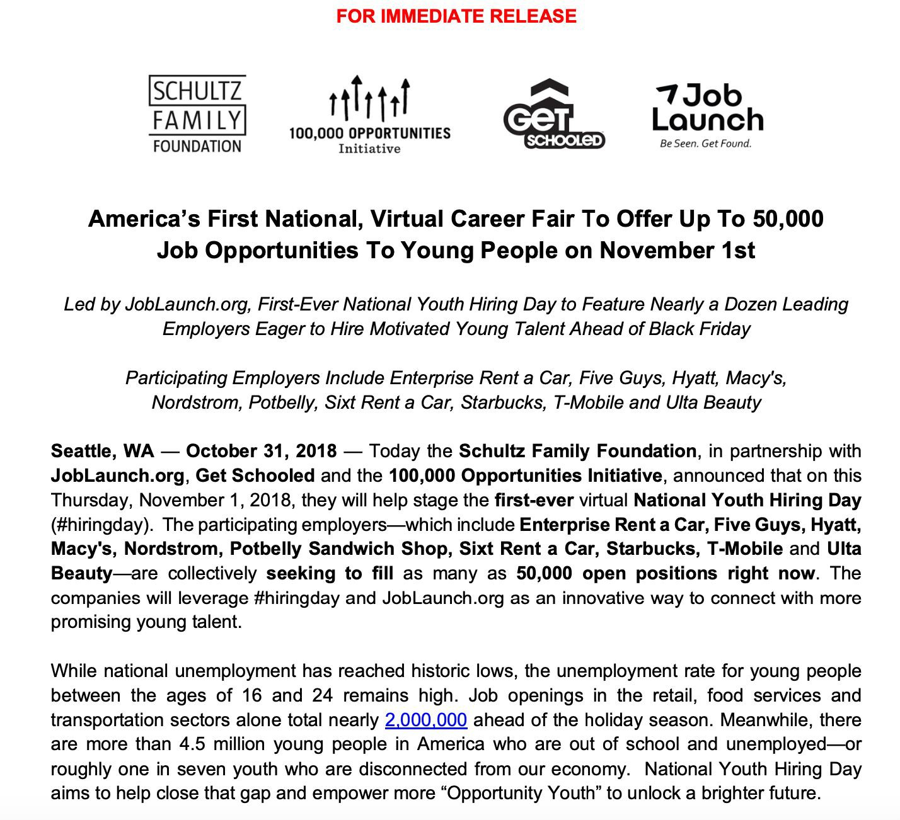


OUR HISTORY:
Pioneering New Ways for Youth & Employers to Connect

Slide 44
OUR INTENTION:
An Urgent Response for Urgent Needs
+ FOR YOUTH. National Youth Hiring Day (NYHD) is designed to help as many young people as possible take their next step towards finding meaningful employment.
+ FOR EMPLOYERS. NYHD is an innovative new way for companies to connect with and make their case to motivated young job seekers.
+ FOR YOUTH SERVICE PROVIDERS. NYHD is a chance to enroll and be of service to youth who need additional supports at the beginning of their career.
+ FOR AMERICA. NYHD is a reminder of the tremendous capabilities and potential of our young people — especially those who have extra barriers standing in their way — and a call to action to continue investing in them.

Slide 45












OUR PARTNERS:
Industry Leaders,
150K+ Immediate Openings

Slide 46


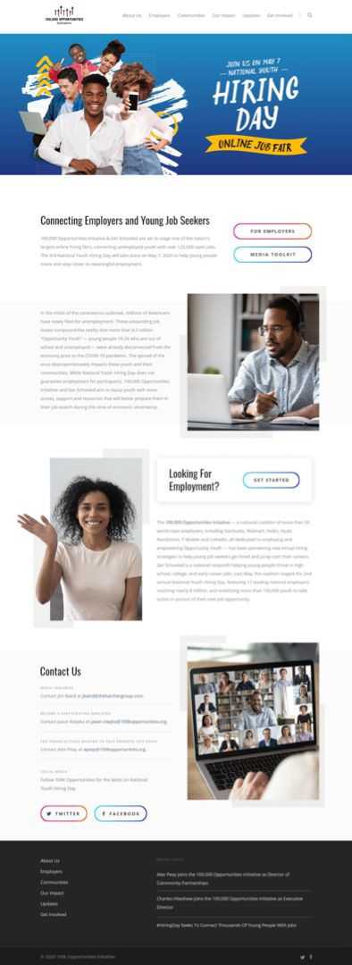


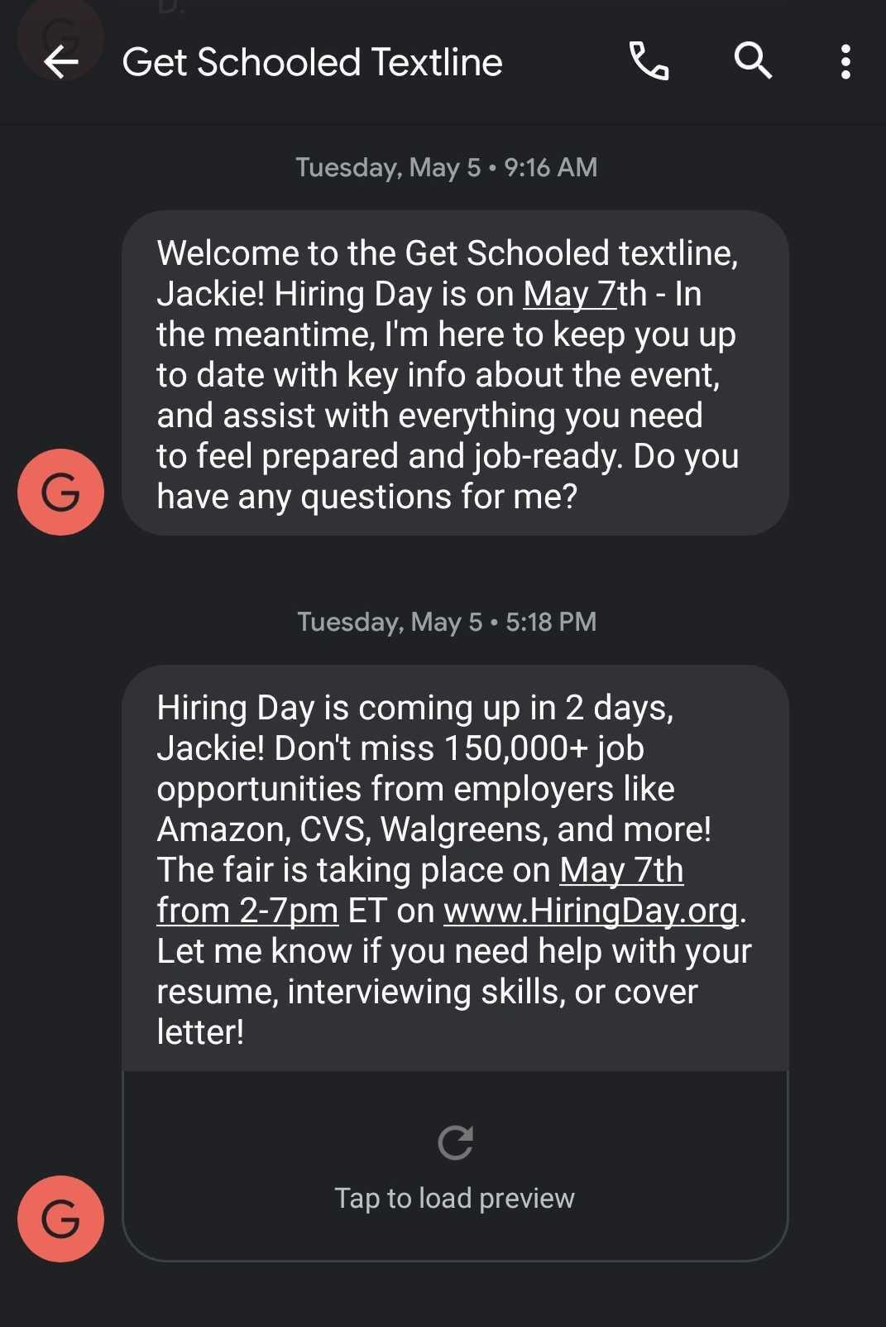


PRE-FAIR: Spreading the Word, Prepping Job Seekers

Slide 47

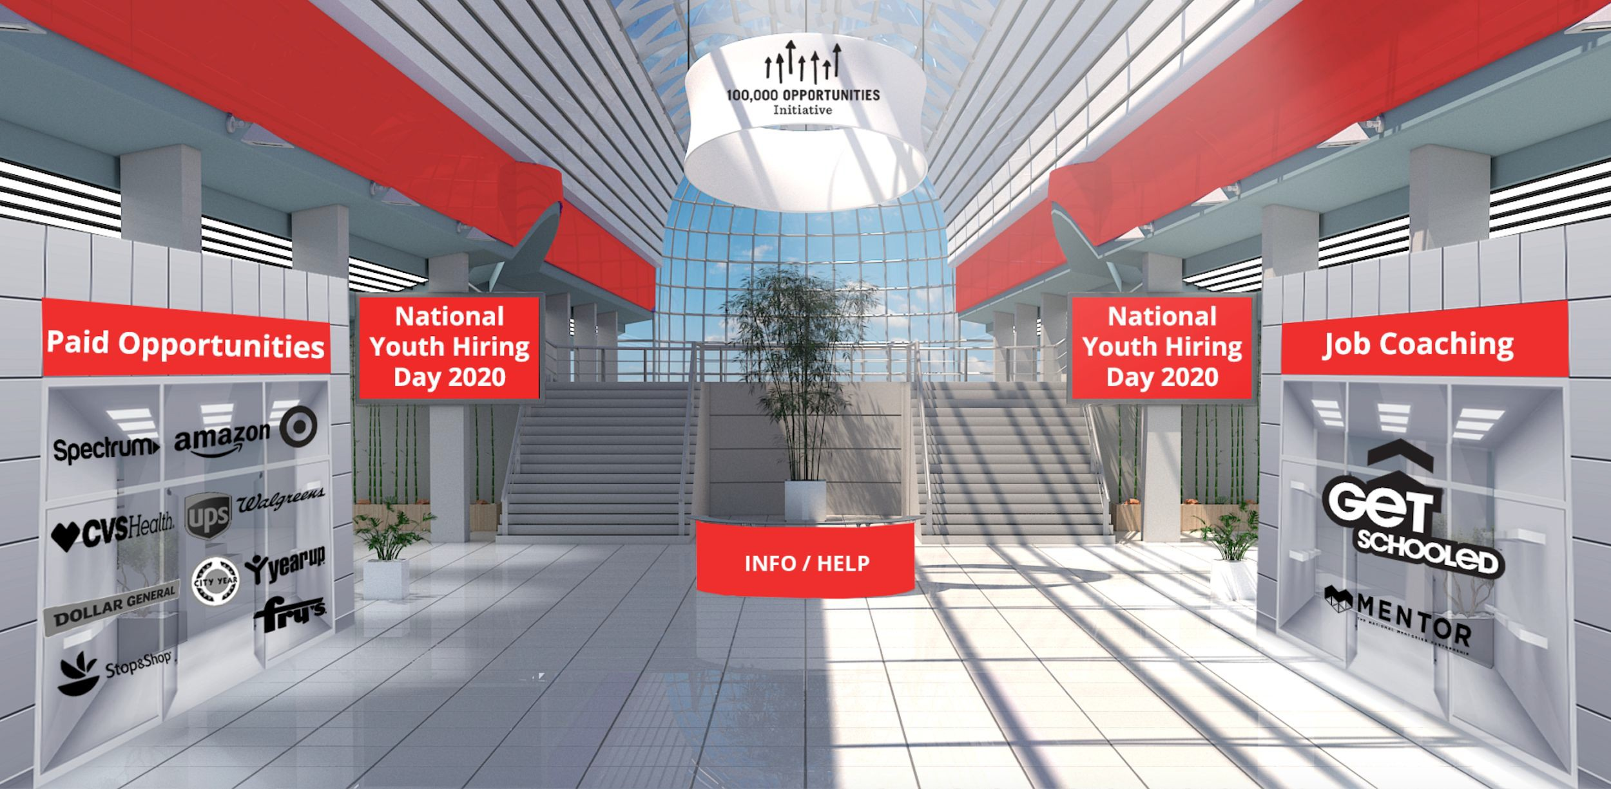
THE VFAIR: Job Seeker Experience / Lobby

Slide 48

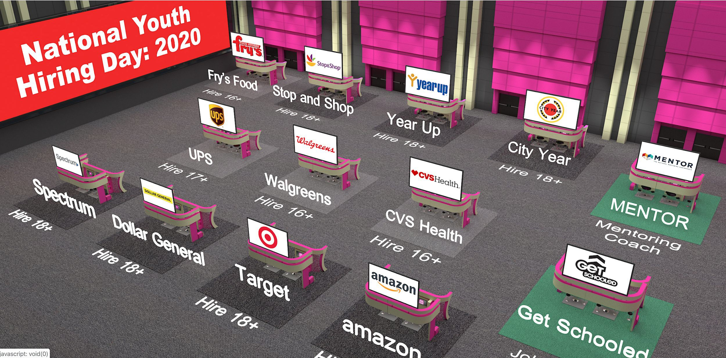
THE VFAIR: Job Seeker Experience / Trade Show Floor

Slide 49
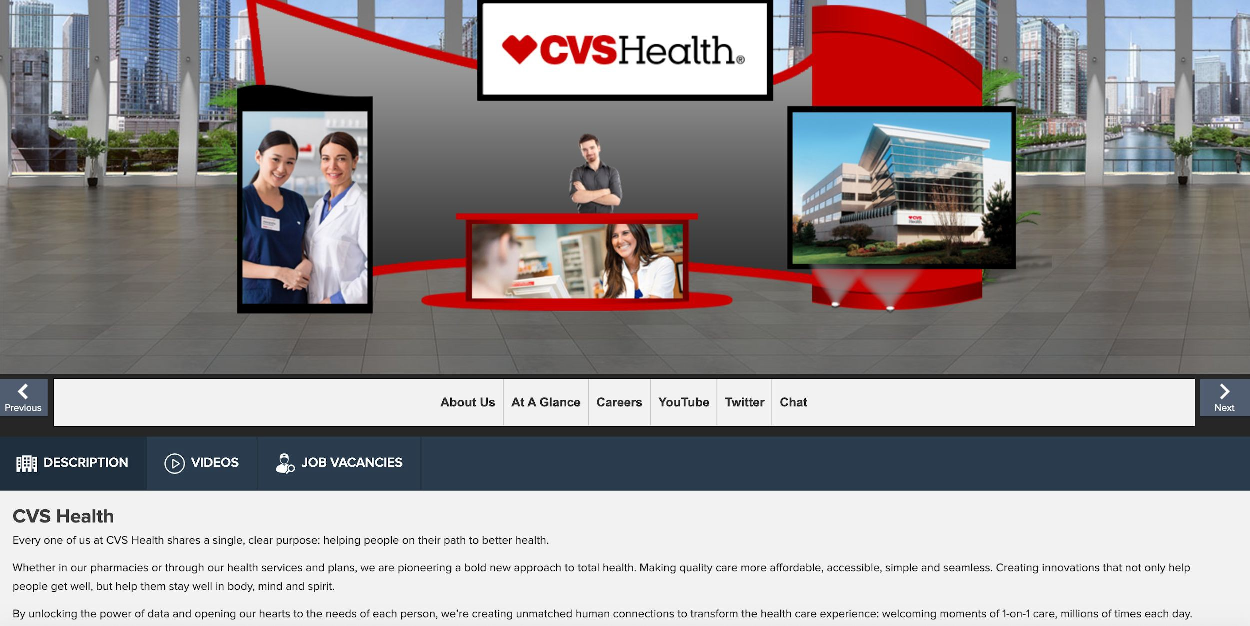
THE VFAIR: Job Seeker Experience / Exhibitor Booth

Slide 50
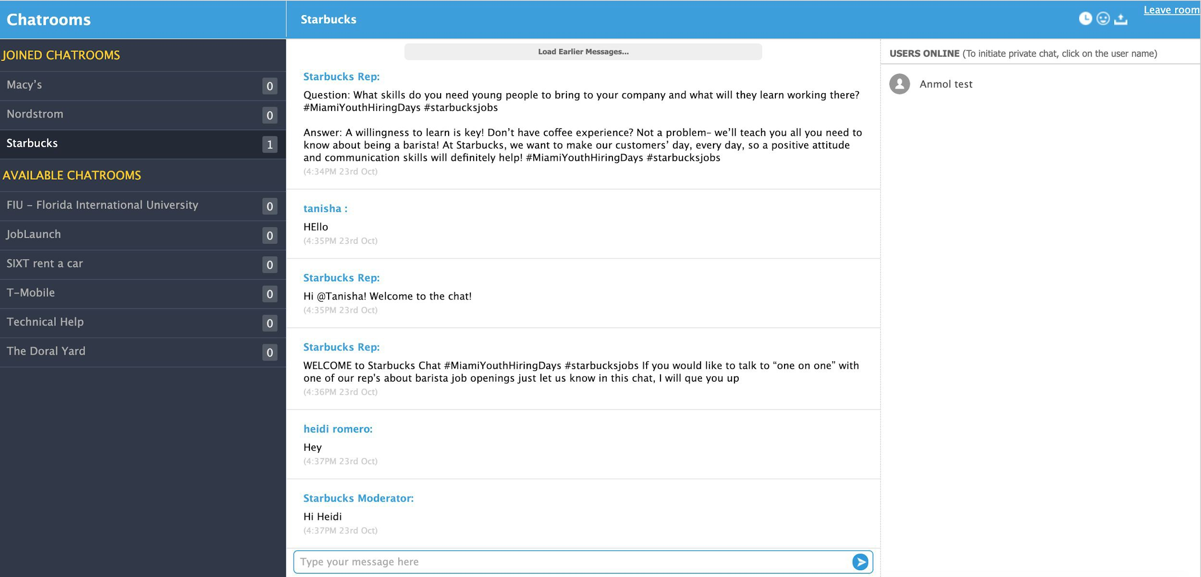
THE VFAIR: Job Seeker Experience / Chat Rooms

Slide 51
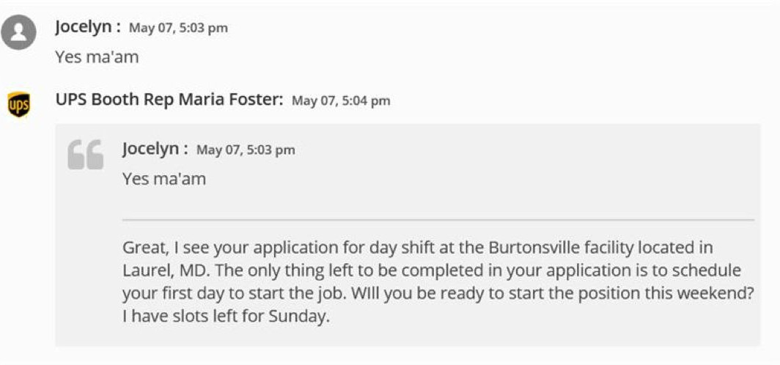
THE VFAIR: Job Seeker Experience / Chat Rooms

Slide 52
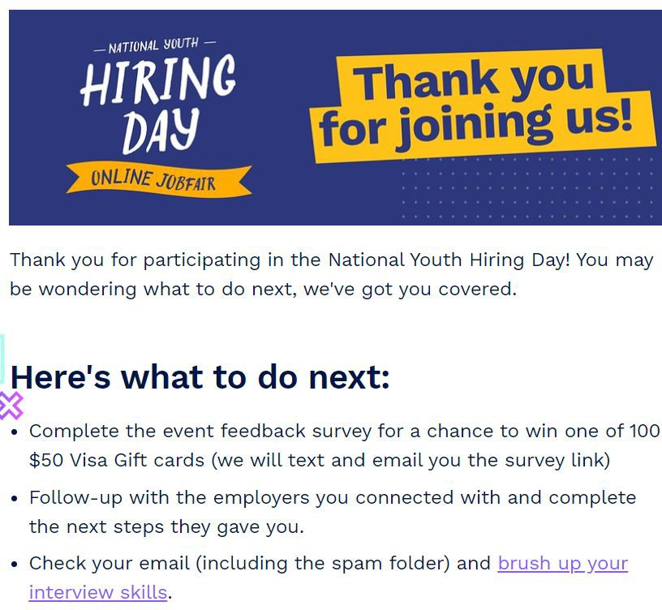
POST-FAIR: Helping Young Job Seekers Navigate the Process
Complete post-event survey
Provided resume, interview, job search assistance, and resources
Encouraged youth to join our textline to receive 1:1 help from job coaches (text “JOBS” to 33-55-77)
Direct links to JobLaunch, our youth-friendly job search tool
_

Slide 53

THE RESULTS: Biggest Job Fair in Our Five Year History!
+ Impressions - 12.9M
+ Campaign Referrals - 150,000
+ Unique Visitors - 48,000
+ SMS Registrations - 10,000+
+ Participants - 4,582
+ Total Booth Visits - 26,741
+ Unique Booth Visits - 17,880
+ Chat Conversations - 8,561
+ Applications - 2,584
+ Press hits - 3,456, reaching 15M+

Slide 54
POST-FAIR: Lessons Learned & Key Takeaways
+ GO BEYOND HIRING. Incorporate an array of partners that can help youth be more successful job seekers during these trying times. Support employers on other business/brand priorities, beyond just filling open roles (e.g. press coverage, social media exposure, etc.).
+ EMPHASIZE THE PROMISES YOU CAN KEEP. Most attendees won’t be hired and most exhibitors won’t fill many reqs. Set expectations appropriately with both parties ahead of time and over-index on the outcomes you can control.
+ EVERYBODY LOVES DATA. Design the experience so you and your exhibitors can learn as much as possible from the fair. Tracking hiring and retention outcomes also continues to be a vexing, $64,000 question.
+ TIME IS THE MOST PRECIOUS RESOURCE. Give yourself as much runway as possible — ideally 6-8 weeks from employer outreach to showday — as there will be learning curve for everybody involved (you, exhibitors & youth).
+ EXPECT THE TECH WILL FAIL. It’s inevitable some part of the experience won’t work for somebody — it’s technology! Practice, prep and build contingency plans for the facets that matter most.
+ DESIGN FOR THOSE WHO NEED IT MOST. Always consider the attendee with the greatest barriers to participation and ensure your experience makes it easy for her to participate — and succeed.

Slide 55
Any Questions?
Charles Hiteshew - chiteshew@100kopportunities.org
Jackie Ivy - jackie.ivy@getschooled.com
Jason Rzepka - jason.rzepka@100kopportunities.org
_
_

Slide 56
Virtual Work Experience
Brian Walker
  Program Manager
    Youth Career Connections
    Employ Prince George's, Inc., MD

Slide 57


Youth Career Connections
Virtual Working Experience

Slide 58
PROGRAM FRAMEWORK AND DESIGN
6 Industry Career Paths
Weekly Schedule
Employer Engagement
Job Readiness Training
Student Engagement

Slide 59
6 industry career paths
Business and Finance
Culinary Arts
Cosmetology
Information Technology
Healthcare
Construction

Slide 60
Weekly Schedule
1-Week Cohorts
3 Hours per Day (10:00 AM – 1:00 PM)
15 hours per Week
Final 2 Weeks
Hosted 2 Cohorts per Day

Slide 61
Employer Engagement
Contact Employer Partners/
Industry Professionals
Commitment of 3 hours
Provide a Template for Virtual Work Based Learning Projects
Employer Develop/Present Virtual Projects during mini-workshops
Participate in Guest Speaker Day
Share “Pearls of Wisdom” during
Mentoring Session

Slide 62
Job readiness training
Technical Skills
Soft Skills

Slide 63
Student engagement
Recruitment through Prince George’s County Public Schools
Online Etiquette
Question and Answer Segments on Relevant Topics
Pre & Post Assessments
Completion of Work-Based Learning Project
Earned $150 stipend

Slide 64

Student experience

Slide 65
Thank you!
Contact Information:
Brian Walker, YCC Program Manager,
BTWalker@co.pg.md.us
Monica Chavis, YCC Career Consultant,
Mchavis@co.pg.md.us
Denise Higgs, YCC Business Consultant, DMHiggs@co.pg.md.us

Slide 66
Questions?

Slide 67
Solutions
Are there any virtual engagement solutions you’ve implemented that are working well?
Type your input into the chat feature

Slide 68
Virtual Engagement Solutions
Do you plan to plan to keep your program’s virtual engagement solutions long term?
Yes
No
Select your answer

Slide 69
Technical Assistance Needs
Are there any other technical assistance needs?
Type your input into the chat feature

Slide 70
Highlighted Resources

Slide 71
Federal Resources: DOL
U.S. Department of Labor Coronavirus Resources
  The U.S. Department of Labor released resources to help workers and employers prepare for the COVID-19 virus.
  https://www.dol.gov/agencies/eta/coronavirus
Summer Jobs for Youth Resources
  Resources and lessons learned from past summers that are relevant to any program and can be used to enhance a summer youth employment program. https://youthsummerjobs.workforcegps.org/
Youth Connections Community of Practice
  The Youth Connections Community is an online learning destination for public workforce system staff and partners who serve youth in the Workforce Innovation and Opportunity Act (WIOA) Youth Program. https://youth.workforcegps.org/
_
_
_

Slide 72
Federal Resources: DOL
  WIOA Youth Program COVID-19 Session Lessons Shared
  Highlights attendees shared solutions https://youth.workforcegps.org/resources/2020/06/15/18/59/WIOA-Youth-Program-COVID-19-Session-Lessons-Shared
  Region 6: Strategies for Operating the YouthBuild Program in a Virtual Environment Training Series, https://youthbuild.workforcegps.org/resources/2020/05/19/12/29/Region-6-Strategies-for-Operating-the-YouthBuild-Program-In-a-Virtual-Environment
  Resources on Virtual Engagement pages Part One & Two
  Resources for virtual environments in order to keep participants connected to workforce development, education, supportive services, and training
  https://youth.workforcegps.org/resources/2020/06/18/13/10/Resources-on-Virtual-Engagement
  https://youth.workforcegps.org/resources/2020/06/18/20/00/Resources-on-Virtual-Engagement-part-2
_
_
_
_

Slide 73
Any Questions?
Additional questions can be sent to: youth.services@dol.gov.
_

Slide 74
Contact Us
Employment and Training Administration’s
Division of Youth Services
      youth.services@dol.gov
    Become a member of Youth Connections Community
    youth.workforcegps.org
_
_

Slide 75
Thank You!
Thank you for all the work you do on behalf of our nation’s most vulnerable youth!
Need help? Email: Support@workforceGPS.org
_

