Slide 1
Introduce yourself
Your name
Your affiliation
(name of your institution)
Your role in the SCC grant

Slide 2
Learning Outcomes
What do you hope to learn from today’s session?

Slide 3
Strengthening Community Colleges Training Grants:
Third-Party Evaluations

Slide 4
Disclaimer
This webinar was prepared for the U.S. Department of Labor (DOL), Chief Evaluation Office by MN Associates, Inc., under contract number 1605DC-18-A-0019/ 1605DC-18-F-00431. The views expressed are those of the presenter and should not be attributed to DOL, nor does mention of trade names, commercial products, or organizations imply endorsement of same by the U.S. Government.

Slide 5

Today’s Moderator
Eugenie Agia
SCC Program Lead, Division of Strategic Investments
U.S. Department of Labor, Employment and Training Administration

Slide 6
SCC Third-Party Evaluation Requirements
No later than Month 2: Submit detailed procurement work plan
No later than Month 6 (or earliest timing that is feasible under institutional guidelines): Procure third-party evaluator
No later than Month 9: Submit draft detailed evaluation design from evaluator
No later than Month 12: Submit final detailed evaluation design
No later than Month 27: Interim report due
No later than Month 48: Final report due
Program Office will coordinate technical assistance for third-party evaluations.

Slide 7

Today’s Presenter
Kavita Mittapalli, Ph.D.
  CEO, MN Associates, Inc. (MNA)
  A Research and Evaluation Firm
  www.mnassociatesinc.com

Slide 8

Agenda
Evaluation (quick facts)
Implementation Evaluation
Developmental Evaluation
Traditional vs. Developmental Evaluation
When to conduct Developmental Evaluation
Selecting an evaluator
Trade-offs
Resources
Questions and Answers
Contact

Slide 9
Poll
My current level of familiarity with grant evaluation is…..
Beginning
Intermediate
Advanced
New to the grant field

Slide 10
Poll
Have you started a procurement process to hire an evaluator?
No, not yet.
In the procurement and selection process.
Completed (we have an evaluator!)

Slide 11
Evaluation: Quick Facts

Slide 12
What Evaluation (Simply) Isn’t….
Compliance checks
Auditing
Data analyses only
Performance reporting only
Monitoring only

Slide 13
What Evaluation Is and Does….
To assess fidelity of a program or an initiative
Formative/Implementation and Summative uses
How effective has it been?
Assess the processes, outputs, and outcomes achieved
Gauge what’s working, what’s not, what needs to be improved-when, how, by whom?
Types of evaluation: Context really matters

Slide 14
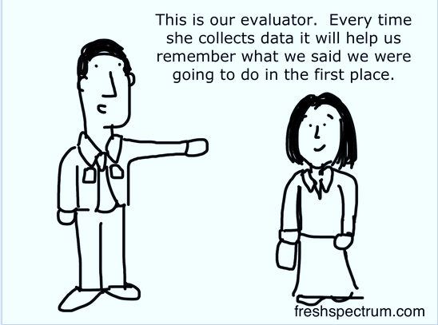
Keeping Each Other Honest (Client and Evaluator Relationship)

Slide 15
Types of Evaluation

Slide 16
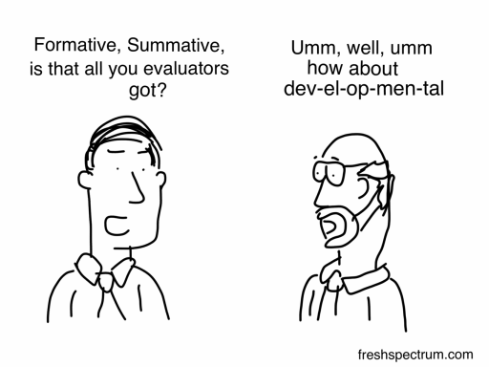
Types of Evaluation

Slide 17
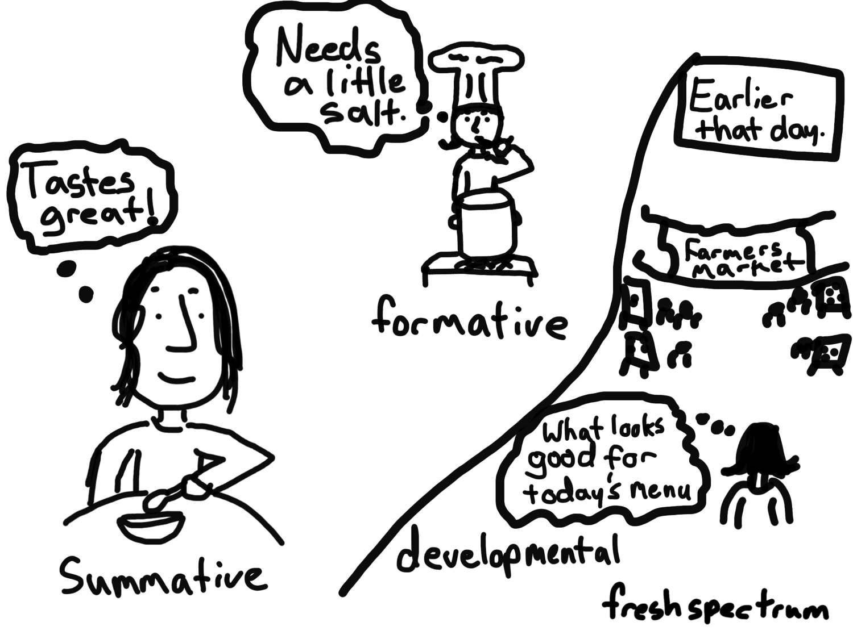
Formative, Summative, and Developmental Evaluation

Slide 18
Formative / Process / Implementation Evaluation
1st/ 2nd year(s) of the grant
Focus on process and planning
Linear, Logic Model as a blueprint/roadmap as a guide
Collection of baseline data
A future summative evaluation may be expected that is focused on outcomes/impacts (with predetermined goals)
Focus on initial roll out or implementation of an initiative
Singular feedback loop to make programmatic changes as they occur
Not too immersive / intensive
Periodic check-ins with stakeholders
Evaluator tends to control the evaluation (data collection processes)
Formative “assessment” of the program

Slide 19
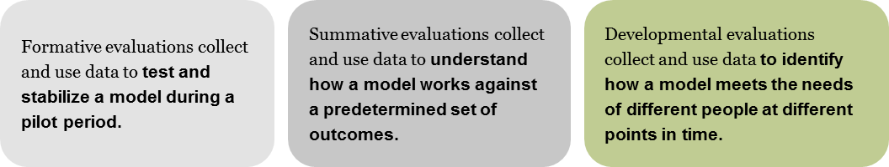
In Essence…

Slide 20
Developmental Evaluation

Slide 21
Poll
Yes
No
Undecided at this time
What is Developmental Evaluation?
Have you decided to conduct a developmental evaluation for your project?

Slide 22
Definition
Developmental evaluation collects and uses data to identify HOW a process, model, or an initiative meets the needs of different people (i.e., stakeholders) at different points in time (Patton, 2008, 2010)

Slide 23
Key Attributes of Developmental Evaluation
A partnering relationship between evaluators and those engaged in innovative initiatives and development.
Process includes asking evaluative questions and gathering information to provide feedback and support developmental decision-making and course corrections along the emergent path.
An integral part. Evaluator is a team member who collaborates to conceptualize, design, and test new approaches, ongoing process of continuous improvement, adaptation, and intentional change.
It elucidates team discussions with evaluative questions, data, and to facilitate data-based decision-making in the unfolding and developmental processes of the innovation. (Patton, 2008, 2010)

Slide 24
Developmental Evaluation by Another Name…
Real time
Emergent
Action
Adaptive

Slide 25
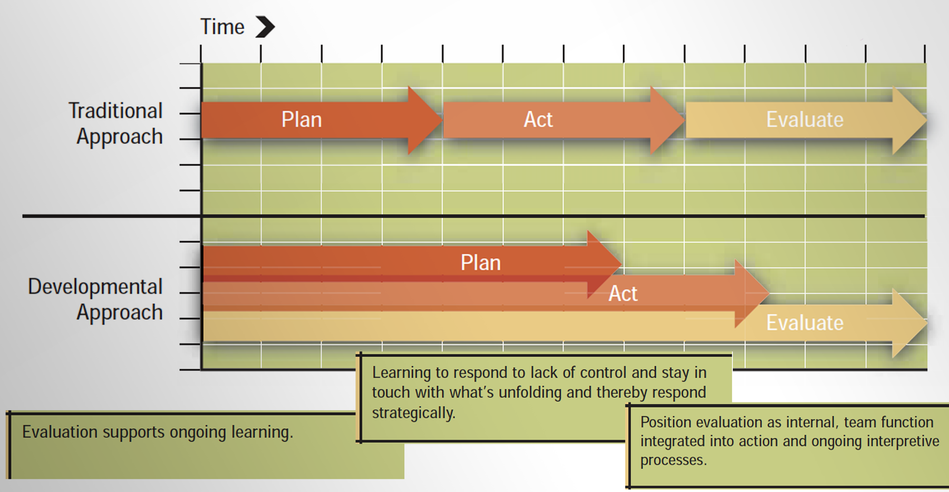
How does Developmental Evaluation differ from a “Traditional” Evaluation?

Slide 26
Developmental Evaluation Process(es)
Participatory and Collaborative
Stakeholder-centered, Context specific
Iterative and Informative
Flexible and Immersive, and Intrusive
Just-in-time reporting

Slide 27
The Scientific Process of Conducting an Evaluation
Goals and Objectives
Literature Review
Evaluation Questions
Study Design / Approach
Data Collection
Analysis
Reporting
Dissemination / Presentation

Slide 28
Key Evaluation Questions: Implementation vs Developmental
How are the program and strategies being designed, planned, and implemented?
To what extent are participants being reached and served as intended?
To what extent are sector partnerships with stakeholders (e.g., business /industry leaders and workforce development system) clearly aligned with training programs and career pathways?
How satisfied are program stakeholders?
What has been done in an innovative way?
What has been successful implementation strategies? Any lesson(s) learned?
In what ways is the initiative evolving/developing with the changing levels/quality of stakeholders’ involvement?
What are the stakeholders learning from the ongoing iterations to the initiative?
In what ways is design thinking/other framework(s) influencing the initiative?
In what ways do the decision-makers have the capacity/interest to work in the adaptive way for innovation and working with complex issues?
To what extent are the planners ready to embrace evaluative feedback and data to help make decisions?

Slide 29
Foci of Developmental Evaluation --> Role of an evaluator
Focuses on adaptive learning in complex social systems (highly-contextual), and non-linear
Real-time feedback to generate learning to inform program development (highly iterative)
Captures system dynamics and innovative strategies and ideas
Is flexible and evolves with program development
Evaluator is a thought-partner, embedded in the initiative as a member of the team
Evaluator not just a participant observer (e.g., not external to the initiative) but internal
Evaluator intervenes to shape the course of development and decision-making
Evaluator facilitates continuous learning

Slide 30
Foci of Developmental Evaluation
Assists program staff to develop social change, capacity building initiative in complex, uncertain, ever changing environment(s)
Is completed in real-time as the program is being planned or developed
It provides quick, continuous feedback to program staff and all its stakeholders
It is highly team-oriented, immersive, adaptive, iterative, and flexible
It is process and facilitation centered
It tests quick iterations to the program, tracks development as issues surface in the program development process(es)

Slide 31
When is Developmental Evaluation Appropriate?
Actions and results are non-linear and have multiple, compounded effects in the short-and-long terms
Multiple, diverse stakeholders
Patterns emerge as planning is going on
Stakeholder interactions have varying degrees of involvement, engagement, intensity, and regularity
Stakeholders adapt as they respond, interact, shape the initiative
Processes are not definitively tied to particular pre-determined outcomes
Programs / initiatives are seated in complex social and / or economic environments

Slide 32
General Competencies of a Developmental Evaluator
Partner, collaborator, and facilitator
Participatory, a thought-partner
Generalist (e.g., methods wise)
Understands complex social systems
Understands systems design approach to conduct Developmental Evaluation
Internal to the team; not an outsider
Facilitation and active learning skills
Flexibility and resourcefulness
Collects and reports data early and often
Develops a Learning Framework to guide DE work

Slide 33
Some Challenges with Developmental Evaluation
Threat to objectivity due to proximity (framing one’s personal biases is critical, member check ins, triangulation, selection bias)
Ambiguity and uncertainty about pre-determined deliverables
Volume of data
Time allocation (tied to deliverables)
Keeping a results or outcomes focus
Sustainability and building evaluation capacity difficult
Budgetary concerns (attached to deliverables)

Slide 34
Locating an Evaluator for Your Grant
American Evaluation Association (eval.org/jobs) (Locate an evaluator)
Competitive procurement process at Community Colleges
Vendor list(s) maintained by your institution
Third-party apps or job sites to post an evaluator RFP
Other sources

Slide 35
Any Questions/Comments
Enter your question(s) in the chat

Slide 36
Resources
https://evalhub.workforcegps.org/resources/2018/09/07/19/58/WIOA-Evaluation-Toolkit
https://evalhub.workforcegps.org
https://collegeconnection.workforcegps.org/home/
https://collegeconnection.workforcegps.org/resources/2016/08/22/14/12/Guidance_for_TAACCCT_Grant-s_Third_-_Party_Evaluations
https://collegeconnection.workforcegps.org/resources/2016/04/14/21/06/TAACCCT_Round_4_Evaluation_Orientation_Powerpoint
  Betterevaluation.org/developmenatlevaluation
  https://developmental-evaluation.org/whatisde
  Dozois, E., Langlois, M., & Blanchet-Cohen, N. The J.W. McConnell Family Foundation and the International Institute for Child Rights and Development, (2010).A practitioner’s guide to developmental evaluation. Retrieved from website: https://mcconnellfoundation.ca/report/de-201-a-practitioners-guide-to-de...
  Patton, M.Q. (2008). Utilization-focused evaluation. (4th ed.). SAGE Publications: CA.

Slide 37
Resources
  Patton, M.Q. (2010). Developmental Evaluation. Applying Complexity Concepts to Enhance Innovation. SAGE Publications: CA
  https://evaluationcanada.ca/distribution/20001012_hummelbrunner_richard.pdf
  http://www.pointk.org/resources/files/Latham_Human_Services_Systems.pdf

Slide 38
Contact Us
      SCC@dol.gov

Slide 39
Thank You!
Need help? Email: Support@workforceGPS.org

