Slide 1
Workforce Opportunities for Rural Communities (WORC 4) New Grantee Orientation
October 7, 2022
An introductory webinar for WORC round four grantees.

Slide 2
Your Moderator
Charlotte Harris
  Unit Chief
  Office of Workforce Investment, US Department of Labor/ Employment and Training Administration

Slide 3
Welcome and Introductions
Let’s get to know each other!

Slide 4

Today’s Agenda
Welcome & Introductions
Federal Team Overview
Grant Program Overview
Grant Management / Package Overview
Grant Modifications
WORC 4 Performance Reporting
Technical Assistance
Communication / Next Steps

Slide 5
Today’s Presenters
Keith Campbell, Program Analyst
  Office of Workforce Investment/ETA
Jenifer McEnery
  Grant Officer
  Office of Grants Management/ ETA
Kinsey Walker
  Program Analyst
  Appalachian Regional Commission
Alex Holland
  Program Manager
  Delta Regional Authority

Slide 6

Funding Overview
DOL awarded $34.2 million for the
WORC Initiative.
26 total grantees
  13 representing Appalachian Region, 13 representing Delta Region
  Awards range from approximately $835,000 to $1.4 million
Period of performance is 36 months
  Grant start date: 9/15/2022
  Grant end date: 9/30/2025

Slide 7
Grantees: ARC Region
Northeast State Community College
Randolph County Housing Authority
Rural Action, Inc
Southwest Virginia Community College
University of Maryland Center for Substance Abuse Research
University of Pittsburgh School of Computing and Information
Westmoreland-Fayette Workforce Development Board
Bridge Valley Community and Technical College
Generation WV
Hazard Community and Technical College
Kentucky Dataseam Initiative, Inc
Land of Sky Regional Council
The New River/Mount Rogers Workforce Development Area Consortium Board

Slide 8
Grantees: DRA Region
Ozark Action, Inc.
South Arkansas Community College
Southeast Missouri Hospital College of Nursing and Health Sciences
Strada Collaborative Inc.
Workforce Development Board SDA-83, Inc.
YoWealth Academy
Alabama Department of Commerce
Arkansas Center for Data Sciences
Delta Health Alliance, Inc
Dream Innovations, Inc.
Mississippi Community College Board
The New Orleans Career Center
NextOp

Slide 9
Grantee Polling Question
What are your 3 biggest concerns as you begin your grant?
Allowable activities
Performance reporting
Partnering with the workforce system (e.g. American Job Centers)
Addressing and promoting racial equity throughout the grant process
Grant modifications and prior approval
Other (please specify in the chat window!)

Slide 10
Your Federal Team
Roles and Responsibilities

Slide 11
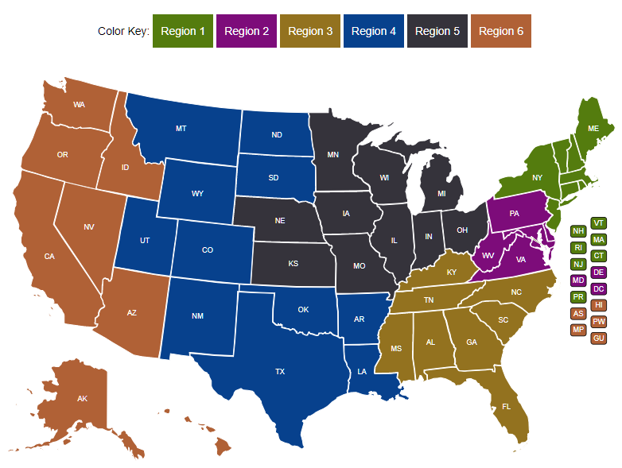
Your Federal Project Officer (FPO) is identified in your grant package.
Federal Project Officer (FPO)
Your FPO is critical to the success of your grant.
Role of Your FPO
Assist you on grant-related matters
Provide compliance assistance
Conduct oversight and review of grant performance
Deliver or arrange for technical assistance
Serve as your primary point of contact

Slide 12
Program Office Staff
Support FPOs
Provide policy clarification and guidance
Support technical assistance (TA) efforts provided by ARC and DRA
Help create peer learning opportunities
Analyze performance data
Review some grant modifications
The Program Office may periodically request information about your grant outcomes for quarterly reports to Congress.

Slide 13

Grant Officer
Your assigned Grant Officer is listed on the Notice of Award page of the Grant Package.
Only the Grant Officer can approve changes to the Grant Agreement
Reviews and approves grant modification requests in consultation with assigned Federal Project Officer and Program Office staff
Maintains official grant file
OGM staff provide guidance and technical assistance on grant policy issues, along with the fiscal/administrative requirements of the grant.

Slide 14
Roles of ARC and DRA
Provide grantee technical assistance including:
  Grantee meetings and peer-exchange workshops
  Issue-focused TA
  Request-based TA
We’ll cover technical assistance for grantees in more detail later in this webinar

Slide 15
Grant Program Overview
Grantee Information, Outcomes

Slide 16

Purpose of Grant
The goal of the WORC Initiative is to create economic mobility, address historic inequities for marginalized communities of color and other under-served and underrepresented communities, by:
comprehensively and intentionally address and promote racial equity through recruitment strategies, service design, implementation, and support services
developing and maintaining meaningful partnerships with community residents, stakeholders, and experts in designing, implementing, and evaluating the proposed project;
supporting workforce development activities that prepare eligible participants for good jobs in high-demand occupations aligned with a state, regional, or community economic development strategy
helping to address the impacts of the opioid crisis and other substance use disorder
ensuring that grant participants achieve high-quality employment outcomes

Slide 17
Point of Emphasis- Creative Commons
Pursuant to 2 CFR 2900.13, to ensure that the federal investment of DOL funds has as broad an impact as possible and to encourage innovation in the development of new learning materials, the grantee will be required to license to the public all work created with the support of the grant under a Creative Commons Attribution 4.0 (CC BY) license. Work that must be licensed under the CC BY includes both new content created with the grant funds and modifications made to pre-existing, grantee-owned content using grant funds.
For general information on CC BY, please visit https://creativecommons.org/licenses/by/4.0.
Instructions for marking your work with CC BY can be found at https://wiki.creativecommons.org/Marking_your_work_with_a_CC_license.

Slide 18
Grants Management Overview
Award Letter, Agreement, Terms and Conditions, Attachments

Slide 19

Grant Package
Welcome Letter
PMS - Payment Management System and Financial Reporting Access Letter
  Instructions for Payment and Reporting Systems
  Payment Management System
  ETA’s Grantee Financial Reporting System
  System Passwords / PINs Information
ETA Grantee Handbook
Grant Agreement
WIPs Performance Reporting – DWG Reporting Handbook
FOA-ETA-22-13 plus Amendments

Slide 20
Grant Package
Grant Agreement
  Notice of Award (NOA) / Signature Page
  Special Conditions of Award
  Federal Award Terms
  Application Components:
    Application for Federal Assistance (SF-424)
    Budget (SF-424A) / Budget Narrative
    Statement of Work (SOW)
    Indirect Cost Rate Agreement, if applicable

Slide 21

Special Conditions of Award
Conditionally approved modifications carry with them specific requests made by the Grant Officer to clarify or revise components of the modification.
A response is generally due 30 days after the conditional award of the modification.
Requested information must be submitted to your Federal Project Officer (FPO) for concurrence.
Project implementation should proceed without delay to ensure timely milestones are achieved while working to resolve the conditions of the award.

Slide 22
Special Conditions of Award
All awards this year carry Special Conditions of Awards.
  Revisions to the SF-424, SF-424A, and Budget Narrative are required to reflect the actual award amount.
For any additional specific conditions, please check with your grant’s Authorized Representative or Point of Contact (referenced on the SF-424 in the initial application submission). Emails went out on or around September 22, 2022.

Slide 23
Special Conditions of Award vs Notifications
Both must be resolved with your assigned FPO.
Special Conditions of Awards
  Require a modification request be submitted as a condition of award.
  For example – Revised SF-424s, SF-424As, and Budget Narratives
Notifications
  May not require a modification request be submitted as a condition of award.
  For example - SAM Registration
  Exception – Indirect Cost Rate Agreements do require a modification request, however, are not considered special conditions of award.

Slide 24
Grant Modifications
Requests, Review Process

Slide 25
Modification Process
Write a formal letter of request addressed to your Grant Officer.
Include modification type, grant name and number, and justification for request.
Submit the final letter, signed by your signatory to FPO.
FPO forwards request to Grant Officer.
Step by Step:

Slide 26

Modification
Analysis
Your FPO reviews the modifications
Limited SOW modifications require review by Program Office
National Grant Officer gives final approval
Grantee receives copy signed by Grant Officer
Regional Grant Officer can approve some budget modifications and equipment purchases
Otherwise, regional management sends to National Grant Officer for review

Slide 27
Fiscal Reporting
WORC Grants

Slide 28
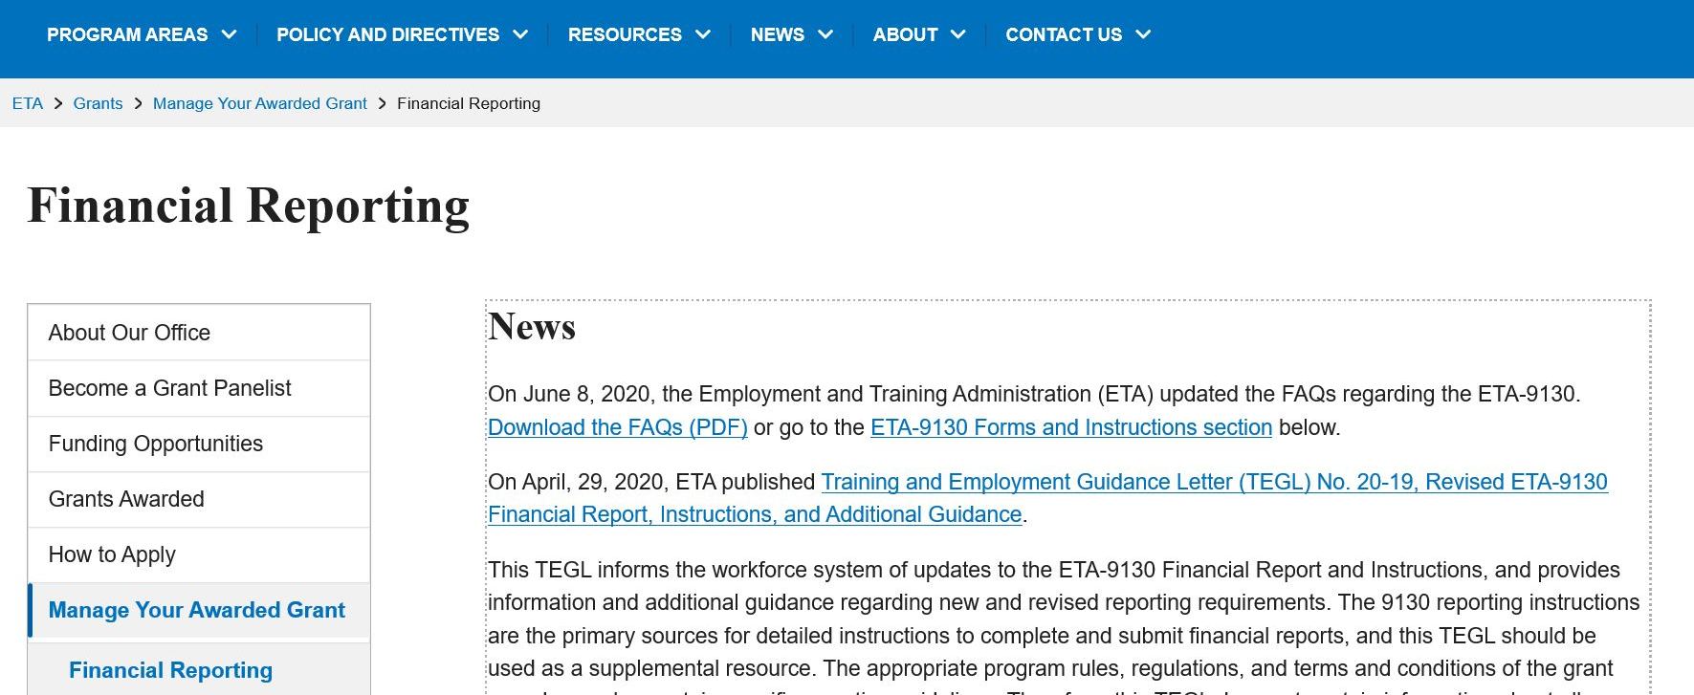
Quarterly Financial Report (QFR)
Each grantee must submit a Quarterly Financial Report (ETA 9130), due no later than 45 days after the end of a quarter.
Use the Grantee Reporting System to submit QFR.
Grant award package included instructions on accessing system.
Your first financial report is due on February 14, 2023.
For resources:
Financial Reporting | U.S. Department of Labor (dol.gov)

Slide 29
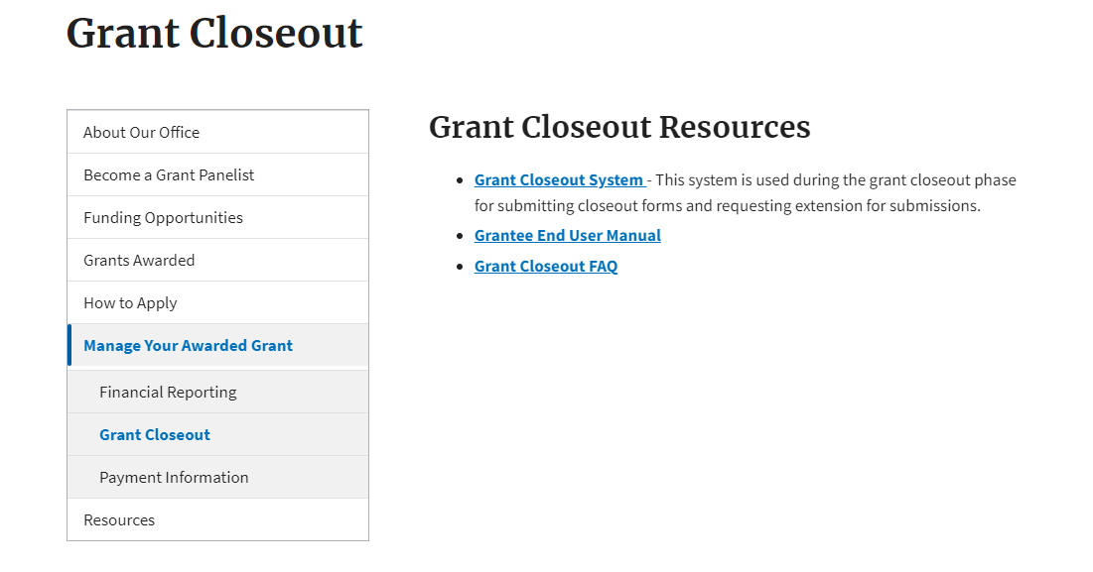
Final ETA-9130 Report
Final Quarterly Financial Reports is due within 45 days of the end of the quarter in which all funds were expended, OR within 45 days of the end of the quarter.
Closeout ETA-9130 Report is due within 90 days of grant expiration.
For additional information, visit: Grant Closeout.

Slide 30
Performance Reporting

Slide 31
WORC IV Performance Reporting
WORC IV grantees will need to submit Quarterly Performance Reports (QPR) and Quarterly Narrative Reports (QNR) to DOL through the Workforce Integrated Performance System (WIPS).
WORC IV grantees must submit the first QNR by November 15, 2022.
ETA will present a series of webinars exclusively for the WORC IV grantees on performance reporting that will provide more details about this process.
The first webinar, WORC Performance, Part I, will be on October 11, 2022, at 1pm EST.
An email invitation was sent to grantees, and registration is through WorkforceGPS

Slide 32
Grantee Technical Assistance
Overview of Technical Assistance Support

Slide 33
Technical Assistance Meetings: ARC
ARC will convene grantees for virtual meetings to support effective project implementation and promote the achievement of project outcomes.
  “Kickoff” calls in late November and early December of this year
    introductions, review your WORC-funded project, and discuss any objectives or preferences you might have for a virtual gathering.
  Conduct a virtual meeting or series of meetings in winter 2022
    Topics likely to include, but are not limited to: a review of contractual requirements, activities designed to help plan for marketing and recruitment, data collection and reporting, role-based discussions, and monitoring preparation and risk mitigation.
    Opportunity for grantees to hear from ARC, DOL subject matter experts, and other speakers.

Slide 34
Technical Assistance Meetings: ARC cont.
  3. On-demand, one-on-one, and group-based TA
    TA via email, phone, and virtual meetings, by request and through a planned schedule of topic based calls and other check-in meetings.
    connect grantees across all 3 rounds, where logical and valuable, for peer exchange and other group discussions.
    conduct one to two voluntary, individual discussions with grantees to check in on progress, discuss any pitfalls with program delivery, operations, data tracking, and other topics, and to identify needed resources and assistance.

Slide 35
Technical Assistance: DRA
DRA’s TA will consist of three components: one-on-one virtual meetings, peer exchange workshop, and on-demand TA requests.
One-on-One Virtual Meetings
  When: November and December 2022
  What we will cover: introductions, review WORC project scope/timeline/project outcomes, discuss anticipated TA needs, and answer questions related to the WORC program.
Peer Exchange Workshops
  When and where: February 2023 | Location TBD
  Purpose: meet other WORC grantees from all funding rounds (2019-2022), learn about workforce development projects throughout the DRA region, take a site visit to an existing WORC grantee, build a community of practice, etc.

Slide 36
Technical Assistance: DRA, cont.
On-Demand TA
  Provide TA via email, phone, or virtual meetings with DRA staff
  Connect grantees with relevant partners and resources
  Conduct site visits to WORC-funded projects
  Requests considered on a continual basis

Slide 37
Technical Assistance Contacts
ARC
  Nicole Dunn
  nd@chamberlindunn.com (preferred contact method)
  317.874.6321
DRA
  Alex Holland
  Senior Advisor
  aholland@dra.gov
  (702) 217-0312

Slide 38
Comparison: Role of FPO vs TA Providers
Federal Project Officer’s Role
Clarification of the FOA, including definitions
Statement of work alterations
Fiscal questions, including allowable expenditures and budget
Quarterly performance outcomes against target outcomes
Connections to the grant officer
Assistance addressing policy questions, as they arise
TA Provider Role
One-on-one coaching and support
Peer-to-peer learning opportunities
Approaches to data collection
Organizational structure: staffing, systems, and processes
Project planning and management
Participant outreach and recruitment strategies
Participant services, including case management, supportive services, and job placement
Employer engagement and participant placement

Slide 39
Communication
Communication Plan, Point of Contact

Slide 40
For Assistance with WORC Grants
GRANTEE
ETA
If you… | Contact:
Are the grant lead (POC) | Federal Project Officer (FPO)
Are a member of a grant project | The lead for your grant
Have questions or difficulty accessing the performance reporting system | Email your FPO
Have questions or difficulty accessing the financial reporting system | EBSS.help@dol.gov, copy to FPO
Always contact the Employment and Training Administration (ETA) assigned FPO first if you have questions.

Slide 41

Communication Guidelines
GRANTEE
ETA
When you communicate with your FPO, etc.:
Include your grant number and lead grantee organization name
Describe your question or issue in detail
Please be patient!

Slide 42
Next Steps

Slide 43

Next Steps
Respond to Conditions of Award in your Grant Award Package, as appropriate
Review the DOL Fiscal Training Tutorials
Review the DOL Performance Reporting Requirements
Review the Grantee Handbook
  https://www.doleta.gov/grants/docs/ETA_Grantee_Handbook.pdf

Slide 45
Thank You!
_
Need help? Email: Support@workforceGPS.org
_

