Slide 1
Polling Question: Who’s on the call?
What role do you play in your Strengthening Community Colleges Grant?
Authorized Representative
Program Director/Manager
Training provider
Employer partner
Other type of partner supporting the grant
Case Manager / Career Navigator
Performance / Data Analyst
Federal Project Officer
Choose the best answer that reflects your role in your SCC grant project!

Slide 2
Strengthening Community Colleges Training Grants Second Round (SCC2)
Grantee Orientation

Slide 3

Welcome and Introductions
Let’s get to know one another!
Enter your name, location, organization name, project name, and contact information into the chat.
What is the name of your project?
What is your name?
What is your email?
Where are you
located?
What is your grant project name?

Slide 4

Moderator
Cheryl Martin
  Program Manager, Community College Unit
  Office of Workforce Investment, Division of Strategic Investments, US Department of Labor, Employment and Training Administration

Slide 5
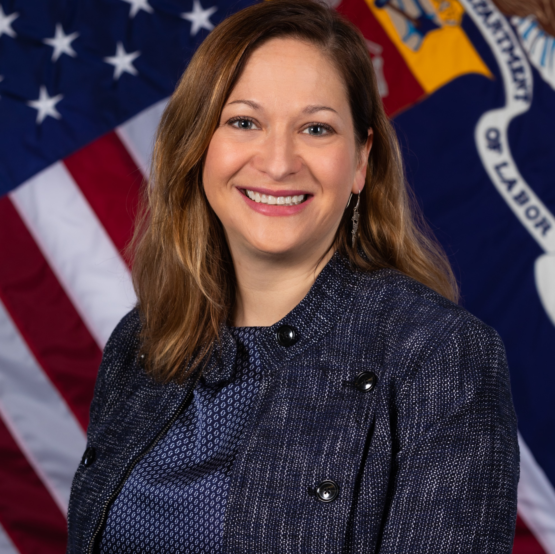

Speakers
Jenn Smith
  Division Chief, Division of Strategic Investments
  Office of Workforce Investment, US Department of Labor, Employment and Training Administration
Denise Roach
  Grants Management Specialist
  Office of Grants Management, US Department of Labor, Employment and Training Administration

Slide 6




Speakers
Eugenie Agia Workforce Analyst, Division of Strategic Investments, USDOL
Zodie Makonnen
Workforce Analyst, Division of Strategic Investments, USDOL
Dawn Jackman Murphy
Workforce Development Specialist, Division of Strategic Investments, USDOL
Angella Alivia
SCC Performance Lead, High Impact Partners

Slide 7
Today’s Agenda
Grant Program Overview
The Federal Team
Grants Management: Award Package Overview
Grant Modifications
Performance Reporting Guidance & Technical Assistance
Communication Methods

Slide 8
What are your biggest concerns right now?
Let’s CHAT!

Slide 9
Strengthening Community Colleges (SCC2) Training Grants
Grant Program Overview

Slide 10
Polling Question: Preparing to Launch your Grant
Which resources have you reviewed in advance prior to today’s webinar?
Grant Award Package
Grantee Handbook
Rise Module: Competitive Grant Program Basics Reference Guide (Reference Guide)
All the above
(Choose all that apply)

Slide 11
SCC2 Program Purpose
Increase the capacity and responsiveness of community colleges to address identified equity gaps.
Meet the skill development needs of employers in in-demand industries and career pathways, as well as the skill development needs of marginalized and underrepresented workers.
SCC2 Program Grants
Additional SCC2 Evaluation Funding

Slide 12
Advancing Equity in the SCC2 FOA
Equity gap analysis
Equity performance outcomes
Bonus points to leads who are Qualified Institutions
Affinity-focused consortium applicants
Funding set-aside of up to $5 million for affinity consortia
  Resource: Equity and Community College Webinar Series https://www.workforcegps.org/events/2021/12/16/16/57/Defining-and-Assessing-Equity-in-Community-Colleges

Slide 13
Grant Award Information
$45 million awarded to 13 grantees
  7 consortia, 6 single institutions
SCC Program Grant awards range from up to $1.6 million for single institutions to up to $5 million for consortium grantees
  One grantee received Additional SCC2 Evaluation Funding
The period of performance is 48 months (no extensions)
  October 1, 2022 – September 30, 2026
Matching funds are not required; leveraged funds are encouraged

Slide 14
Targeted Industry Sectors
Information Technology (IT) only – 4 grants
  including Cybersecurity
Healthcare only – 2 grants
Advanced Manufacturing only – 1 grant
Supply Chain – 2 grants
  Including Distribution & Materials Management (DMM) and Transportation, Distribution, and Logistics (TDL)
Construction – 1 grant
Healthcare and Social Assistance – 1 grant
Advanced Manufacturing and Healthcare – 1 grant
Advanced Manufacturing and IT – 1 grant

Slide 15
Overview of SCC2 Grantees
Applicant Legal Name | Location | Grant Type | Funding Amount | FPO
Amarillo College | TX | Single | $1,525,140 | Yvonne Williford
Atlanta Technical College | GA | Single | $1,600,000 | Jai'lynn Pennington
Bismarck State College | ND | Single | $1,599,686 | Yvonne Williford
Bluegrass Community and Technical College | KY | Consortium | $4,532,178 | David Bridges
Bunker Hill Community College | MA | Consortium | $5,000,000 | Keeva Davis
Capital Community College | CT | Consortium | $5,000,000 | Keeva Davis
Ivy Tech Community College of Indiana | IN | Single | $1,600,000 | Alice Mitchell
Montgomery College | MD | Single | $1,600,000 | Keith Hubert
Northeast State Community College | TN | Single | $1,524,579 | Troy Scott
Onondaga Community College | NY | Consortium | $5,000,000 | Edward Uechi
Parkland College | IL | Consortium | $4,999,726 | Alice Mitchell
Research Foundation/CUNY obo Bronx Community College | NY | Consortium | $4,529,725 | Edward Uechi
West Virginia University at Parkersburg | WV | Consortium | $6,488,966 | Keith Hubert

Slide 16
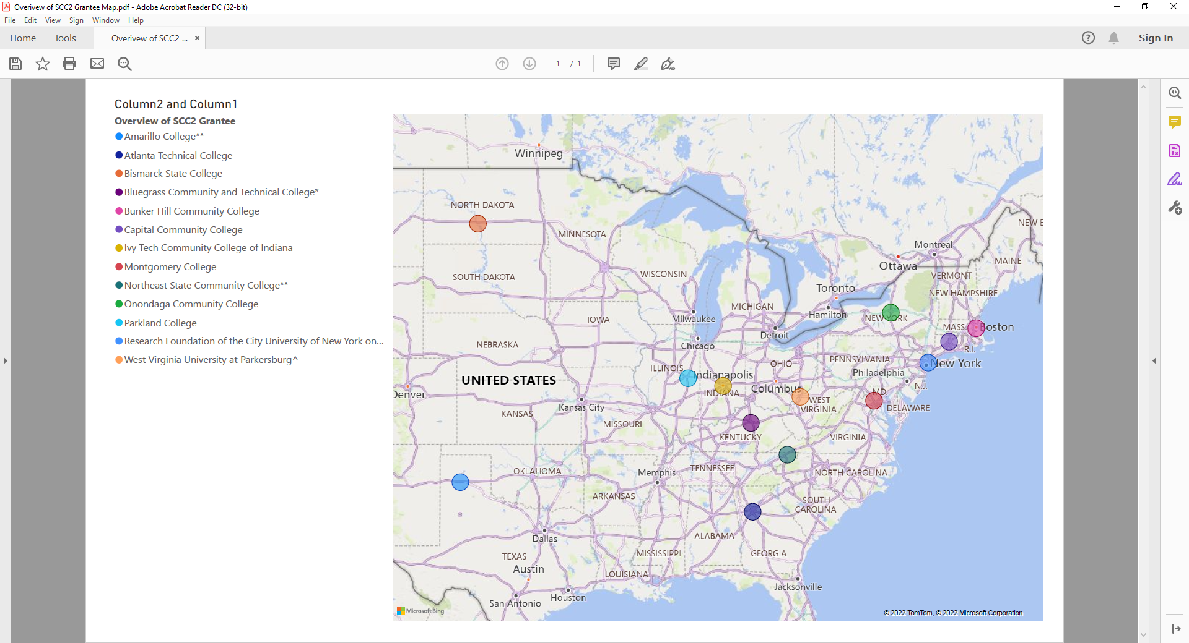
SCC2 Grants Across the United States

Slide 17
Eligible Lead Applicants
Eligible lead applicant is a community college.
Lead applicant applied as a single institution lead or as a consortium lead representing a consortium of institutions of higher education.
Consortium applicants organized around a state focus, a regional labor market focus, or an affinity focus. For more on consortium types see pp. 25-26 in the FOA.
  State focus: 3 grants
  Regional labor market focus: 3 grants
  Affinity focus: 1 grant
Both single institution and consortium leads must partner with required partners to form an SCC2 Partnership.

Slide 18
Qualified Institutions
Priority consideration of two bonus points was available to lead applications submitted by institutions that the Department deems Qualified Institutions—e.g.:
  Historically Black Colleges and Universities
  Tribal Colleges and Universities
  Minority-Serving Institutions Programs
  Strengthening Institutions Programs using U.S. Department of Education eligibility indicators
Qualifying criteria: See Section III.A.3. Qualified Institutions (pp. 27-28)
Affinity-focused consortium applicants had to be an institution consortium in which the lead applicant and a majority of member institutions are Qualified Institutions

Slide 19
SCC2 Partnership
Required Partners
Both consortium and single institution applicants:
  Workforce Development System: One or more partners from the publicly funded workforce development system; and
  Employer Partners: An industry/trade association or a consortium of at least three employers, for each proposed industry sector.
Consortium applicants (only):
  Institution Consortium
Optional Partners
Unions or labor-management organizations
Community-based organizations
For state-focused consortia: a state-level or community college district-level entity
Tribal entities
Technical colleges
State Apprenticeship Agencies
Federally-funded programs, such as:
  Adult Education and Perkins V
  Temporary Assistance to Needy Families programs
  Supplemental Nutrition Assistance Program Employment and Training programs
Economic development agencies
Foundations and philanthropic organizations

Slide 20
Individuals Eligible to Participate in SCC2
Includes a spectrum of adult workers–dislocated workers, incumbent workers, and new entrants to the workforce—as well as older youth who are new entrants to the workforce.
“New entrants to the workforce” may include:
  Long-term unemployed individuals and formerly incarcerated individuals
  Youth enrolled in junior or senior year of secondary school, who could be employed before or within six months after grant end; and youth who have dropped out of school and are seeking their first full-time job
Within these categories, you may serve a wide range of individuals, including:
  Individuals receiving UI or public assistance
  High school students/dropouts
  Enrollees in adult basic/other education programs
  Individuals with disabilities
  Veterans
  Indian and Native Americans
  Individuals with Limited English Proficiency

Slide 21
Allowable Activities: Capacity-Building
Overarching capacity-building activities that most grantees will undertake:
  Hiring or training instructors/staff to develop/deliver curricula, online/distance learning, and work-based learning experiences;
  Purchasing or upgrading classroom supplies/equipment and/or educational technologies;
  Implementing changes in time/scheduling of courses and/or data integration tools;
  Supporting required third-party evaluation.
Other allowable activities fall into these categories:
  Reviewing and adjusting policies/practices
  Developing comprehensive student supports
  Curriculum development
  Program design/continuous improvement
  Partner collaboration
  Technology-enabled learning
  Internal data reporting capacity

Slide 22
Allowable Activities: Participant-related Costs
Participant-related costs are allowable, although DOL encourages grantees to leverage college infrastructure and/or federal/state resources (e.g., WIOA, Perkins) to cover them. Such costs include:
  outreach/recruitment of eligible participants
  direct education/training
  job development/job search
  case management
  supportive services

Slide 23
Allowable Activities: Equipment and Minor Alterations
Expenditures for equipment and minor alterations, renovations, or rearrangements, if specific to the project, are allowable with prior written approval from the Grant Officer.
Written requests for prior approval to acquire grant-funded special purpose equipment and/or to alter space must be submitted no later than 12 months after the award date of the grant.
Grant Officer-approved special purpose equipment and/or altered space must be acquired, completed, and available for use no later than 24 months after the award date of the grant.
Total costs to the grant of all alterations cannot exceed 15 percent of the total grant award

Slide 24
Program Design
Core Elements:
  Core Element 1: Advancing Equity
  Core Element 2: Accelerated Career Pathways
  Core Element 3: Results-Driven Project Design
    Logic Model
    Performance Outcomes
    Project Work Plan
  Core Element 4: Sustainable Systems Change
Evaluations
  Third-Party Evaluation
  Additional SCC2 Evaluation Funding

Slide 25
Performance Outcomes and Grantee Accountability
Five grant-specific performance outcomes:
  Three capacity-building outcomes
  Two equity outcomes
  The five customized performance outcomes, and the related outputs, key milestones, and deliverables in the work plan, form the basis of the Department’s assessment of grantee performance.
  Participant Tracking Plan: Applicants will also track and report participant outputs for a selected cohort of students on a quarterly basis throughout their grants, using DOL’s Workforce Innovation Performance System (WIPS).

Slide 26
Customized Performance Review
Per the grant award package, we are conducting a programmatic compliance review of your grant project.
As part of this process, every grantee and their FPO will receive an email detailing specific performance and/or work plan issues.
If needed, we will schedule a conference call with the grantee and FPO to discuss these issues and required actions.
Any clarifications to the grantee’s proposed performance outcomes targets will require National Program Office review and concurrence and may require a grant modification.
We expect to complete the full review and resolution process within 90 days (i.e., by December 31)

Slide 27
Evaluations
Required Developmental or Implementation Evaluation
  Trewon Technologies, LLC is DOL’s contracted evaluation TA partner for SCC Rounds 1-3
Required Participation in DOL Evaluation (if Department-led)
Additional SCC2 Evaluation Funding
  One grantee (West Virginia University-Parkersburg) received this funding
Evaluation Learnings and Peer Learning Cohort
  ACE-UP Community of Practice (applications due 11/18/22)
For a description of key differences between a developmental evaluation and an implementation evaluation, see Figure 2 on pages 19-20 of the FOA.

Slide 28
Third-Party Evaluation Requirements
Implementation or Developmental Evaluation
No more than 5% of budget, so ~ $40k for singles or ~ $250,000 for consortia
Grantees submitted evaluation procurement plans as part of application
No later than Month 6 (or the earliest timing that is feasible under grantee’s institutional procurement guidelines): Procure third-party evaluator
No later than Month 9: Submit draft detailed evaluation design from evaluator
No later than Month 12: Submit final detailed evaluation design
Month 27: Interim report due
Month 48: Final report due
Program Office & Chief Evaluation Office will coordinate evaluation technical assistance

Slide 29
Open Educational Resources and Credential Transparency
Per the SCC2 FOA (pages 63-64), grantees must:
  license to the public all work created with the support of the grant; and
  make the credentials and competencies that they develop publicly accessible through the use of linked open data formats.
Grantees may need to seek assistance from a specialist in in their SCC Partnership or an outside expert on credential/data transparency.
DOL will provide further information and additional technical assistance regarding both of these requirements.

Slide 30
Polling Question: Preparing to Launch your Grant
When do you anticipate hiring your project manager?
Our project manager is already in place!
By November 30, 2022
By December 31, 2022
By January 1, 2023 or later

Slide 31
Your Federal Team
Collaboration and Coordination

Slide 32
Your Federal Team at the Department of Labor (DOL)
ETA Regional Offices
Office of Grants Management (OGM)
Division of Strategic Investments (DSI, Lead Program Office)
Chief Evaluation Office (CEO)
Federal Project Officer
Grant Officer (OGM / Regional Office)
Program Office
Grantee

Slide 33
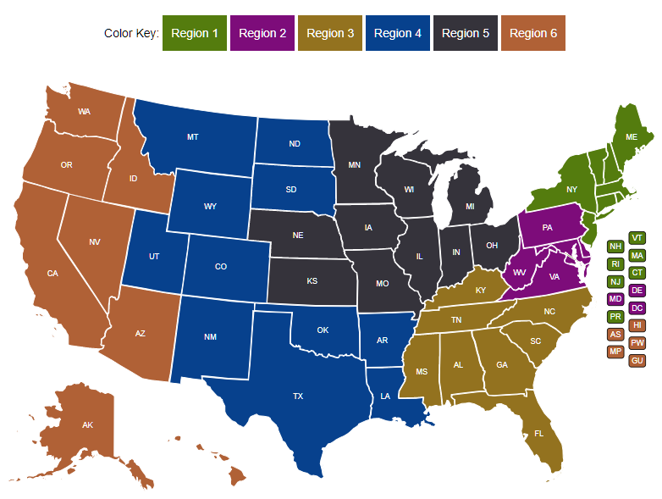
Your FPO is identified in your grant package.
Federal Project Officer (FPO)
Your FPO is critical to the success of your grant program.
Role of Your FPO
Assist you on grant-related matters
Provide compliance assistance
Conduct oversight and review of grant performance
Deliver or arrange for technical assistance
Serve as your primary point of contact

Slide 34

Grant Officer (OGM)
Your assigned Grant Officer is listed on the Notice of Award page of the Grant Package. Only the Grant Officer can approve changes to the Grant Agreement.
Maintains official grant documents
Regional Grant Officer can approve grant modifications and equipment purchases
National Grant Officer approves complicated grant modifications: limited changes to SOW, changes in signatory and NICRA
OGM staff provide guidance and training on policy issues and fiscal/administrative requirements of the grant.

Slide 35
Program Office Staff
Support FPOs
Provide policy clarification and guidance
Provide technical assistance (TA) (together with an external provider)
Create peer learning opportunities
Collect performance data
Review specific grant modifications
The Program Office for your grant may periodically request information about your grant outcomes for quarterly reports to Congress.

Slide 36
Any Questions?

Slide 37
Grants Management Overview
37

Slide 38

Grant Transmittal Package
Grant Award Letter
Grant Agreement
Grantee Handbook

Slide 39
Grant Award Letter
Acknowledgements of Award
Payment Management System
  Information and forms on www.doleta.gov/grants under Manage your Awarded Grant
ETA’s on-line Grantee Financial Reporting System
  ETA 9130
  Information to access system on www.doleta.gov/grants under Manage your Awarded Grant
Passwords/PINs are sent separately after supplying the necessary information.
Once you receive this, please DO NOT LOSE IT!

Slide 40
Grant Award Package
Grant Agreement:
Notice of Award (NOA)/Signature Page
Condition of Award Page/ Program Compliance Notification
Terms and Conditions
Application for Federal Assistance
Budget
Statement of Work (SOW)
Indirect Cost Rate Agreement (if applicable)

Slide 41

Grant Agreement Notice of Award (NOA)
Project Title – Strengthening Community Colleges Training Grants
Grant Awardees' Identifying Information
Federal Award Identification Number (FAIN)
  Grant Number # MI-350XX-20-60-A-XX
Period of Performance
Award Amount
Uniform Administrative Requirements
Cost Principles
Signatures

Slide 42
Notice of Award Regulations
    2 CFR Part 200
      Uniform Administrative Requirements
      Cost Principles, and
      Audit Requirements for Federal Awards
    2 CFR Part 2900
      DOL Exceptions
    Terms and Conditions of Award

Slide 43
Conditions of Award
Areas that require clarification and/or modification are outlined in the award package and specified as conditions of award.
    Budget revisions/clarifications
    Indirect Cost Rate Agreement
Responses were due to your Federal Project Officer (FPO) within 30 days of the receipt of the grant award package.

Slide 44
Conditions of Award
  Conditionally Approved Funding (if applicable): Grantee is conditionally approved with an initial increment of $80,000 drawdown restriction in PMS. This constitutes a Partial Notice to Proceed. Release of additional funds up to the amount approved for the project, will be based on the grantee’s ability to address this Condition (see Conditions of Award page). Grantee is not authorized to incur costs above $80,000 until Condition 1 is resolved.
    Financial Assessment Form (All grantees)
    Financial and Administrative Policies and Procedures (Grantees new to ETA)
  Lifting the Drawdown Restriction: Submission of the requested information specified in Condition 1 does not in itself constitute approval by ETA. Should the provided documentation be found satisfactory, a Full Notice to Proceed will be incorporated into the grant agreement as an official modification, and the drawdown restriction will be lifted.
  New Grantee to ETA: Grantee that has never received ETA grants or has not received ETA grants within five (5) years from the closing date of the FOA. Grantees that meet this criterion will receive Conditionally Approved Funding.
44

Slide 45
Program Compliance Notification
  Federal Staff are still reviewing your projects
  Key areas of Compliance are highlighted
  Grantees are responsible for
      Learning how to manage their award in compliance with all Federal Regulations & this grant agreement
        Reading the grant agreement
        Learning about Federal Regulations, and the nuances of your program
        critically looking at their project and being proactive in clarifying items of potential concern with your FPO

Slide 46
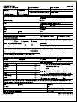
Specific Terms and Conditions of Award
Order of Precedence
Funding Opportunity Announcement (FOA)
  & Amendments One and Two (incorporated by reference)

Slide 47
Terms – Equipment Purchases
  Equipment purchases with a per-unit acquisition cost of $5,000 or more, and a useful life of more than one year need prior approval from Grant Officer
    Capital improvements and other alterations and renovations also allowable with prior approval
  Submit a detailed equipment purchase list with descriptions of each item to your FPO for review
  Your FPO will review the request and submit for approval. A modification to your grant will be processed approving the equipment purchase and/or renovation

Slide 48
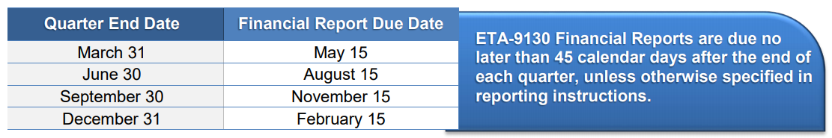
Quarterly Financial Report
Each grantee must submit a Quarterly Financial Report (ETA 9130), due no later than 45 days after the end of a quarter
Use the Grantee Reporting System to submit QFR
Desk Aid - https://www.dol.gov/sites/dolgov/files/ETA/grants/pdfs/ETA-9130_Financial_Reporting_Resources.pdf
48

Slide 49
Grant Agreement
SF-424 – Attachment A
Budget Information
  SF-424A – Attachment B
  Budget Narrative – Attachment C
Statement of Work - Attachment D
  Project Narrative
  Abstract
  Project Work Plan
  Performance Outcomes Table
  Documentation of Partnership Commitments

Slide 50
Indirect Cost Rate Agreement
Attachment E - only applicable to those claiming indirect costs
If grantee is claiming indirect costs but did not provide agreement, placed on 90-day temporary rate
Applicants missing indirect cost rate agreements or submitting expired ones limited to lesser of either total claimed indirect costs or 10% of total Personnel budget

Slide 51
Any Questions?

Slide 52
Grant Modifications
Requests, Review Process
52

Slide 53
Grant Modifications
What is a modification?
Why do a modification?
What are modification indicators?
FPO Modification Analysis
  Reasonable
  Performance
  Best interest of the government
53

Slide 54
What is a Grant Modification?
Mechanism to Change the Terms of the Grant Agreement
54

Slide 55
Why do a Modification?
Change of Scope
  {Very rare & only minor changes will be considered}
Program Design
    Service Area
    Change in Partners (outlined in compliance notification)
    Key Personnel Changes
55

Slide 56
FPO Modification Analysis
Grant Quality
  Services
  Staffing
Grant Efficiency
  Timely
  Cost Effective
Grant Performance
  Enrollments
  Expenditures
Benefit to the Government’s Goals for the Grant Program
56

Slide 57
Required Documentation for Modification Requests
Must be submitted on Organization’s Letterhead
Must be signed by the Authorized Representative
Provide the purpose
Why it’s necessary
How the change will benefit the program
Appropriate documentation to support Modification
57

Slide 58
Modification Process
Write a formal letter of request addressed to your Grant Officer.
Include modification type, grant number, and justification for request.
Submit the final letter, signed by your signatory to FPO, who then forwards to the Grant Officer.
Formal review and execution of approved modification.
Discuss potential mod with your FPO.
58

Slide 59
POP QUIZ!
You would like to add a new industry or occupation to your grant.
Which answer provides the best response that describes the process for submitting a Grant Modification?
A
Launch the program in the new industry and begin enrolling participants.
C
Reach out to your FPO to discuss the need for your request.
Write a formal letter of request to the Grant Officer which provides a justification. Have the Authorized Representative sign and submit the request.
Reach out to your partner organizations to determine if the new industry or occupation is in-demand.
B
D
59

Slide 60
Any Questions?

Slide 61
Performance Reporting Guidance

Slide 62
The Value of Reporting
Department of Labor
SCC2 Grants
Report the success of high-profile programs to Congress, Administration, OMB, GAO, etc.
Inform the design of future grant investments
Demonstrate the outcomes of these grant investments
Capture effective program design models and service delivery strategies.
Demonstrate grant outcomes to investors and partners
Illustrate Return on Investment (ROI) to employer partners
Build additional strategic partnerships and leveraging resources
Sustainability of the project and partnership
Continuously improve program design to meet the needs of participants

Slide 63
SCC2 Performance Reporting Requirements
Grantees must submit performance progress reports quarterly to ETA.
Quarterly Narrative Report (QNR): Grantees will report the required narrative information and five required customized outcomes using the QNR.
  We will provide grantees with a suggested Customized Outcomes Report (COR) template for reporting and tracking their customized outcomes.
Quarterly Performance Report (QPR): All grantees (both single institution and consortium) must track participant outputs related to program enrollment/ completion and credentials earned for a cohort of students.
  Grantees are not required to set participant targets or track employment-related outcomes (DOL will rely on the Common Reporting Information System (CRIS) for the latter).
Final Report
  QPR and QNR submitted at the end of the grant

Slide 64
Quarterly Progress Reports
Submitted to ETA using the Workforce Integrated Performance System (WIPS)
Quarterly Progress Reports
  Quarterly Performance Report (QPR)
    Grantees should prepare to track and collect participant-level data for the QPR.
  Quarterly Narrative Report (QNR)
    Includes the suggested Customized Outcomes Report
WIPS
QNR
QPR
Suggested Customized Outcomes Report
Participant Data File Upload

Slide 65
SCC2 Performance Measures (PM)
Grantees must track and report participant level data for a select cohort of students throughout the grant period of performance using DOL’s Workforce Integrated Performance System.
PM1: Participant Cohort Students Who Begin Education/Training
PM2: Students Who Complete the Cohort Program of Study
PM3: Students Who Complete the Cohort Program of Study and Receive a Credential
PM4: Credentials Received by Students Enrolled in the Cohort Program of Study
These outcomes are reported using participant level data that is uploaded in WIPS and aggregated into the QPR.

Slide 66
Interim Reporting Process for the Quarter Ending 12.31.22
Grantees will submit a Quarterly Narrative Report (QNR) to ETA for this quarter
  Grantees will receive an interim reporting guidance email that includes the QNR Template
  Covers activities from October 1 - December 31
  First QNR will be submitted BY EMAIL to FPOs and the grant mailbox no later than the reporting due date of February 15, 2023
  Grantees will send QNRs to their FPOs, with a cc to SCC@dol.gov
  This interim guidance is only for the quarter ending
  December 31, 2022

Slide 67
Interim Reporting Process
For the quarter ending 12.31.22, grantees will NOT submit a QPR in WIPS
  Grantees will submit their first QPR for the quarter after the participants in their chosen cohort start.
  We will provide additional information soon.

Slide 68
Performance Reporting Requirements
Quarterly Performance Reporting: Key Deadlines
  QNR:
    Quarter ending December 31: QNR due February 15 (email only)
    Quarter ending March 31: QNR and COR due May 15 via WIPS
    QNR and COR via WIPs for all remaining quarters
    Final QNR via WIPs at end of grant
  QPR:
    Grantees will use the WIPS demo schema for reporting participant data (once the selected cohort starts)
    QPRs due via WIPS for all subsequent quarters

Slide 69
Quarterly Progress Report: Key Performance Deadlines
Reminder: Quarterly Progress Reports
  Due no later than approximately 45 days after the end of a quarter
  More information and training will be provided
Quarter End Date | Progress Report Due Date | Report Activities Occurring Between
March 31 | May 15 | January 1 – March 31
June 30 | August 15 | April 1 – June 30
September 30 | November 15 | July 1 – September 30
December 31 | February 15 | October 1 – December 31
Your 1st progress report is due no later than February 15, 2023
Covers activities from October 1 through December 31 , 2022

Slide 70
Any Questions?

Slide 71
Communication
Communication Plan, Point of Contact and Community of Practice

Slide 72

Your Primary Point of Contact (POC)
Role of POC
Receives communication from ETA
Is responsible for sharing information with project team and consortium members
Any time the main point of contact for your grant changes, please remember to contact the Federal Project Officer (FPO) and Program Office by email.

Slide 73
Communication Plan
YOU
ETA
Always contact your FPO first if you have questions.
If you… | Contact:
Are the grant lead (POC) | FPO
Are a member of a grant project | The lead for your grant
Have questions or difficulty accessing the performance reporting system | https://www.doleta.gov/performance/wips/WIPS_Technical_Assistance_Request.cfm
Have questions or difficulty accessing the financial reporting system | EBSS.help@dol.gov, with a copy to your FPO
Have questions about evaluations | SCC@dol.gov with a copy to your FPO

Slide 74
Communication Guidelines
YOU
ETA
When you communicate with your FPO, etc.:
Copy the SCC mailbox at SCC@dol.gov, if appropriate
Include your grant number and lead grantee organization name
Describe your question or issue in detail
Please be patient!

Slide 75
ETA Communications to You
ETA
YOU
Program Office staff may send periodic guidance and other communications through the SCC Mailbox.
Your FPO or Program Office staff may contact you for specific requests and information.
ETA posts information on the WorkforceGPS.org Community of Practice site.
  https://collegeconnection.workforcegps.org/
ETA shares new information on its website.
  https://www.dol.gov/agencies/eta/skills-training-grants/scc
Please make sure your email system does not confuse our communication as spam.

Slide 76
Technical Assistance

Slide 77
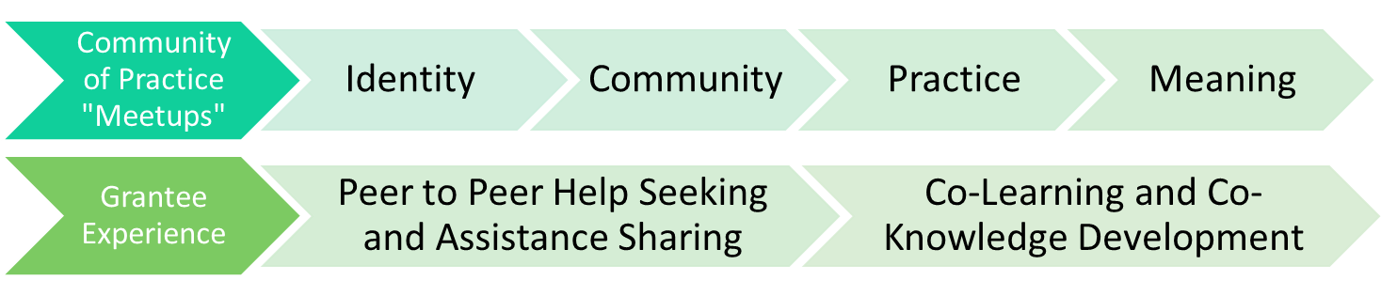
SCC2 TA Theory of Change
SCC Technical Assistance is a dynamic, capacity-building process for designing or improving quality, and effectiveness of SCC grantee projects to achieve sustainable systems change.
Deep Equity
Personal
Interpersonal
Organizational
Societal
Grantee Experience
1:1 Coaching
SME Consultation
Peer to Peer Small Groups
SME Webinars
SCC Newsletter
Success Indicators
Operational Systems
Organizational Management
Equity-minded Change
Stakeholder Engagement
Accelerated Career Pathways

Slide 78
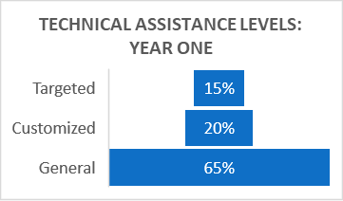
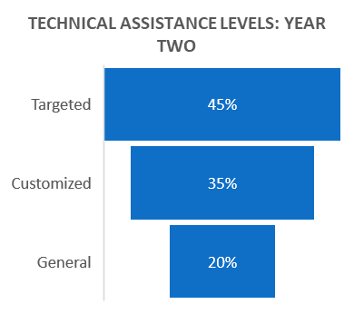
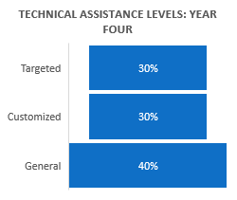
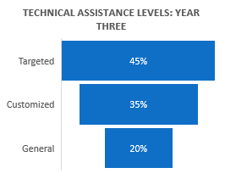
SCC2 TA Theory of Change (cont.)

Slide 79
Grant Timeline (First Quarter)
October 1, 2022 – Grants Start
  Compliance Notification Letter, Condition(s) of Award: Packages Sent
October through December 2022 – Performance and Work Plan Reviews
November 10, 2022 – Grantee Orientation
February 15, 2022 – First Quarterly Narrative Report (QNR) (email only)
TBD – Grantee Performance Reporting TA Rollout

Slide 80

Next Steps
Respond to Conditions of Award in your Grant Award Package
(send to FPO, cc SCC) (if you have conditions of award)
Review the DOL Fiscal Training Tutorials from the SMART 3.0 Webinar Series
Review the SCC2 Foundational Resources page on College Connections (FOA, grantee handbook, evaluation rubric, SCC2 abstracts, and more)
Review the Funding Opportunity Announcement
Review the Grantee Handbook
Review the DOL Performance Reporting Requirements
Update your grant’s Point of Contact(s) as needed
Get to know your FPO and ask questions!

Slide 81
Any Questions?

Slide 82
Thank You!
Need help? Email: Support@workforceGPS.org

