Slide 1
Evaluation Culture, Awareness, and Strategic Planning
Peer Learning Cohort: Session 4
February 23, 2023

Slide 2


Your Moderators
Gloria Salas-Kos
  Senior Program Analyst/Evaluation Technical Assistance Coordinator
    Office of Policy Development and Research
    Employment and Training Administration/
    U.S. DOL
Cynthia Forland
  EvalPLC Lead
    Employment and Training Administration/
    Evaluation Dissemination and Technical Assistance Team

Slide 3
Overview of Today’s Activities
Welcome and Recap of Strategies for Funding Evaluation Session
Highlights from Evaluation Design and Implementation Assessment Results
Opening Polling Questions: Setting the Stage
A State Perspective: Commitment to a Culture of Evidence
A National Perspective: Evidence-Building and Evaluation in Government
Breakout Peer Discussions: States’ Challenges and Next Steps in Establishing a Culture of Evidence
Looking Ahead: State Presentations at Final Session, Completing Capstone Projects, Coaching, and Resources

Slide 4
Recap and Open Discussion
Let’s get started!

Slide 5
Recap of EvalPLC3: Strategies for Funding Evaluation
Highlights from Evaluation Readiness Assessment Results
Open Discussion: Evaluation Design and Implementation Assessment
An Expert Panel: Strategies for Funding Research and Evaluation of Workforce Development Programs
Focused Peer Discussion: States’ Next Steps in Funding Research and Evaluation

Slide 6
Evaluation Design and Implementation Results

Slide 7
Opening Polling Question 1
Do agency staff and partners understand the benefits of evaluation to improve services to customers (job seekers and employers) and use evidence-based results to inform decisions?
Unfortunately, no.
Making progress, but only in pockets across programs and titles.
Doing well, but not sure it is going to be sustainable long term.
Yes! Consistently across programs and titles and confident we can sustain long term.

Slide 8
Opening Polling Question 2
When planning to implement new or revamped programs and services, do agency staff and partners regularly consider effective evaluation strategies?
Not currently.
We are starting to and participating in this cohort is helping to raise awareness.
Yes, but not consistent across programs and titles.
Yes, and consistently across programs and titles.

Slide 9


Today’s Speakers
Elise Lowe-Vaughn
  Director, Workforce Development Programs
    Colorado Department of Labor and Employment
Nick Hart, Ph.D.
  President and CEO
    Data Foundation

Slide 10
A State Perspective: Commitment to a Culture of Evidence

Slide 11
Colorado Workforce Innovation and Opportunity Act (WIOA) Evaluation Team
A Statewide Initiative

Slide 12
How Colorado Got Here
Contract with Northern Illinois University (NIU)
Build evaluation capacity in Colorado workforce system
Response to the Office of the State Auditors (OSA)
Return on investment for training-related placements
Shared Results with the State and Local Leaders
Identified areas’ success the auditors did not note
Built trust with the state and local areas in evaluation
Built the WIOA Evaluation Team
State and local staff unified goals

Slide 13
Colorado WIOA Evaluation Team
Northern Illinois University (NIU)
Brian Richard, Ph.D.
Yolanda Clark, Ph.D.
Colorado Department of Labor and Employment (CDLE)
Elise Lowe-Vaughn, Director, Workforce Development Programs
Robin Bauknecht, Workforce Development Programs
Adams Workforce and Business Center
Greg McBoat, Qualitative Analysis Lead & Workforce Evaluation Team (WET) Coordinator
Workforce Boulder County & Larimer County
Barbara Larsen, Quantitative Analysis Co-Lead
Glenda Delenstarr, Quantitative Analysis Co-Lead

Slide 14
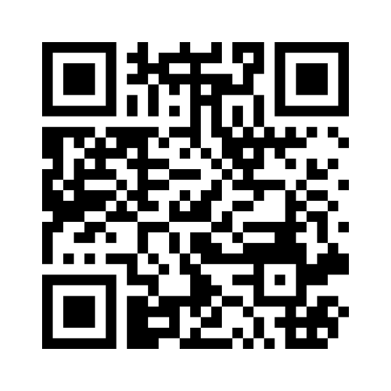
Hearing from You
What is your biggest challenge in evaluation?
On your cell or computer go to: www.menti.com
Enter code: 5140 7476

Slide 15
Colorado’s Paradigm Shift
Federal government’s paradigm shift and focus on diversity, equity, and inclusion (DEI)
  President’s Biden’s Executive Order On Advancing Racial Equity and Support for Underserved Communities Through the Federal Government | The White House

Slide 16
Colorado’s Culture of Success
CDLE is dedicated to evaluation
Diverse evaluation team with internal and external partners
Buy-in at state and local area
Shared knowledge and understanding of key terms
Mixed methods evaluation approach

Slide 17
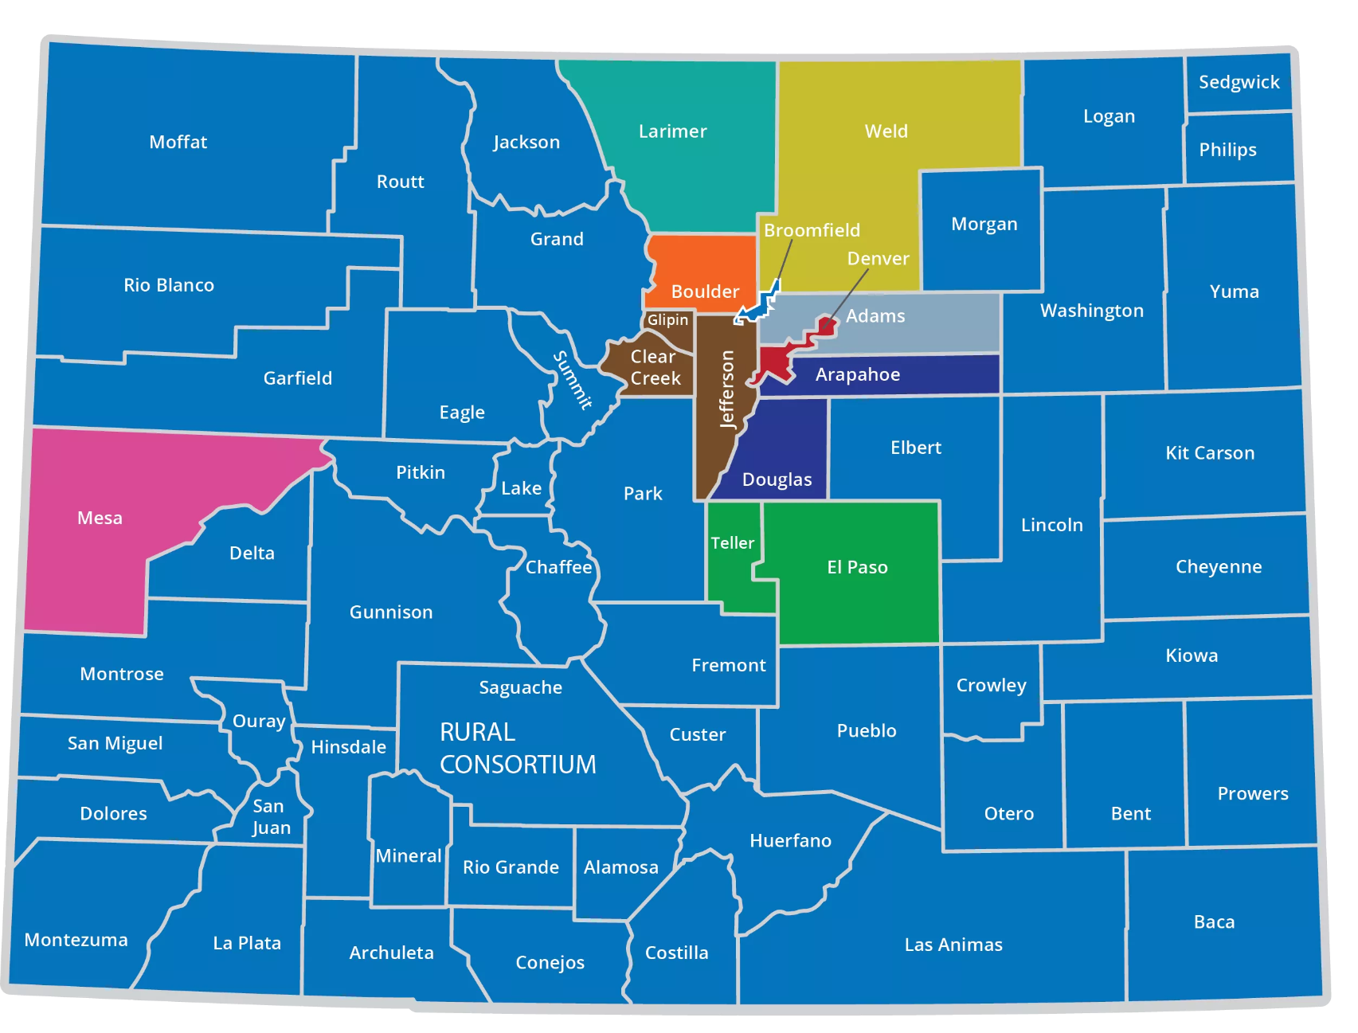
Colorado’s WIOA Evaluation Team (WET)
The team is comprised of state and local staff
Quantitative Team
Qualitative Team
NIU Technical Assistance and Guidance
Statewide Evaluation Coordinator

Slide 18
Colorado’s Ongoing/Next Steps
Three-Pronged Approach:
Quantitative | Qualitative Local Research | Customer Surveys
Analyzing data provides breadth for qualitative | In-depth understanding | Creating the customer survey
Training the 10 local areas | Persona and Journey Mapping | Surveying customers
Monthly reporting | Training | Training the WIOA Evaluation Team
Look at multiple years of data to identify trends

Slide 19
Colorado’s Challenges
Comfort level with evaluation
Working with administrative data sets
Varying levels of research knowledge
Staff turnover
Time commitment vs. allocated dollars

Slide 20
Incorporating Aspects of Research and Evaluation in Colorado’s State Plan
Workforce Development Programs is dedicated to conducting research and evaluation in order to test new services and strategies and achieve high levels of performance and outcomes
State Grant Coordinators have attended evaluation and are beginning to incorporate the techniques into grant reporting
New initiatives have an evaluation component
Evaluation will be incorporated into the next State Report cycle, 2024

Slide 21
Questions?
What questions do you have for the Colorado panel regarding their work advancing evaluation of workforce development programs?

Slide 22
A National Perspective: Evidence-Building and Evaluation in Government

Slide 23
Current Demand
Historical arc over 60 years
Growing momentum in just last 4 – passage of the Evidence Act in federal government
Increasing flexibilities in federal funding
Year of Evidence for Action - concluded yesterday

Slide 24
What Is Evidence Capacity?
Leadership support and motivation
Culture for evaluative thinking
Data and technical capacity
Challenged by:
  Legal frameworks
  Expertise and resources
  Access and quality of data
  Coordination across silos
  Leadership capacity and commitment

Slide 25
Connecting Supply-Demand / Production-Use
Use occurs all around us – and often government not given credit
Instrumental / Conceptual / Imposed / Political
Research-Practice Partnerships encourage use – Co-production of useful evidence with stakeholders

Slide 26
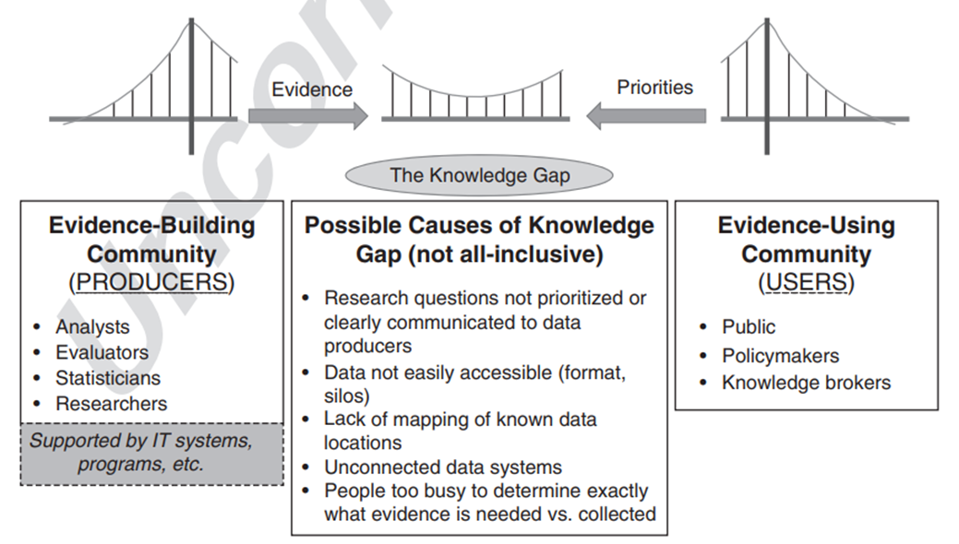
Learning Agendas Help Bridge the Gap

Slide 27
How This All Connects: Evidence Works for Workforce
In 2008 evaluators provided final WIA non-experimental evaluation to DOL – finding increased earnings 15-25 percent for program participants; also identified small returns for the Dislocated Worker program
Study was cited by Obama Administration as evidence of efficacy (without distinction between the programs)

Slide 28
Challenges in the Workforce Investment Act Evaluation
Program redesigns and use of non-experimental methods
Critiques of the study design
Only 12 of 50 states provided data voluntarily
Time in analyzing long-term outcomes of interest

Slide 29
Benefits in the WIA Evaluation
Better knowledge than before
Broken into bite sizes over time
Investment demonstrates the value of building evidence that is useful for future actions

Slide 30
Capacity for Use in Workforce Development
Leadership
Incentives
Intermediaries
Access
Partnerships

Slide 31
Questions?
What questions do you have for Dr. Hart regarding the demand for and application of evidence?

Slide 32
Peer Discussion Breakouts

Slide 33
Share Your Next Steps in Developing and Maintaining a Culture of Evidence
What steps have you taken to date to develop a culture of evidence?
What will your next (2-3) steps be in furthering your research and evaluation of workforce development programs?
What are the greatest obstacles in taking those next steps?

Slide 34
Looking Ahead . . .
Upcoming activities, coaching support, and resources

Slide 35
State Presentations at Final EvalPLC Meeting
Expectations for state presentations at final EvalPLC meeting, scheduled for Thursday, March 23, 2023:
What have you learned through the Evaluation Peer Learning Cohort process?
  Strengths
  Challenges
  Where you started, and using the assessments as a map of where you went
  Capstone Project
Next steps for your state in research and evaluation of workforce development programs and services
  Basic evaluation action plans
  Approach for next 6-12 months
Bigger picture
  How we see our state moving forward on research and evaluation over the next 1, 2, and 3 years
  Continuing to engage in the community of practice
Please provide slides to your coach by COB Friday, March 10, 2023.

Slide 36
Capstone Projects
With your coach’s support, complete and submit your capstone project by April 28, 2023.

Slide 37
Evaluation and Evidence Resources
WIOA Evaluation Toolkit
Evidence-Building Capacity in State Workforce Agencies​:Insights from a National Scan and Two States (2016)
  National Association of State Workforce Boards
Evaluation and Research Hub
  https://evalhub.workforcegps.org/
Workforce System Strategies
  https://strategies.workforcegps.org/
P.L. 115-435 - Foundations for Evidence-Based Policymaking Act of 2018
Evidence-Based Policy Primer
  Bipartisan Policy Council
New Directions for Evaluation
  Special Issue Evaluation Policy, Spring 2022
  Data Foundation

Slide 38
Upcoming EvalPLC Events and Meetings
All EvalPLC events and meetings are held on Thursdays at 3 PM ET
2023
March 1 | Public Webinar – Participatory Research Methods
March 23 | EvalPLC Meeting 5 – State Reflections and Next Steps

Slide 39
Contact Us
Gloria Salas-Kos
  Senior Program Analyst/Evaluation Dissemination and Technical Assistance Project COR
    Employment and Training Administration/U.S. DOL
      Salas-Kos.Gloria@dol.gov
Wayne Gordon
  Director, Research and Evaluation
    Employment and Training Administration/U.S. DOL
      Gordon.Wayne@dol.gov
Evaluation Peer Learning Cohort Support
    Safal Partners
      EvalPLC@SafalPartners.com

Slide 40
Thank You!
We are glad you joined us today.

