Slide 1

Welcome to the Co-enrollment Across WIOA Core Programs: Requirements, Promising Practices, and Resources !
Use the chat to share your name, organization, and location.
Also, tell us what you expect to learn from today’s webinar!
The event recording will be available in five business days on the WorkforceGPS website.

Slide 2

Joint Co-Enrollment Webinar

Slide 3
Description of Co-enrollment Data
My program’s
co-enrollment data is:
Very accurate
Pretty accurate
Has room for improvement
Select one response

Slide 4

Today’s Moderator
Cesar Villanueva
  Workforce Analyst
    Employment and Training Administration
    U.S. Department of Labor

Slide 5



Today’s Speakers: U.S. Department of Labor
Christina Eckenroth
  Workforce Analyst
    Employment & Training Administration,
    U.S. Department of Labor
Evan Rosenberg
  Workforce Analyst
    Employment & Training Administration,
    U.S. Department of Labor
Dana Westgren
  Workforce Analyst
    Employment & Training Administration,
    U.S. Department of Labor

Slide 6


Today’s Speakers: U.S. Department of Education
Michael Quinn
  Management & Program Analyst
    Rehabilitation Services Administration
    U.S. Department of Education
Lekesha Campbell
  Management & Program Analyst
    Office of Career, Technical, and Adult Education
    U.S. Department of Education

Slide 7


Today’s Speakers: Alaska
Kim Kolvig
  Employment Security Analyst 3, Program Coordinator
    Alaska WIOA Title I
      Kimberly.Kolvig@alaska.gov
Windy Swearingin
  Alaska Adult Education & GED State Director
    Alaska Adult Education
      Windy.Swearingin@alaska.gov

Slide 8


Today’s Speakers: Wisconsin
Deanna Krell
  Director, Bureau of Management Services
    Wisconsin Department of Workforce Development
      Deanna.Krell@dwd.wisconsin.gov
Andrew Eastman
  Section Chief, Special Services
    Wisconsin Department of Workforce Development
      Andrew.Eastman@dwd.wisconsin.gov

Slide 9


Today’s Speakers: Wyoming
Christina West
  Employment and Training Deputy Administrator
    Wyoming Department of Workforce Services
      Christina.West@wyo.gov
Diane McQueen
  Wyoming State Director for Adult Education
    Wyoming Community College Commission
      Diane.McQueen@wyo.gov

Slide 10




Today’s Objectives
Background
Data Analysis
State Highlights
Q&A

Slide 11
Background

Slide 12
WIOA and Co-enrollment
Title I:
WIOA Adult, Dislocated Worker (DW),
Youth
Title II:
Adult Education and Family Literacy Act (AEFLA)
Title III:
Wagner-Peyser (WP)
Title IV:
Vocational Rehabilitation (VR)
I
II
III
IV

Slide 13

WIOA and Co-enrollment
WIOA Service Integration
Reduce duplication of services
Data informed policy decisions

Slide 14
The departments require the programs to submit data on their participants, and have taken steps to help them do so. But the departments still don't have complete data on participants who are enrolled in multiple programs. For example, program data submitted to Labor didn't include co-enrollment information on up to 67% of participants.
Workforce Innovation and Opportunity Act and Co-enrollment
Additional Steps Needed to Help States Collect Complete Enrollment Information
GAO-23-104830

Slide 15
Requirements
WIOA Sec. 116 (d) (2) (I):
(I) the number of participants who are enrolled in more than 1 of the programs described in subsection (b)(3)(A)(ii)
677.160 What information is required for State performance reports?:
(ii) Co-enrollment in any of the programs in WIOA sec. 116(b)(3)(A)(ii).
Information Collect Request (ICR) OMB Control Number 1205-0526 Expiration Date: 05-31-2024:
Joint definitions for Participant Individual Record Layout

Slide 16
Requirements
Joint Participant Individual Record Layout (ETA-9170):
Element Numbers
903 (Adult)
904 (Dislocated Worker)
905 (WIOA Youth)
910 (Adult Education)
917 (Vocational Rehabilitation)
918 (Wagner-Peyser)

Slide 17
Data Analysis

Slide 18
Co-Enrollment by Program
Title I Programs: Adult, Dislocated Worker (DW), Youth
Co-Enrollment WIOA Title / Program
Program | Title II (AEFLA): % Co-Enrolled | Title II (AEFLA): % Unknown | Title III (WP): % Co-Enrolled | Title III (WP): % Unknown | Title IV (VR): % Co-Enrolled | Title IV (VR): % Unknown
Adult | 0.9% | 18.5% | 64.5% | 3.9% | 0.4% | 62.6%
DW | 0.4% | 12.1% | 84.0% | 3.3% | 0.2% | 32.1%
Youth | 2.7% | 15.7% | 34.1% | 8.0% | 0.8% | 69.7%
Data from U.S. Department of Labor, indicating which participants in Title I programs are marked as co-enrolled with one of the other core programs.

Slide 19
Co-Enrollment by Program
Highest Rates Reported: Adult Co-Enrollment
Adult &
AEFLA
9.9%
7.2%
5.1%
4.4%
3.3%
Adult &
Vocational Rehabilitation
8.2%
6.5%
5.2%
4.3%
2.7%
14 states reporting 0.0% co-enrollment
0.6% Median rate
0.9% Mean rate
20 states reporting 0.0% co-enrollment
0.2% Median rate
0.4% Mean rate

Slide 20
Co-Enrollment by Program
Highest Rates Reported: Dislocated Worker (DW) Co-Enrollment
DW &
AEFLA
4.0%
3.2%
3.0%
2.8%
2.8%
DW &
Vocational Rehabilitation
10.0%
6.0%
2.8%
2.1%
2.0%
22 states reporting 0.0% co-enrollment
0.4% Median rate
0.4% Mean rate
22 states reporting 0.0% co-enrollment
0.2% Median rate
0.2% Mean rate

Slide 21
Co-Enrollment by Program
Highest Rates Reported: Youth Co-Enrollment
Youth &
AEFLA
37.1%
32.1%
26.5%
22.2%
18.3%
Youth &
Vocational Rehabilitation
29.8%
13.8%
9.0%
7.5%
5.4%
17 states reporting 0.0% co-enrollment
0.5% Median rate
2.7% Mean rate
17 states reporting 0.0% co-enrollment
0.5% Median rate
0.8% Mean rate

Slide 22
Co-Enrollment by Program
Highest Co-enrollment Rates Reported for 10 States
30.3%
23.0%
20.2%
15.3%
15.0%
11.6%
9.8%
9.6%
9.1%
8.7%
Highest Rates Reported: AEFLA
PY 2021 national co-enrollment rate for the AEFLA program is 5.63%
10 states reported 0.0%
co-enrollment in PY 2021

Slide 23
Co-Enrollment by Program
Title III Program: Wagner-Peyser (WP)
Co-Enrollment WIOA Title / Program
Enrollment: | Title II (AEFLA): % Co-Enrolled | Title II (AEFLA): % Unknown | Title IV (VR): % Co-Enrolled | Title IV (VR): % Unknown
Title III (WP) | 0.5% | 54.8% | 0.3% | 63.0%
Data from U.S. Department of Labor, indicating which participants in WP are marked as co-enrolled with one of the other core programs.

Slide 24
Co-Enrollment by Program
Highest Rates Reported: Wagner-Peyser
Wagner-Peyser &
AEFLA
4.1%
3.2%
2.8%
1.6%
1.4%
Wagner-Peyser &
Vocational Rehabilitation
4.0%
2.2%
1.7%
1.6%
1.5%
25 states reporting 0.0% co-enrollment
0.1% Median rate
0.5% Mean rate
10 states reporting 0.0% co-enrollment
0.2% Median rate
0.3% Mean rate

Slide 25
Co-Enrollment by Program
Title IV Program: Vocational Rehabilitation
National Perspective – Program Year 21 – National Co-Enrollment 9.3%
Enrollment | Title I: Adult | Title I: DW | Title I: Youth | Title II: AEFLA | Title III: WP
Title IV- VR National Percent | 3.2% | 1.3% | 2.8% | 2.2% | 4.5%
State Range | 0 to 33% | 0 to 3% | 0 to 22% | 0 to 6% | 0 to 43%
States with Zero | 2 | 2 | 1 | 1 | 3

Slide 26
Co-Enrollment by Program
Title IV Program: Vocational Rehabilitation
Program Year | ETA 9169 % Co-Enrolled | RSA 911 % Co-Enrolled | ETA 9169 Range by State | RSA 911 Range by State | States with Zero Co-Enrollment
2017 | 15.5 | 8.1 | 0 to 85 | 0 to 41 | 10
2018 | 11.1 | 8 | 0 to 100 | 0 to 45 | 5
2019 | 8.6 | 7 | 0 to 55 | 0 to 46 | 5
2020 | 9.7 | 12.9 | 0 to 78 | 0 to 51 | 1
2021 | 9.3 | 9.4 | 0 to 67 | 0 to 65 | 1

Slide 27
Co-Enrollment by Program
Title IV Program: Vocational Rehabilitation
How do Title IV Programs acquire co-enrollment data?
  Most through data sharing agreements.
  Some collect by self report at the initial plan and update as necessary.
How is co-enrollment data reported to RSA?
  Quarterly via the RSA 911 at the case level (data elements 54 through 61).
  Annually via the ETA 9169 at the aggregate level for program participants.
  Review Updated Specification
What are the expectations for VR co-enrollment?
  VR Service populations often require comprehensive & specialized services that are sometimes incompatible with co-enrollment.
  Improved accuracy is expected.

Slide 28
State Highlights
Alaska
Wisconsin
Wyoming

Slide 29




Successful Strategies
Partnerships
Data Matches
Joint Tools
Administrative Structure

Slide 30
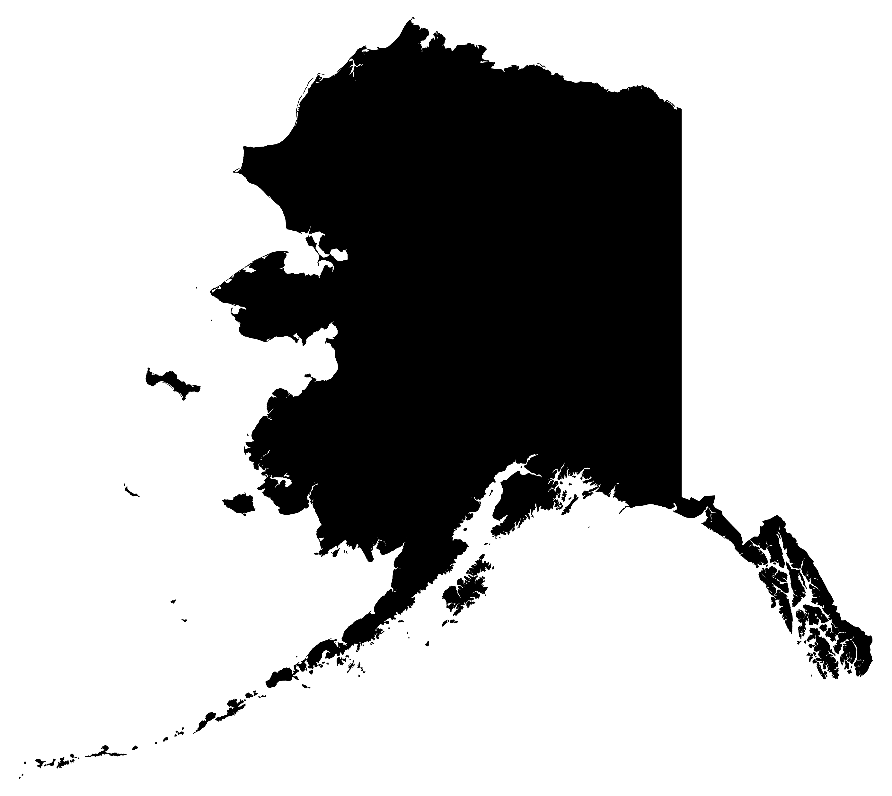
Alaska
Overview of Structure
Data Matching &
System Integration
Partnerships & Battling Silos
Joint Tools

Slide 31
Alaska: Overview of Structure
Title I, Title II, Title III, and Title IV are all housed in the Department of Labor and Workforce Development
DOWLD Commissioner
DVR Director
DETS Director
Adult, Dislocated Worker
Adult Education and Family Literacy
Wagner-Peyser
Vocational Rehabilitation
AWIB Director
Youth
Provides a natural link between AAE, Title I and III services for co-enrollment
Better understanding of programs for local adult education providers and
job center personnel

Slide 32
Alaska: Data Matching and System Integration
What data matching solutions are you pursuing in your current system?

Slide 33

Alaska: Data Matching and System Integration
System Integration
Co-Enrollment Module

Slide 34
Alaska: Partnerships & Battling Silos
Can you describe your success in battling state silos and making key partnership connections?

Slide 35





Alaska: Partnerships & Battling Silos
State Level Operational Team
  Division of Employment and Training Services (DETS)
Partnership with Division of Public Assistance (DPA)
Monitoring and Training

Slide 36
Alaska: Joint Tools
Where are you now, and where do you still want to make progress?
Tell us about successful tools or outcomes and what you plan to continue to pursue.

Slide 37
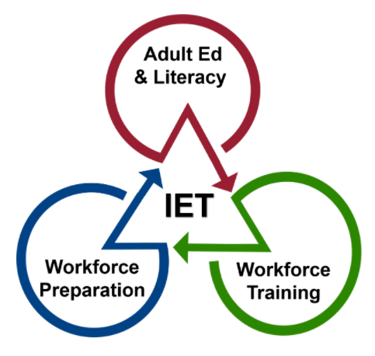
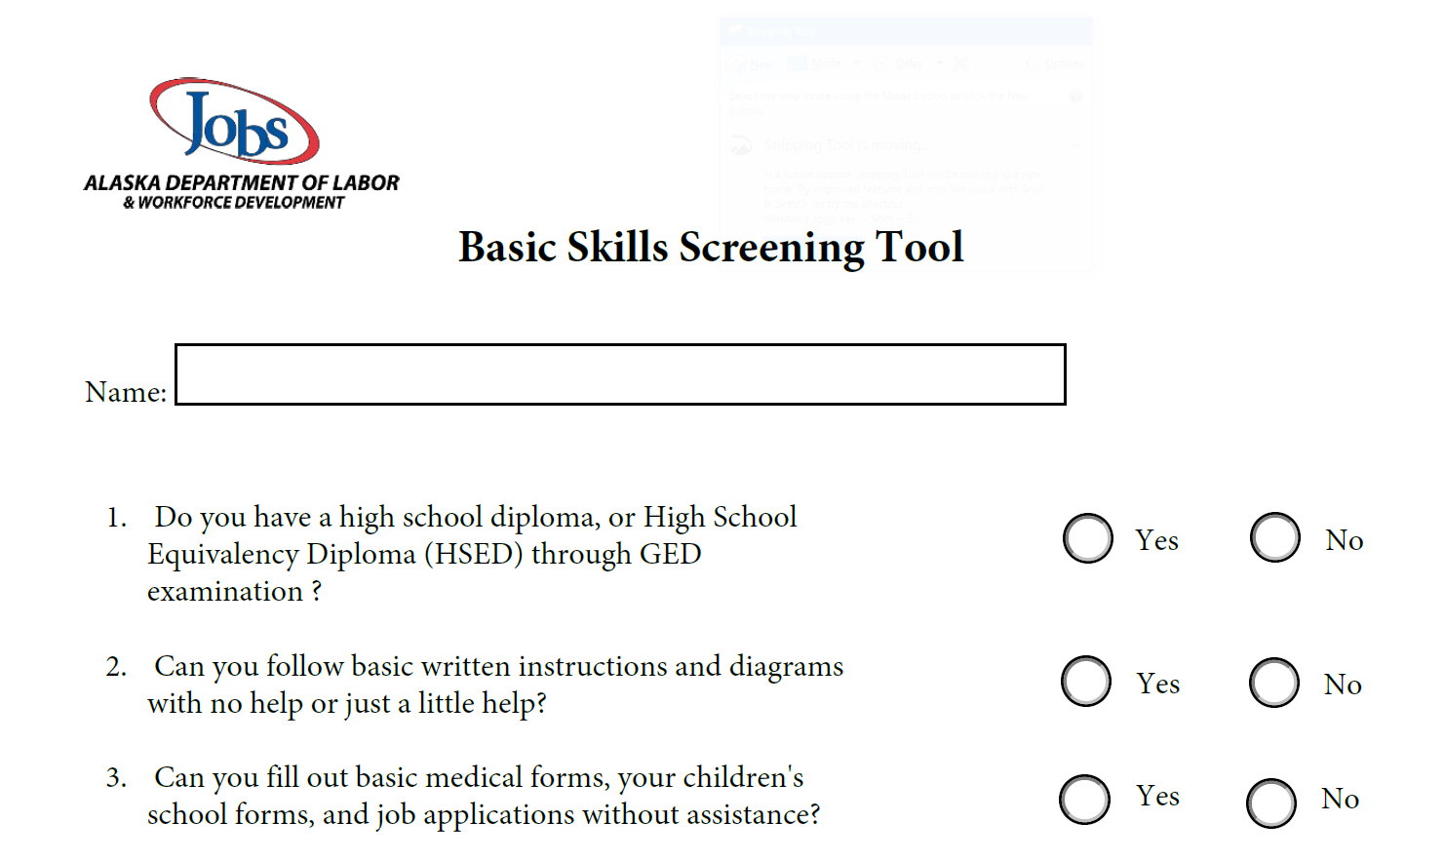
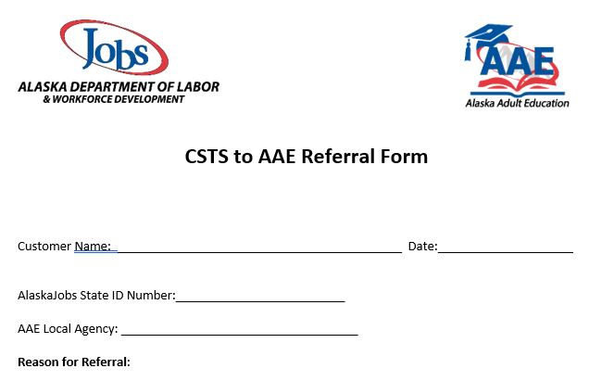
Alaska: Joint Tools
Integrated Education and Training (IETs)
Basic Skills Deficiencies (BSD) Screening
Priority of Service

Slide 38

Wisconsin
Overview of Structure
Data Matching Solutions

Slide 39

Wisconsin: Overview of Structure

Slide 40
Wisconsin: Data Matching Solutions
What is WI’s approach to data matching when information is not available?

Slide 41

Wyoming
Overview of Structure
Focus on Partnerships

Slide 42
Wyoming: Overview of Structure
Overview of Structure
Wyoming Department of Workforce Services (DWS)
  WIOA Title IB Adult, Dislocated Worker, and Youth,
  Title III Wagner Peyser, and
  Title IV Vocational Rehabilitation
Wyoming Community College Commission
  Title II, Adult Education

Slide 43
Wyoming: Focus on Partnerships
What impact has partnership development played in your co-enrollment strategy?

Slide 44
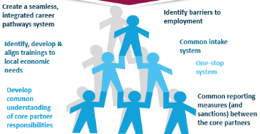
Wyoming: Focus on Partnerships
Collaborative Efforts Mandated & Outlined in State Plan

Slide 45
Wyoming: Focus on Partnerships
Quarterly Meetings Provided:
Cross Collaboration Efforts
Shared Projects/Opportunities
General Information Sharing
Challenges were Brought to the Forefront
Cross Training on Services Provided
(to include eligibility) and Performance Measures
Promoted Stronger Relationship Building

Slide 46
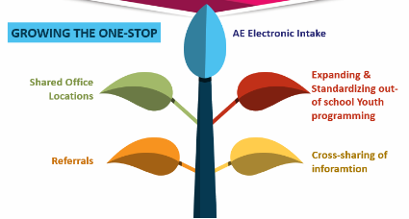
Wyoming: Focus on Partnerships
Relationship Building’s Impact on Service Delivery

Slide 47

Wyoming: Focus on Partnerships
Eliminating Silos: Changing “Me” to “We”

Slide 48
Any Questions?

Slide 49
Thank You!

