Slide 1

SENIOR COMMUNITY SERVICE EMPLOYMENT PROGRAM
GRANTEE PERFORMANCE MANAGEMENT SYSTEM (GPMS)
MODULE 3
Creating a new case INTAKE
AND
Eligibility
Notes:
We’ve focused on Navigating GPMS and the Admin Console and how to complete task and activities at a grantee level or in bulk.
The Case Management Series, shows you how to do task and activities at an individual Case level, primarily as a Case Manager and Case Supervisor.
This first Case Management Segment will focus on Intake and Eligibility and those steps to Create a New Participant Case in GPMS

Slide 2
Training objectives
Creating A New Case
Completing the Intake Process
Submitting Final Eligibility Determination
Documenting Applicant Characteristics
Documenting Applicant’s Other Enrollment Information
Ready for Assignment or Referral
Conducting a Nationwide Participant Search
Notes:
This module focuses on
Creating a New Case
Verifying a new applicant through a Nationwide Search
Intake Process
Eligibility Determination and Supervisor Approval
Entering Characteristic Information
Entering Other Enrollment Information
Program Introduction and Overview
Getting Ready for Assignment, Waitlist or Referral

Slide 3
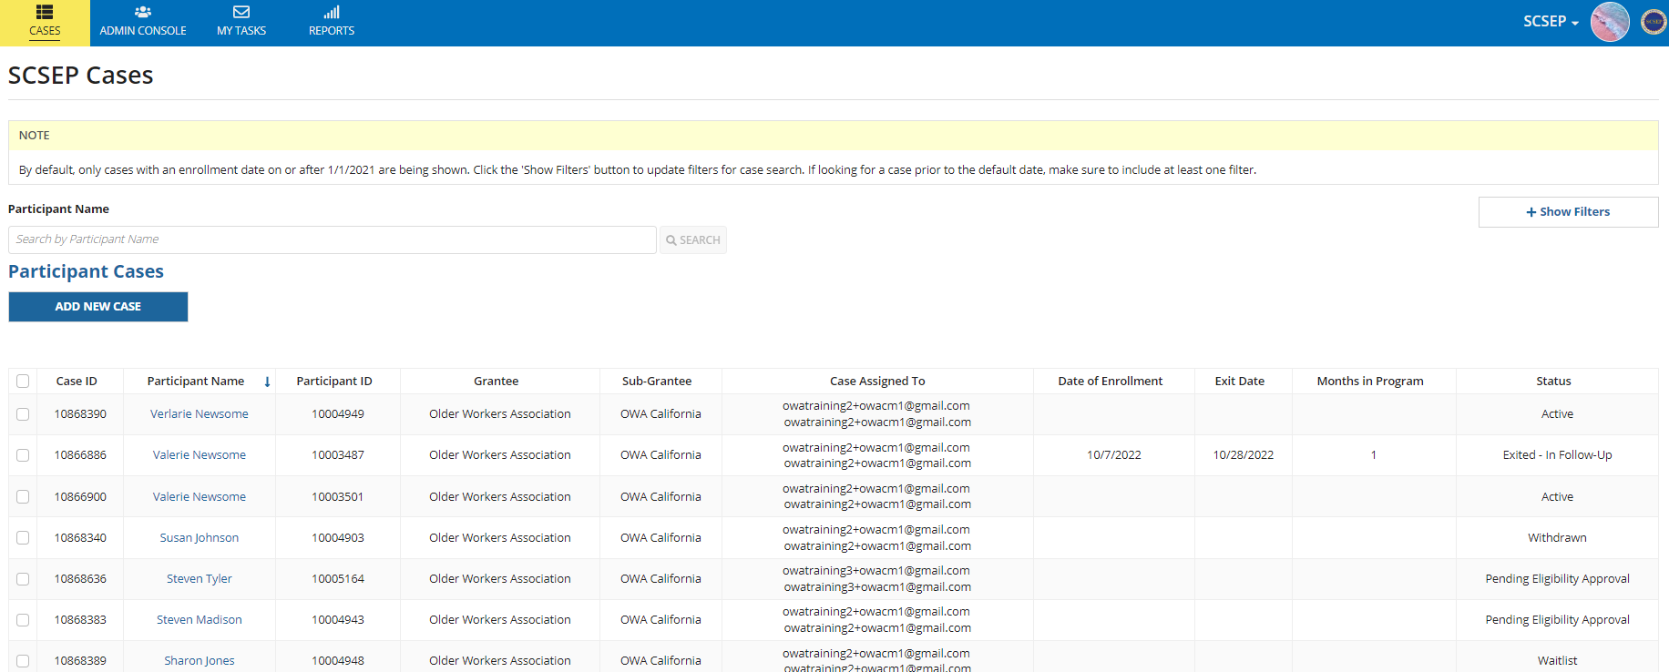
Create a new case
1
Notes:
Case Management begins on the SCSEP Landing Page
From the SCSEP Cases Landing page, select Add New Case

Slide 4
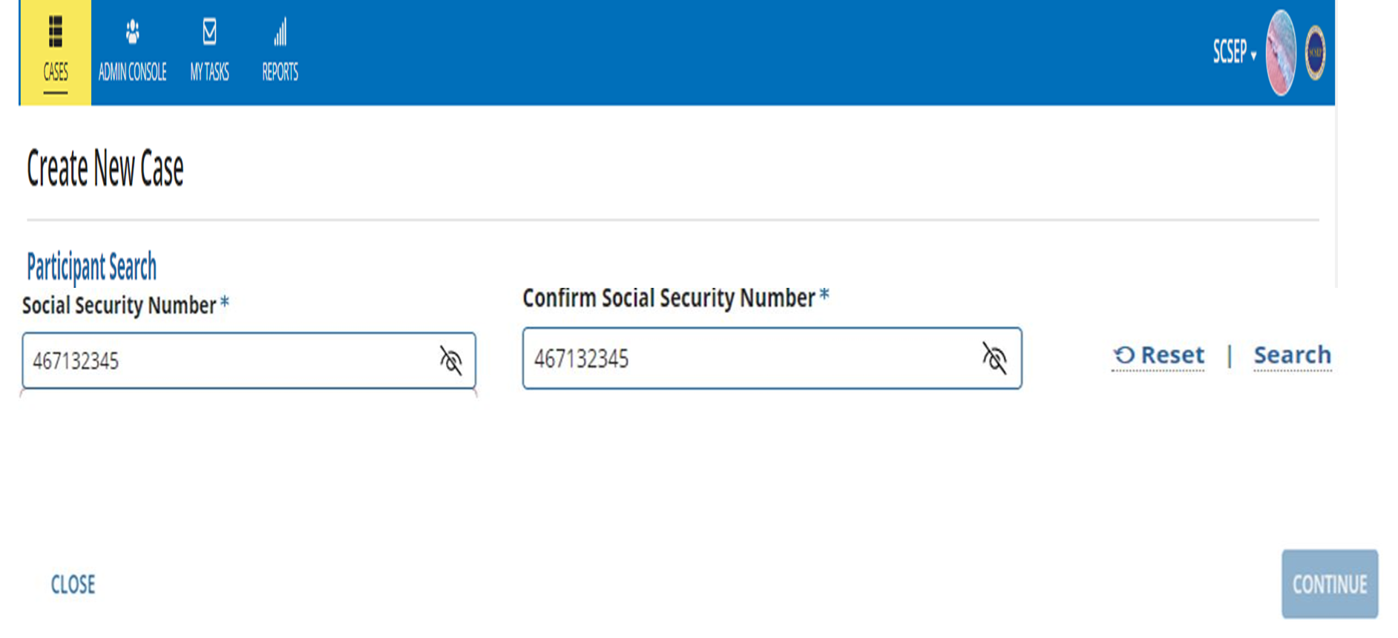
PARTICIPANT search by social security number (ssn)
1
2
3
4
5
Notes:
Nationwide Search across all Grantees is done to ensure that the applicant is not currently or previously enrolled in SCSEP.
Enter the Applicant’s Social Security Number (SSN) in the Social Security Number (SSN) field
Re-enter the SSN in Confirm Social Security Number field and click enter
SSN Confirmed will display the Search and Reset fields when both fields match
Click Search to begin the process
Click Close to exit without performing a search
Use Alvira Davenport 417-87-1234

Slide 5
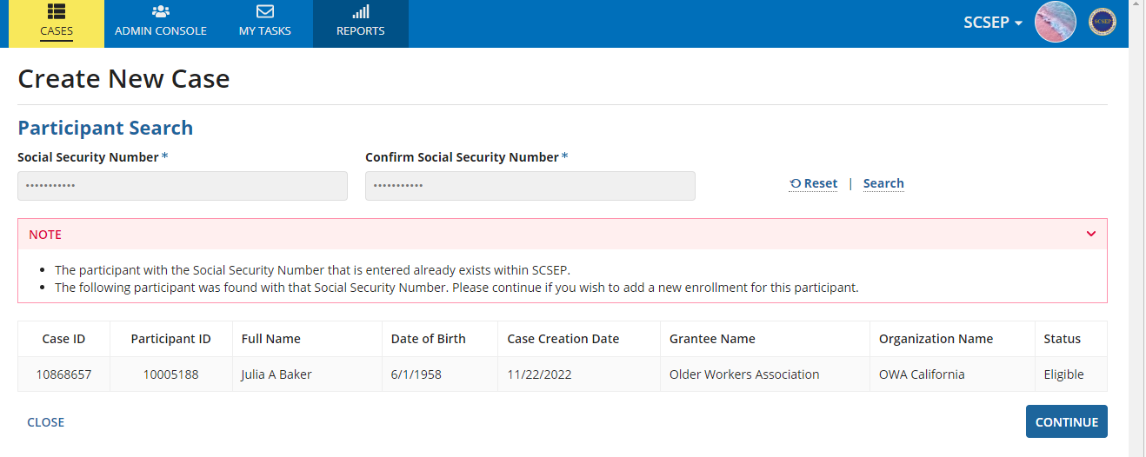
Create new case – ssn found
1
2
X
3
Notes:
Create New Case – SSN Found
Search outcome displays SSN Found
Participant Information displays (Case ID, Participant ID, Name, DOB, Case Creation Date, Grantee Name, Organization Name, Status). This information should be used to contact the current Grantee that is displayed and determine course of action
Select Close to exit to the SCSEP Cases Landing Page

Slide 6
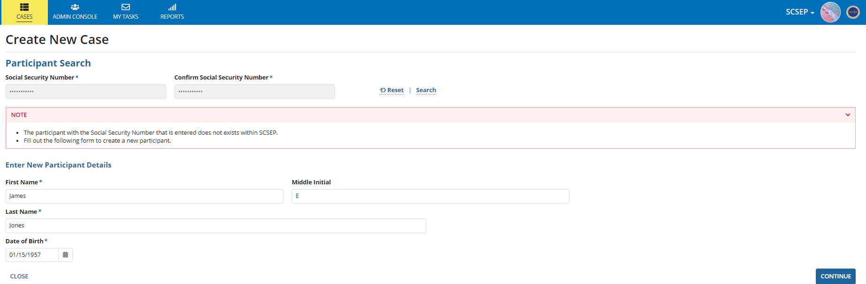
Create new case – ssn not found
1
2
3
4
5
6
Notes:
Create New Case – SSN Not Found
Search outcome displays SSN Not Found a New Case may now be created
New Participant Details form displays for input all fields marked with an * are Required Fields and must be completed
Complete Name fields
Enter Date of Birth manually or use the calendar icon
Select Close to exit without saving changes
Select Continue to create the case and begin the Intake process

Slide 7
intake
Notes:
Applicant contact and demographic information is documented during the Intake process

Slide 8
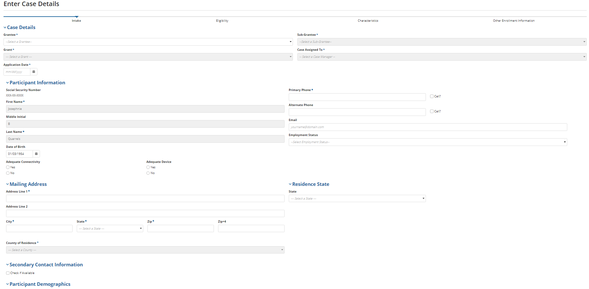
Intake
5
Notes:
The sections in Case Details will be expanded on the initial screen. You can collapse these clicking on the associated arrows for ease of completing the different sections - that make up the Intake process

Slide 9
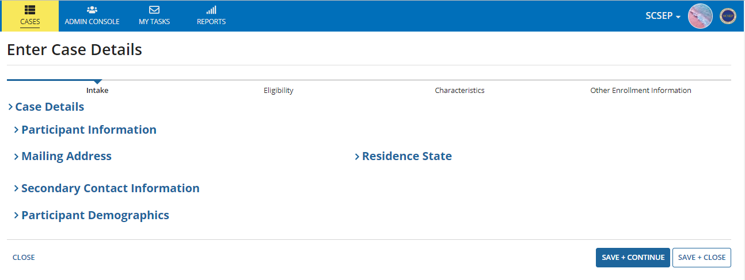
Intake
1
2
3
4
5
6
7
8
9
Notes:
Case Details
Intake is the current case status
Completing the sections in Case Details take you through the Intake process
Participant Information – contact information and employment status for the applicant
The Mailing Address – for the applicant along with their County of Residence
The Residence State where the applicant resides
Secondary Contact Information if known should be entered and can also be used as an emergency contact
Participant Demographics gender, ethnicity and race information is entered into the system
Select Close to exit without saving
Select Save+Continue to move to the next section or Save+Close to exit the Intake process

Slide 10
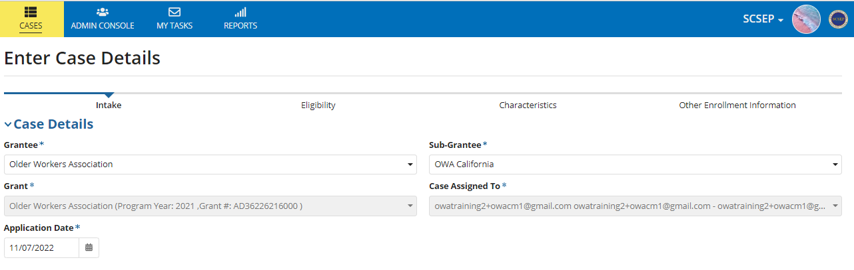
Intake – case details
1
2
3
4
5
Notes:
Case Details will display in expanded format
Select the Grantee from the dropdown menu
Select the Sub-Grantee from dropdown menus
The Grant information auto populates based on the Grantee information
The Case Manager information auto populates based on login information, if you are a Supervisor, GA or Sub-GA, you will need to select who the case is assigned to
Enter the Application Date

Slide 11
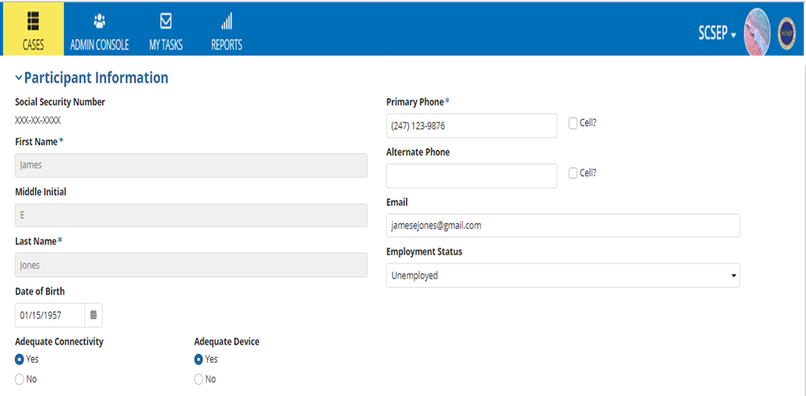
Intake - participant information
6
11
7
12
13
14
8
9
10
Notes:
Participant Information
The SSN is masked and will not be visible in GPMS
Name information has been prepopulated by the system
Date of Birth has been pre-populated but can be edited if necessary
Adequate Connectivity select Yes or No if the applicant has adequate internet connectivity
Adequate Device select Yes or No if the applicant has an adequate device, like a smartphone, tablet or a computer
Enter Primary Phone number if applicable and indicate if it is a cell phone number
Enter Alternate Phone number if applicable and indicate if it is a cell phone number
Enter Email information
Select the applicant’s Employment Status from the dropdown menu
Select the next section Mailing Information

Slide 12
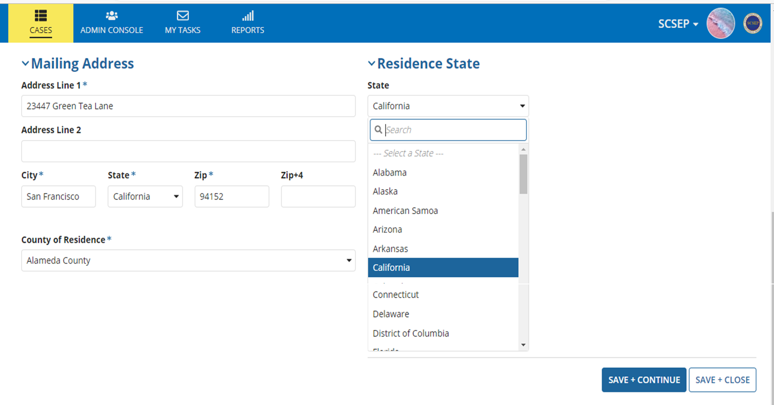
Intake - mailing address
15
21
16
17
18
19
20
Notes:
Mailing Address
Enter the applicant’s Address Line 1of residence
Enter the applicant’s, secondary address information in Address Line 2 if applicable (i.e. apartment or unit number)
Enter the applicant’s City of residence
Select the applicant's State of residence from the drop-down menu, the County of Residence field will now open for selection
Enter the applicant’s Zip code and Zip+4 if known
Select the applicant’s County of Residence from the drop-down menu
Select the applicant’s Residence State from the drop-down menu

Slide 13
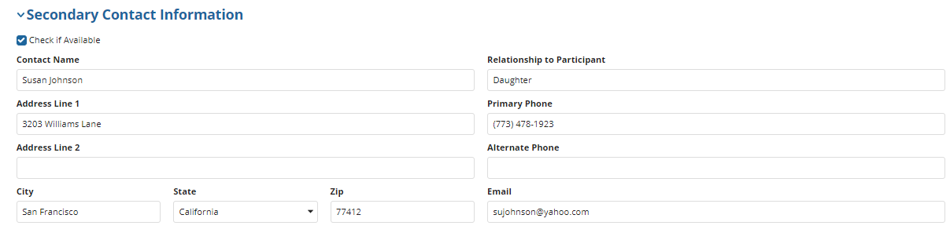
Intake – secondary contact information
22
29
23
24
30
25
16
27
28
31
Notes:
Secondary Contact Information maybe used for emergency contact information – New
Click Check if Available if the information is provided
Enter the secondary’s Contact Name
Enter the secondary’s Address Line 1 of residence
Enter the secondary’s, apartment or unit number if applicable in Address Line 2
Enter the secondary’s City of residence
Select the secondary’s State of residence from the drop-down menu
Enter the secondary’s Zip code
Enter the Relationship to Participant
Enter the secondary’s Primary Phone Number and Alternate Number if known
Enter the secondary’s Email address if known

Slide 14
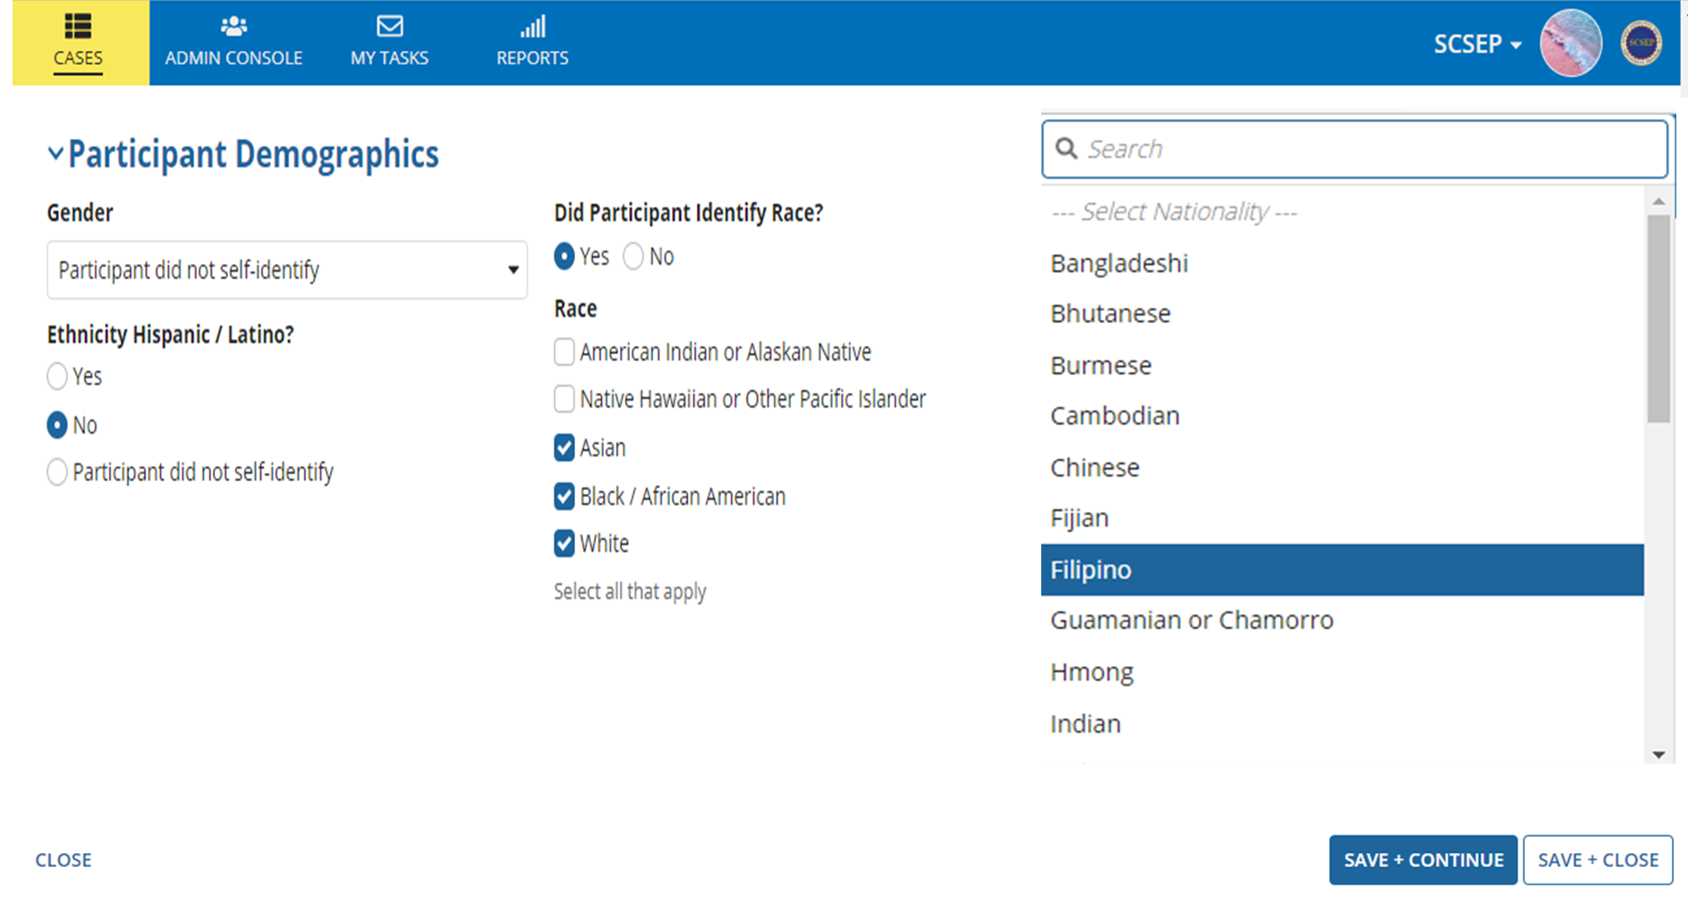
Intake – participant demographics
36
32
34
33
35
37
38
Notes:
Participant Demographics
Select Gender from the dropdown menu
Select Yes or No for Ethnicity Hispanic/Latino
Select Yes or No did Participant Identify Race
If Yes is selected for Race, Select All that Apply
Certain selected races, will generate a Nationality dropdown menu, select one
Select Close to exit without saving any changes
Select Save+Continue to enter Confirm Case Creation or Save +Close to exit

Slide 15
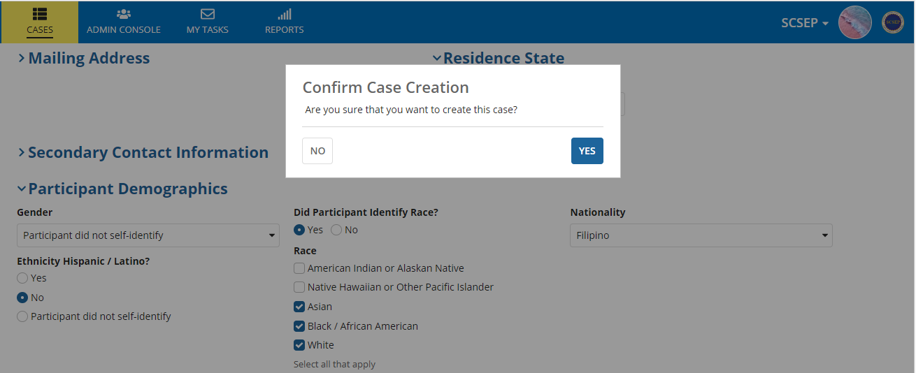
CREATE NEW CASE - confirmation
1
2
Notes:
Confirm Case Creation
Select No to return and revise case details
Select Yes to create the Case and begin the Eligibility Process –
GPMS will navigate to the Eligibility screen, you may also exit to check the current case status
Note: Until you confirm the Case for creation, it will not exist in the system. If you don’t confirm, you’ll have to reenter all of the previous information.

Slide 16
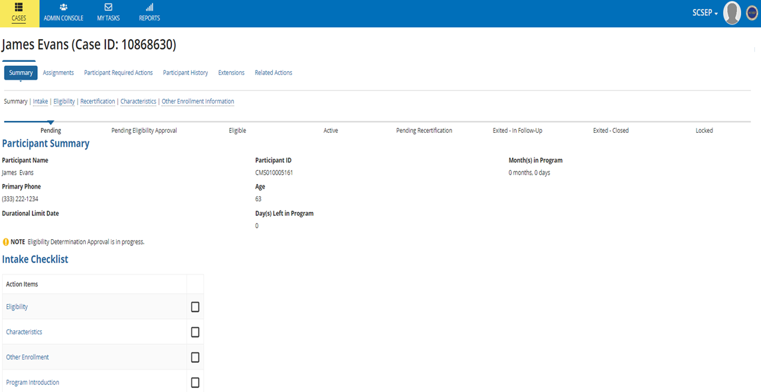
Intake – case details
1
2
3
Notes:
To see the current status and Case Information, select Summary
A Participant Summary has been created
The Participant ID (PID) has been established

Slide 17

Eligibility determination eligible ineligible
Notes:
The Case has now been confirmed in the system. The next step is to enter the applicant’s Eligibility information
Regardless of the initial Eligibility Determination, the Case Supervisor is responsible for making the Final Eligibility Determination in GPMS

Slide 18
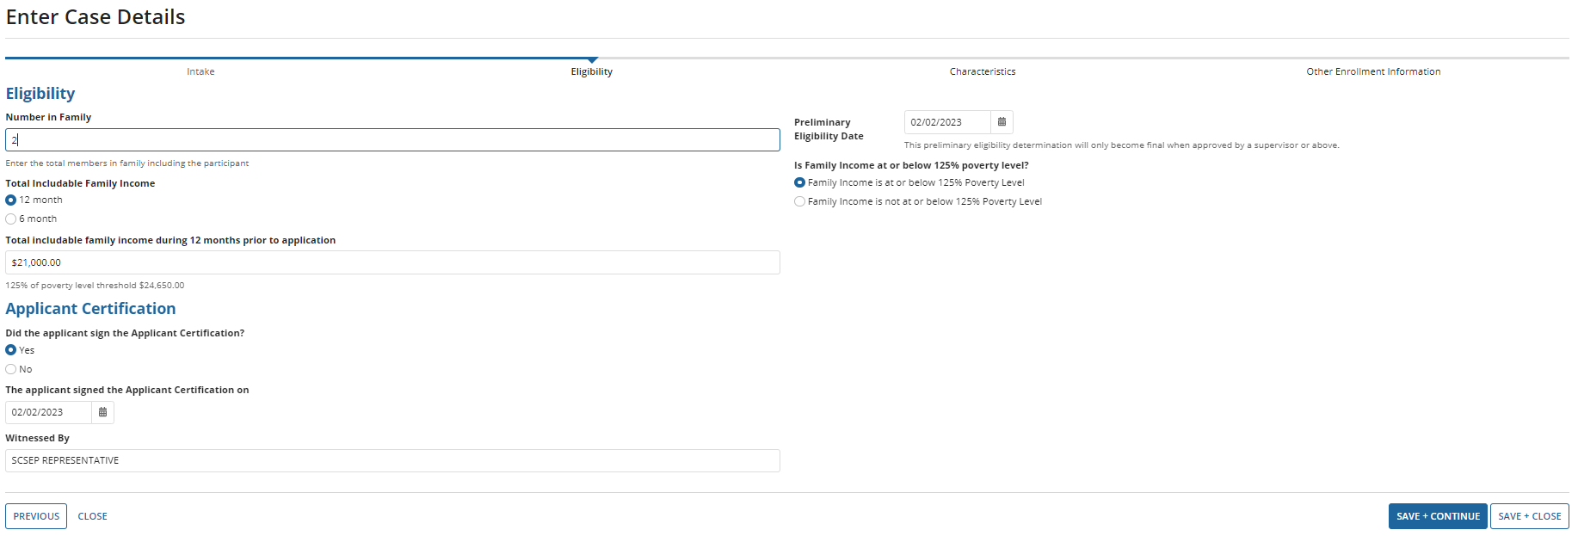
Eligibility - eligible case details
1
2
6
3
4
5
7
8
Notes:
The Case Status is now Eligible as Eligibility screen displays for input
Enter the Number in Family information
Select 12 Month or 6 Month, look back under Total Includable Family Income
Enter the dollar amount Total Includable Family Income During the Months Prior to Application - the system will reflect the selection from above, if you put 6 months or 12 months, it will be indicated here. The system will provide 125% of poverty level threshold based on information entered
Select Yes or No, Did the applicant sign the Applicant Certification
If No is selected, the Save+Continue option will not be visible and you will not be able to continue the process until the certification response is Yes
Select Save+Close to exit
If Yes is selected enter the name of Witnessed By and Date/Timestamp
Enter the Preliminary Eligibility Date (the system will validate Family Income at or below 125% poverty level) in this example it has been verified as yes)
Select Previous or Close to exit without saving
Select Save+Close to exit or Save+Continue to continue the Eligibility process

Slide 19
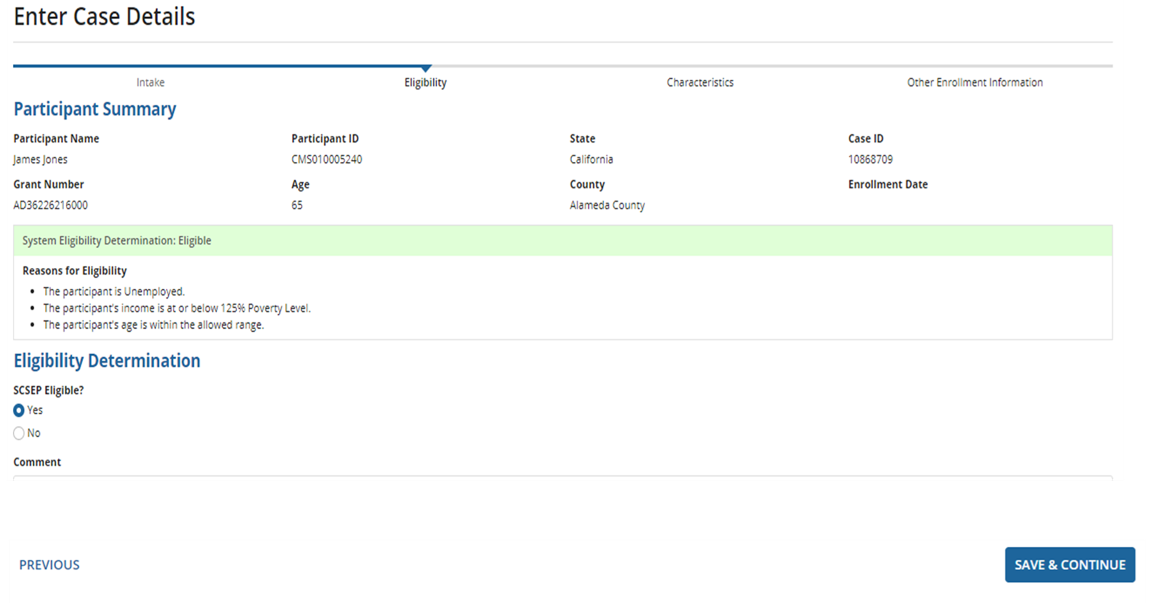
Eligible - system determination
1
2
3
4
5
6
Notes:
Selecting System Eligibility Determination – review Reasons for Eligibility
Participant Summary displays current overview of applicant’s status
Reasons for Eligibility display
Select Yes, SCSEP Eligible under Eligibility Determination if in agreement
Enter any related comments
Select Previous to exit without saving
Click Save+Continue

Slide 20
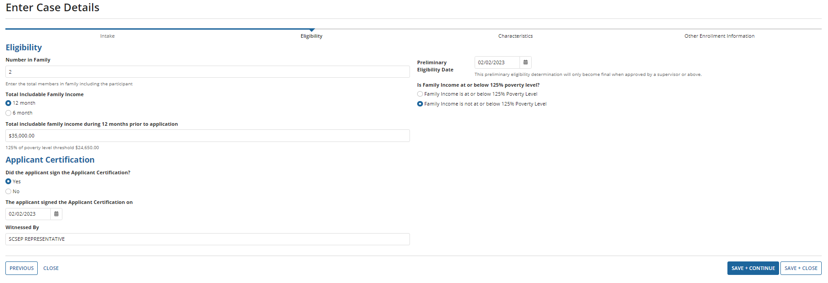
Eligibility - ineligible case details
1
2
6
3
4
5
7
8
Notes:
Ineligible
The Case Status is now Eligible as Eligibility screen displays for input
Enter the Number in Family information
Select 12 Month or 6 Month, look back under Total Includable Family Income
Enter the dollar amount Total Includable Family Income During the Months Prior to Application - the system will reflect the selection from above, if you put 6 months or 12 months, it will be indicated here. The system will provide 125% of poverty level threshold based on information entered
Select Yes or No, Did the applicant sign the Applicant Certification
If No is selected, the Save+Continue option will not be visible and you will not be able to continue the process until the certification response is Yes
Select Save+Close to exit
If Yes is selected enter the name of Witnessed By and Date/Timestamp
Enter the Preliminary Eligibility Date (the system will validate Family Income at or below 125% poverty level) in this example it has been verified as no
Select Previous or Close to exit without saving
Select Save+Close to exit or Save+Continue to continue the Eligibility process

Slide 21
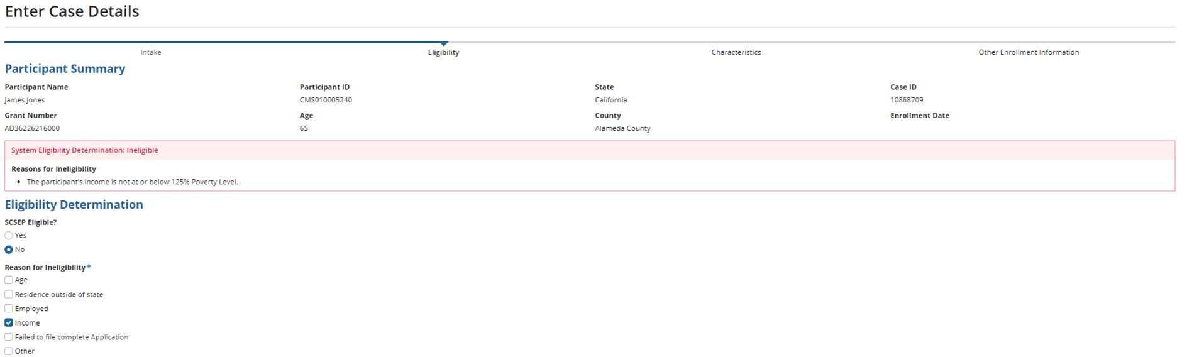
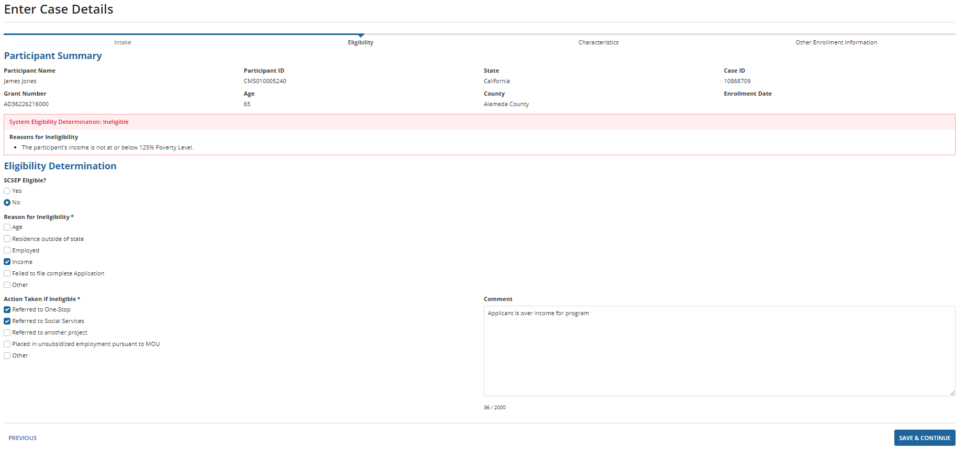
Ineligible – system determination
1
2
3
4
5
6
7
8
Notes:
System Eligibility Determination – review Reasons for In-Eligibility
Participant Summary displays
Reasons for Ineligibility displays
Select No SCSEP Eligible under Eligibility Determination if in agreement
Check Reasons for Ineligibility
Select Action Taken if Ineligible
Enter any related Comments
Select Previous to exit without saving
Select Save & Continue to continue the Eligibility process

Slide 22
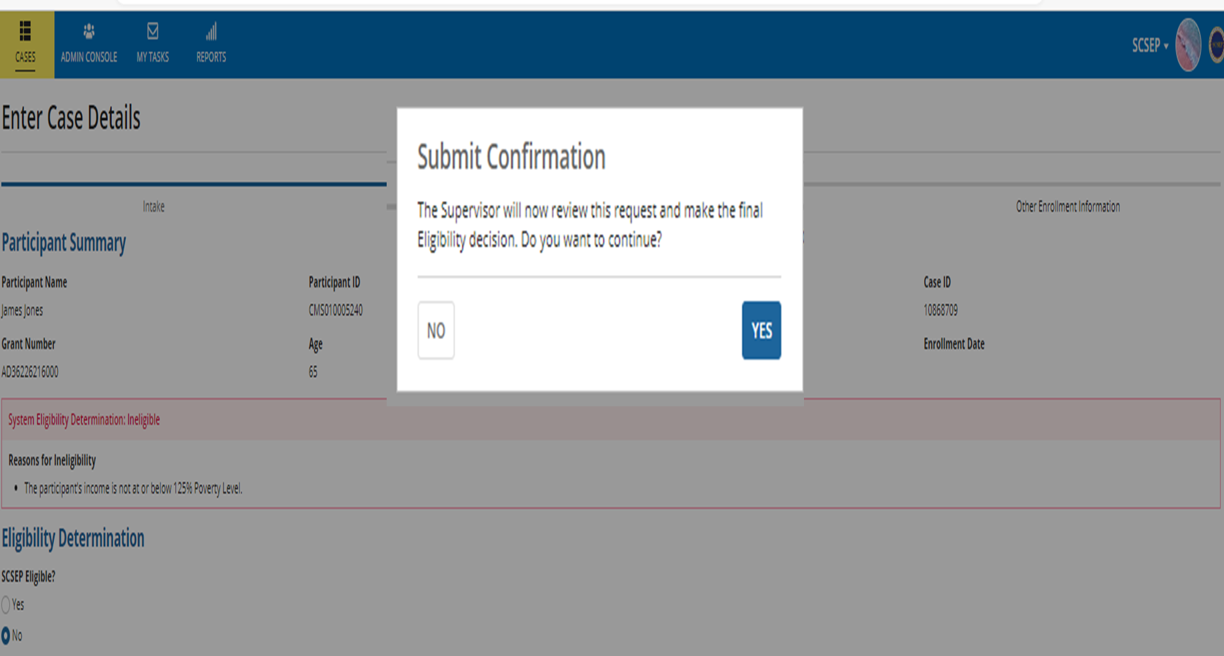
Submit - confirmation
1
2
Notes:
Submit Confirmation– Supervisor Final Eligibility Determination
Submit Confirmation, click No to return to the Case Details to make any changes
Submit Confirmation, click Yes to Submit the request, and generated a task for the Case Supervisor for review and final Eligibility Determination
This generates a task for the Case Supervisor to review and approve all Cases (Eligible and Ineligible)
If the case has initially been deemed Ineligible, no additional information is entered at this time
If the case has initially been deemed Eligible Characteristics and Other Enrollment Information should be completed, while waiting for Final Eligibility Determination
If you are logged in as a Case Supervisor or above, this step will be skipped and you will navigate directly to Approver the Eligibility Determination

Slide 23
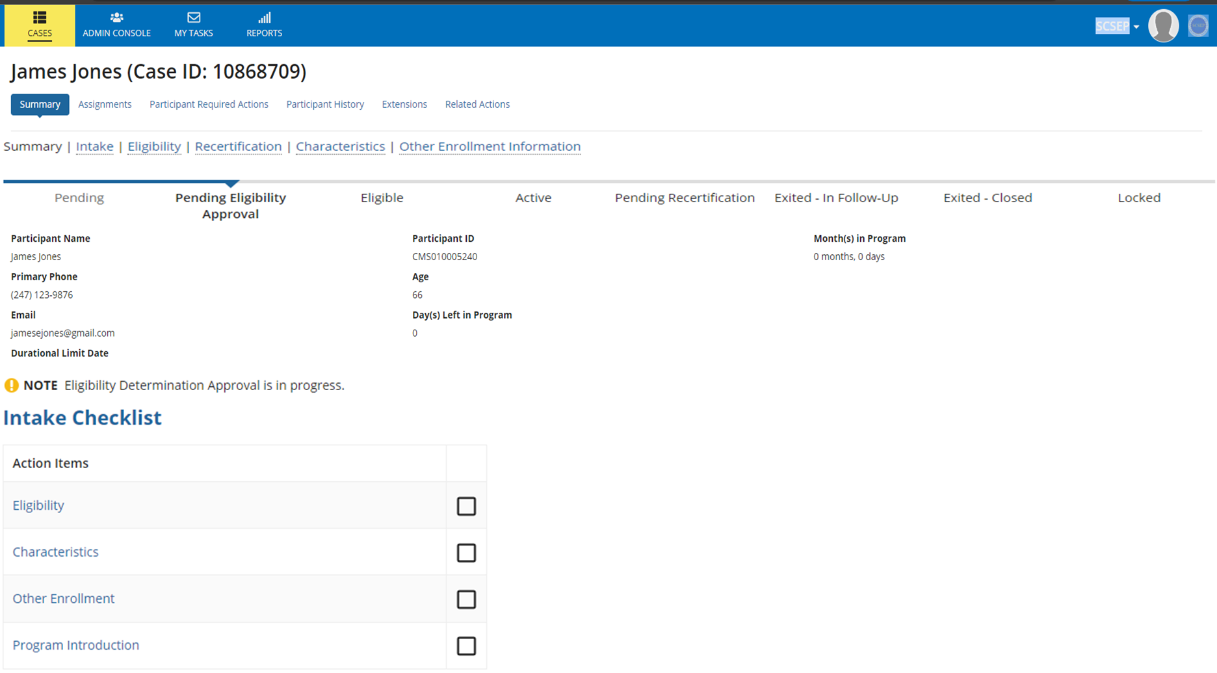

Case SUPERVISOR ELIGIBILITY approval status eligible
1
2
3
Notes:
The Participant Summary screen has been updated, the case status is now Pending Eligibility Approval, IDL and Contact information is visible
The case status is now Note Eligibility Determination Approval is In Progress
The Intake Checklist shows Action Items that need to be completed, Characteristics, Other Enrollment

Slide 24
characteristics
Notes:
While the Case Supervisor is reviewing the eligibility details Characteristics for the applicant may be entered. It is strongly recommended that this process be completed during this time.
Characteristics consist of 4 areas that may be expanded or collapsed

Slide 25
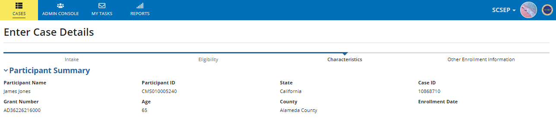
Characteristics – participant summary
1
2
4
6
8
3
5
7
9
Notes:
Participant Summary provides an overview of the participant
The Participant Summary has been auto-populated with the applicant’s name, grant information, age and mailing information
A unique Participant ID has been created
The next Characteristics section is Priority of Service scroll down to enter information

Slide 26
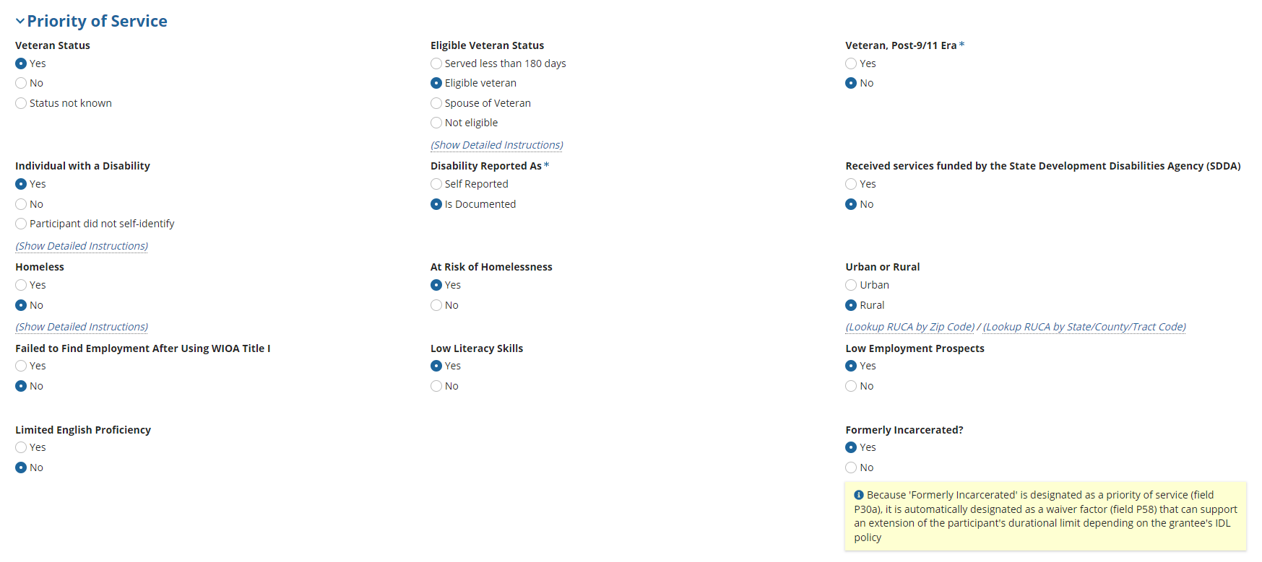
CHARACTERISTICS – priority of service
1
3
2
2a
4
Notes:
Priority of Service
Recommend starting with the 2ND column Eligible Veteran Status as it will validate column 1 and 3
Select Yes or No for Veteran, Post 911 Era
Select yes or no for Low Literacy Skills if yes is selected, Limited English Skills must be no
Selecting yes for Limited English Proficiency (LEP), will open an additional Required Field * for Primary Language selection from the drop-down menu
To validate Urban or Rural field, (Rural Urban Commuting Area) select Lookup RUCA by Zip Code/Lookup RUCA by State/County Code
If you need to determine if a county is Rural or Urban, select lookup by ZC. If you need to know your state or county code, use the RUCA State County Tract
Since Formerly Incarcerated is Yes, as a Priority of Service, it is automatically designated as a waiver factor field if your organization depending on the Grantees IDL Policy. This field auto updates in Waiver Factors.
Strongly recommended completion of all fields at this time, you will not be able to assign the Case until all Characteristic fields have been completed
The next Characteristics tab is Most in Need Waiver Factors select the arrow to open it

Slide 27
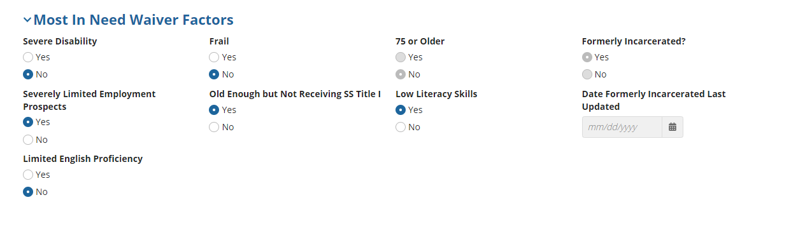
CHARACTERISTICS – most in need waiver factors
1
Notes:
Most in Need Waiver Factors
Complete all applicable fields;
The next Characteristics tab is Other Characteristics select the arrow to open it

Slide 28
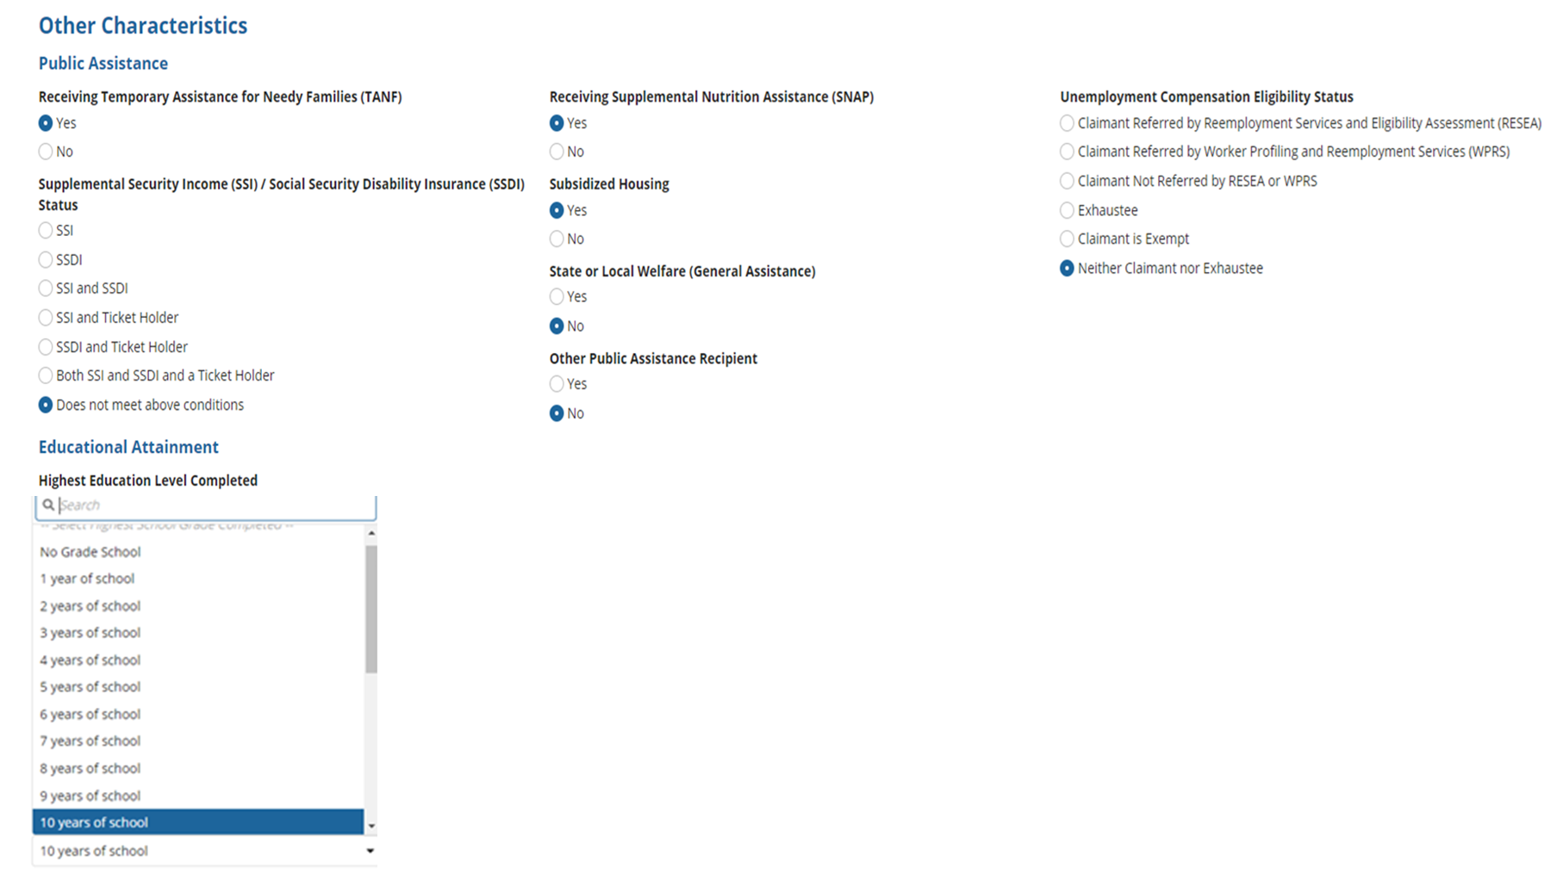
CHARACTERISTICS – other characteristics
1
4
2
4
3
Notes:
Other Characteristics
Select Yes or No for fields regarding Public Assistance TANF, SNAP, Subsidized Housing, General Assistance, Other Public Assistance Recipient
Select the corresponding answer for Supplemental Security Income (SSI)/Social Security Disability Insurance (SSDI) Status
From the dropdown menu, select the Highest Education Level Completed*
Select corresponding answer for Unemployment Compensation Eligibility Status
Strongly recommended completion of all fields at this time as they will be required prior to assigning the case
The next Characteristics tab is Other Barriers to Employment the arrow to open it

Slide 29
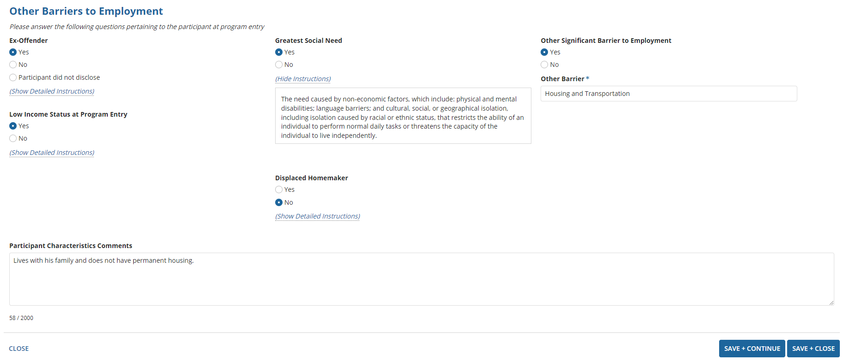
CHARACTERISTICS – other barriers to employment
1
3
2
4
5
6
Notes:
Other Barriers to Employment
Complete fields relating to Ex-Offender, Low Income Status at Program Entry, Greatest Social Need, Displaced Homemaker
Click Show Instructions for detailed information on field input)
Selecting Yes to Other Significant Barriers to Employment will open an additional required field for completion
Input any associated Characteristics Comments
Select Previous or Close to exit without saving
Select Save+Close when completed to enter Other Enrollment Information

Slide 30
Other Enrollment information
Notes:
Other Enrollment Information is documented for programs the applicant may be Co-enrolled in should also be completed while the Case Supervisor is reviewing the eligibility details.

Slide 31
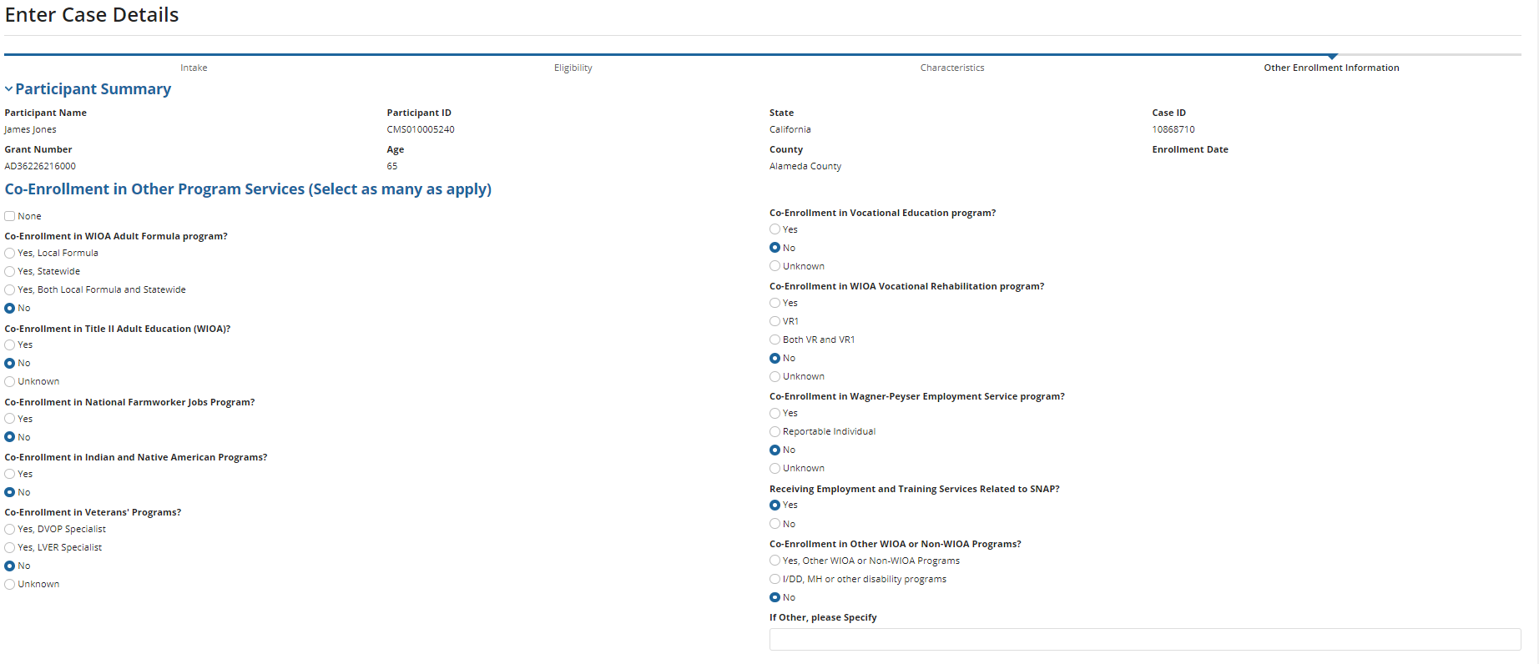
other enrollment information – CO-ENROLLMENT
1
2
3
Notes:
Other Enrolment Information
The case status is now Other Enrollment Information
Select as many Co-Enrollment Services that apply
Select None, to default all fields to No
Participant Job Code is the next section for completion

Slide 32
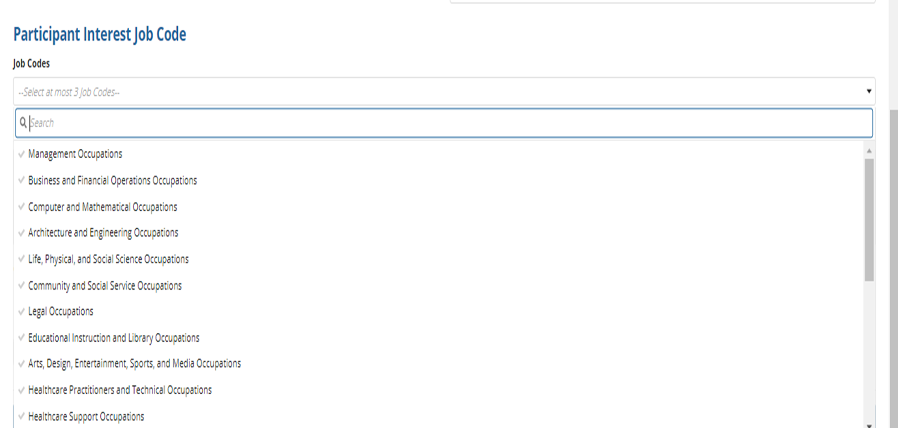
other enrollment INFORMATION – PARTICIPANT JOB CODES
1
2
Notes:
Participant Interest Job Code
Job Codes are not required, but it is strongly recommended that they be completed
Select up to 3 applicable Job Codes
Can be useful when looking at CSA assignments
Program Introduction is the next section for completion

Slide 33
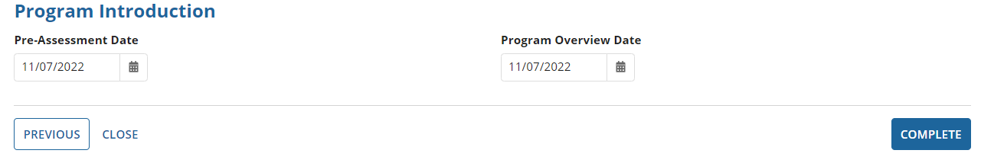
other enrollment information - PROGRAM INTRODUCTION
1
2
3
4
5
Notes:
Program Introduction – both the Pre-Assessment and Overview must occur after the Application Date and can’t be in the future
Use the calendar icon or enter the Pre-Assessment Date that was provided to the applicant
Use the calendar icon or enter the Program Over Date that was provided to the applicant
Select Previous or Close to exit without saving
Select Complete when done and to return to the SCSEP Summary Page

Slide 34
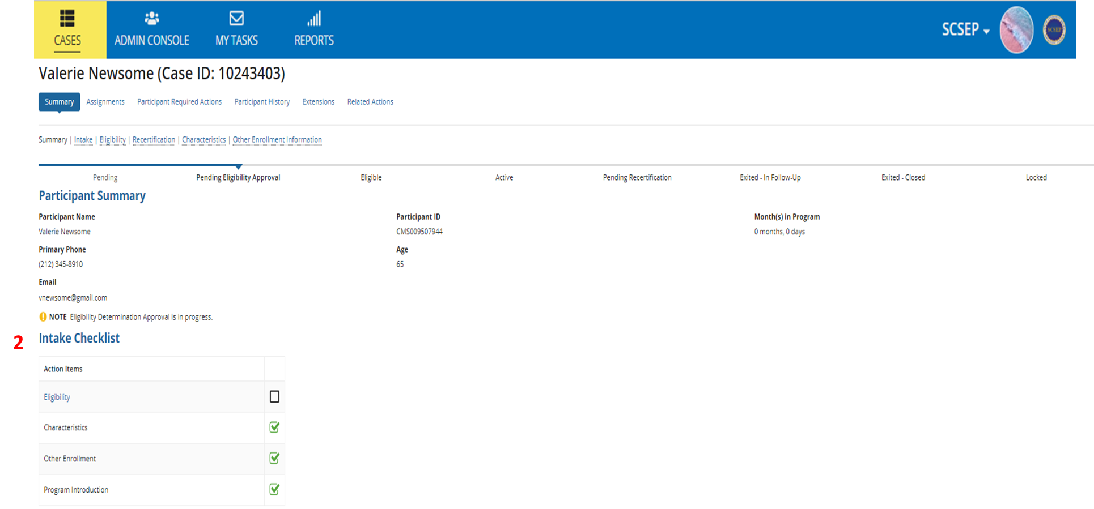
Participant summary
1
2
Notes:
Participant Summary displays and the current status is Pending Eligibility Approval
The Intake Checklist has now been updated and Characteristic, Other Enrollment Information and Program Introduction task are now marked as complete
No other task can be completed until the Final Eligibility Determination by the Case Supervisor has been completed

Slide 35
Case supervisor eligibility determination
Notes:
When a Case is Submitted for Eligibility Determination. a task is created in My Tasks for review and approval by the Case Supervisor

Slide 36
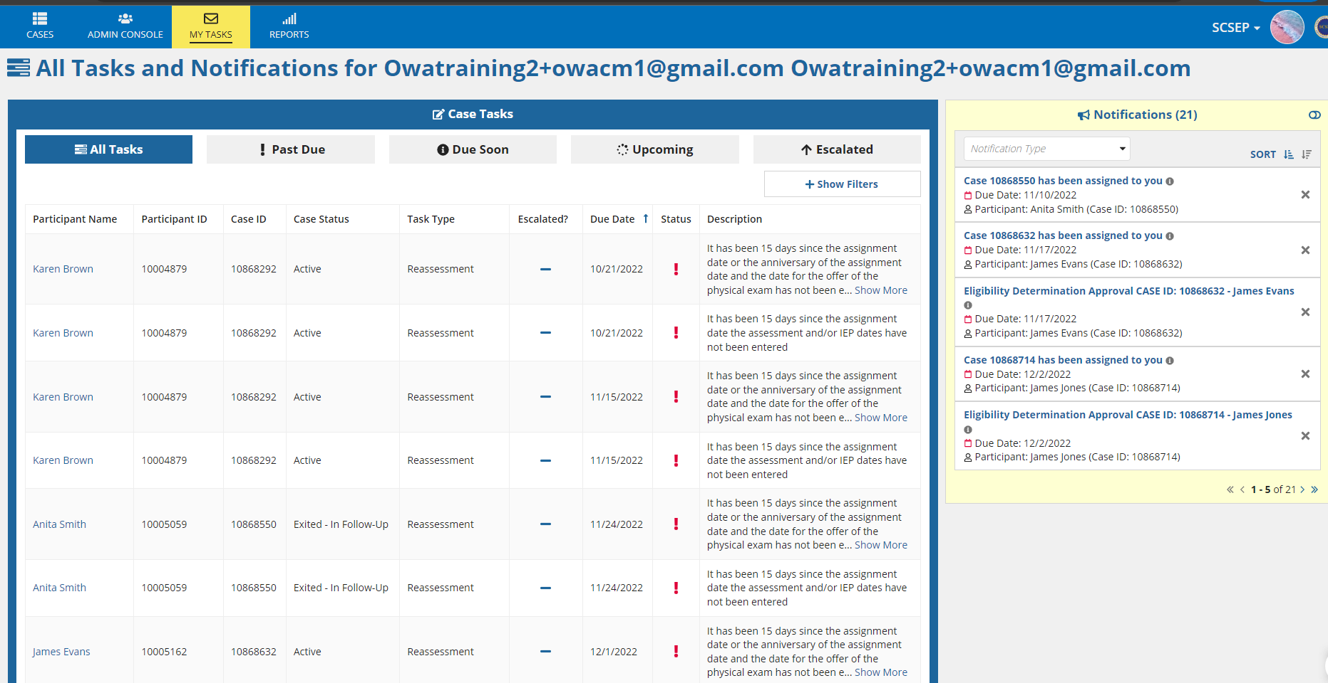
Case SUPERVISOR ELIGIBILITY determination – my tasks
1
2
Notes:
The Case Supervisor selects My Tasks from the Navigation bar to see tasks that need to be completed
Notifications will also display what type of task have been assigned, click the toggle button to expand the section
Selecting either will take you to the related participant’s summary page

Slide 37
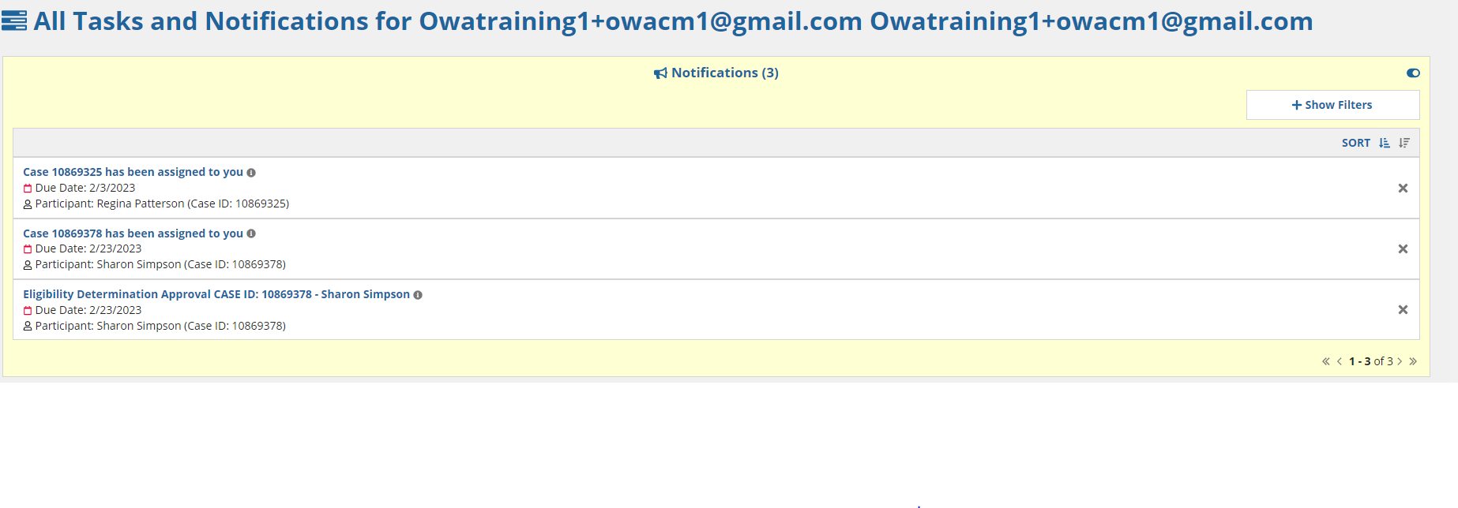
Case SUPERVISOR ELIGIBILITY determination – notifications
1
Notes:
Notifications display, in hyperlinks to open the particular task

Slide 38
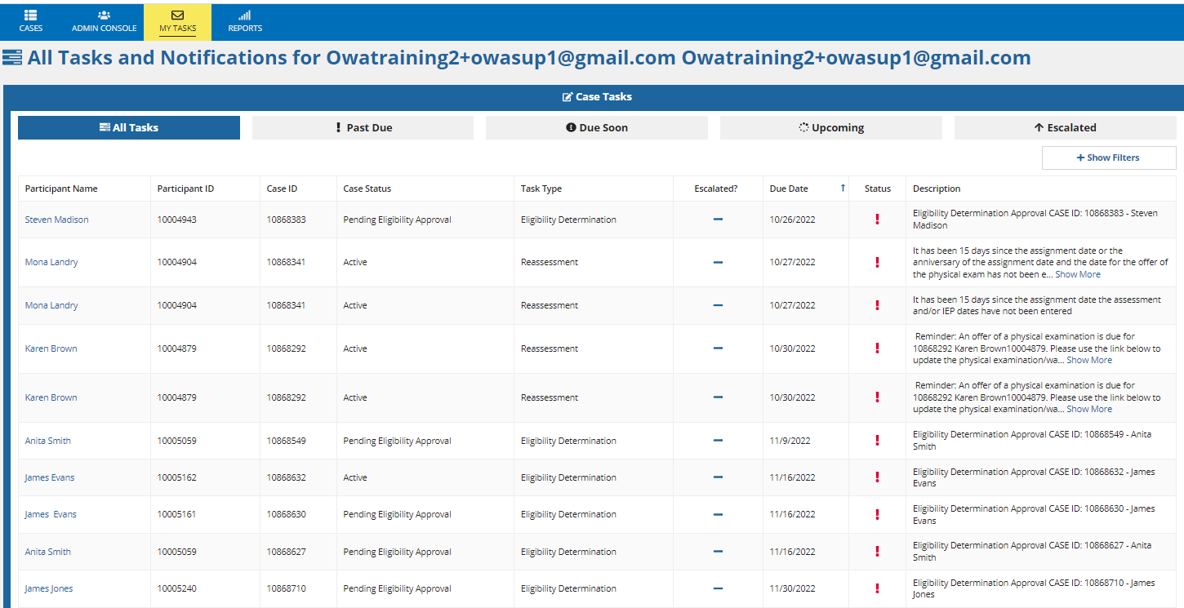
Case SUPERVISOR ELIGIBILITY determination - show filters
1
2
Notes:
Final Eligibility Determination
A Task has been generated for the Case Supervisor for Eligibility Determination
To narrow search options, select Show Filters

Slide 39
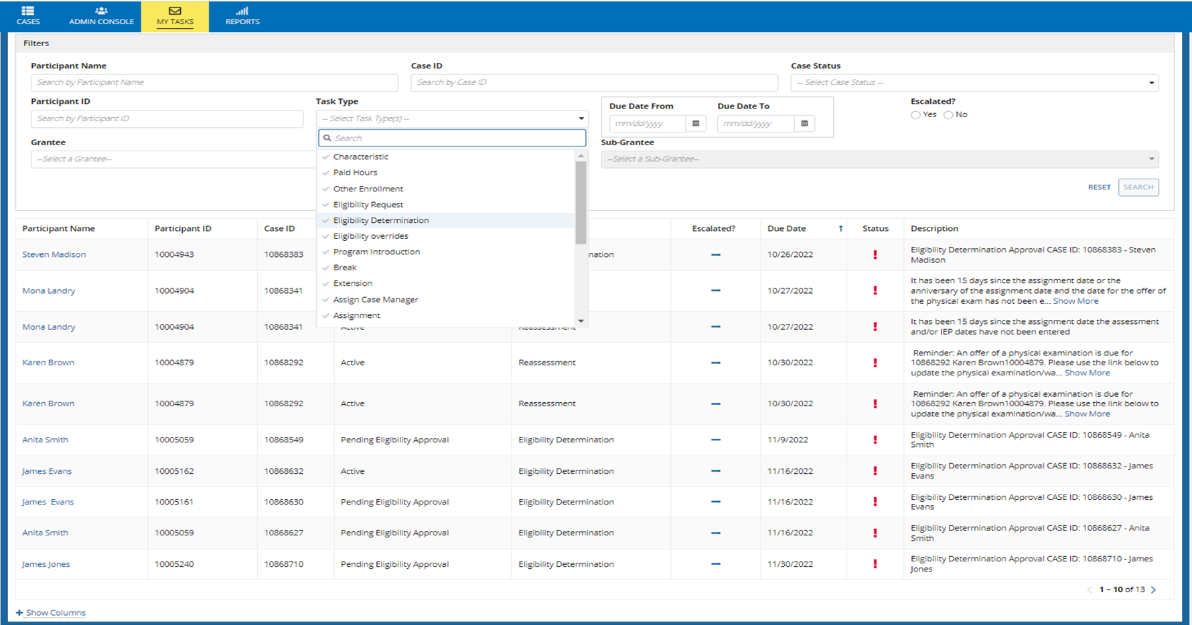
Case SUPERVISOR ELIGIBILITY determination – search results
1
2
3
4
Notes:
Searches can be conducted by Participant’s Name and entering Search
Enter the Participant ID and select Search
Select the Grantee from the drop-down menu
Select a Task Type from the drop-down menu and select Search, for this example, Eligibility Determination is selected
Additional filters may also be used (i.e. Grantee Name, Case ID, Case Status, Due Dates etc.)

Slide 40
Case SUPERVISOR ELIGIBILITY determination
1
2
Notes:
The Participant’s case is now visible
Select the blue name link to begin the Eligibility Determination review and approval process

Slide 41
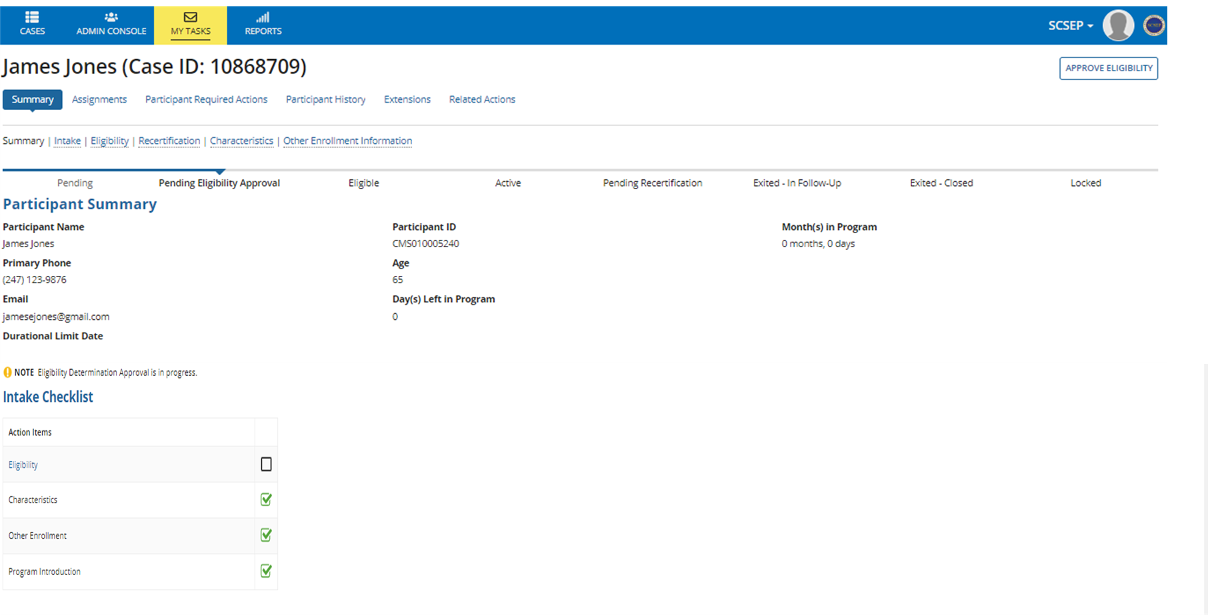
Case SUPERVISOR ELIGIBILITY determination - approve eligibility
4
1
2
3
Notes:
Case Summary displays the Current Case Status as Pending Eligibility Approval
Note Eligibility Determination Approval is in Progress
The Intake Checklist shows completed tabs with green check marks and incomplete as blank
Case Supervisor selects Approve Eligibility to begin the review and approval process

Slide 42
Eligible case

Slide 43
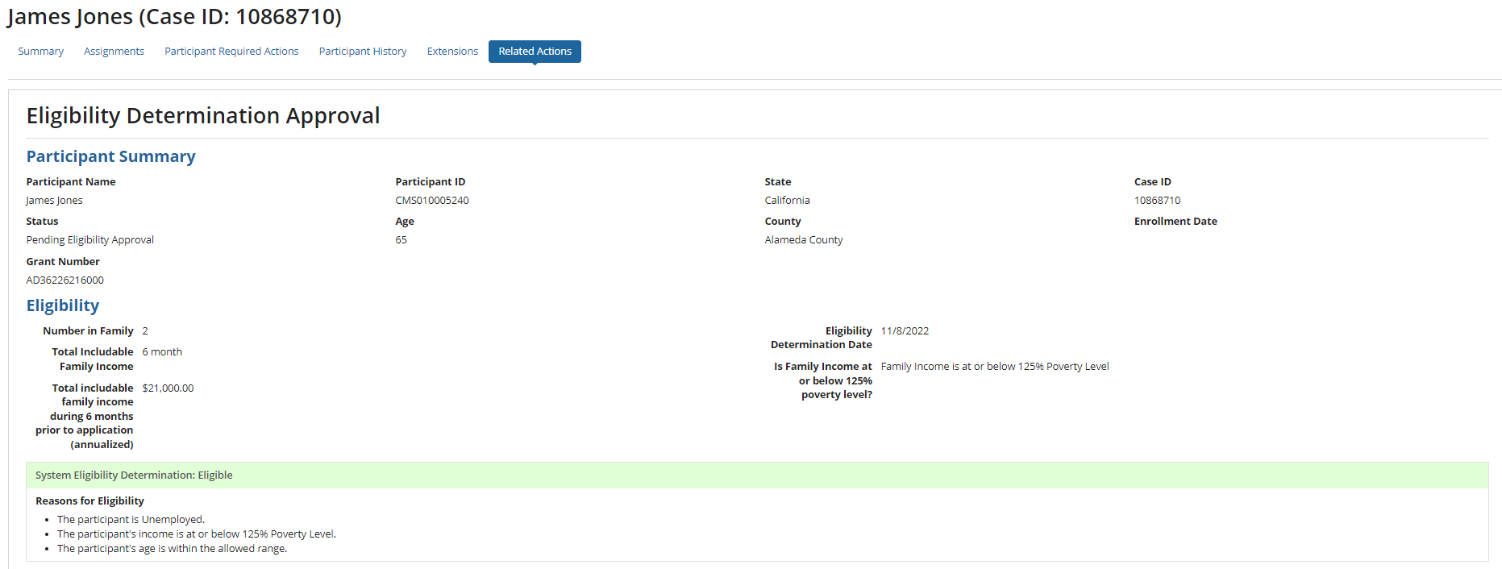
Case SUPERVISOR ELIGIBILITY determination - eligible
1
2
3
4
Notes:
Eligible Case
The Eligibility Determination Approval screen displays and provides the Participant’s Summary
Case Supervisor reviews the Participant Summary for accuracy
Eligibility information displays
System Eligibility Determination of Eligible and Reasons for Eligibility display for review

Slide 44
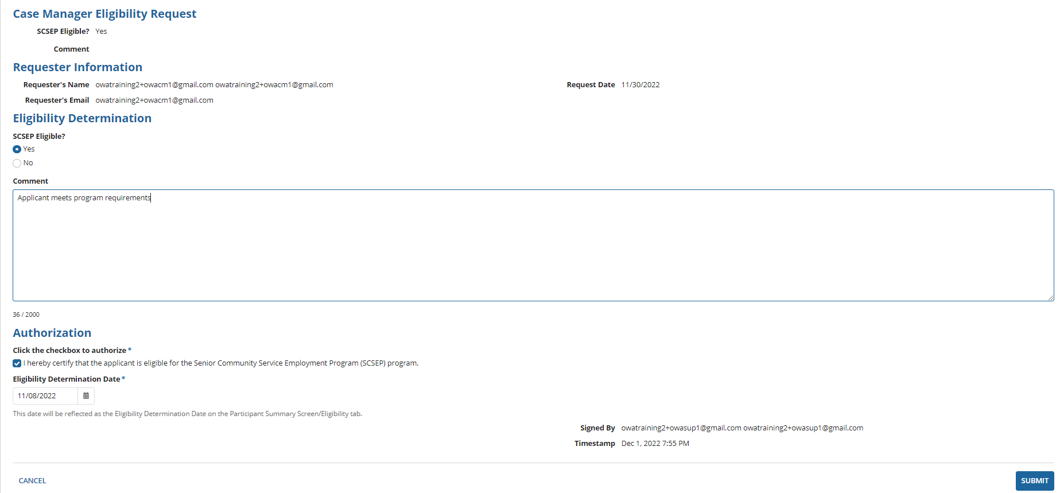
Case SUPERVISOR ELIGIBILITY determination - authorization
5
6
7
8
9
10
11
12
Notes:
Case Manager Eligibility Request displays
Case Supervisor reviews the Eligibility Determination
Case Supervisor adds any associated Comments
Case Supervisor clicks the Authorization checkbox to authorize the case as eligible
The Eligibility Determination Date auto populates and will be displayed on the Participant’s Summary as the Eligibility Determination Date
The Signed By and Timestamp are auto generated based on login information
Case Supervisor selects Cancel to exit without saving changes
Case Supervisor selects Submit to approve the case and return to the Participant Summary Screen

Slide 45
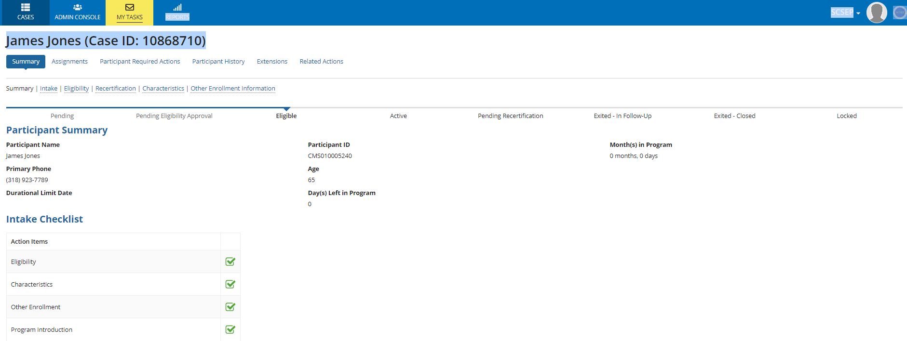
Case SUPERVISOR ELIGIBILITY approval status eligible
1
2
3
Notes:
The Participant Summary screen has been updated with IDL and contact information
The case status is now Eligible
The Intake Checklist shows all tasks have been completed
The next step in the process is to assign the Eligible Participant Case to a Community Service Assignment

Slide 46
ineligible case

Slide 47
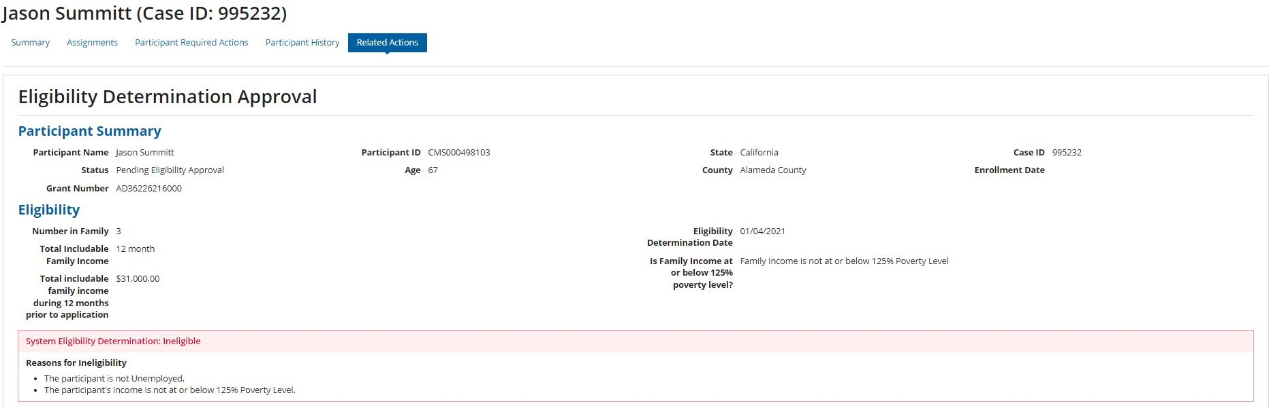
Case SUPERVISOR ELIGIBILITY determination - ineligible
1
2
3
Notes:
Cases that are deemed Ineligible, follow the same process for review and approval as an Eligible case
The Eligibility Determination Approval screen displays
Case Supervisor reviews the Participant Summary for accuracy
Case Supervisor reviews the Eligibility information for accuracy, the System Eligibility Determination is Ineligible

Slide 48
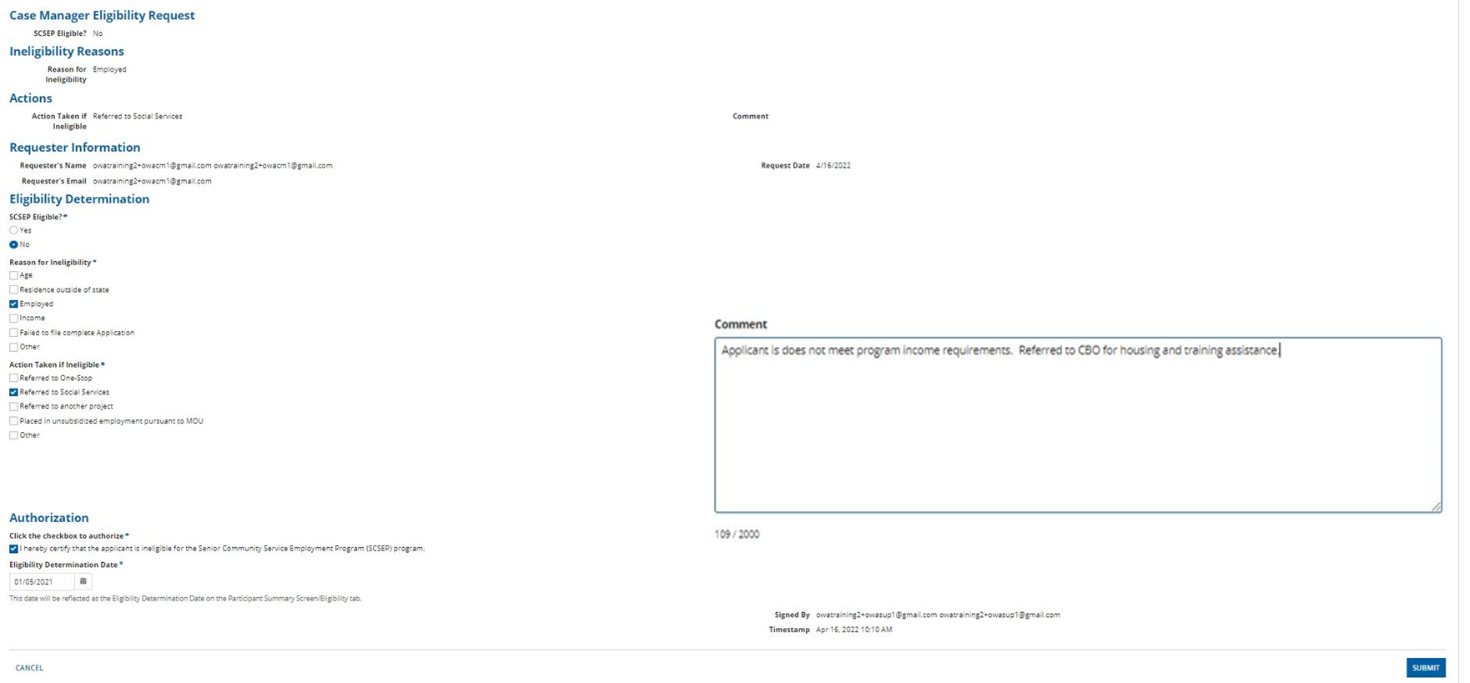
Case SUPERVISOR ELIGIBILITY determination reasons for ineligibility
4
5
6
7
9
8
10
11
12
13
Notes:
Case Manager Eligibility Request displays
Case Supervisor reviews the Ineligibility Reasons
Case Supervisor reviews the Eligibility Determination
Case Supervisor reviews Reasons for Ineligibility
Case Supervisor reviews Actions Taken if Ineligible
Case Supervisor reviews or may add any associated Comments
Case Supervisor clicks the Authorization
Case Supervisor enters the Eligibility Determination Date
Case Supervisor selects Cancel to exit without saving
Case Supervisor selects Submit to complete the eligibility process

Slide 49
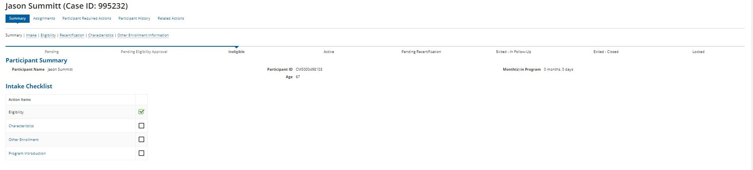
Case SUPERVISOR ELIGIBILITY determination status ineligible
1
2
3
Notes:
Summary Page displays
The Case Status is Ineligible
Intake Checklist shows the completion of Eligibility
No other tasks require completion

Slide 50
Check and Edit eligibility
Notes:
Check Eligibility should be used if there are changes to a Case that affect eligibility, the User would select the specific case from the SCSEP Cases page to display the Summary page

Slide 51
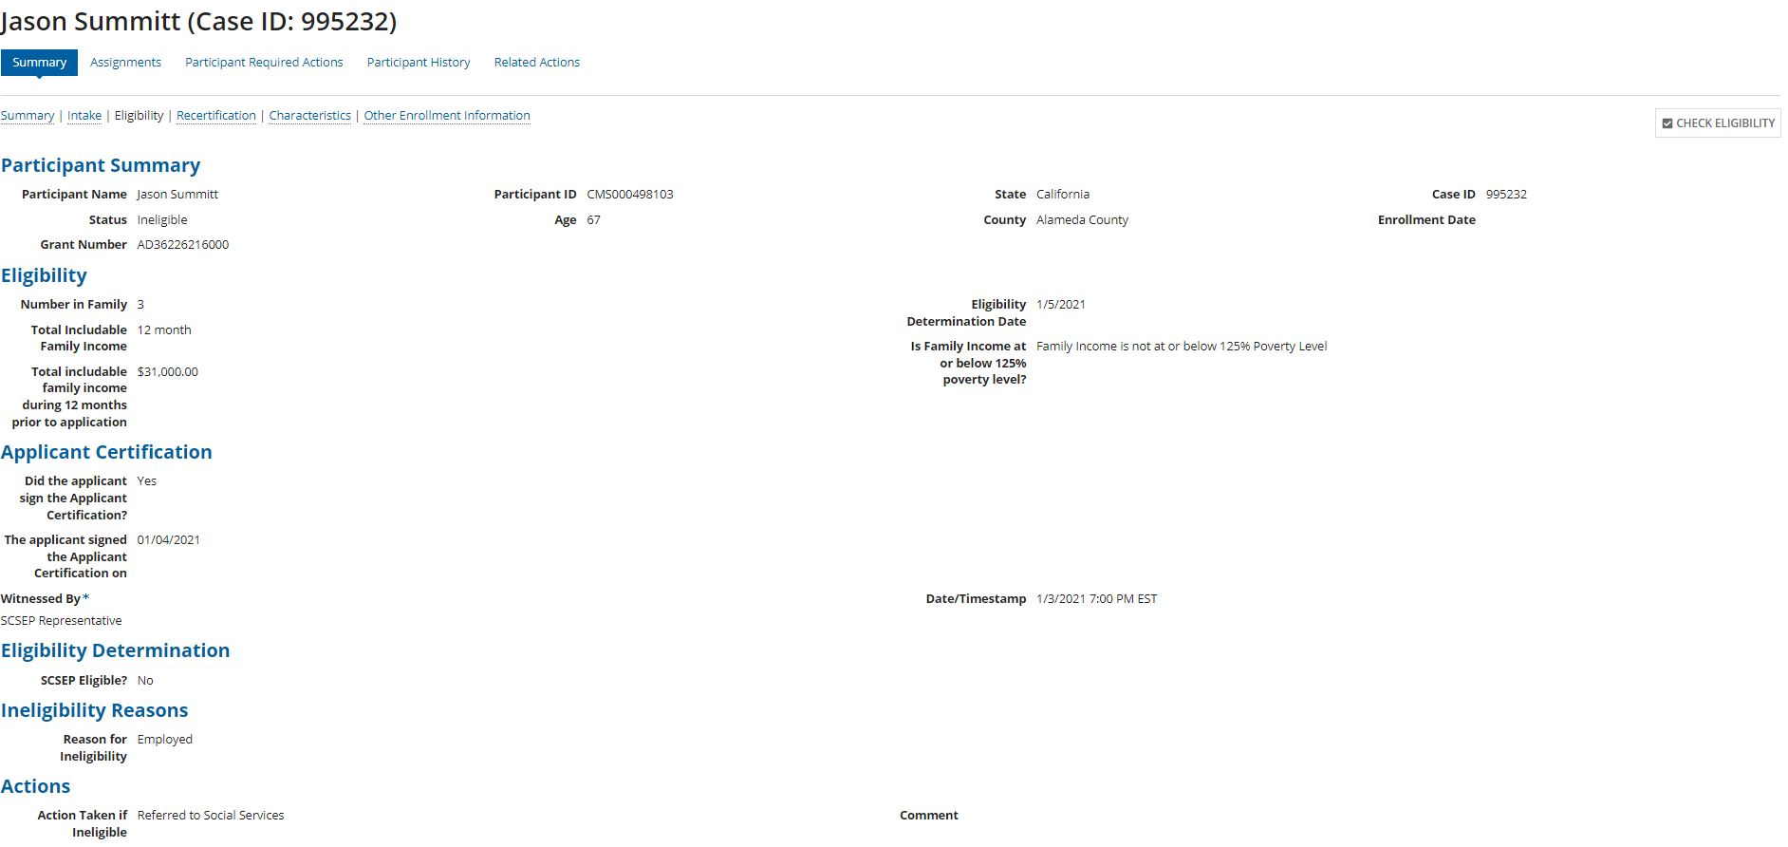
Check eligibility
1
2
Notes:
Check Eligibility
Select Eligibility from the case level tabs
Select the Check Eligibility button to edit the details entered previously

Slide 52
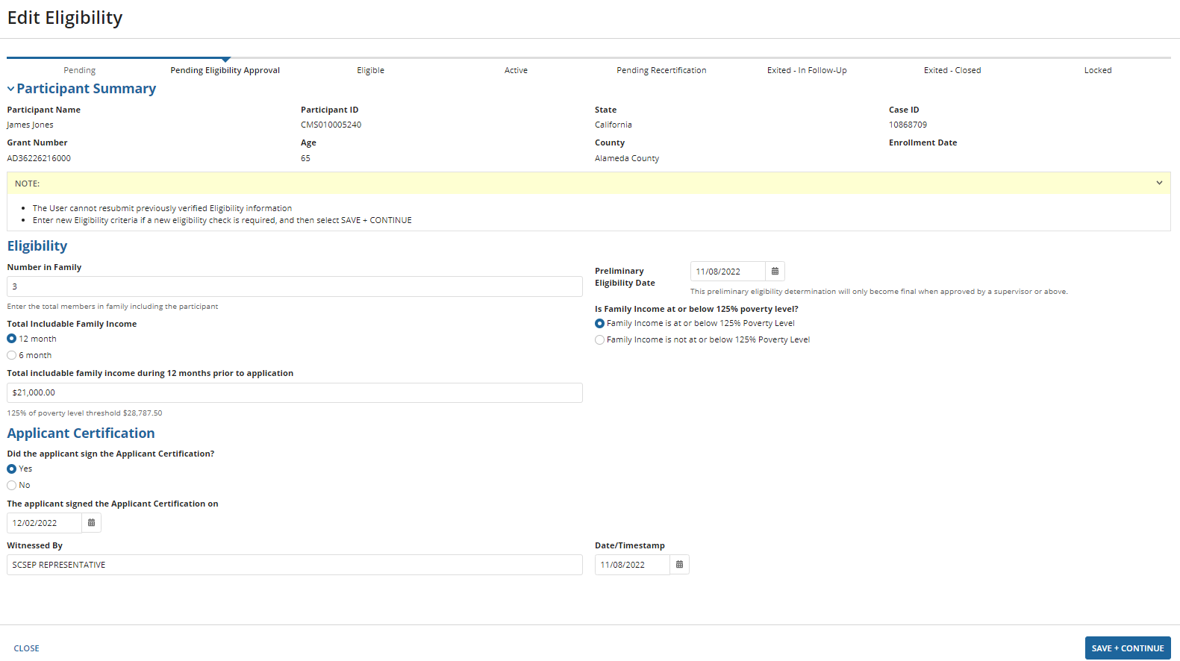
Edit eligibility
1
2
3
Notes:
Edit Eligibility screen displays to review and update as applicable, in this example the family size increased affecting the income threshold
Select Close to exit without changes
Select Save+Continue if changes are made or
If changes were made that affect the eligibility, a new task will be generated to the Case Supervisor for eligibility determination

Slide 53
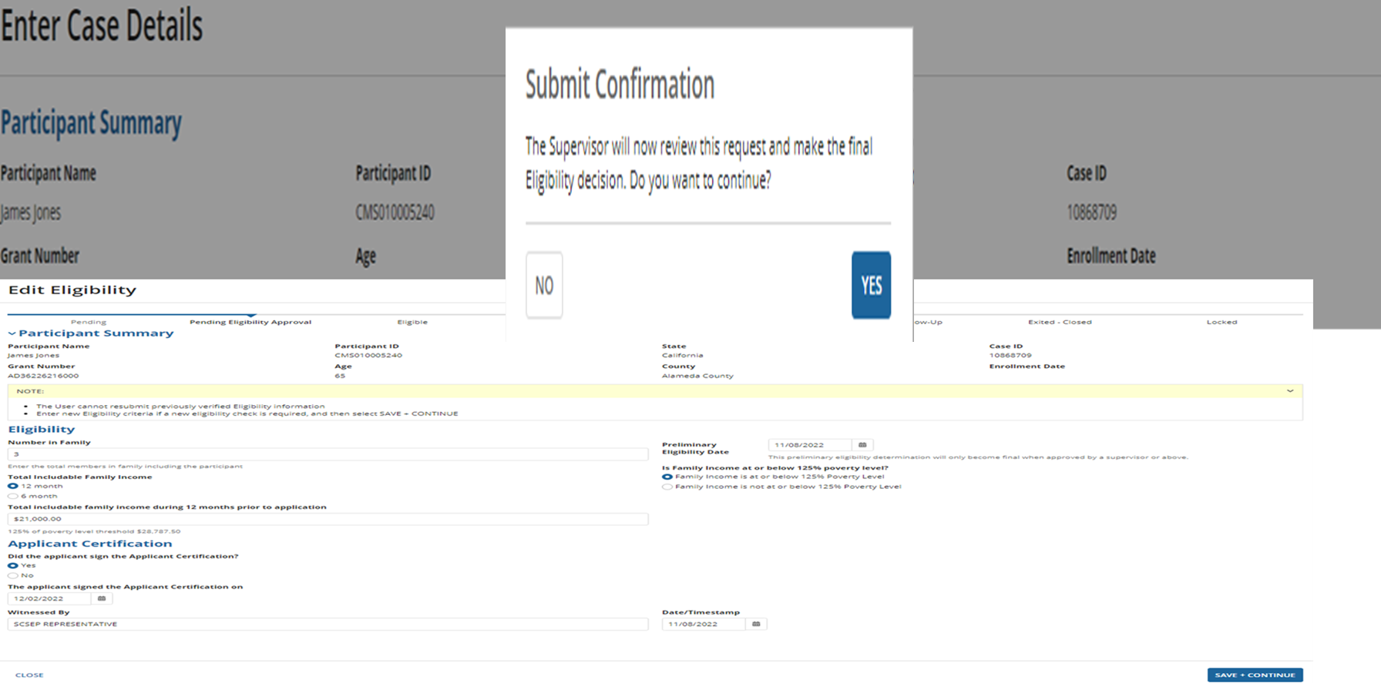
Edit eligibility – supervisor review and approval
1
2
Notes:
Eligibility Submission
Since the family size was changed, a new Final Eligibility Determination task is generated for the Case Supervisor.
Select No to exit without the changes being made or Submitted
Select Yes to Submit and generate a task for the Case Supervisor’s review and approval
The system navigates to the Participant Case Summary Page

Slide 54
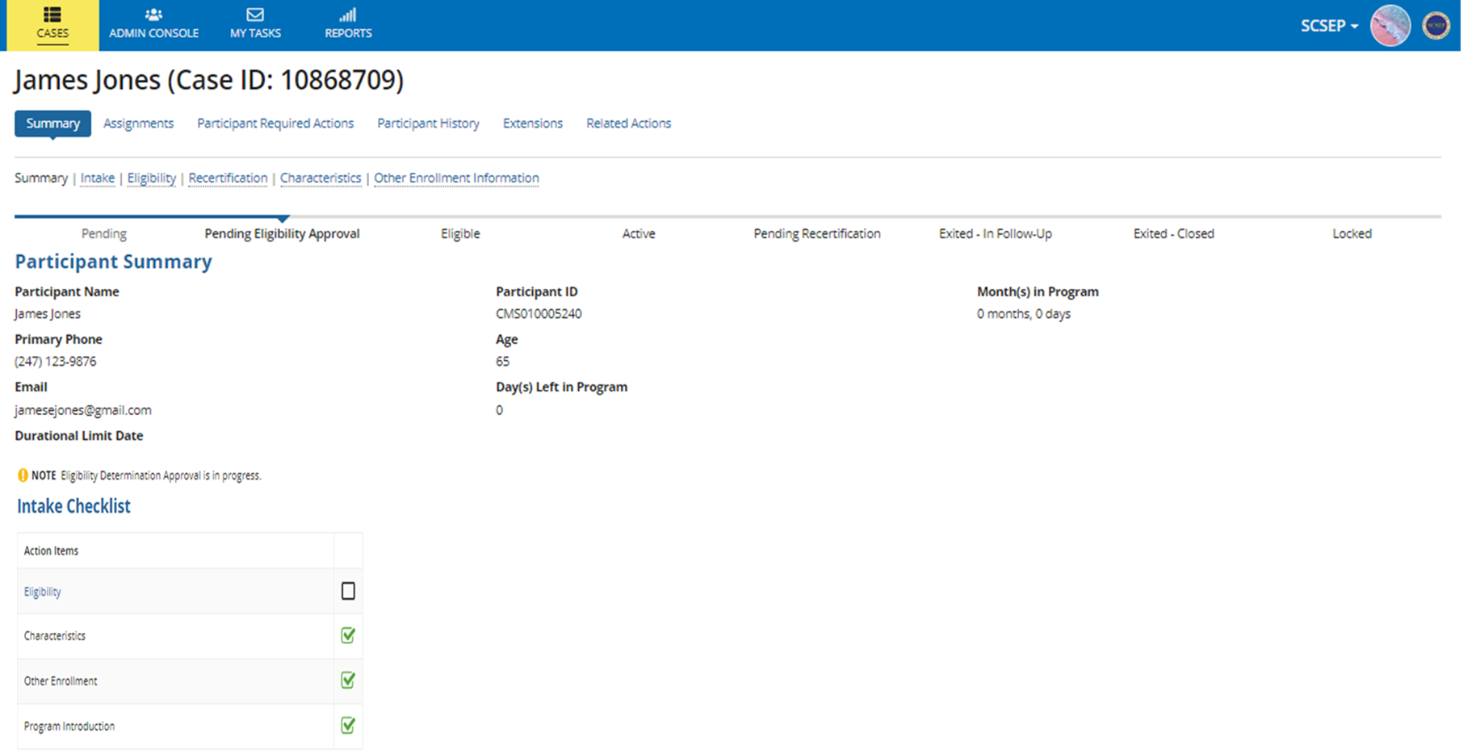
Case status – pending eligibility approval
4
1
2
3
Notes:
Case Summary displays the Current Case Status as Pending Eligibility Approval
Note Eligibility Determination Approval is in Progress
The Intake Checklist will show Eligibility unchecked/incomplete until the Supervisor Final Eligibility Determination process has been completed

Slide 55
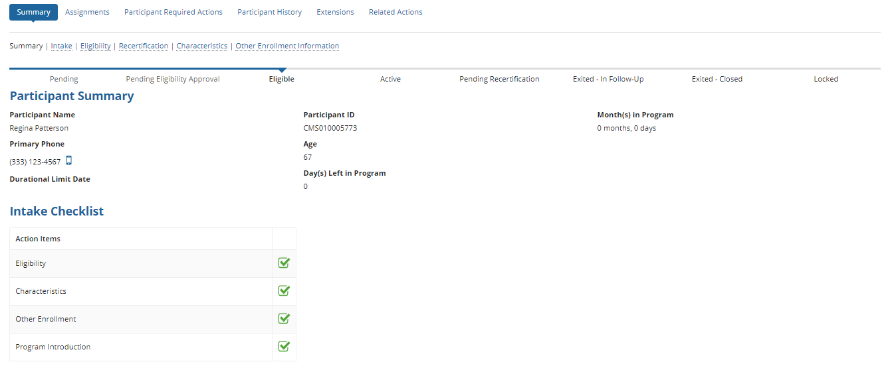
Case status – Eligible
1
2
Notes:
Once the Final Eligibility Determination is completed, the Intake Checklist updates
Eligibility has now been completed and the Participant can now be Assigned to a CSA

Slide 56
Next steps
The Participant Case has been Created and an Eligible or Ineligible Final Determination has been made.
The next steps are to Assign the Participant, Manage the Community Service Assignment (CSA) and other Organizations.
Notes:
Next Steps
The Participant Case has been created and an Eligible or Ineligible final determination has been made.
Ineligible Applicants should be referred to any available resources
For Eligible Participants, the next step is to Assign the Participant and Manage the Community Service Assignment (CSA) and other Organizations

Slide 57


Slide 58

GPMS RESOURCES
  GPMS Training Related Questions send directly to SCSEPTechnicalAssistance@dol.gov
  GPMS System Technical Assistance Related Questions
  scsephelp.zendesk.com
  WKGPS Older Workers Community of Practice, GPMS Resources Tab

