Slide 1
Polling Question: Who’s on the call?
What role do you play in your Strengthening Community Colleges Grant?
Authorized Representative
Program Director/Manager
Training provider
Employer partner
Other type of partner supporting the grant
Case Manager / Career Navigator
Performance / Data Analyst
Federal Project Officer
Choose the best answer that reflects your role in your SCC grant project!

Slide 2
Strengthening Community Colleges Training Grants Third Round (SCC3)
Grantee Orientation

Slide 3

Welcome and Introductions
Let’s get to know one another!
Enter your name, location, organization name, project name, and contact information into the chat.
What is the name of your project?
What is your name?
What is your email?
Where are you
located?
What is your grant project name?

Slide 4
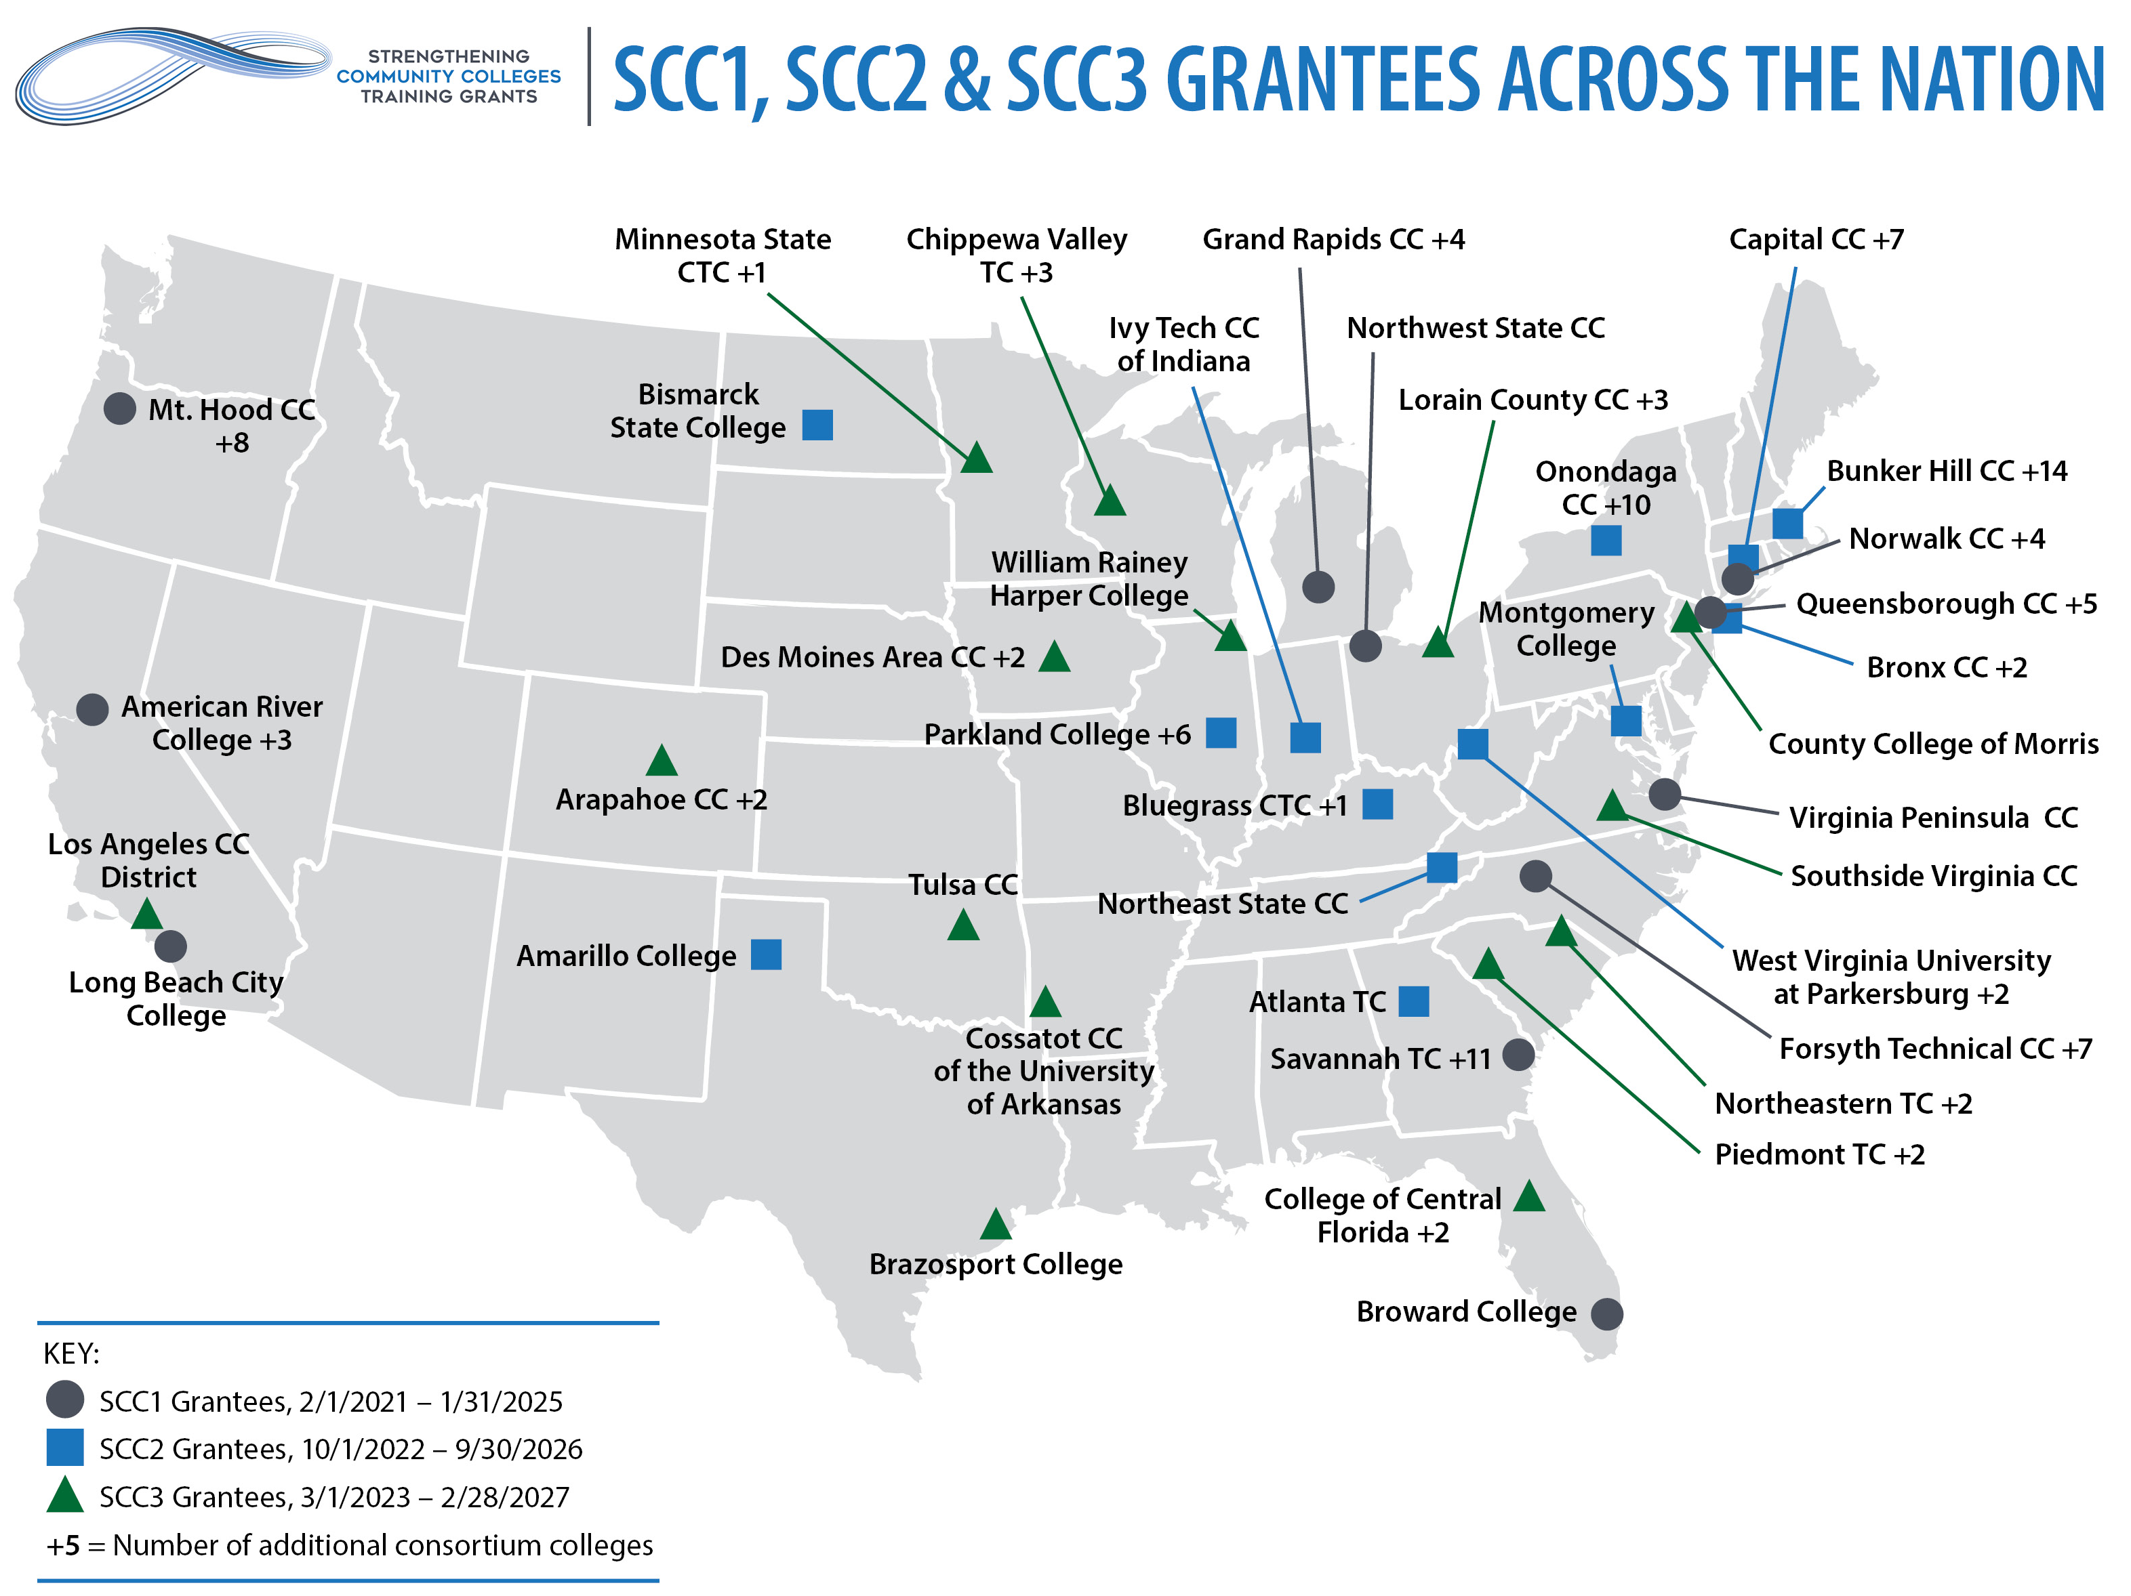
SCC Grants Across the United States
4

Slide 5
Overview of SCC3 Grantees
Applicant Legal Name | State | Grant Type | Amount | FPO
Arapahoe Community College | CO | Consortium | $4,989,434 | Yvonne Williford
Brazosport College | TX | Single | $1,598,762 | Francine Cormier
Chippewa Valley Technical College | WI | Consortium | $4,994,776 | Patrick Campbell
College of Central Florida | FL | Consortium | $4,732,384 | Jai'lynn Pennington
Cossatot Community College of the University of Arkansas | AR | Single | $1,597,031 | Francine Cormier
County College of Morris | NJ | Single | $1,600,000 | Matthew Malone
Des Moines Area Community College | IA | Consortium | $4,999,094 | Clay Webb
Lorain County Community College District | OH | Consortium | $5,000,000 | Clay Webb
Los Angeles Community College District aka Los Angeles Mission College | CA | Single | $1,600,000 | Joshua Hodges
Minnesota State Community and Technical College | MN | Consortium | $4,201,050 | Patrick Campbell
Northeastern Technical College | SC | Consortium | $4,900,636 | Jai'lynn Pennington
Piedmont Technical College | SC | Consortium | $4,987,461 | Tamarra Roseburgh
Southside Virginia Community College | VA | Single | $1,599,530 | Keith Hubert
Tulsa Community College | OK | Single | $1,600,000 | Yvonne Williford
William Rainey Harper College | IL | Single | $1,599,842 | Patrick Campbell

Slide 6

Moderator
Cheryl Martin
  Program Manager, Community College Unit
  Office of Workforce Investment, Division of Strategic Investments, US Department of Labor, Employment and Training Administration

Slide 7
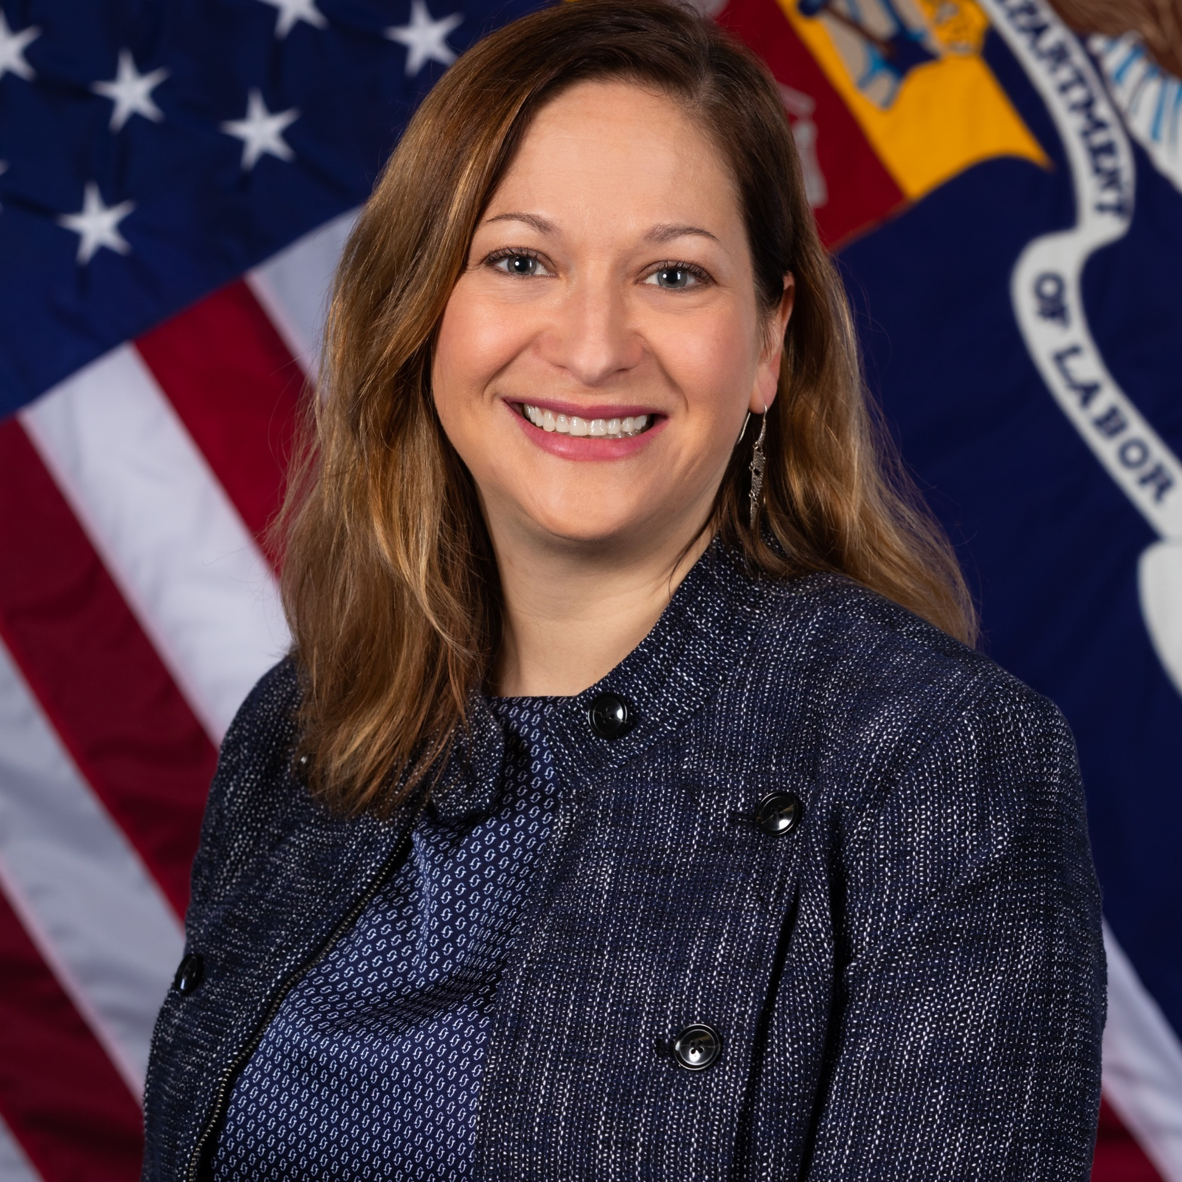

Speakers
Jenn Smith
  Division Chief, Division of Strategic Investments
  Office of Workforce Investment, US Department of Labor, Employment and Training Administration
Matthew Carls
  Grants Management Specialist
  Office of Grants Management, US Department of Labor, Employment and Training Administration

Slide 8



Speakers
Eugenie Agia Workforce Analyst, Division of Strategic Investments, USDOL
Angella Alivia
SCC Technical Assistance and Performance,
High Impact Partners
Dawn Jackman Murphy
Workforce Development Specialist, Division of Strategic Investments, USDOL

Slide 9
Today’s Agenda
Grant Program Overview
The Federal Team
Grants Management: Award Package Overview
Grant Modifications
Performance Reporting Guidance & Technical Assistance
Communication Methods

Slide 10
What are your biggest concerns right now?
Let’s CHAT!

Slide 11
Strengthening Community Colleges (SCC3) Training Grants
Grant Program Overview

Slide 12
SCC3 and SCC2 Compared
Applications for both the second and third rounds of SCC grants used the same Funding Opportunity Announcement (FOA) (FOA-ETA-22-02); Amendment 2 of the FOA pertains to SCC3 grants.
Per Amendment 2: For the purpose of SCC3, all references in FOA-ETA-22-02 to SCC2 will refer to the third round of grants, SCC3.
In other words, SCC2 and SCC3 are identical, except for their funding levels ($50 million for SCC3 and $45 million for SCC2).

Slide 13
Polling Question: Preparing to Launch your Grant
Which resources have you reviewed in advance prior to today’s webinar?
Grant Award Package
Grantee Handbook
SMART 4.0 Grants Management Training
All the above
(Choose all that apply)

Slide 14
SCC3 Program Purpose
Increase the capacity and responsiveness of community colleges to address identified equity gaps.
Meet the skill development needs of employers in in-demand industries and career pathways, as well as the skill development needs of marginalized and underrepresented workers.
SCC2/3 Program Grants
Additional SCC2/3 Evaluation Funding (but only used for SCC2)
14

Slide 15
Advancing Equity in the SCC3 FOA
Equity gap analysis
Equity performance outcomes
Bonus points to leads who are Qualified Institutions
Affinity-focused consortium applicants
Funding set-aside of up to $5 million for affinity consortia
  Resource: Equity and Community College Webinar Series: https://collegeconnection.workforcegps.org/resources/2022/01/07/20/40/Community-College-Researchers-in-Exploring-Equity-Gap-Interventions

Slide 16
Grant Award Information
$50 million awarded to 15 grantees
  8 consortia, 7 single institutions
Awards range from up to $1.6 million for single institutions to up to $5 million for consortium grantees
  The period of performance is 48 months (no extensions)
  March 1, 2023 – February 28, 2027
Matching funds are not required; leveraged funds are encouraged
16

Slide 17
Targeted Industry Sectors
11 grants focus on a single sector; 4 focus on multiple sectors
Sectors represented:
  Advanced Manufacturing (4)
  Healthcare, including Allied Health, Emergency Services and Nursing (8)
  Information Technology (4)
  Clean Energy (1)
  Education (2)

Slide 18
Lead Applicants and Consortium Types
Eligible lead applicant is a community college that applied as a:
  Single Institution, or
  Consortium lead representing a consortium of institutions, focused around a state focus, a regional labor market focus, or an affinity focus.
Single Institutions | Affinity-Focused Consortia | Labor-Market Consortia
Brazosport College | Arapahoe CC | College of Central Florida
Cossatot CC | Chippewa Valley TC | Des Moines Area CC
County College of Morris | Northeastern TC | Lorain County CCD
Los Angeles Mission College | Piedmont TC | Minnesota State CTC
Southside Virginia CC
Tulsa CC
William Rainey Harper College

Slide 19
SCC3 Partnership
Required Partners
Both consortium and single institution applicants:
  Workforce Development System: One or more partners from the publicly funded workforce development system; and
  Employer Partners: An industry/trade association or a consortium of at least three employers, for each proposed industry sector.
Consortium applicants (only):
  Institution Consortium
Optional Partners
Unions or labor-management organizations
Community-based organizations
For state-focused consortia: a state-level or community college district-level entity
Tribal entities
Technical colleges
State Apprenticeship Agencies
Federally-funded programs, such as:
  Adult Education and Perkins V
  Temporary Assistance to Needy Families programs
  Supplemental Nutrition Assistance Program Employment and Training programs
Economic development agencies
Foundations and philanthropic organizations

Slide 20
Individuals Eligible to Participate in SCC3
Includes a spectrum of adult workers–dislocated workers, incumbent workers, and new entrants to the workforce—as well as older youth who are new entrants to the workforce.
“New entrants to the workforce” may include:
  Long-term unemployed individuals and formerly incarcerated individuals
  Youth enrolled in junior or senior year of secondary school, who could be employed before or within six months after grant end; and youth who have dropped out of school and are seeking their first full-time job
Within these categories, you may serve a wide range of individuals, including:
  Individuals receiving UI or public assistance
  High school students in Grades 11-12/dropouts
  Enrollees in adult basic/other education programs
  Individuals with disabilities
  Veterans
  Indian and Native Americans
  Individuals with Limited English Proficiency

Slide 21
Allowable Activities: Capacity-Building
Overarching capacity-building activities that most grantees will undertake:
  Hiring or training instructors/staff to develop/deliver curricula, online/distance learning, and work-based learning experiences;
  Purchasing or upgrading classroom supplies/equipment and/or educational technologies;
  Implementing changes in time/scheduling of courses and/or data integration tools;
  Supporting required third-party evaluation.
Other allowable activities fall into these categories:
  Reviewing and adjusting policies/practices
  Developing comprehensive student supports
  Curriculum development
  Program design/continuous improvement
  Partner collaboration
  Technology-enabled learning
  Internal data reporting capacity
21

Slide 22
Allowable Activities: Participant-related Costs
Participant-related costs are allowable, although DOL encourages grantees to leverage college infrastructure and/or federal/state resources (e.g., WIOA, Perkins) to cover them. Such costs include:
  outreach/recruitment of eligible participants
  direct education/training
  job development/job search
  case management
  supportive services
22

Slide 23
Allowable Activities: Equipment and Minor Alterations
Expenditures for equipment and minor alterations, renovations, or rearrangements, if specific to the project, are allowable with prior written approval from the Grant Officer.
Written requests for prior approval to acquire grant-funded special purpose equipment and/or to alter space must be submitted no later than 12 months after the award date of the grant.
Grant Officer-approved special purpose equipment and/or altered space must be acquired, completed, and available for use no later than 24 months after the award date of the grant.
Total costs to the grant of all alterations cannot exceed 15 percent of the total grant award. (Equipment is not included in that cap.)
23

Slide 24
Program Design
Core Elements:
  Core Element 1: Advancing Equity
  Core Element 2: Accelerated Career Pathways
  Core Element 3: Results-Driven Project Design
    Logic Model
    Performance Outcomes
    Project Work Plan
  Core Element 4: Sustainable Systems Change
Evaluation

Slide 25
Performance Outcomes and Grantee Accountability
Five grant-specific performance outcomes:
  Three capacity-building outcomes
  Two equity outcomes
  The five customized performance outcomes, and the related outputs, key milestones, and deliverables in the work plan, form the basis of the Department’s assessment of grantee performance.
  Participant Tracking Plan: Applicants will also track and report participant outputs for a selected cohort of students on a quarterly basis throughout their grants, using DOL’s Workforce Innovation Performance System (WIPS).

Slide 26
Customized Performance Review
Per the grant award package, we are conducting a programmatic compliance review of your grant project.
As part of this process, every grantee and their FPO will receive an email detailing specific performance and/or work plan issues.
If needed, we will schedule a conference call with the grantee and FPO to discuss these issues and required actions.
Any clarifications to the grantee’s proposed performance outcomes targets will require National Program Office review and concurrence and may require a grant modification.
We expect to complete the full review and resolution process by June 30.

Slide 27
Evaluation
Required Implementation or Developmental Evaluation
  Required Participation in National Evaluation (if DOL conducts one)
No more than 5 percent of budget, so ~ $40k for singles or ~ $250,000 for consortia
Trewon Technologies, LLC is DOL’s contracted evaluation TA partner for SCC Rounds 1-3
Third-Party Evaluation Requirements:
  No later than Month 6 (or the earliest timing that is feasible under grantee’s institutional procurement guidelines): Procure third-party evaluator
  No later than Month 9: Submit draft detailed evaluation design from evaluator
  No later than Month 12: Submit final detailed evaluation design
  Month 27: Interim report due
  Month 48: Final report due

Slide 28
Open Educational Resources and Credential Transparency
Per the SCC2/3 FOA (pages 63-64), grantees must:
  license to the public all work created with the support of the grant; and
  make the credentials and competencies that they develop publicly accessible through the use of linked open data formats.
Grantees may need to seek assistance from a specialist in in their SCC Partnership or an outside expert on credential/data transparency.
DOL will provide further information and additional technical assistance regarding both of these requirements.

Slide 29
Polling Question: Preparing to Launch your Grant
When do you anticipate hiring your project manager?
Our project manager is already in place!
By May 1, 2023
By June 1, 2023
By September 1, 2023 or later

Slide 30
Your Federal Team
Collaboration and Coordination

Slide 31
Your Federal Team at the Department of Labor (DOL)
ETA Regional Offices
Office of Grants Management (OGM)
Division of Strategic Investments (DSI, Lead Program Office)
Chief Evaluation Office (CEO)
Federal Project Officer
Grant Officer (OGM / Regional Office)
Program Office
Grantee

Slide 32
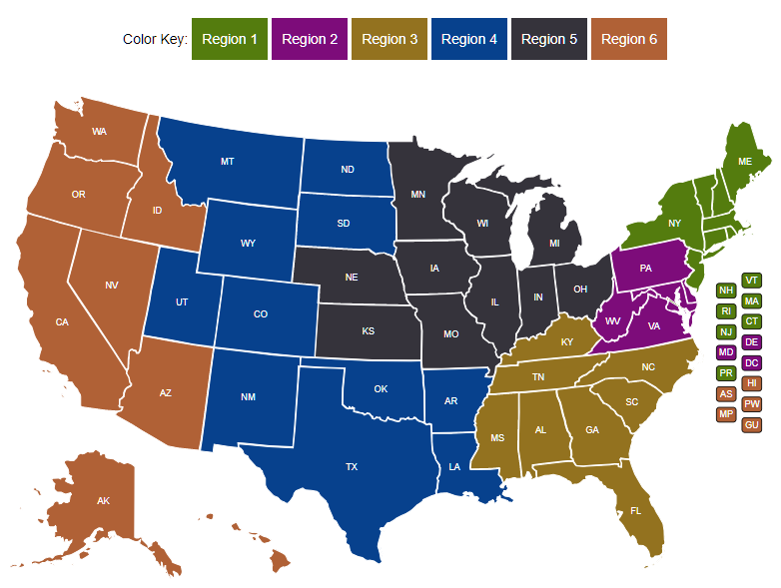
Your FPO is identified in your grant package.
Federal Project Officer (FPO)
Your FPO is critical to the success of your grant program.
Role of Your FPO
Assist you on grant-related matters
Provide compliance assistance
Conduct oversight and review of grant performance
Deliver or arrange for technical assistance
Serve as your primary point of contact

Slide 33

Grant Officer (OGM)
Your assigned Grant Officer is listed on the Notice of Award page of the Grant Package. Only the Grant Officer can approve changes to the Grant Agreement.
Maintains official grant documents
Regional Grant Officer can approve grant modifications and equipment purchases
National Grant Officer approves complicated grant modifications: limited changes to SOW, changes in signatory and NICRA
OGM staff provide guidance and training on policy issues and fiscal/administrative requirements of the grant.

Slide 34
Program Office Staff
Support FPOs
Provide policy clarification and guidance
Provide technical assistance (TA) (together with an external provider)
Create peer learning opportunities
Collect performance data
Review specific grant modifications
The Program Office for your grant may periodically request information about your grant outcomes for reports to Congress, the White House, or others.

Slide 35
Any Questions?

Slide 36
Grants Management Overview
36

Slide 37

Grant Transmittal Package
Congratulatory Letter
Training and Employment Notice
(TEN) 16-22
Additional Information:
Grantee Handbook
GrantSolutions links/resources

Slide 38
Financial Reporting Resources
ETA-9130 Financial Report forms and instructions may be found at: http://www.dol.gov/agencies/eta/grants/management/reporting
PMS Helpdesk at: https://pms.psc.gov/support/help-desk.html.
Request Access as a new user and update user permissions are available at: https://pms.psc.gov/grant-recipients/user-access.html

Slide 39
Grant Award
Notice of Award (NOA)/Signature Page
Condition of Award Page/ Program Compliance Notification
Terms and Conditions
Application for Federal Assistance
Budget
Statement of Work (SOW)
Indirect Cost Rate Agreement (if applicable)

Slide 40

Grant Agreement Notice of Award (NOA)
Project Title – Strengthening Community Colleges Training Grants
Grant Awardees' Identifying Information
Award Number
  Example: CC000004
Period of Performance
Award Amount
Uniform Administrative Requirements
Cost Principles

Slide 41
Notice of Award Regulations
    2 CFR Part 200
      Uniform Administrative Requirements
      Cost Principles, and
      Audit Requirements for Federal Awards
    2 CFR Part 2900
      DOL Exceptions
    Terms and Conditions of Award

Slide 42
Conditions of Award (COA)
Areas that require clarification and/or modification are outlined in the award package and specified as conditions of award.
    Budget revisions/clarifications
    Indirect Cost Rate Agreement
Contact your assigned Federal Project Officer (FPO) if you have any questions related to COAs.

Slide 43
Conditions of Award
  Conditionally Approved Funding (if applicable): Grantee is conditionally approved with an initial increment of $80,000 drawdown restriction in PMS. This constitutes a Partial Notice to Proceed. Release of additional funds up to the amount approved for the project, will be based on the grantee’s ability to address this Condition (see Conditions of Award page). Grantee is not authorized to incur costs above $80,000 until Condition 1 is resolved.
    Financial Assessment Form (All grantees)
    Financial and Administrative Policies and Procedures (Grantees new to ETA)
  Lifting the Drawdown Restriction: Submission of the requested information specified in Condition 1 does not in itself constitute approval by ETA. Should the provided documentation be found satisfactory, a Full Notice to Proceed will be incorporated into the grant agreement as an official modification, and the drawdown restriction will be lifted.
  New Grantee to ETA: Grantee that has never received ETA grants or has not received ETA grants within five (5) years from the closing date of the FOA. Grantees that meet this criterion will receive Conditionally Approved Funding.
43

Slide 44
Program Compliance Notification
  Federal Staff are still reviewing your projects
  Key areas of Compliance are highlighted
  Grantees are responsible for
      Learning how to manage their award in compliance with all Federal Regulations & this grant agreement
        Reading the grant agreement
        Learning about Federal Regulations, and the nuances of your program
        critically looking at their project and being proactive in clarifying items of potential concern with your FPO

Slide 45
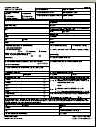
Specific Terms and Conditions of Award
Order of Precedence
Funding Opportunity Announcement (FOA)
  & Amendments One and Two (incorporated by reference)

Slide 46
Terms – Equipment Purchases
  Equipment purchases with a per-unit acquisition cost of $5,000 or more, and a useful life of more than one year need prior approval from Grant Officer
    Capital improvements and other alterations and renovations also allowable with prior approval
  Submit a detailed equipment purchase list with descriptions of each item to your FPO for review
  Your FPO will review the request and submit for approval. A modification to your grant will be processed approving the equipment purchase and/or renovation

Slide 47
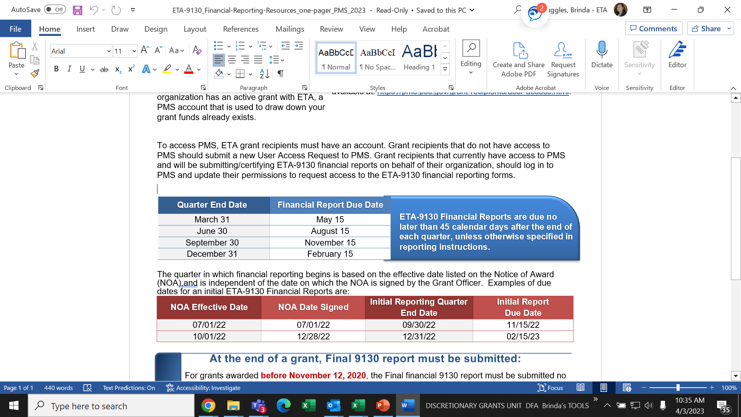
Quarterly Financial Report
47

Slide 48
Grant Agreement
SF-424 – Attachment A
Budget Information
  SF-424A – Attachment B
  Budget Narrative – Attachment C
Statement of Work - Attachment D
  Project Narrative
  Abstract
  Project Work Plan
  Performance Outcomes Table
  Documentation of Partnership Commitments

Slide 49
Indirect Cost Rate Agreement
Attachment E - only applicable to those claiming indirect costs
If grantee is claiming indirect costs but did not provide agreement, placed on 90-day temporary rate
Applicants missing indirect cost rate agreements or submitting expired ones limited to lesser of either total claimed indirect costs or 10% of total Personnel budget

Slide 50
Any Questions?

Slide 51
Grant Amendments
Requests, Review Process
51

Slide 52
Grant Amendments
What is an amendment?
Why do an amendment?
What are amendment indicators?
FPO Modification Analysis
  Reasonable
  Performance
  Best interest of the government
52

Slide 53
What is a Grant Amendment?
Mechanism to Change the Terms of the Grant Agreement
53

Slide 54
Why do an Amendment?
Change of Scope
  {Very rare & only minor changes will be considered}
Program Design
    Service Area
    Change in Partners (outlined in compliance notification)
    Key Personnel Changes
54

Slide 55
FPO Modification Analysis
Grant Quality
  Services
  Staffing
Grant Efficiency
  Timely
  Cost Effective
Grant Performance
  Enrollments
  Expenditures
Benefit to the Government’s Goals for the Grant Program
55

Slide 56
Required Documentation for Amendments
Must come from Authorized Representative
Provide the purpose
Why it’s necessary
How the change will benefit the program
Appropriate documentation to support the amendment
56

Slide 57
Modification Process
Must come from the Authorized Representative.
Include amendment type, grant number, and justification for request.
Discuss potential mod with your FPO.
57

Slide 58
POP QUIZ!
You would like to add a new industry or occupation to your grant.
Which answer provides the best response that describes the best first step for submitting a Grant Amendment?
A
Launch the program in the new industry and begin enrolling participants.
C
Reach out to your FPO to discuss the need for your request.
Write a formal letter of request to the Grant Officer which provides a justification. Have the Authorized Representative sign and submit the request.
Reach out to your partner organizations to determine if the new industry or occupation is in-demand.
B
D
58

Slide 59
Any Questions?

Slide 60
Performance Reporting Guidance

Slide 61
The Value of Reporting
Department of Labor
SCC3 Grants
Report the success of high-profile programs to Congress, Administration, OMB, GAO, etc.
Inform the design of future grant investments
Demonstrate the outcomes of these grant investments
Capture effective program design models and service delivery strategies.
Demonstrate grant outcomes to investors and partners
Illustrate Return on Investment (ROI) to employer partners
Build additional strategic partnerships and leveraging resources
Sustainability of the project and partnership
Continuously improve program design to meet the needs of participants

Slide 62
SCC3 Performance Reporting Requirements
Grantees must submit performance progress reports quarterly to ETA.
Quarterly Narrative Report (QNR): Grantees will report the required narrative information and five required customized outcomes using the QNR.
  We will provide grantees with a suggested Customized Outcomes Report (COR) template for reporting and tracking their customized outcomes.
Quarterly Performance Report (QPR): All grantees (both single institution and consortium) must track participant outputs related to program enrollment/ completion and credentials earned for a cohort of students.
  Grantees are not required to set participant targets or track employment-related outcomes (DOL will rely on the Common Reporting Information System (CRIS) for the latter).
Final Report
  QPR and QNR submitted at the end of the grant

Slide 63
Quarterly Reports
Submitted to ETA using the Workforce Integrated Performance System (WIPS)
Quarterly Reports
  Quarterly Performance Report (QPR)
    Grantees should prepare to track and collect participant-level data for the QPR.
  Quarterly Narrative Report (QNR)
    Includes your Customized Outcomes Report
WIPS
QNR
QPR
Suggested Customized Outcomes Report
Participant Data File Upload

Slide 64
SCC3 Performance Measures (PM)
Grantees must track and report participant level data for a select cohort of students throughout the grant period of performance using DOL’s Workforce Integrated Performance System.
PM1: Participant Cohort Students Who Begin Education/Training
PM2: Students Who Complete the Cohort Program of Study
PM3: Students Who Complete the Cohort Program of Study and Receive a Credential
PM4: Credentials Received by Students Enrolled in the Cohort Program of Study
These outcomes are reported using participant level data that is uploaded in WIPS and aggregated into the QPR.

Slide 65
Interim Reporting Process for the Quarter Ending 3.31.23
Grantees will submit a Quarterly Narrative Report (QNR) to ETA for this quarter
  Grantees should have already received an interim reporting guidance email that includes the QNR Template
  Covers activities from March 1 - 31
  First QNR will be submitted BY EMAIL to FPOs and the grant mailbox no later than the reporting due date of May 15, 2023
  Grantees will send QNRs to their FPOs, with a cc to SCC@dol.gov
  This interim guidance is only for the quarter ending
  March 31, 2023

Slide 66
Performance Reporting Requirements
Quarterly Performance Reporting: Key Deadlines
  QNR:
    Quarter ending Mach 31: QNR due May 15 (email only)
    Quarter ending June 30: QNR and COR due August 15 via WIPS
    QNR and COR via WIPs for all remaining quarters
    Final QNR via WIPs at end of grant
  QPR:
    Grantees will use the WIPS demo schema for reporting participant data (once the selected cohort starts)
    QPRs due via WIPS for all subsequent quarters

Slide 67
Quarterly Progress Report: Key Performance Deadlines
Reminder: Quarterly Progress Reports
  Due no later than the 15th day of the second month after the end of a quarter
  More information and training will be provided
Quarter End Date | Progress Report Due Date | Report Activities Occurring Between
March 31 | May 15 | January 1 – March 31
June 30 | August 15 | April 1 – June 30
September 30 | November 15 | July 1 – September 30
December 31 | February 15 | October 1 – December 31
Your 1st quarterly report is due no later than May 15, 2023
Covers activities from March 1 – 31, 2023

Slide 68
Any Questions?

Slide 69
Communication
Communication Plan, Point of Contact and Community of Practice

Slide 70

Your Primary Point of Contact (POC)
Role of POC
Receives communication from ETA
Is responsible for sharing information with project team and consortium members
Any time the main point of contact for your grant changes, please remember to contact the Federal Project Officer (FPO) and Program Office by email.

Slide 71
Communication Plan
YOU
ETA
Always contact your FPO first if you have questions.
If you… | Contact:
Are the grant lead (POC) | FPO
Are a member of a grant project | The lead for your grant
Have questions or difficulty accessing the performance reporting system | https://www.doleta.gov/performance/wips/WIPS_Technical_Assistance_Request.cfm
Have questions or difficulty accessing the financial reporting system | PMS Helpdesk: https://pms.psc.gov/support/help-desk.html.
Have questions about evaluations | SCC@dol.gov with a copy to your FPO

Slide 72
Communication Guidelines
YOU
ETA
When you communicate with your FPO, etc.:
Copy the SCC mailbox at SCC@dol.gov, if appropriate
Include your grant number and lead grantee organization name
Describe your question or issue in detail
Please be patient!

Slide 73
ETA Communications to You
ETA
YOU
Program Office staff may send periodic guidance and other communications through the SCC Mailbox.
Your FPO or Program Office staff may contact you for specific requests and information.
ETA posts information on the WorkforceGPS.org Community of Practice site.
  https://collegeconnection.workforcegps.org/
ETA shares new information on its website.
  https://www.dol.gov/agencies/eta/skills-training-grants/scc
Please make sure your email system does not confuse our communication as spam.

Slide 74
Technical Assistance

Slide 75
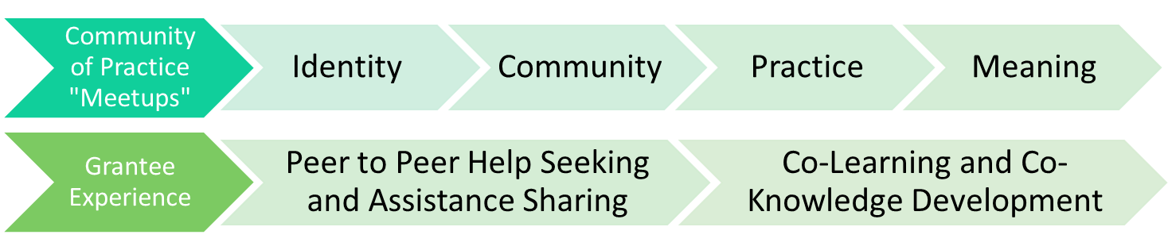
SCC3 TA Theory of Change
SCC Technical Assistance is a dynamic, capacity-building process for designing or improving quality, and effectiveness of SCC grantee projects to achieve sustainable systems change.
Deep Equity
Personal
Interpersonal
Organizational
Societal
Grantee Experience
1:1 Coaching
SME Consultation
Peer to Peer Small Groups
SME Webinars
SCC Newsletter
Success Indicators
Operational Systems
Organizational Management
Equity-minded Change
Stakeholder Engagement
Accelerated Career Pathways

Slide 76
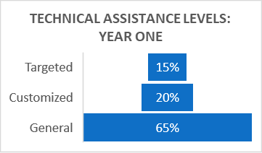
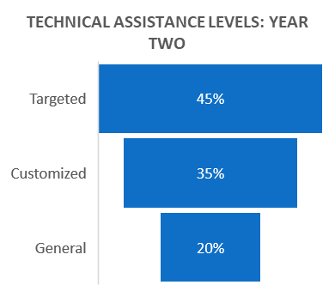
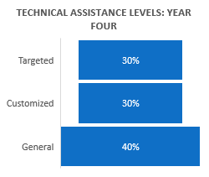
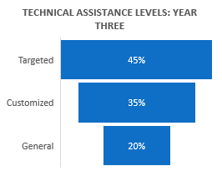
SCC3 TA Theory of Change (cont.)

Slide 77
Grant Timeline (First Quarter)
March 1, 2023– Grants Start
  Compliance Notification Letter, Condition(s) of Award: Packages Sent
March through June 2023 – Performance and Work Plan Reviews
April 3, 2023 – Today! Grantee Orientation
May 15, 2023 – First Quarterly Narrative Report (QNR) (email only)
TBD – Grantee Performance Reporting TA Rollout

Slide 78

Next Steps
Respond to Conditions of Award in your Grant Award Package
(send to FPO, cc SCC) (if you have conditions of award)
Review the DOL Fiscal Training Tutorials from the SMART 4.0 Webinar Series
Review the SCC2/3 Foundational Resources page on College Connections (FOA, grantee handbook, evaluation rubric, SCC3 abstracts, and more)
Review the Funding Opportunity Announcement
Review the Grantee Handbook
Review the DOL Performance Reporting Requirements
Update your grant’s Point of Contact(s) as needed
Get to know your FPO and ask questions!

Slide 79
Any Questions?

Slide 80
Thank You!
Need help? Email: Support@workforceGPS.org

