Slide 1
Grant Closeout Process
American Apprenticeship Closeout
2023
Division of Resolution and Closeout
ETA Office of Grants Management

Slide 2
Who We Are
Office of Grants Management
  Division of Resolution and Closeout
    Division Chief - Latonya Torrence
  Audit Unit
    Unit Supervisor – Anita Robinson, Grant Officer
  Closeout & Reporting Unit
    Unit Supervisor – Meron Assefa, Grant Officer
      Avery Malone, Grant Officer/Resolution Specialist
      Artine Jones, Resolution Specialist
      Joe Mathew, Resolution Specialist
      Mary Oben, Resolution Specialist
      Mark McEnery, Resolution Specialist
      Naomi Kimani, Resolution Specialist
      Charles Cox, Resolution Specialist
      J’Zhane Dobson, Resolution Specialist

Slide 3

What is Grant Closeout?
2 CFR 200.344
  Closeout.
    Awards issued after November 2020: No later than 120 calendar days to submit closeout documents
    Awards issued prior to November 2020: No later than 90 calendar days to submit closeout documents.
2 CFR 200.345
  Post- closeout adjustment and continuing responsibilities.
2 CFR 200.346
  Collection of amounts due.
2 CFR 2900.15
  Closeout (additional guidance)

Slide 4
Liquidation of Obligation and Accrued Expenditures
2 CFR 2900.15
In closeout, grantee may only liquidate obligations incurred during PoP – not incur new obligations
The only liquidation that can occur during closeout is the liquidation of accrued expenditures (NOT obligations) for goods and/or services received during the grant period.
Grantee may not direct charge staff time to work on closeout of grant after PoP end date

Slide 5

Preparing for Closeout
Grant Recipients will need to ensure they have access to GrantSolution (GS) website.
  Grant Recipient personnel register in GS will receive a notification through GS and will access the Closeout Package documents
Grant Recipient must have an active status in SAMS.GOV.
  Unique Entity Identifier (UEI) Number must be active.
Grant Recipient must register in US Department of Health & Human Services Payment Management System (PMS)
  To submit the Final 9130 financial report.

Slide 6
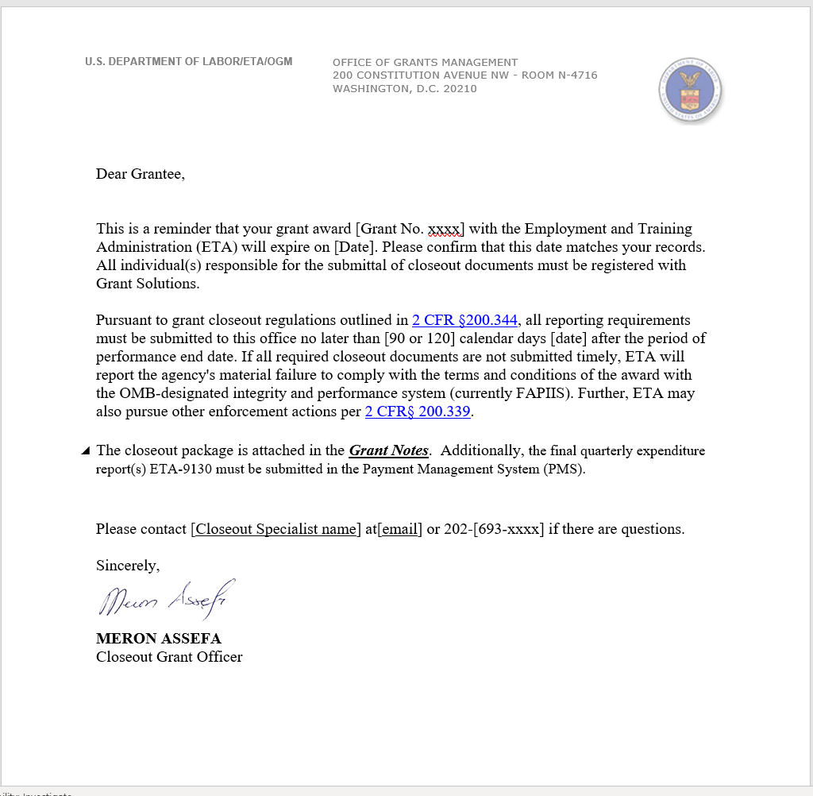
Closeout Initial Letter

Slide 7
Closeout Processing
Within 90 days after period of performance (PoP) end date - Grantee must submit final 9130 for last quarter. Check box 6 as “Final.” for awards issued prior to November 2020.
Within 120 days after period of performance (PoP) end date - Grantee must submit final 9130 for last quarter. Check box 6 as “Final.” for awards issued after November 2020.
Specialist sends follow up reminder to grant recipient to submit all documents.

Slide 8
Closeout
Processing Continues
Closeout Documents must be submitted within the 90 to 120 day guidelines.
All grants should be closed within 1 year of expiration (DLMS-2 Chapter 800)
Under Uniform Guidance (UG), awards must be closed within one year of receipt and acceptance of all required final reports
Non-Federal entities that do not submit all required closeout documents within one-year of POP end date are reported to OMB’s integrity and performance system (currently FAPIIS)
Grants Oversight and New Efficiency Act (GONE Act) (Public Law 114-117) requires agencies to report federal grant awards which have not yet been closed out and the period of performance has elapsed for more than two years.

Slide 9
Closeout TIme-line
March 30, 2023 – 0 Day (Expiration)
  Closeout begins.
June 30, 2023 – 90 Days (Pre 11/2020)
  Final quarterly 9130 & all Closeout documents.
July 30, 2023 – 120 Days (Post 11/2020)
  Final quarterly 9130 & all Closeout documents.
Final Funding Draw Requests – 90 Days
  Account will lock 90-days after grant expiration.

Slide 10
Grant Closeout Package elements
Documents to be submitted:
  Final Quarter 9130
  NICRA & breakdown (if applicable)
  Grantee’s Detail Statement of Costs
  Government Property Inventory Certification
  Property Listing form

Slide 11
Compliance
  Ex. If There is a 10% limitation on administrative costs. 10% of grant award amount.
Closeout Submission
Administrative Requirements
Case Management
Match Requirement
Program Income
Indirect Costs
Budget Spending

Slide 12
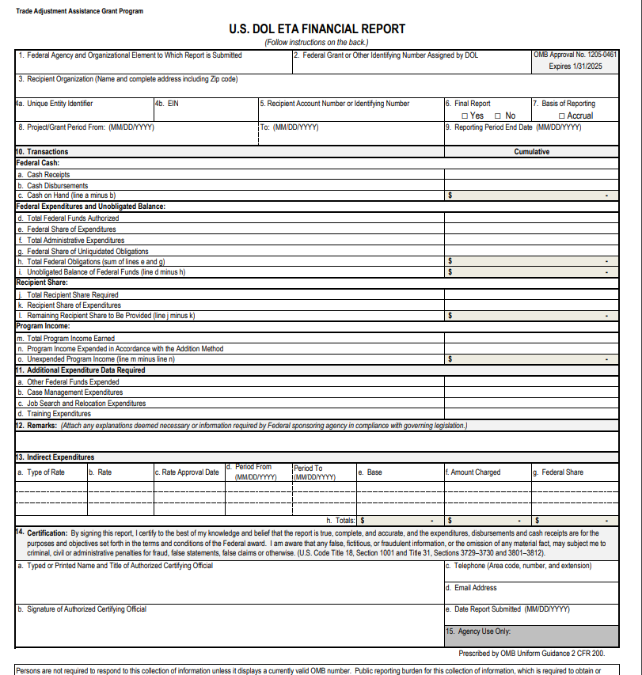
Closeout Documents –
Final Quarterly 9130

Slide 13
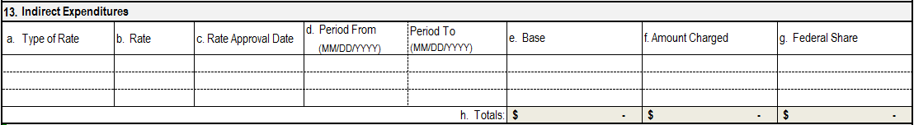
Closeout document
Indirect Costs
Indirect cost expenses are only to be reported by the non-federal entity receiving direct awards from DOL.
Indirect cost expenses are reported only on the FINAL ETA-9130 report.
  If a revision is required the Resolution Specialist will provide a template that can be emailed as an attachment.

Slide 14
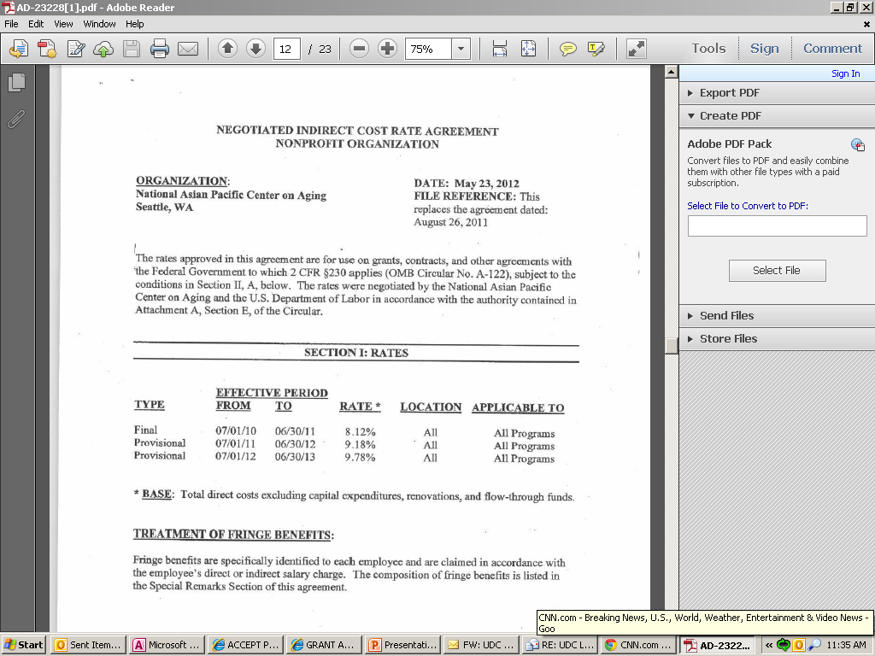
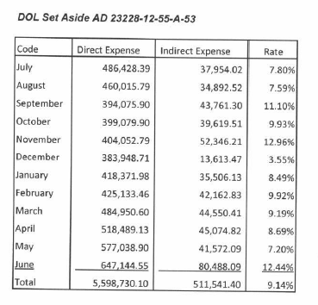
Indirect Costs Rate Agreement/Cost allocation Plan

Slide 15
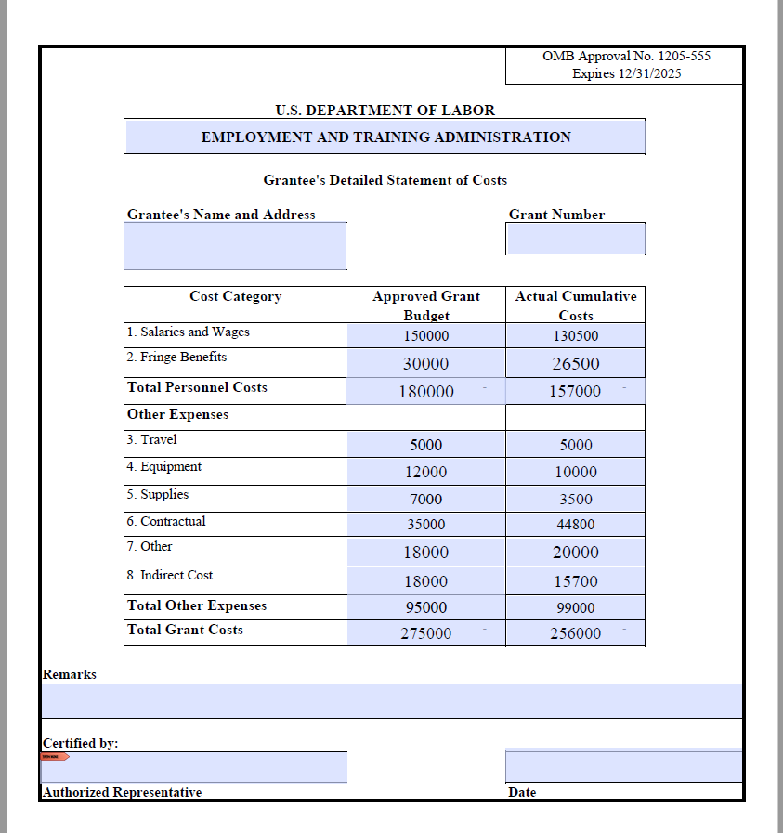
Closeout Document –
Detailed Statement of Costs

Slide 16
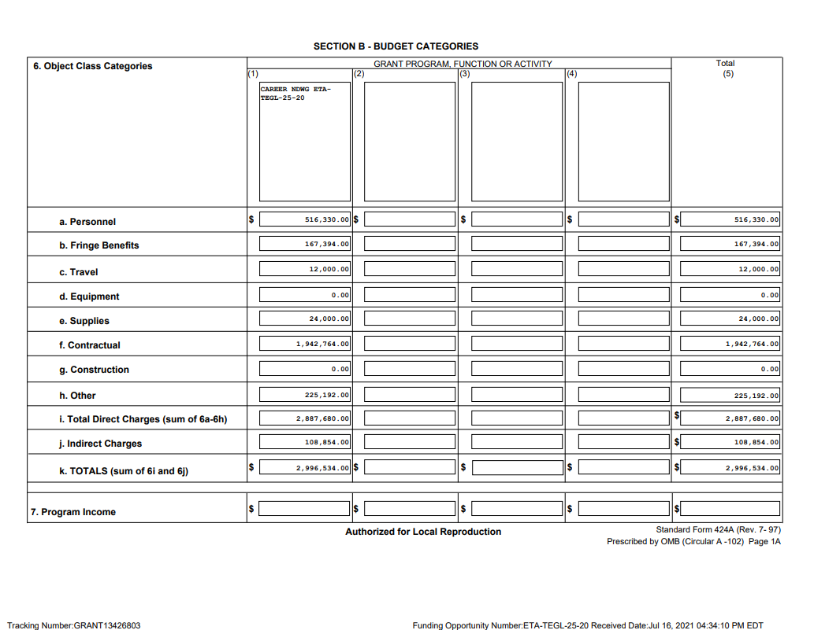
Compliance – Budget 424A

Slide 17
Budget Realignments in Closeout
Justification Submission
  To FPO & Resolution Specialist
Determination of appropriateness
Justification Approved/Disapproves
  Documented in file

Slide 18
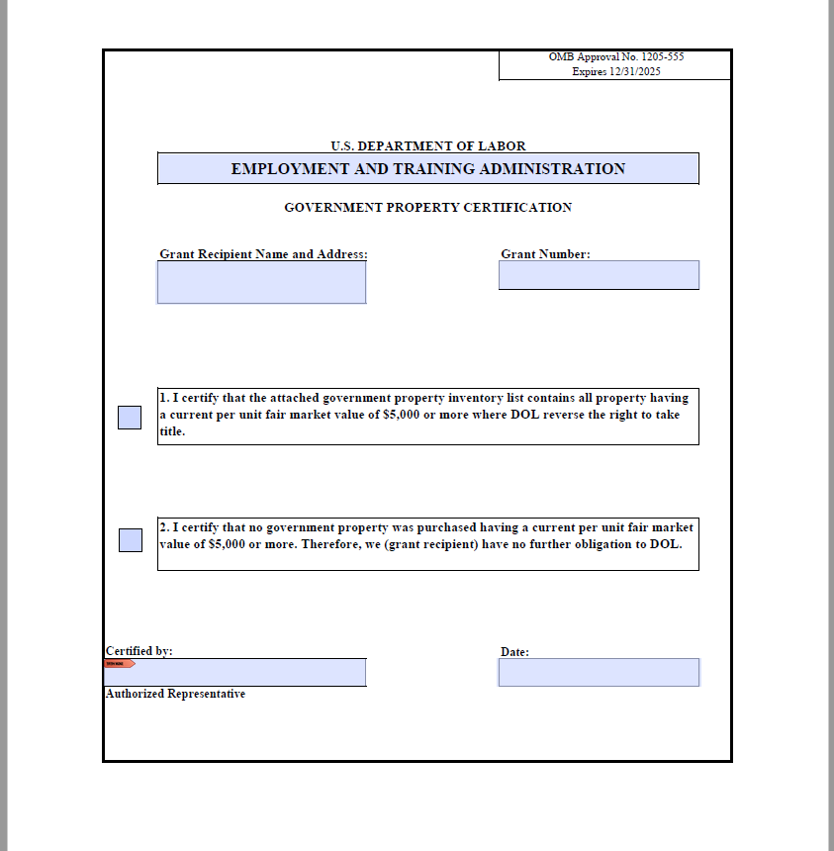
Closeout Document –
Property Certification

Slide 19
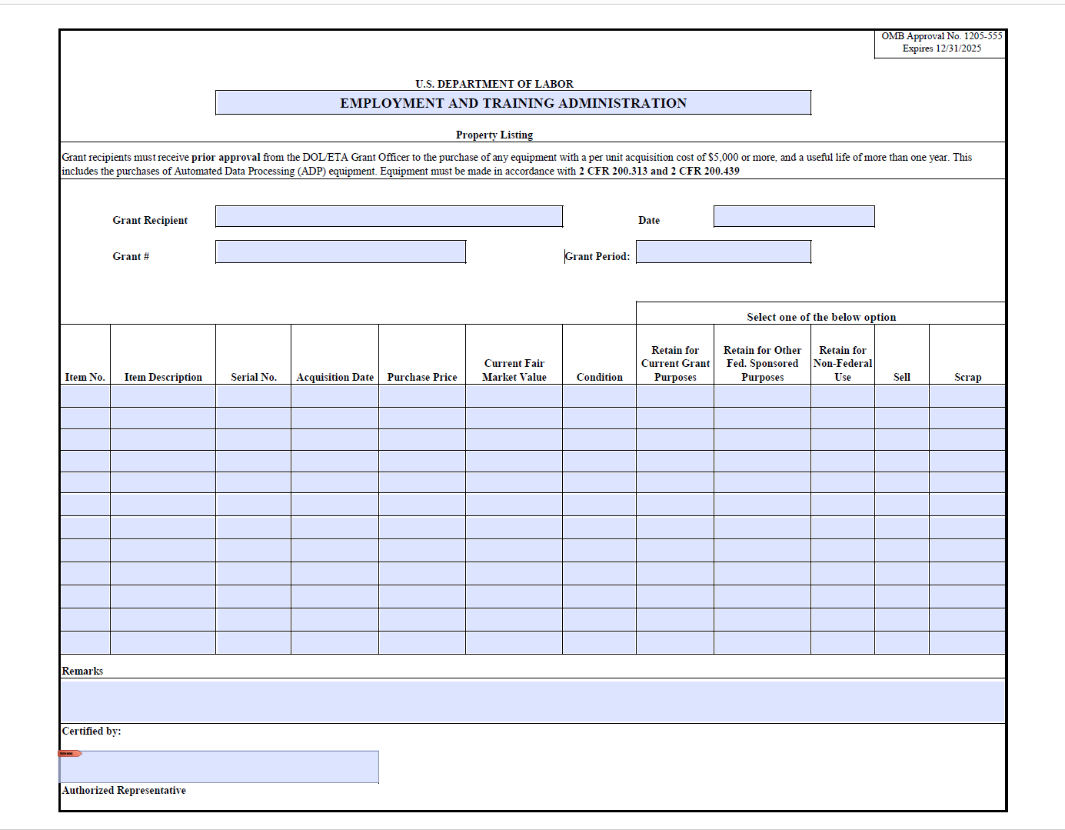
Closeout Documents – property listing form

Slide 20
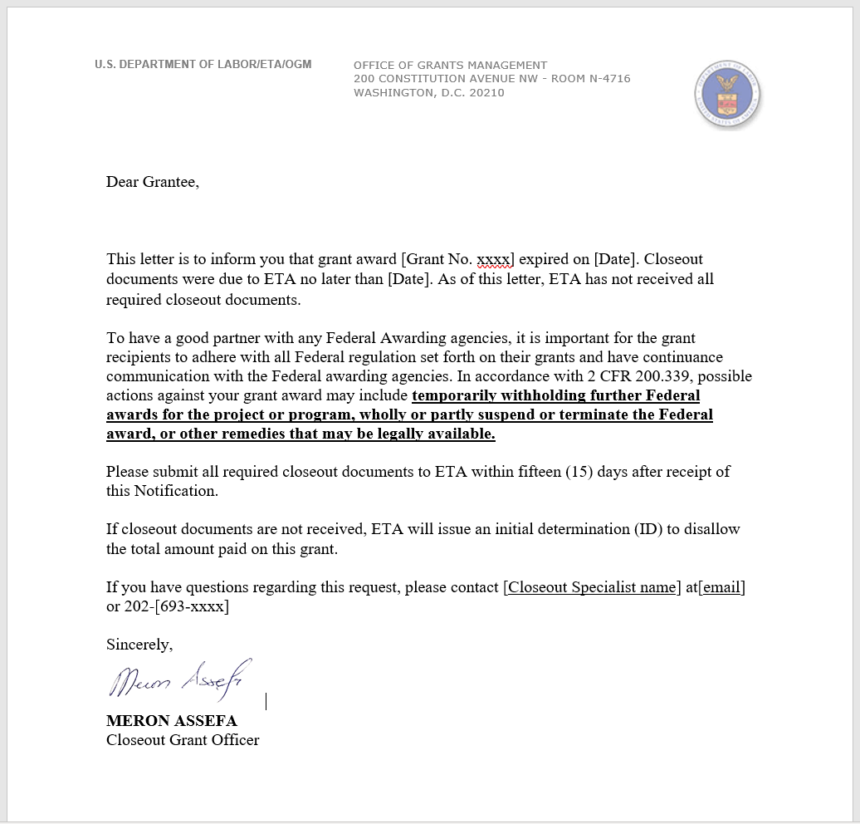
Closeout Non Submittal Letter

Slide 21
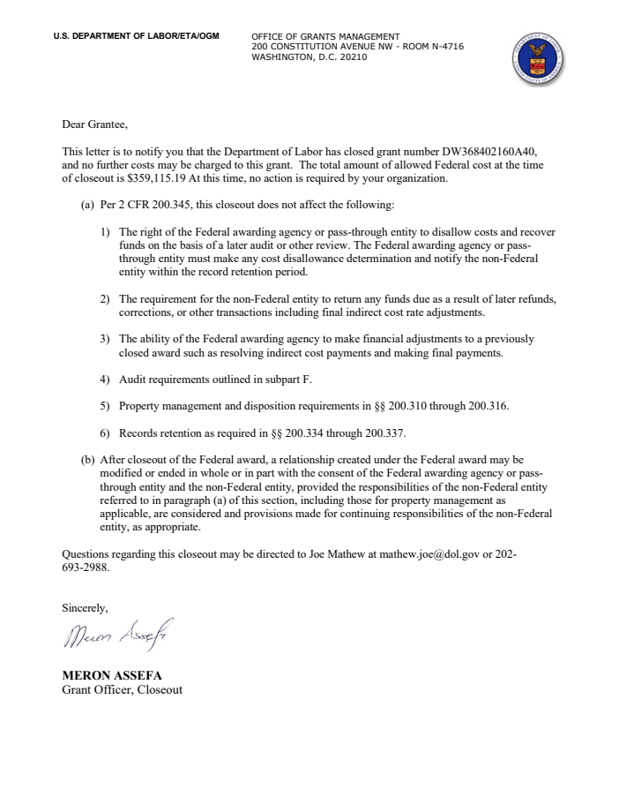
Closeout Final Letter

Slide 22
Common Misunderstandings
Clicking “Yes” on Box 6, of the ETA 9130 report, does not trigger the closeout process.
Indirect cost may only be charged with an approved rate agreement.
Grants may be closed using a provisional indirect cost rate

Slide 23
issues Which Delay Closeout
Non-responsive grantees
Refunds
Equipment disposition
9130 issues
Indirect cost issues
Question and disallowed costs/ID’s and FD’s
Budget realignments

Slide 24
Refunds
2 CFR 200.343 (d)
Grant closeout does not affect recipients obligation to return funds due to DOL as a result of refund.
Prompt refund of any balances of unobligated funds.
Refunds may require revising final expenditure report.
Refunds can be electronically through PMS or Pay.gov.

Slide 25
FAQ & Recap
Closeout begins once an award expires.
Final (9130) Financial Report submission via Payment Management System
Closeout Package Documents submission via GrantSolutions
When does the grant recipient submit the Final 9130 Financial Report (closeout)?
    Grant Awarded after November 2020
      Reports due 120-days after the expiration date.
    Grant Awarded prior to November 2020
      Report is due 90-days after the expiration date.

Slide 26
FAQ & Recap (cont’d)
When is the last time I can draw down funds?
    Grant Expired March 30, 2023 – Final Draw Date June 30, 2023
Final (9130) Financial Report
Cash Receipts=Cash Disbursed=Federal Expenditures
Completing the equipment form correctly
All required forms and documents must to be submitted.
(3) Important Notifications Letters
  Closeout Initial letter
  Non Submittal letter
  Closeout Final letter

Slide 27

Thank You!

