Slide 1
Engage Businesses Through Registered Apprenticeships
…Yes, WIOA Can!

Slide 2

Brought to You by the…
Next Level Now Collaborative

Slide 3

Today’s Moderator
Robert Kight
  Director
US Department of Labor,
Office of Workforce Investment,
Division of Adult Services and Governance

Slide 4







Next Level Now Collaborative
U.S. Department of Labor, Employment & Training
Administration (ETA)
Live Technical Assistance Office Hours
For More Info: nextlevelnow@safalpartners.com
U.S. DOL’s ETA’s Training Hub for Workforce Grantees and Partners
Equitable Economic Recovery
WIOA Implementation
Fiscal, Administrative, Programmatic
and Operational Strategies
Sector Partnerships and Employer Engagement
Performance and Results

Slide 5





Today’s Presenters
Katie
Adams
  Chief Delivery
  Officer,
    Safal
    Partners
Kathryn
Castelloes
  Director,
    ApprenticeshipNC
Wanda
Ramos-
McPherson
  Apprenticeship
  Consultant
    ApprenticeshipNC
Kimberly
Meadows
  Training Director,
    National Association
    of Workforce
    Development
    Professionals
    (NAWDP)
Melissa
Smith
  Business Services Consultant and Apprenticeship Coordinator
  Guilford Works

Slide 6

Agenda
Setting the Stage
Engaging Businesses thru Registered Apprenticeship
  National Perspective
  State Perspective
  Local Perspective
Final Thoughts
Question and Answer

Slide 7
Setting the Stage

Slide 8

Talent Pipeline Needs
The Business Talent Pipeline refers to the process of
identifying, recruiting, developing and retaining talented individuals.
Major Pain Point for Businesses…
Struggling to hire, engage, and retain
the RIGHT people…
with the RIGHT skills…
for the RIGHT position.

Slide 9
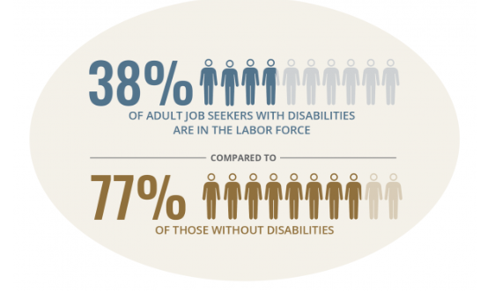
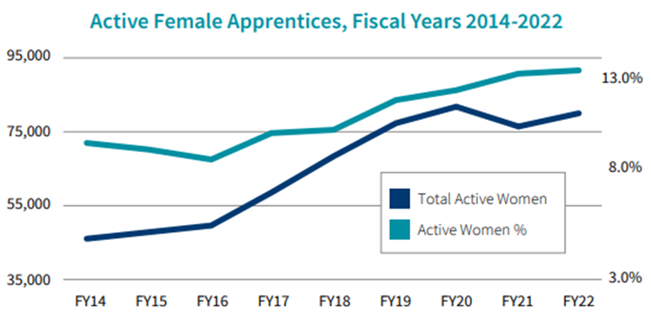
RA thru a DEIA Lens
RA programs promote recruitment and retention of a highly-skilled workforce and recognize the value of attracting a diverse array of candidates to good, quality jobs.
  Partnership on Inclusive Apprenticeships Initiative
  Women In Apprenticeship
PIA's Impact - Partnership on Inclusive Apprenticeship
Apprenticeship.gov

Slide 10
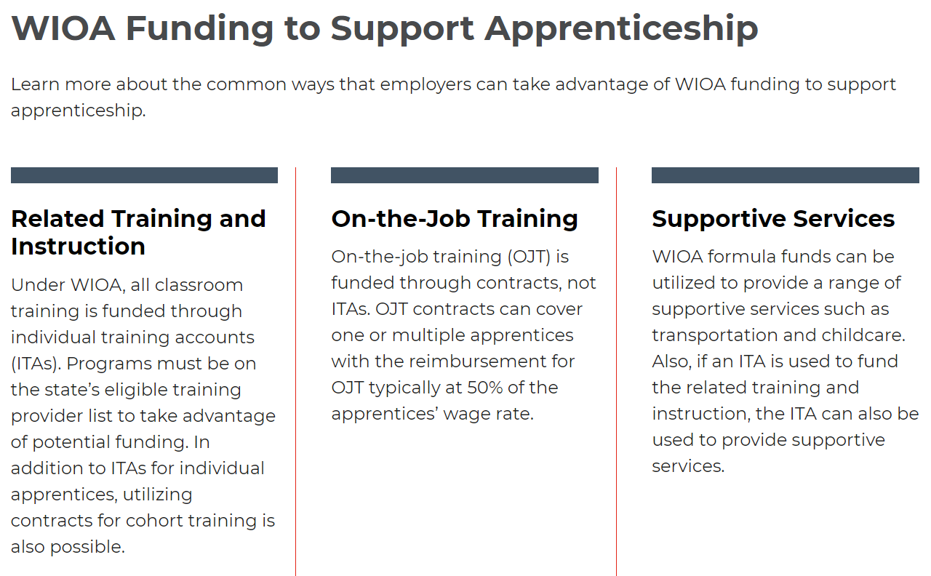

Partnership with WIOA is Important

Slide 11

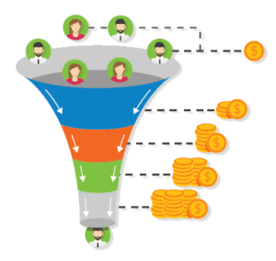


Today’s Perspectives is about Engaging Businesses but also…
About System Alignment and Partnership….
Engaging a
Diverse
Talent Pipeline
Engaging Employers
Who Invest in Developing
a Talent Pipeline

Slide 12
Learning from the Field…
National Perspective

Slide 13
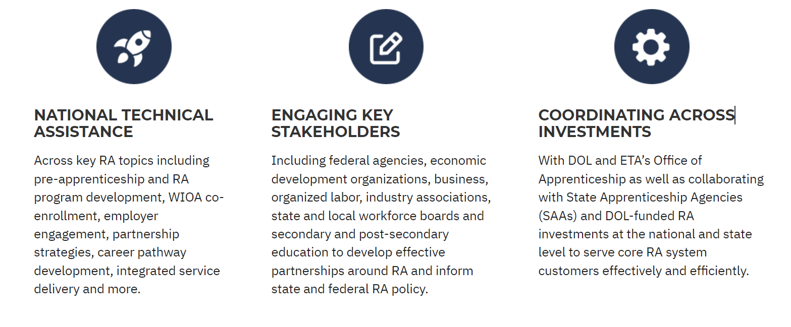

NATIONAL Perspective:
The Registered Apprenticeship Technical Assistance Center of Excellence
Mission
Build scalable, sustainable partnerships to accelerate registered apprenticeship
(RA) adoption and improve alignment with our nation’s workforce
and education systems.

Slide 14
Investment and ROI
National Apprenticeship Act of 2021
National investment $3.5 billion over five years
to expand apprenticeships across the country and is expected
to create nearly one million new apprenticeship opportunities
Expectation to yield $10.6 billion in net benefits
through increased worker productivity and decreased spending
on public-assistance programs and unemployment insurance
Sources: https://www.aami.org: National Apprenticeship Act of 2021

Slide 15
National Perspective:
Create Skilled Workers. Build Loyal Talent. Engage in Apprenticeship.
For Employers, Registered Apprenticeship….
Generates positive ROI - employers report* earning an average of $1.47 for every $1 invested in apprenticeship through cost savings and increased productivity
Reduces turnover and drives higher worker loyalty rates - 92% of all apprentices who complete a program are retained as permanent, full-time workers* and 91% are still with their employer a year out
Creates more diverse, inclusive workplaces because with a structured training program employers can widen the pool of candidates from which they source talent
Creates a platform for stronger relationships with local education and workforce partners to identify and recruit talent earlier
Provides access to unique federal and state funding and support, including tax credits, potential wage support/reimbursements, tuition support, no-cost federal bonding, supportive services for qualified apprentices and more
Source: *USDOL Office of Apprenticeship

Slide 16
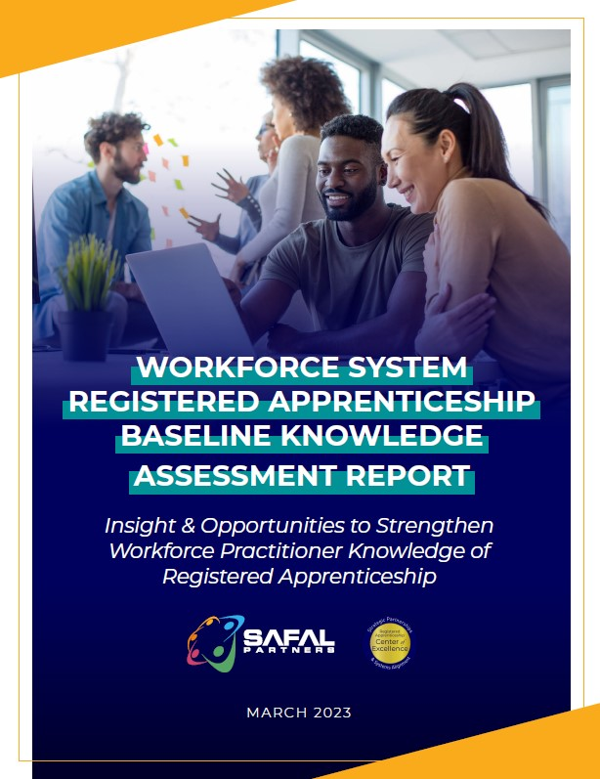
National Perspective:
Registered Apprenticeship Knowledge Survey
Key Findings…
42% had "no" or "very little" understanding of how
to communicate benefits of RA to local employers
40% had "no" or "very little" understanding of what
RA programs exist in their local area
44% had "no" or "very little" understanding of what
programs can pay for components of RA
47% of respondents indicated they had "no" or
"very little" understanding of how to convene
partners locally
Sources: Final Baseline Report.pdf (safalapps.com)

Slide 17
National Perspective:
National Perspective Summary
Actions to Take:
Learn about and understand potential Registered Apprenticeship industry successes
Partner with your local DOL Office of Apprenticeship or State Apprenticeship Agency to create registered apprenticeship opportunities
Explore Registered Apprenticeship as an effective tool for your employers
Understand how Registered Apprenticeship alignment and co-enrollment can help you with your WIOA system

Slide 18
Learning from the Field…
State and Local Perspective

Slide 19


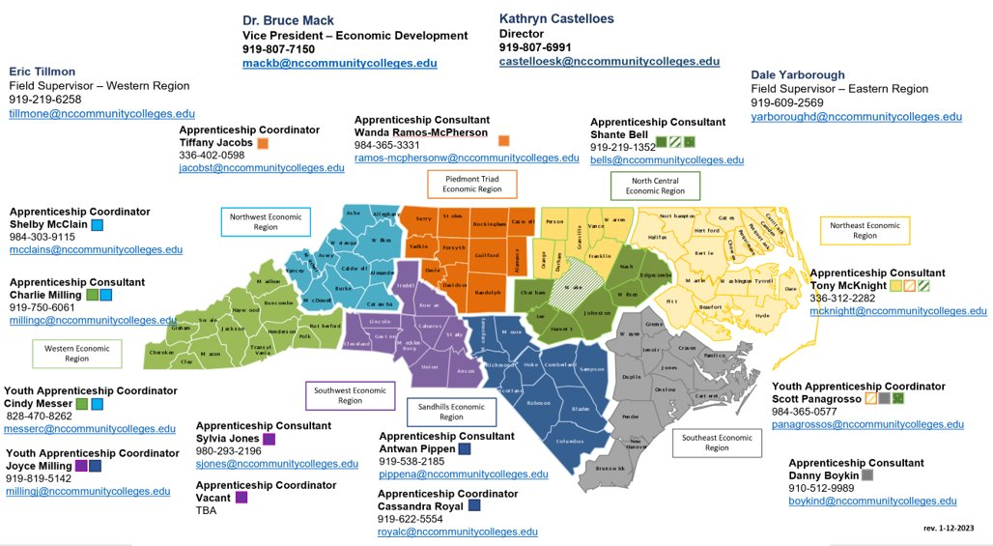
STATE Perspective: North Carolina
Sources: apprenticeshipnc.com

Slide 20
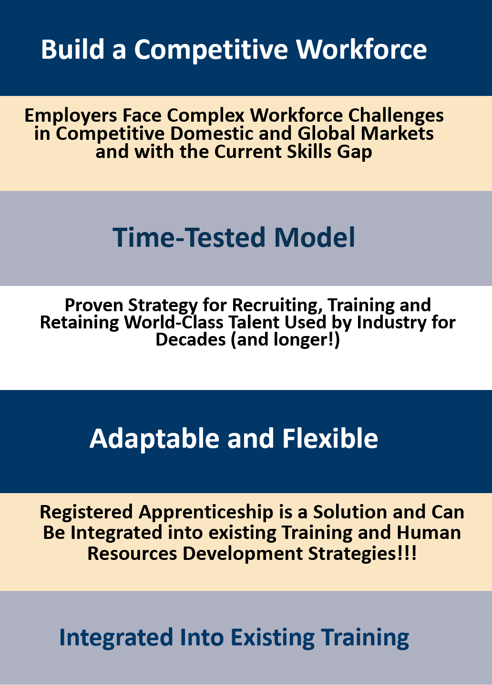
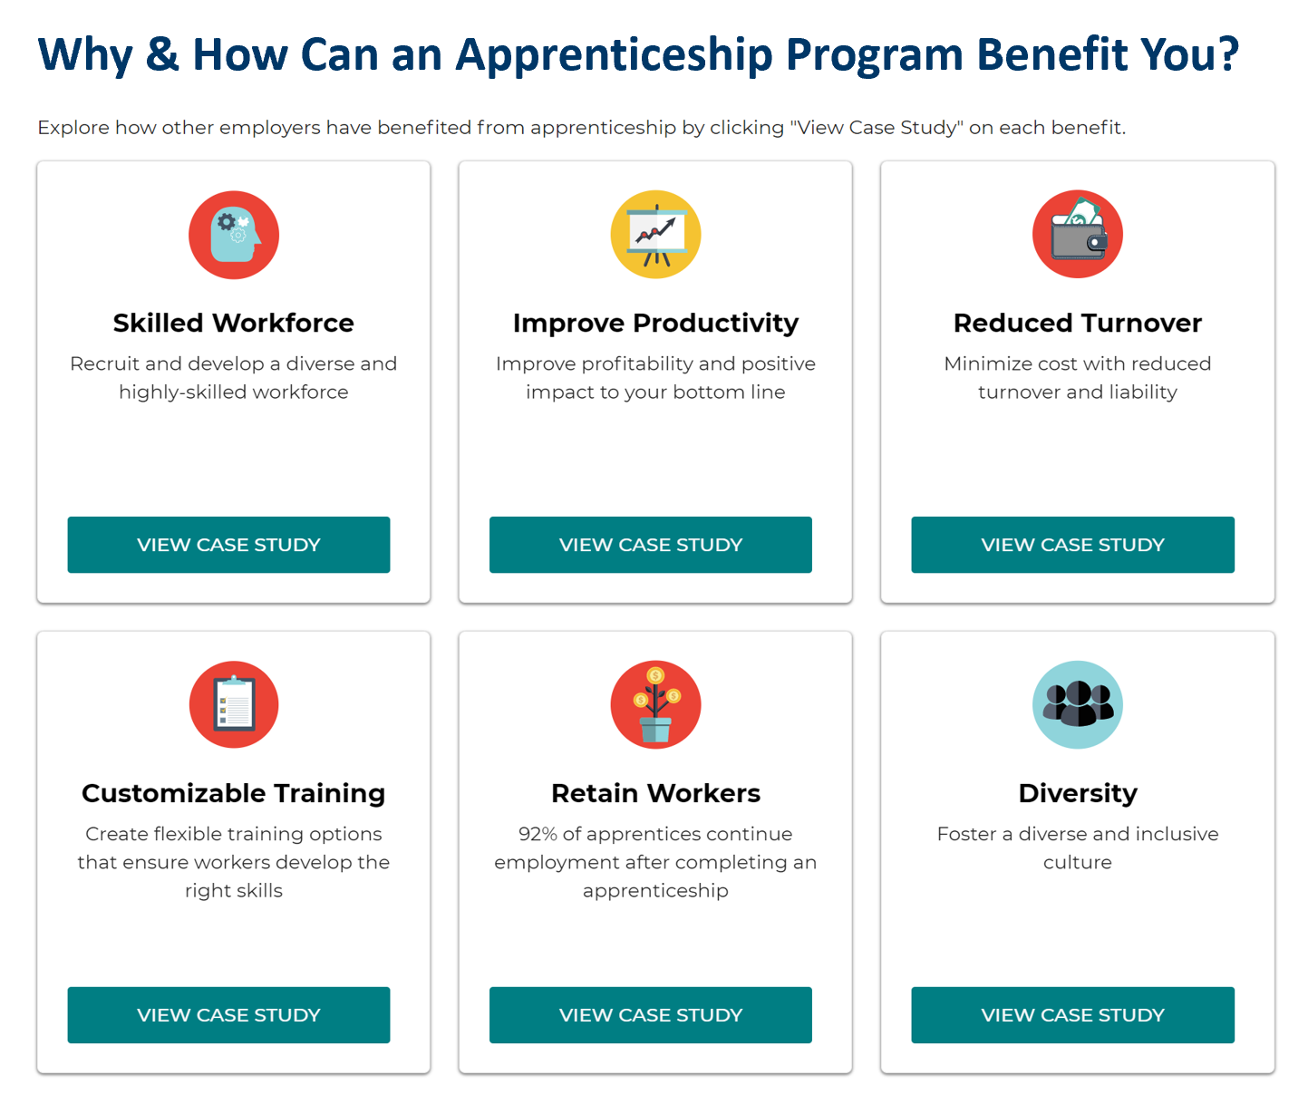
STATE Perspective: North Carolina
Source: https://www.apprenticeship.gov/employers/explore-apprenticeship

Slide 21
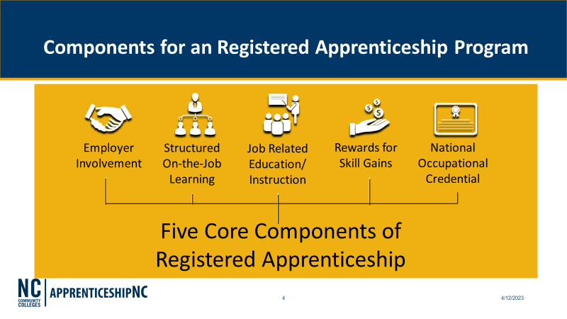
STATE Perspective: North Carolina 2

Slide 22


STATE & LOCAL Perspective: North Carolina

Slide 23
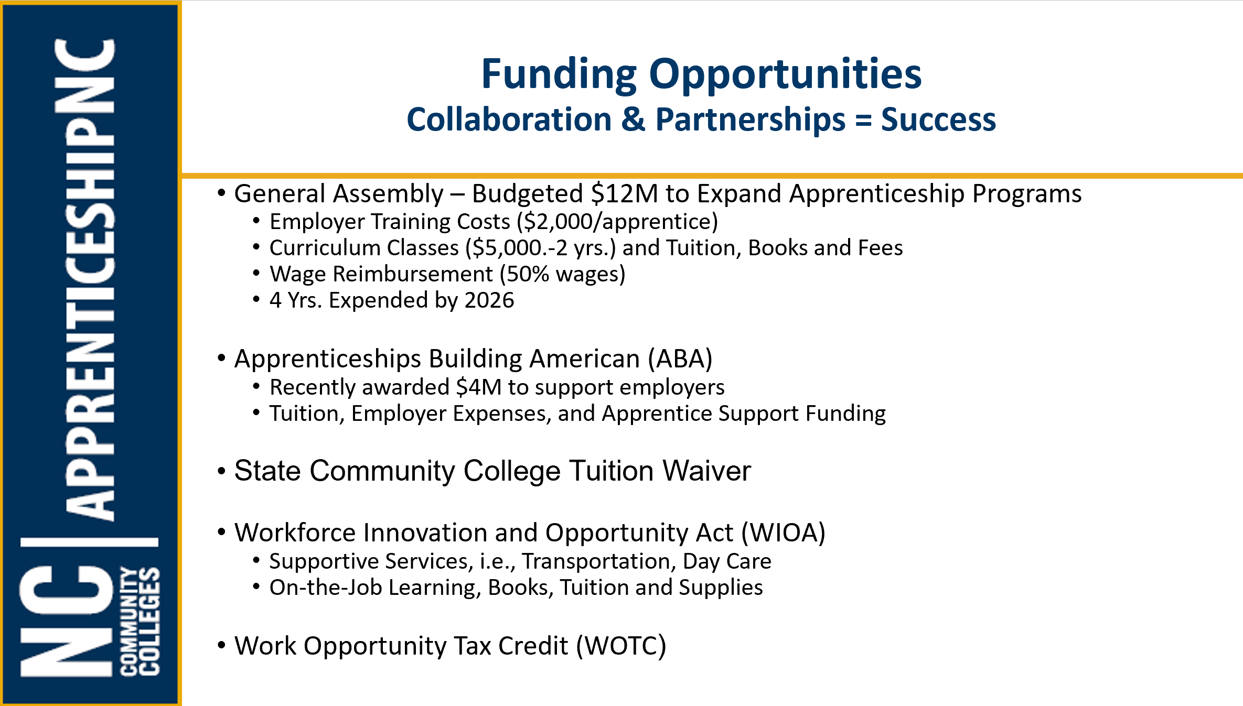

STATE Perspective: North Carolina
Source: apprenticeshipnc.com

Slide 24
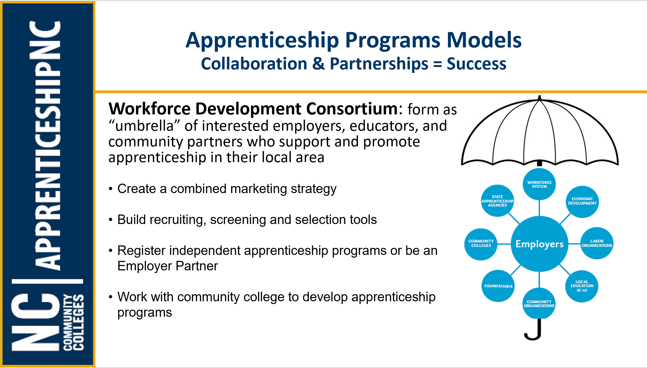
STATE Perspective: North Carolina
Sources: apprenticeship.gov; apprenticeshipnc.com

Slide 25
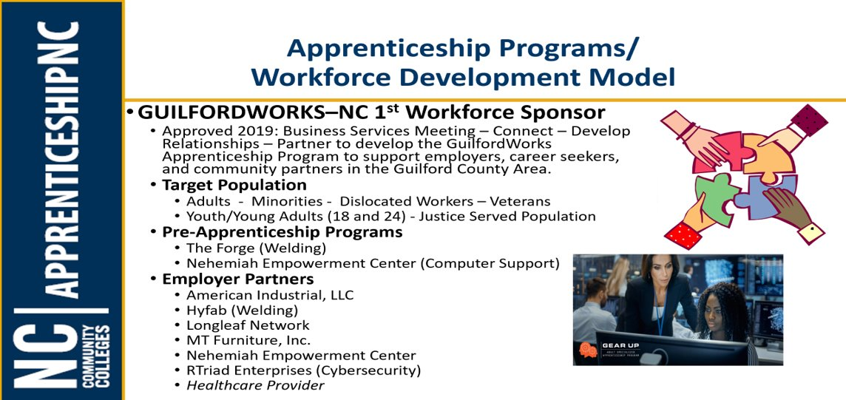
STATE Perspective: North Carolina
Source: https://guilfordworks.org/reigniting-an-existing-program Gear Up | ASAP (Adult Specialized Apprenticeship Program)

Slide 26


How We Began...
In 2018-19, GuilfordWorks formerly the Guilford County Workforce Development Board (WDB) started discussions about the need for adult apprenticeships w/various partners
Conversations intensified in 2019 w/The Forge, Guilford Technical Community College (GTCC) and ApprenticeshipNC to launch a new initiative that will lead the charge to create adult apprenticeship opportunities for adults.
In March 2020, GuilfordWorks became the first WDB Sponsored Apprenticeship Program in the Piedmont Triad Region.

Slide 27
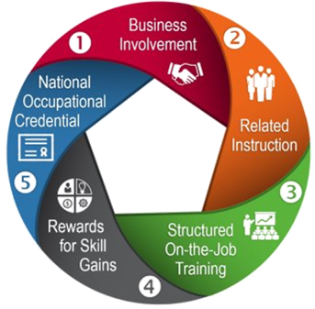
GuilfordWorks Support
We Are Here to Support Many Aspects of Your Apprenticeship Program
RELATED INSTRUCTION
WIOA funds classroom training through Individual Training Accounts, Specialty grants can also be applied; must be on Eligible Training Provider List
BUSINESS INVOLVEMENT
Our Business Services Team meets with employers to address workforce needs.
STRUCTURED ON-THE-JOB TRAINING
WIOA funds OJT through contracts, Specialty grants can also be applied
We can Support Pre Apprenticeship Training...
Work Experience
Ø We cover 100% wage
Ø280 hours of hands-on training
27

Slide 28

How to Engage Employers
Apprenticeship Speak
Business Speak
Outreach and Selection
Work Processes/ Competencies
Related Technical Instruction s
On-the-Job Training/On-the-Job Learning
Graduated Wages Scale
Certificate of Completion
Recruitment and Interviewing
Job Descriptions/Position Responsibilities
Internal/External Training, Education, or On-boarding
Mentoring/Supervision of Work, Performance Reviews
Merit-Based Increases, Performance Increases
Position/Title Change

Slide 29
We are in this TOGETHER!
Business Services
Promote Pre-Apprenticeship/Apprenticeship to employers
Sector Focus - create a strategic plan
Conducting Needs Assessments/ Pain Points Questionnaire with employers
Serve as a convener to employer and operational staff in matching candidates with employer partners
Provide support to the employer partner from the start of training and throughout training period

Slide 30
Local Perspective: Guilford Works / Co-Enrollment
Welcome
*Register NCWorks
Talent Development
*Determine WIOA
Eligibility
*Identify potential
streams & Co
enrollment
opportunities
*Needs Assessment
Recommendations
*Recommend tracks
*Complete Pre-Assessments/Interview
*Register with ApprenticeshipNC
*Enrollment in classes (if needed)
Employer
*setting up agreements (WEX/OJT)
Placement /
Track Begins
*set up Monitor /
check in periods
Employment Solutions
*Meet with
Business Services
to identify
potential candidates
in the pipeline
Sources: xxx
GuilfordWorks GEAR Up Adult Apprenticeship ISD Model

Slide 31
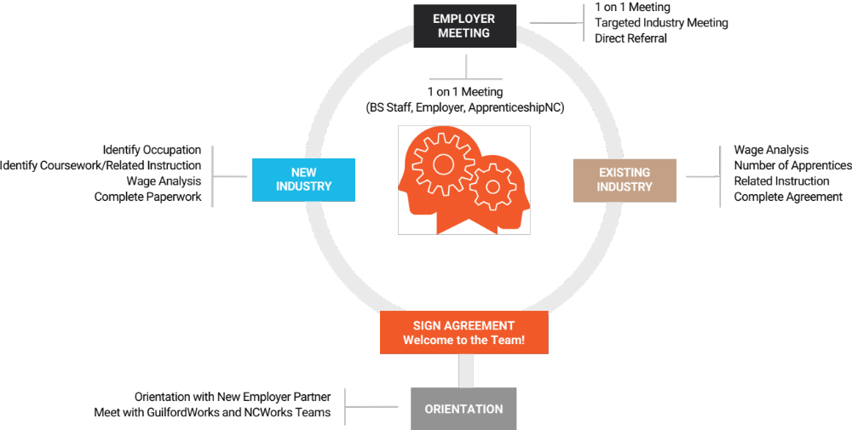

Employer Partnership Model

Slide 32
Partnerships: A Win-Win for ALL!
Our Pre-Apprenticeship/Apprenticeship Programs have best served career seekers as an opportunity to expose underserved/underrepresented populations for in demand career opportunities
Employers look to this model as a feeder to access quality talent
GuilfordWorks has been able to develop initiatives that support Reentry, Refugee/Immigrants etc. to bring CBOs and Industry together to support Apprenticeship
Ex: Forge Pre-Apprenticeship (Welding) -----> Hyfab Industries (Apprenticeship)
Ex: Nehemiah, Rtriad, Reading Connections (IT, Healthcare) -----> Cone Health, Longleaf (Apprenticeship)

Slide 33
Best Practices: What works for us!
Create Apprenticeship 101 training for operational staff
Biweekly meetings with ApprenticeshipNC facilitators
Ensure local polices are aligned with Apprenticeship objectives
Stay engaged with industry: interest meetings
Educate employers of benefits of programs and supportive services under WIOA (Co-Enrollment)

Slide 34

Any Questions?
Type your questions in the Q&A.

Slide 35

Additional Resources:
Ensuring a DEIA Lens for RA
JFF's Program Design Framework for Diversity, Equity, Inclusion, and Accessibility in
Registered Apprenticeship (JFF, 2021)
Building and Growing Apprenticeship with Equity in Mind (Grow Apprenticeship California, 2021)
Incorporating DEIA: Increasing Diverse Populations in Scaling Apprenticeship Programs (WorkforceGPS, 2022)
Growing Equity and Diversity Through Apprenticeship: Business Perspectives (JFF, 2019)
    Embedding Equity in Your Registered Apprenticeship: Strategies to Advance Diversity, Equity, Inclusion, and Accessibility in RA (JFF, 2022)
    Diversity, Equity, Inclusion, and Accessibility in Mentorship for Registered Apprenticeship (JFF, 2022)

Slide 36




Today's Presenters
Kimberly Meadows, NAWDP
  Kim@nawdp.org
Katie Adams, Safal Partners
Katie.Adams@safalpartners.com
Kathryn Castelloes, ApprenticeshipNC
castelloesk@nccommunitycolleges.edu
Wanda Ramos-McPherson, ApprenticeshipNC
ramos-mcphersonw@nccommunitycolleges.edu
Melissa Smith, Guilford Works
Melissa.Smith@greensboro-nc.gov

Slide 37


For More Info on the NEXT LEVEL NOW Collaborative…
Become a Member…
of our Next Level Now Community of Practice on WorkforceGPS!
Melissa Aguilar-Southard
  Director and SME - Safal Partners
    Melissa.Aguilar-Southard@safalpartners.com
Judy Blanchard
  Project Manager - Safal Partners
    Judy.Blanchard@safalpartners.com

Slide 38
Thank You!
We look forward to seeing you in our upcoming sessions!
Need help? Email: Support@workforceGPS.org

