Slide 1
Which program are you from?
WIOA Adult or Dislocated Worker
Other State Non-Youth Program
  TAA, Registered Apprenticeship, DWG State Grants, etc.
Youth-Focused Program
  WIOA Youth, REO Youth, YouthBuild, Job Corps, etc.
Tribal Grantees
  DINAP, etc.
Discretionary Grants Programs
  H1B, DWG Non-State Grantees, NFJP, SCC, REO Adult, etc.
State Cross-Program Reporting Staff
Other (Explain in Chat)
Let us know what programs are here!

Slide 2
Understanding
TEN No. 19-22
(with Change 1)
Reporting Training in the DOL PIRL

Slide 3

Today’s Speakers
Robert Hoekstra
Shelia Lewis
Gregory Scheib
Workforce Analyst
Workforce Investment: H-1B
Dana Westgren
Workforce Analyst
Workforce Investment: Adult Programs
Senior Program Analyst
Trade Adjustment Assistance
Senior Program Analyst
Registered Apprenticeship
Kellen Grode
Economist
Policy Development and Research

Slide 4

Today’s Agenda
Introduction
  Purpose of the TEN
  Change 1 Updates
Definitions
  What is Training?
  Training Dates
  Other Definitions
Training Types
  Distinctions Between
  More than One Applicable
Multiple Trainings
Highlights of Program-Specific Reporting
Follow Along in the Training and Employment Notice (TEN)!
https://www.dol.gov/agencies/eta/advisories/ten-19-22-change-1

Slide 5
Familiarity with the Training and Employment Notice (TEN)
What is a TEN?
What is the PIRL?
I have it, but haven’t read it.
Skimmed, but need details.
Read and have questions/comments.
Read and am just here in case someone asks a good question.
Let us know whether you’ve looked at the TEN already so we know where you’re at.

Slide 6
Let’s Get Started

Slide 7
Why TEN now?
No common understanding of training types
Inconsistent guidance on dates
Lack of meaningful technical assistance materials
Data showed grantees’ interpretations varied considerably
Common reporting and more cross-program analysis requires consistent meanings
Is this a training or not?
Skills upgrading vs. occupational skills?
Is this one training? Two trainings? Seven?
Does the training end include exams?

Slide 8

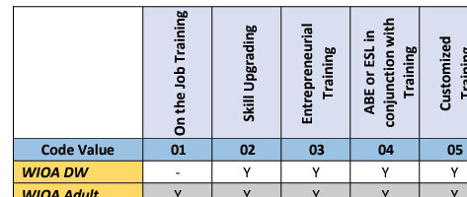
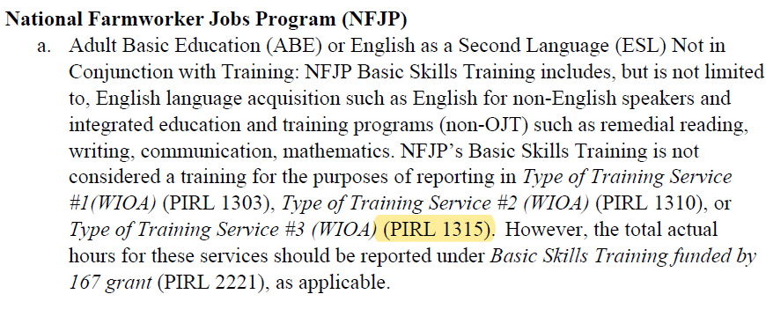
Fixed in Change 1!
WIOA Dislocated Worker can provide OJT
  Attachment I mistakenly left WIOA DW as blank for OJT
NFJP Participant Individual Record Layout (PIRL) Element Number
  Attachment II mistakenly forgot to reference the PIRL Element Number 1315 for the NFJP notation.

Slide 9
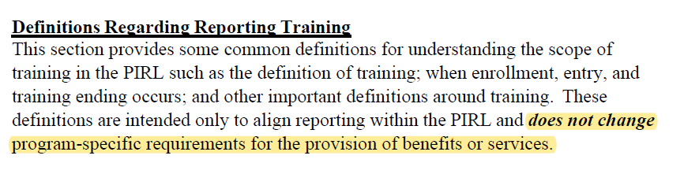
Definitions
(aka The Fun Part!)

Slide 10
Defining Training
Training
“programs that have the purpose of developing skills and qualifications to attain employment”
Not Training
“short-term, task-oriented skills development or that are related to general skills within one or more industries or occupations”
Formal occupational skills programs
Long-term certificate programs
Programs to provide specific occupational skills
Registered Apprenticeships
On the job training*
Writing workshops
Resume workshops
Health and safety certifications
Work experience
Internships
Job shadowing
*Not considered training for WIOA Youth

Slide 11

Defining Training: Exceptions
Exceptions not normally considered training (no specific occupational goal)
  Adult Basic Education (ABE)*
  English as a Second Language (ESL)*
  Job Readiness Training*
Report these as a separate training when provided in conjunction
  Allows us to track these specific services
  Important context for us in their broader learning agenda
*Not reported for WIOA Youth or H1B programs

Slide 12

Training Dates
Starting Training
Ending Training
First day the participant attends (virtually or in person)
Date Entered Training = Enrollment in Training
Last day of attendance for any service provided as part of that training
If provided as part of the service, includes the last date of examinations
Note: Some elements have additional criteria such as “leading to an associate’s degree” – Provide the date for the program that meets this requirement
This Photo by Unknown Author is licensed under CC BY-SA

Slide 13
Other Fun Definitions!
Program of Study
  One or more courses or classes / structured regimen
  Job-driven training services
  Leads to any of the following: post-secondary credential, certificate, license, secondary school diplomas or equivalent, employment, MSG
  Modality Irrelevant (in-person, online, blended)
Incumbent Worker Training
  Training
  Avert potential layoff OR skills to retain employment
Pre-Apprenticeship
  Work Experience -> Report as work experience
  MAY include an occupational skills training component -> Report as training

Slide 14
Training Types
How do I categorize this training?

Slide 15
Training Types Highlights
General
Work-Based
Occupational vs. Skills Upgrading
  Occupational Skills = new field/occupation
  Skills Upgrading = additional skills/certificates in same field/occupation
ABE/ESL – is it in conjunction?
Other Non-Occupational Skills – Yuck!
Registered Apprenticeship = under National Apprenticeship Act (NAA), structured work-based learning + related instructional
OJT* = Contract with Employer for knowledge and skills + optional instructional component*
Customized = designed to meet special requirements of employer(s) + commitment to employ after completion
*WIOA Youth reports as work experience, not training

Slide 16
When Multiple Shoes Fit
Other Non-Occupational Skills
Skills Upgrading or Occupational Skills
Prerequisite or Entrepreneurial
ABE or ESL
OJT
Customized
RA
Type must apply to the training program broadly
  i.e. no prerequisite just because there are some prerequisite classes
Use the most specific code (see hierarchy)
Must report consistently
Not all trainings are applicable for all programs (see Attachment I)

Slide 17
Multiple Trainings

Slide 18
Multiple Trainings
PIRL collects up to three trainings (for the purposes of reporting)
Allows tracking of different kinds of training being provided and different programs of study
Reporting of two trainings in the PIRL not related to other program requirements
 | Training #1 | Training #2 | Training #3
Date Entered Training | 1302 | 1309 | 1314
Type of Training Service | 1303 | 1310 | 1315
Occupational Skills Training Code | 1306 | 1311 | 1316
Training Completed | 1307 | 1312 | 1317
Date Completed, or Withdrew from, Training | 1308 | 1313 | 1318

Slide 19
Multiple Trainings
Same Training
Different Training
Multiple providers
Multiple academic calendars
Multiple funding sources
Co-Enrollment
Multiple formats, modalities, deliveries
Gaps in time
New program of study leading to a new credential
New occupational goal + modifications to training plan
New training after previous training was all completed
Concurrent programs with different training types

Slide 20
Multiple Trainings – Reporting Order
Report trainings in order of date entered (earliest = #1)
More than 3?
  First, second, and final
  Allows for us to track the first time they went into training and the last date they stopped training
Training #1
Training #2
Replaced with Final Training
Training #3

Slide 21
Program-Specific Notations

Slide 22
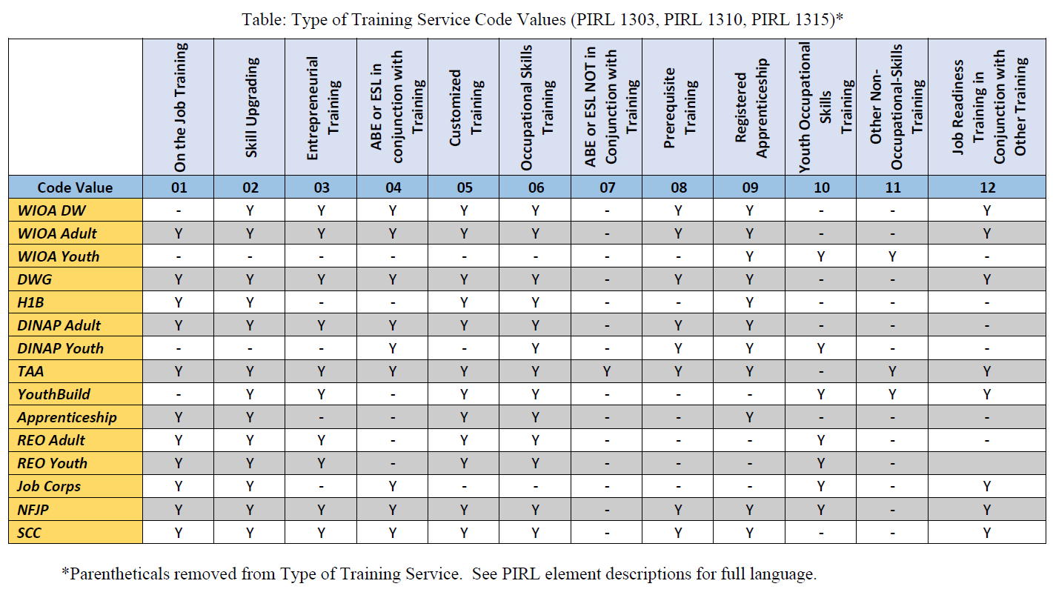
Attachment I: Types That Can Be Funded by Program
Y

Slide 23
Youth Programs
Report Youth Occupational Skills (10), not Occupational Skills (06)
  WIOA Youth
  YouthBuild
  Reentry Employment Opportunities (REO) Youth
  Job Corps
WIOA Youth Only
  No training reported for OJT, just the work experience (PIRL 1405)
  Entrepreneurial training not considered a training, instead report as Entrepreneurial Skills Training (PIRL 1413)
  Do not use training code for ABE/ESL in Conjunction with training – ABE/ESL should be reported in PIRL 1203

Slide 24
Other Programs
H1B
  Don’t report ABE/ESL as an additional training
TAA
  Report ABE/ESL as training even when not in conjunction with training
  Non-registered “apprenticeships” reported as OJT
Registered Apprenticeship
  Anything provided as part of apprenticeship program is just reported as one Registered Apprenticeship (09) training
  Pre-apprenticeship training reported as a separate training
National Farmworkers Jobs Program (NFJP)
  NFJP’s Basic Skills Training not reported in training elements, but reported under PIRL 2221

Slide 25
Any Questions?
Type your questions into the Q&A!
  We will get to as many as we can.

Slide 26
Thank You!
More questions?
Ask your program officer!
Need help? Email: Support@workforceGPS.org

