Slide 1
Promising Practices on Engaging Local Elected Officials (LEOs) -
…Yes, WIOA Can!

Slide 2

Brought to You by the…
Next Level Now Collaborative

Slide 3
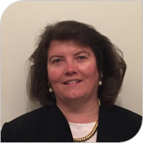
Today’s Moderator
Robin Fernkas
Deputy Administrator,
Office of Workforce Investment, Employment and Training Administration,
U.S. Department of Labor

Slide 4






Next Level Now Collaborative
U.S. Department of Labor, Employment & Training
Administration (ETA)
U.S. DOL’s ETA’s Training Hub for Workforce Grantees and Partners
Equitable Economic Recovery
WIOA Implementation
Fiscal, Administrative, Programmatic
and Operational Strategies
Sector Partnerships and Employer Engagement
Performance and Results
Live Technical Assistance Office Hours
Learn more by emailing... NextLevelNow@SafalPartners.com

Slide 5
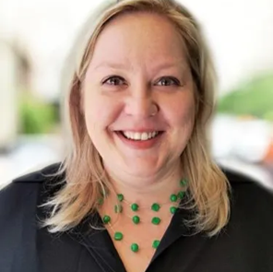
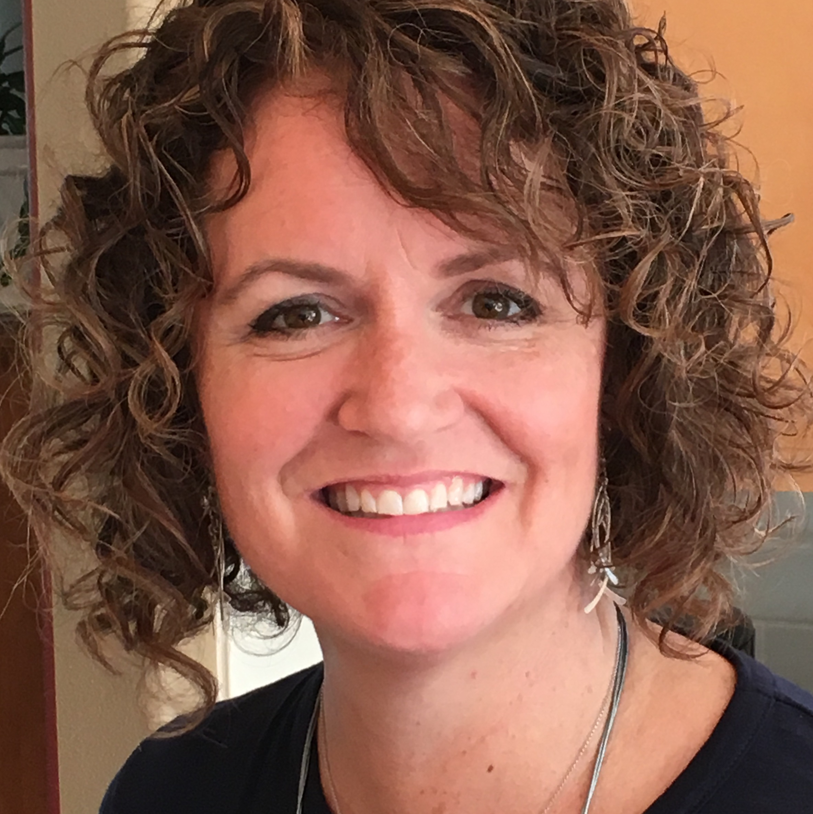
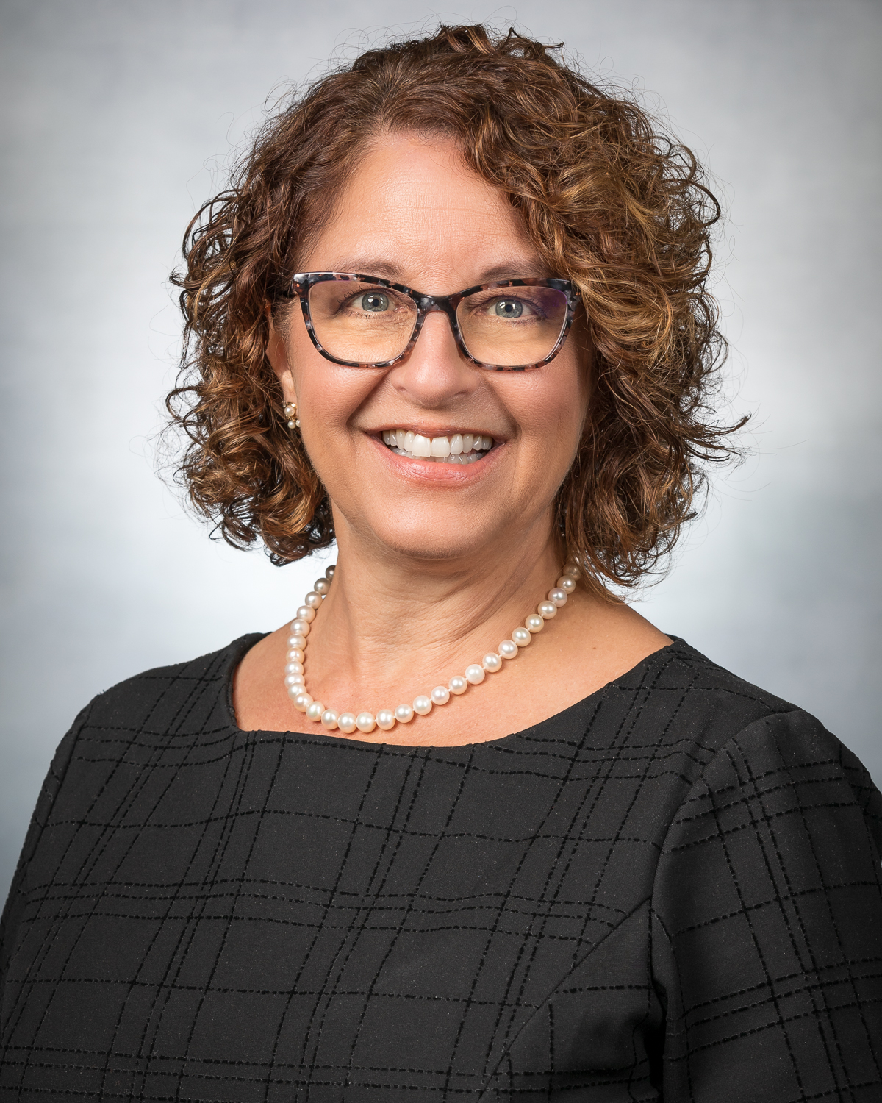
Today’s Presenters
Melanie Anderson
Executive Vice President,
National Association of Workforce Board
Kim Parker-Llerenas
Executive Director,
Willamette Workforce Partnership, Oregon
Lisa Patt McDaniel
Chief Executive Officer,
Workforce Development Board of Central Ohio

Slide 6

Agenda
Setting the Stage for Today's Conversation
Key Ideas, Strategies and Approaches
Learning from the Field
  Building and Sustaining LEO Relationships
  Breaking Down Silos and Encouraging Engagement
Q&A Session
Additional Resources
Next Steps/Engagement Opportunities

Slide 7
Engaging LEOs Poll
What category
best describes
how your organization is engaging LEOs?
Emerging- We are in the process of identifying an engagement strategy to connect with our LEOs.
Advancing- We have ongoing and existing partnerships with our local LEOs and are working to strengthen those connections.
Leading- Our LEOs are actively engaged and connected to our work, providing advocacy and support to our on-going workforce efforts.
  Select the category that best describes your organization.

Slide 8

Setting the Stage

Slide 9

Setting the Stage (101 Materials)
  Workforce Innovation and Opportunity Act Governance Training Webcast Series
  WIOA Governance
    Overview of Workforce System Governance Stakeholders
  LEO and WDB Roles and Responsibilities
    Local Workforce Development Board Roles and Responsibilities
    Roles and Responsibilities of Chief Elected Officials

Slide 10
Learning Objectives…
  Effective strategies to engage local elected officials in workforce development
  Examples of collaborative and strong relationships between local elected officials and workforce boards
  Examples of how local elected officials can and should engage and participate in activities of the workforce system
  Understanding "What's In It For Me" for LEOs as well as building the economy for the community

Slide 11
From the Field…
Key Ideas, Strategies and Approaches for Engaging Local Elected Officials

Slide 12
From the Field…
Kim Parker-Llerenas
Executive Director
Willamette Workforce Partnership
Salem, OR

Slide 13

Willamette Workforce Partnership
  4-county region represents approximately 664k residents, with a solid rural/urban divide.
  Home to the state capital, represents multiple universities and college systems, has a thriving agricultural & wine industry and holds the distinction for having the 45th parallel passing through one of its' cities.
  Fun Fact: One of their cities is hosting its 23rd annual UFO festival this year (2nd only to Roswell, NM).
  Focused Sectors: (1) Healthcare, (2) Manufacturing,
  (3) Warehousing Transportation and Distribution, and
  (4) Construction

Slide 14
Building and Sustaining LEO Relationships
  Building the Trust
  (Getting to know one-another)
  Consistent communication and touch-points
  (Building on those relationships)
  Navigating the Politics
  (Staying neutral)

Slide 15
Building and Sustaining LEO Relationships
  Building the Trust (Getting to Know One-Another)
    The Executive Director's Responsibility as the Primary Point of Contact...
      Go to the LEO! Visit them in their county/city!
      Understand what's important to the LEO for their county/city
      Weave in mandated roles and responsibilities but do it softly in conversation
          Schedule an official orientation
      Continuously relay critical or relevant information as it relates to their respective work
          Layoffs in the area, businesses who need immediate help, schools who need connections, etc.
      Help them become aware of overall workforce opportunities and challenges –
      connect the dots for them!
      Create ongoing and consistent time to spend with LEOs to foster the relationship
      Ask for their insight

Slide 16
Building and Sustaining LEO Relationships
  Maintaining Consistent Communication and Touch-Points (Building Relationships)
      Ongoing process with turnover with elections.
      Before inviting the LEOs to board meetings, orient/onboard them with information for EVERY meeting.
            NO BLINDFOLDED meetings!
            No surprises!
            Get input and solutions to problems before meetings
      For yourself and the LEO, have a 30-second elevator speech to ensure they understand and can explain their own role.
          Points to understand and interject in the elevator speech
            Understanding the needs of businesses and citizens served in LEO’s county/city/ area
            Understanding that workforce, education and economic development are all working together to achieve workforce success
            Helping businesses be proactive in times of downsizing or needing workforce assistance
            Connecting skilled and trained workforce to good paying jobs

Slide 17
Building and Sustaining LEO Relationships
  Navigating the Politics (Staying Neutral)
      Stay neutral as much as possible
      Focus on the facts of workforce challenges and opportunities
      Create a streamlined process of helping the LEO to help others in their communities
      Create, for yourself and your LEO, an elevator speech to ensure the LEO understands and can explain their role:
    Example:
    "My job in being a local elected official on the workforce board is to ensure that the citizens of my county, as well as our county's businesses have the workforce related assistance and resources available as and when needed. As your "County Commissioner/Judge Exec/title" I am here to work with business owners, employees, students.... to make sure you are prosperous in celebrating opportunities, and in challenging times and have a point of contact that you can go to for access to help.
    In the last year, we had 150K people unemployed. However, we worked to get 3K of the unemployed back into jobs. This equaled an estimated $X back into the pockets of citizens, thus raising almost $X dollars in taxes to help our community grow. Workforce is so very important to our community!

Slide 18

Building and Sustaining LEO Relationships
      Invest the time needed with your LEO
      Do your homework before the LEO meeting
      Understand LEO motivators
      Understand what they already know vs what they don’t
      They truly want to be communicated with
      Build relationships with the LEO staff
      Always help LEOs understand “WIIFM”
      in every situation
      LEOs are busy people – be effective
      and efficient as possible

Slide 19
From the Field…
Lisa Patt McDaniel
Chief Executive Officer
Workforce Development Board of Central Ohio
Columbus, OH

Slide 20

Workforce Development Board of Central Ohio
  Comprised of a single county, representing approximately 1.32-mil residents, with a very healthy rural/urban divide
  Home to the state capitol and to the world-famous The Ohio State University, is the future site of Intel and its capitol holds the distinction for being one of only several cities to never have declined in population.
  Fun Fact: Abraham Lincoln learned he had been elected president in the Ohio Statehouse (Source)
  Focused Sectors: (1) Healthcare, (2) Tech, Insurance & Finance, (3) Manufacturing and (4) Construction

Slide 21
Breaking Down Silos and Encouraging Engagement
  Soliciting their input and providing opportunity for engagement
  (Mutual goals and collaboration)
  Educating, informing and collaborating
  (Clarifying the value-add for respective communities)
  Providing opportunity to better understand the impact of the work (Understanding how a healthy workforce contributes greatly to
  the local economy)

Slide 22
Building and Sustaining LEO Relationships
Soliciting input and providing opportunity for engagement
    Local MOUs and MOAs
        Mayor of Columbus and the Franklin County Commissioners - cooperatively builds board membership
        Creates an outline as to how local and regional government can work together
        Ensures the over-arching goals/themes are addressed
        Serves to build, develop and sustaining ways of supporting the local economy and initiatives
    Hold annual discussions on mutual goals and concrete strategies for accomplishing goals and areas of collaboration
    Example:
    City of Columbus and the Board are working together on economic development deals that result in new jobs… Focuses on the talent pipeline of city residents by creating a collaborative plan with the company as soon as the deal is approved by the Mayor and City Council.

Slide 23
Building and Sustaining LEO Relationships
  Educating, informing and collaborating (Clarifying the value-add to their respective communities)
    Build “LEO Ambassadors” to establish greater support and outreach on behalf of the workforce system
    Ensure their staff understands how to showcase the workforce system for local elected officials to expand their overall knowledge of the ecosystem
    Help maintain regular communication between actual board members, LEOs and their staff, and Board Director/CEO
    Assist LEOs in staying informed on challenges facing the region and any possible strategies/approaches that exist to address the challenges
    Involve LEOs in celebrations of success or major announcements events/milestones that could be an opportunity for exposure and publicity to the overall theme of workforce (grant award announcements, opening of new service centers, groundbreaking ceremonies, etc.)

Slide 24
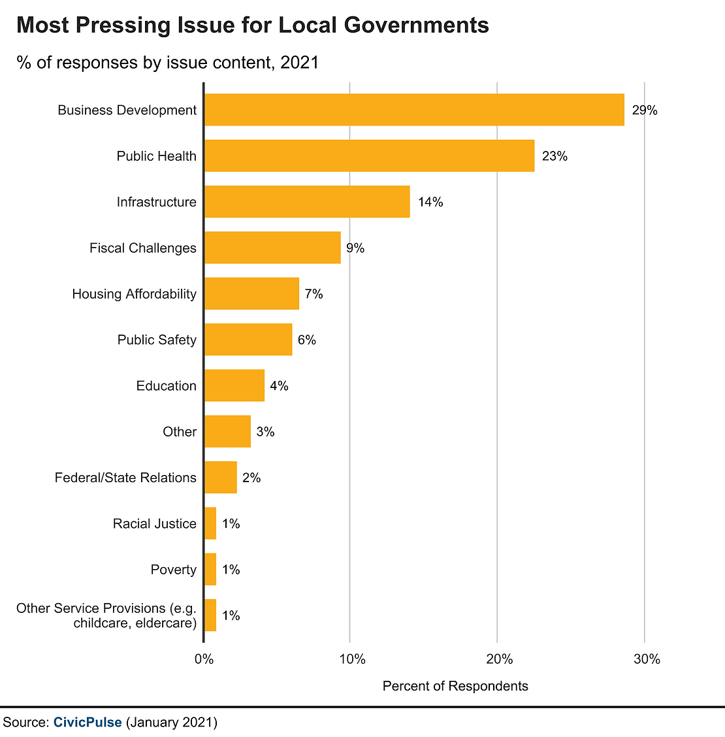
Building and Sustaining LEO Relationships
On Behalf of the LEO…

Slide 25

Any Questions?
Type your questions in the chat.

Slide 26
Additional Resources:
1. WIOA Governance and Training Webcast Series
    https://ion.workforcegps.org/resources/2022/06/23/14/26/Workforce-Innovation-and-Opportunity-Act-Governance-Training-Webcast-Series
  2. NAWB Advocacy Toolkit
    https://www.nawb.org/advocacy-and-policy/tools
3. Foundations of Governance in the Workforce Innovation Opportunity Act
    https://www.workforcegps.org/events/2020/09/30/12/38/The-foundations-of-Governance-in-the-Workforce-Innovation-and-Opportunity-Act
4. Study Workforce: Workforce 101 for Elected Officials and Boards
    https://ion.workforcegps.org/resources/2017/05/19/14/42/Workforce_101_for_Elected_Officials

Slide 27
POLL: What Engaging LEO topic(s) do you need additional assistance with, or would like to discuss with a SME?
Developing Strategies to Engage with Your LEOs
Showing the Value-Add and ROI of LEO Engagement
Identifying LEOs in Your Region
Operationalizing Your LEO engagement
(MOU, Fiscal, etc.)
Other
What Questions May We Answer?
and/or
What Technical Assistance May We Provide to You?

Slide 28

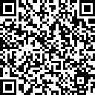
Upcoming LEO Roundtable Discussion
Audience:
Executive Directors Accompanied By Their
Local Elected Officials
Local Elected Officials
(Direct Audience)
State and/or Local Workforce Board Directors and Staff
Designated Topics to be Posted on the
NLN Community of Practice
Mark Your Calendars…
May 23, 2023
1 – 2:30 PM EST

Slide 29
Today’s Presenters.... THANK YOU!
Melanie Anderson
National Association of Workforce Board
andersonm@nawb.org
Kim Parker-Llerenas
Willamette Workforce Partnership
kparker-llerenas@willwp.org
Lisa Patt McDaniel
Workforce Development Board of Central Ohio
Email

Slide 30
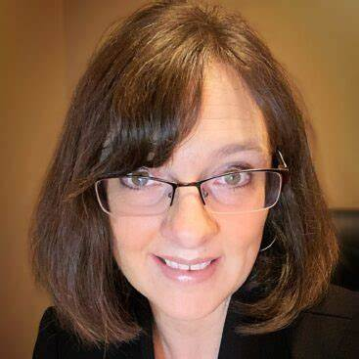
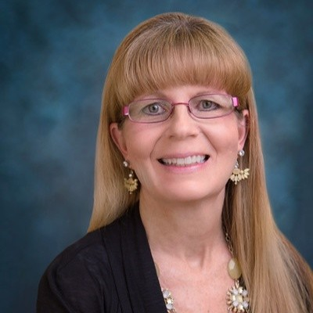
For More Info on the NEXT LEVEL NOW Collaborative…
Become a member of our Next Level Now Community of Practice!
The Next Level Now Community of Practice can be found at www.nextlevelnow.workforcegps.org/
Feel free to reach out to us to request technical assistance, ask a question or submit your promising practice!!!
Melissa Aguilar-Southard
  Director and SME
    Safal Partners
    Melissa.Aguilar-Southard@safalpartners.com
Judy Blanchard
  Project Manager
    Safal Partners
    Judy.Blanchard@safalpartners.com

Slide 31
Thank You!
We look forward to seeing you in our upcoming sessions!
Need help? Email: Support@workforceGPS.org

