Slide 1
Poll Question #1
Let’s get to know who is on the call today. Using the poll, select the role that you play in your Strengthening Community Colleges Training, Round 2 Grant.
Authorized Representative
Program Director/Manager
IT Data Manager/Staff
Training Partner
Employer Partner
Service Provider
Other (case manager, job developer, or employment specialist)
Choose the answer that best reflects you (or your organization)

Slide 2
Poll Question #2
Have you begun serving participants?
We are hard at work on activities such as hiring and partnership-building and have not yet had any contact with participants or potential participants.
We are actively recruiting participants but have not yet served any.
Training hasn’t started yet, but we are serving participants.
Participants are enrolled in and receiving training/education activities right now.
Choose the best answer that reflects you (or your organization)

Slide 3
Strengthening Community Colleges, Round Two (SCC2)
Performance Orientation 2.0

Slide 4

Today’s Moderator
Dawn J. Murphy
  Workforce Development Specialist
  U.S. Department of Labor/Employment and Training Administration

Slide 5


Today’s Speakers
Angella Alivia
  Performance and Technical Assistance
  High Impact Partners
Christina Stocks
  Workforce Analyst
  U.S. Department of Labor/Employment and Training Administration

Slide 6
Today’s Objectives
Review the performance reporting guidance for the quarters ending March 31, 2023 and June 30, 2023
Provide tips on data collection, data management, and data reporting
Provide guidance on the how to report training and employment outcomes using PIRL data elements; and
Review quarterly performance report (QPR) and the data elements that are reported

Slide 7
Report Alphabet Soup Review
WIPS:
Workforce Integrated Performance System (WIPS)
QNR:
Quarterly Narrative Report (QNR)
The QNR includes an uploaded Customized Outcomes Report (COR)
QPR:
Quarterly Performance Report (QPR)
The QPR is created by the WIPS system after a participant data file is successfully uploaded to WIPS

Slide 8
Interim Reporting Guidance Reminder for 3/31/2023 and Reporting Process for 6/30/2023
For the quarter ending March 31, 2023:
Grantees will submit a Quarterly Narrative Report (QNR) using WIPS
The QNR includes the Customized Outcomes Report (COR)
    Report due May 15, 2023
Grantees will not upload a participant data file and therefore will not submit a Quarterly Performance Report (QPR)
For the quarter ending June 30, 2023:
Grantees will submit a QNR and if your selected cohort of participants has received a grant funded service or have entered the grant enhanced program of study, a QPR.
  Report due August 15, 2023

Slide 9
Data Collection, Data Management and Reporting
Tips and Strategies

Slide 10
Three Steps for Accurately Reporting on Participants
Data Collection
Data Management
Data Reporting

Slide 11
Data Collection
What information do I need to collect?
From whom do I need to collect it?
When should I be collecting this information?
Who at my grant is going to collect it, track it, manage it, and report it?
When should I be compiling this information so I can report it on time?

Slide 12
Data Collection Tips
Develop policies, procedures, and tools for when and how the data will be collected each quarter from participants and partners that allow all the data to be reported on time.
Participants
  Use a face-to-face intermediary
  Add relevant dates to the enrollment form
  Add disclaimer language and guidance during the enrollment process so participants will understand why certain information is being collected
Partners
  Ensure partners understand definitions and why information is collected
  Develop an electronic case management system that can be transferable between program partners

Slide 13
Data Management
Where is participant data being tracked and stored?
What procedures and processes are being used to compile data in one place each quarter?
What procedures and processes are used to validate the data to ensure it is being collected and reported accurately?
What procedures are used to correct inaccurate data?
What documentation is appropriate for these data elements?

Slide 14
Data Management: Tips
Assign clear roles for each step in the process.
Set up participant files management procedures to document the data reported.
  Speak with your FPO about how data will be reviewed on a monitoring visit.
Before collecting PII, have participants sign release forms acknowledging the use of PII for grant purposes only.
Ensure the collection method is sophisticated enough to securely store participant information including PII.
  Do not leave records containing PII open and unattended.
  Store paper documents containing PII in locked cabinets when not in use.
  Use appropriate methods for destroying sensitive PII.

Slide 15
Data Reporting
How is [x event] about a participant in our program reported? (i.e., where do we go to find information about the data elements and code values)?
How is a thorough and valid data file for WIPS developed?
How can we get our data files to pass WIPS edit checks?
How often will we review our data to ensure accuracy?

Slide 16
Data Reporting: Tips
Document and validate the information you report to DOL for each data element using TEGL 23-19
Review the following Performance TA documents, depending on need:
  SCC2/3 Performance Reporting Handbook
  2021 Demonstration PIRL for SCC Grantees
  SCC Reporting Toolkit & WIPS Technical Guide
  SCC2 Performance Reporting Orientation Webinar 1.0, 2.0 and 3.0 (scheduled for June 7, 2023)
Resources are located here:
SCC2/3 Performance Reporting Resources Page
Correct any errors DOL notified you about in previous quarter’s submission
Review the QPR and check it against your own records and progress against targets

Slide 17
Demo Participant Individual Record Layout (PIRL) Data Elements
2021 PIRL for Demonstration Grants (including SCC)

Slide 18
Demo PIRL Schema – Tab 2 and 2b
DATA ELEMENT NO. | DATA ELEMENT NAME | DATA TYPE/ FIELD LENGTH | DATA ELEMENT DEFINITIONS/INSTRUCTIONS | CODE VALUE | DEMO PROGRAM REQUIREMENTS | SCC PIRL for Data Collection and Reporting
N/A | OBS Number | IN 9 | Record a unique nine integer number for each record.to support processing | 000000000 (No hyphens) | R | Yes
100 | Unique Individual Identifier (WIOA) | AN 12 | Record the unique identification number assigned to the participant. At a minimum, this identifier for a person must be the same for each program entry and exit (i.e., "period of participation") that… | XXXXXXXXXXXX | R | Yes
1302 | Date Entered Training #1 (WIOA) | DT 8 | Record the date on which the participant's first training service actually began. Leave blank if the participant did not receive a first training service or this data element does not apply to the participant. | YYYYMMDD | R | Yes
1303 | Type of Training Service #1 (WIOA) | IN 2 | Use the appropriate code to indicate the type of approved training being provided to the participant. NOTE: If OJT or Skill Upgrading is being provided as part of a Registered Apprenticeship program, choose Code 09. NOTE: Code 06 should only be utilized when other codes are clearly not appropriate. Record 00 if the participant did not receive a training service. Leave blank if this data element does not apply to the participant. | 01 = On the Job Training (non-WIOA Youth). 02 = Skill Upgrading 03 = Entrepreneurial Training (non-WIOA Youth) 04 = ABE or ESL (contextualized or other) in conjunction with Training 05 = Customized Training 06 = Occupational Skills Training (non-WIOA Youth)… | R | Yes

Slide 19
Demo PIRL Schema – Tab 3, Tab 4 and Tab 5
Tab 3: Validation Rules
  This tab provides the order in which participant data files are checked for errors in WIPS.
Tab 4: Valid Rules
  This tab lets you know if a logic rule is currently in effect. Logic rules can change as WIPS is updated.
Tab 5: Duplicate Rules
  This tab describes the duplication rules that WIPS follows when checking a participant data file.

Slide 20
Demo PIRL Schema – Tab 6
Element Number | Element Name | Rule | This Logic Rule Applies to the Current WIPS Reporting Quarter Please Note: Logic Rules are Subject to Change as System Development Continues
200 | Date of Birth (WIOA) | A) IF Date of Program Entry (WIOA) (PIRL 900) is NOT blank, THEN Date of Birth (WIOA) (PIRL 200) is Mandatory Field | Yes, this is a current logic rule.
1302 | Date Entered Training #1 (WIOA) | C) IF Type of Training Service #1 (WIOA) (PIRL 1303) = 1 - 12, THEN Date Entered Training #1 (WIOA) (PIRL 1302) is Mandatory Field | Yes, this is a current logic rule.

Slide 21
Demo PIRL Schema – Tab 7
Aggregations for the quarterly performance report (QPR)
REPORT ITEM NUMBER | IDENTIFIER (Definition) | WIPS AGGREGATION RULE
A-2 | Total Participants Served (Cohort Period: mm/dd/yyyy - mm/dd/yyyy) | Count of UNIQUE RECORDS where ([PIRL 105] = DEM1111 and DATE OF PROGRAM ENTRY [PIRL 900] <= end of the report period)) and (DATE OF PROGRAM EXIT [PIRL 901] => beginning of the report period or DATE OF PROGRAM EXIT [PIRL 901] is null)

Slide 22
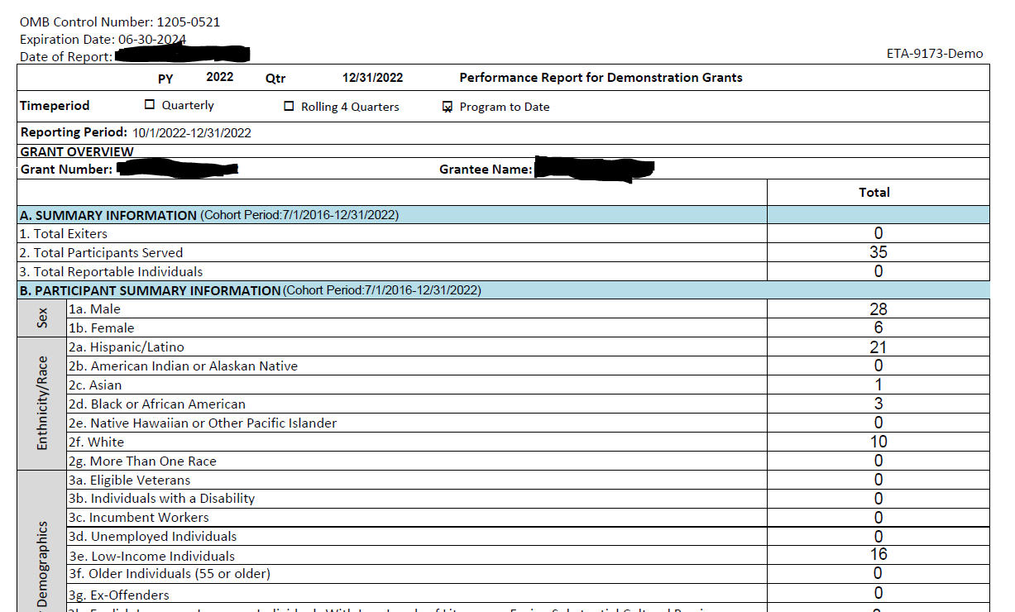
Demo PIRL Schema – Tab 8

Slide 23
PIRL Data Element Sections
Section I - Individual Information (DEs 100-803)
Section II - Program Participation (DEs 900-938)
Section III - Services and Activities (DEs 1203-1409)
Section IV - Program Outcomes (DEs 1800-1813)
Section V – Employment Outcomes (DEs 2101-2700)

Slide 24
Section I – Individual Information
Participant demographics
Employment status at entry
Special project ID codes

Slide 25
Employment Status at Program Entry for Participants
PIRL 400 Employment Status at Entry
Logic Rule: Mandatory Field; Must Not be Blank
Underemployed: (PIRL 400 Code Value = 1 Employed AND PIRL 2101: Underemployed Worker; Code Value 1 = Yes)
Unemployed: (PIRL 400: Employment Status at Program Entry; Code Value = 0)
Employed (PIRL 400: Employment Status at Program Entry; Code Value = 1)
Incumbent Worker: (PIRL 400 Code Value = 1 Employed AND PIRL 907: Recipient of Incumbent Worker Training; Code Value = 4 H-1B Funded Grant)
Participant Status at Entry is Key. It does not change in WIPS.

Slide 26
PIRL 105, 106, 107: Special Project ID Codes
Data Element | Data Element Definition
PIRL 105 | Special Project ID – 1
PIRL 106 | Special Project ID – 2
PIRL 107 | Special Project ID – 3
Reporting Guidance:
Data elements to indicate use of the demonstration schema and which grant program
Grantees will use PIRL 105 to indicate use of the demonstration schema = DEM1111
Grantees will use PIRL 106 to indicate which round of SCC
  SCC, Round 1 = SCC1111
  SCC, Round 2 = SCC2222
  SCC, Round 3 = SCC3333

Slide 27
Section II and III – Program Participation Information and
Services and Activities
Dates of Program Entry
Dates of Exit
Types of Training Activities
Work Experience Opportunities
Supportive Services

Slide 28
Reporting Participants
PIRL 900 Date of Program Entry
  The date an individual has received a grant funded service or training after they have been determined eligible by the grantee.
  An example of a service that would require grantees to report individuals as participants in PIRL 900 is an assessment.
  In some cases, the date of program entry may be the same as the date a participant begins training.

Slide 29
Date of Program Exit
When do I report Date of Program Exit (WIOA)?
  PIRL 901 Date of Program Exit is the date in which the participant received their last grant-funded service
  This PIRL data element is reported in your data file 90 days after the participant received their last grant-funded service
  The DATE entered in this PIRL should be the date of the last grant funded service
    Not the same as Date of Completion (PIRL 1813)
    Should be entered retroactively!
TIP! At the end of each quarter as you prepare your QPR, check participant files for participants who did not receive any grant-funded services within the quarter and report the date of the last service received as their exit date in PIRL 901.

Slide 30
Reporting Education/Training Enrollment
PIRL 1302 Date Entered Training #1
    The date the participant’s first training service started
      Work-based learning component and/or educational/instructional training
PIRL 1303 Type of Training Service #1
  SCC grantees can only use:
    01 = On the Job Training (non-WIOA Youth).
    02 = Skill Upgrading
    03 = Entrepreneurial Training
    04 = ABE or ESL in conjunction with training
    05 = Customized Training
    06 = Occupational Skills Training (non-WIOA Youth)
    08 = Prerequisite Training
    09 = Registered Apprenticeship
    12 = Job Readiness in conjunction with other training
Two additional training services can be separately reported:
  Date Entered Training #2/ Type of Training Service #2 (PIRL 1309/1310)
  Date Entered Training #3/ Type of Training Service #3 (PIRL 1314/1315)

Slide 31
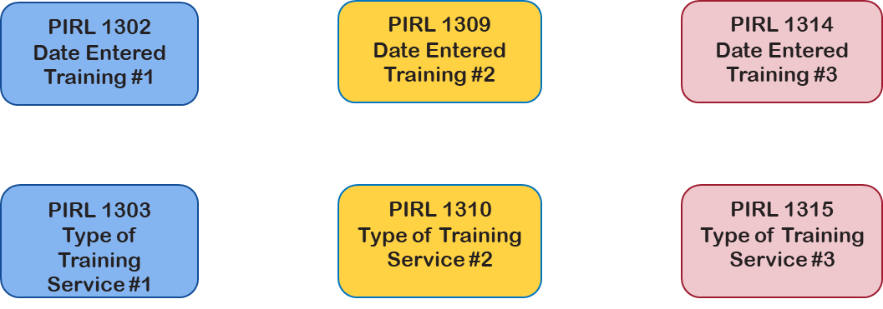
Reporting Training Outcomes
How do I report Training Activities?
  1303, 1310, 1315: Remember SCC Grantees will only use the nine code values shared on the last slide

Slide 32
Reporting Education/Training Completion
If a date is reported in any of PIRL 1302/PIRL 1309/PIRL 1314, then PIRL 1307/PIRL 1312/PIRL 1317 must be reported before reporting that a participant has completed their program or exits your grant program.
PIRL 1307/1308 Training Completed #1/Date Training #1 Completed
PIRL 1312/1313 Training Completed #2/Date Training #2 Completed
PIRL 1317/1318 Training Completed #3/Date Training #3 Completed

Slide 33
Supportive Services - *Optionally Reported*
PIRL 1409 = Most Recent Date Participant Received a Supportive Service
  Supportive Services: Services necessary to ensure an individual is able to participate in education and training funded through this grant program.
  Examples include:
    Transportation
    Housing
    Childcare and dependent care
    Needs-related payments
    Tools
  Grantee may provide in the form of:
    Direct services
    Vouchers
    Stipends

Slide 34
Any Questions?
Enter your questions in the Q&A.

Slide 35
Section IV and V – Program Outcomes and SCC Specific Outcomes
Dates of Program Enrollment and Completion
Types and Dates of Recognized Credentials Received
Underemployment at Program Entry
Employment and Employment Retention Outcomes
Social Security Numbers

Slide 36
Date Enrolled in a Program Leading to a Credential
PIRL 1811 – Date Enrolled in an Education or Training Program Leading to a Recognized Postsecondary Credential or Employment
It encompasses all of the individual training components that are reported in PIRL 1302/1309/1314
You should note that this is different from PIRL 900
  PIRL 900 is the date a participant enters your program and receives any grant-funded service

Slide 37
Types and Dates of Recognized Credentials
PIRL 1800/1802/1804:
The type of credential for the first three types of credentials obtained
PIRL 1801/1803/1805:
The dates the credentials were obtained
NOTE: If a participant receives more than three types of credentials, grantees are encouraged to replace data for the third type with the highest credential received to date in 1804/1805.

Slide 38
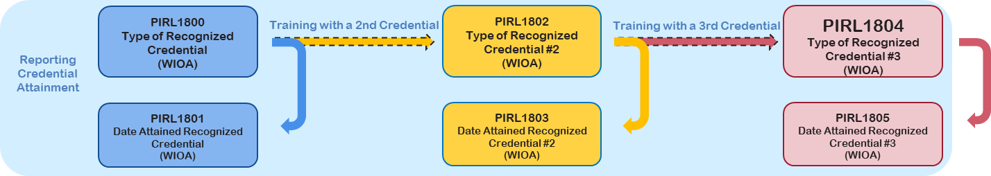
Reporting Credential Attainment
When do I report Credential Outcomes?
  Flexibility to report up to three credentials for one training activity
  Report code value 0, if no credentials earned
  Review TEGL 14-18 and TEN 25-19 for further guidance on credentials

Slide 39
Reporting Completion and the Related Employment Outcome
PIRL 1813 – Date Completed an Education or Training Program Leading to a Recognized Credential or Employment
  Participants must complete all training components of their program.
PIRL 2118 Date Entered Employment
  Non-incumbent worker participants who completed their training components of their program and enter employment.
PIRL 2126 Entered Training-Related Employment
  Non-incumbent worker participants who completed their training components of their program and enter employment that is training-related.

Slide 40
Reporting Employment Outcomes for Incumbent Workers
PIRL 2119 Incumbent Workers Retained Current Position
  Used to report this outcome measure if an incumbent worker completed their program and retained their current position in the following quarter.
PIRL 2120/2122/2124 Incumbent Workers Advanced to New Employment
  Used to report if an incumbent worker has advanced to a new position that requires a higher level of skill, either with their current employer or new employer.
  Incumbent workers must complete their program and advance into a new position with the employer or with another employer within three quarters after completion.
  A new position of employment with a different employer may or may not have a different title or job description from the previous occupation.

Slide 41
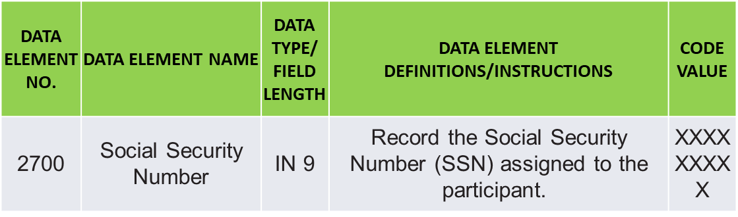
Guidance for Collecting Social Security Numbers
Grantees must ask participants for their SSNs
However, if an individual chooses not to disclose their SSN, services can not be denied
If no SSN is provided, use 999999999 for PIRL 2700

Slide 42
Any Questions?
Enter your questions in the chat window (lower left of screen)

Slide 43
PIRL Demonstration Grants
QPR Aggregation Rules

Slide 44
Demo QPR aggregation Rules
Grantee Database System
CSV Data File Upload in WIPS
QPR Generated
Data File
Data Elements And Edit Checks
aggregation Rules
Overview of aggregation Rules
  Rules to aggregate performance data into SCC QPR data
  Includes total participants served, number began and completed training, credentials, and employment outcomes
  Ensure aggregation rules are applied to grantee’s internal systems for calculating QPR data

Slide 45
Demo Quarterly Performance Report aggregations
QPR Sections
  Grant Summary Information (e.g., participants served, exits, etc.)
  Participant Summary Information (demographics)
  Program Services and Training Activities (e.g., service types, began training, etc.)
  WIOA Primary Indicators of Performance (e.g. employment rate, median earnings, etc.)
  Effectiveness in Serving Employers (Retention with the Same Employer in the 2nd and 4th Quarter After Exit)

Slide 46
WIOA Primary Indicators of Performance
WIOA Primary Indicators of Performance | Description
1. Employment Rate – 2nd Quarter After Exit | Percentage of participants who are in unsubsidized employment during the second quarter after exit from the program.
2. Employment Rate – 4th Quarter After Exit | Percentage of participants who are in unsubsidized employment during the fourth quarter after exit from the program.
3. Median Earnings – 2nd Quarter After Exit | Median earnings of participants who are in unsubsidized employment during the second quarter after exit from the program.
4. Credential Attainment Rate | Percentage of participants enrolled in an education or training program who attain a recognized postsecondary credential during participation in or within one year after exit from the program.
5. Measurable Skills Gains | Percentage of program participants who, during a program year, are in an education or training program that leads to a recognized postsecondary credential or employment and who are achieving measurable skill gains.
6. Effectiveness in Serving Employers (Retention of your participants with the same employer in the 2nd and 4th quarter after exit) | Retention with the same employer in the 2nd and 4th quarter after exit.

Slide 47
WIOA Primary Indicators of Performance Calculations
WIPS retrieves participant employment and earnings outcomes through a secure third-party system using Social Security Numbers (SSNs)
WIPS will populate QPRs with the missing information
  This process may take up to 30 days
  SSNs must be in the file for WIPS to retrieve WIOA outcomes (PIRL 2700)
WIPS is only able to retrieve outcomes information for individuals with a social security number (SSN) in the participant data file

Slide 48
WIOA Primary Indicators of Performance on QPR
CSV Data File
Measurable Skills Gains
Credential Attainment
Employment Rate – 2nd Quarter After Exit
Employment Rate – 4th Quarter After Exit
Median Earnings – 2nd Quarter After Exit
Effectiveness in Serving Employers

Slide 49
Real-Time Performance Measures
Real-Time Performance Measures | Real-time Performance Outcomes as Captured in the QPR
Total participants served | A2. Total Participants Served
Total participants enrolled in education/training activities | C4. Received Education/Job Training Activities
Total participants who complete education/training activities | C5. Completed Education/Job Training Program Activities
Total number of participants that have obtained measurable skills gains | D5. Measurable Skill Gains

Slide 50
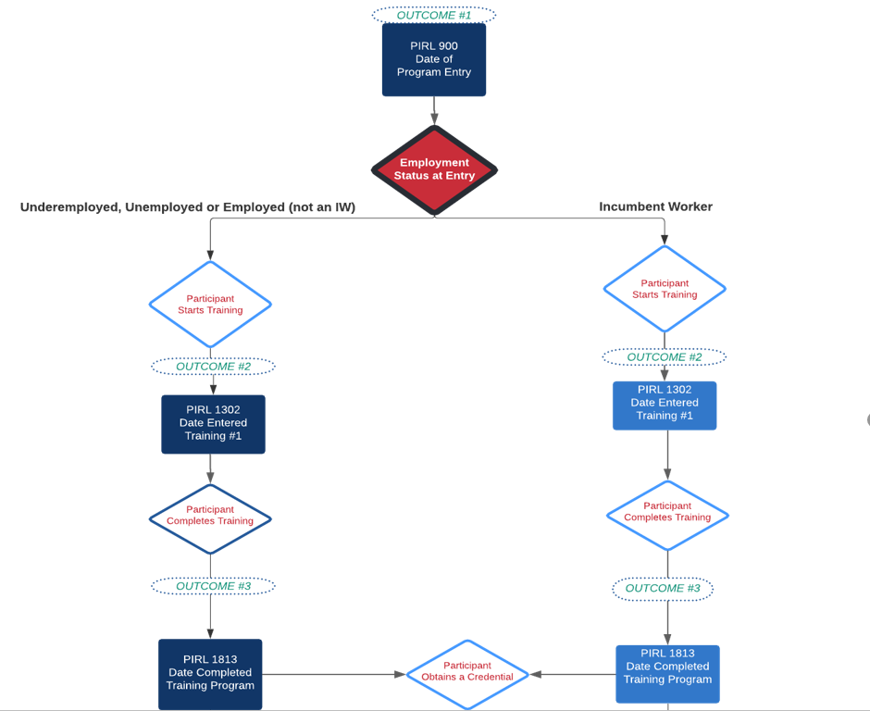
Flow Chart: Reporting the Real-Time Outcomes

Slide 51
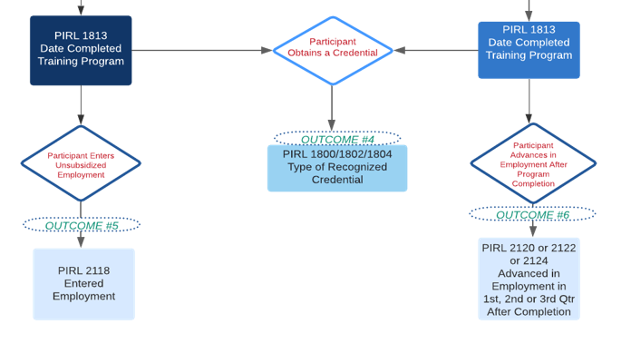
Flow Chart: Reporting the Real-Time Outcomes (continued)

Slide 52
Poll Question & Discussion: Tracking Systems
What system are you using to track and report your grant’s participant level data?
Existing MIS system
Third-Party Vendor
Excel Spreadsheet
Access Database
Other
Choose the answer that best reflects you (or your organization)

Slide 53
Any Questions?

Slide 54
Next Steps:
Your Action Items
What should you do …

Slide 55
Quarter Ending 3/31/2023 – Reporting Reminders
Next Steps for Grantees:
  Submit the QNR and COR in WIPS for the quarter ending 3/31/2023 due 5/15/2023
  Begin preparing for your first QPR submission (this may be for quarter ending 6/30/2023):
    Start or continue collecting and tracking information on your participants in your selected cohorts
    Start or continue developing internal reporting systems that align with the data elements in preparation for submission of data to WIPS
    Attend Performance Reporting Webinar 3.0 on June 7, 2023, 3:00pm ET.

Slide 56
SCC Performance Reporting Phase-In
Q1
12/31/23
Narrative
Submitted via email to FPO and SCC@dol.gov
Q2
3/31/23
Narrative +
Outcomes
Submitted in WIPS
Q3
6/30/23
Narrative + Outcomes + Participant Data*
Submitted in WIPS

Slide 57
Questions?
  Contact:
    SCC@dol.gov
Please make sure to cc: your FPO.

Slide 58
Any Questions?

Slide 59
Thank You!

