Slide 1
Native Americans and the Opioid Epidemic: Finding Solutions in the Workplace

Slide 2
Today’s Moderators
Ashley Moore
  Workforce Analyst
  Division of Adult Services and Governance
  Office of Workforce Investment
  Employment and Training Administration
  US Department of Labor
Vivian Clarke, Osage Nation
  Student Intern
  Division of Adult Services and Governance
  Office of Workforce Investment
  Employment and Training Administration
  University of North Carolina at Chapel Hill

Slide 3
Today’s Speakers
Spero Manson, PhD
Little Shell Chippewa | Distinguished Professor, Director of Centers for American Indian & Alaska Native Health, and Colorado Trust Chair in American Indian Health at the Colorado School of Public Health at the University of Colorado Anschutz Medical Campus
Jacky England
Cherokee Nation | Manager, Career Programs with Cherokee Nation
Matt Lamont
Cherokee Nation | Director of Reentry & Justice Involved Programs with Cherokee Nation
Johnna Williams
Chickasaw Nation | (PRSS) Peer Recovery Support Specialist with Chickasaw Nation
Jennifer Davis
Cherokee Nation | Career Specialist I with Cherokee Nation

Slide 4
American Indians and Alaska Natives: At a Glance

Slide 5


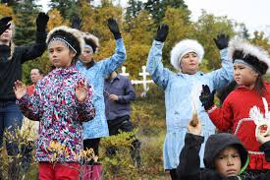
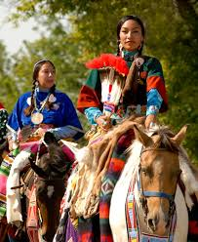
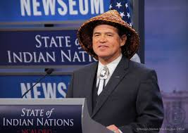
American Indians and Alaska Natives: At a Glance
According to the 2020 U.S. Census, 1.7% of the U.S. population — or 5.2 million people — identified as American Indians/Alaska Natives (AI/AN) alone or in combination with another race.
574 federally recognized tribal nations; more than 100 state-recognized tribes
Approximately 75% of AI/AN live in our cities, although many migrate back and forth to rural or reservation homelands.
Trust doctrine is a source of federal responsibility to AI/AN requiring the federal government to support tribal self-government and economic prosperity, duties that stem from the government's treaty guarantees to protect Indian tribes and respect their sovereignty.

Slide 6
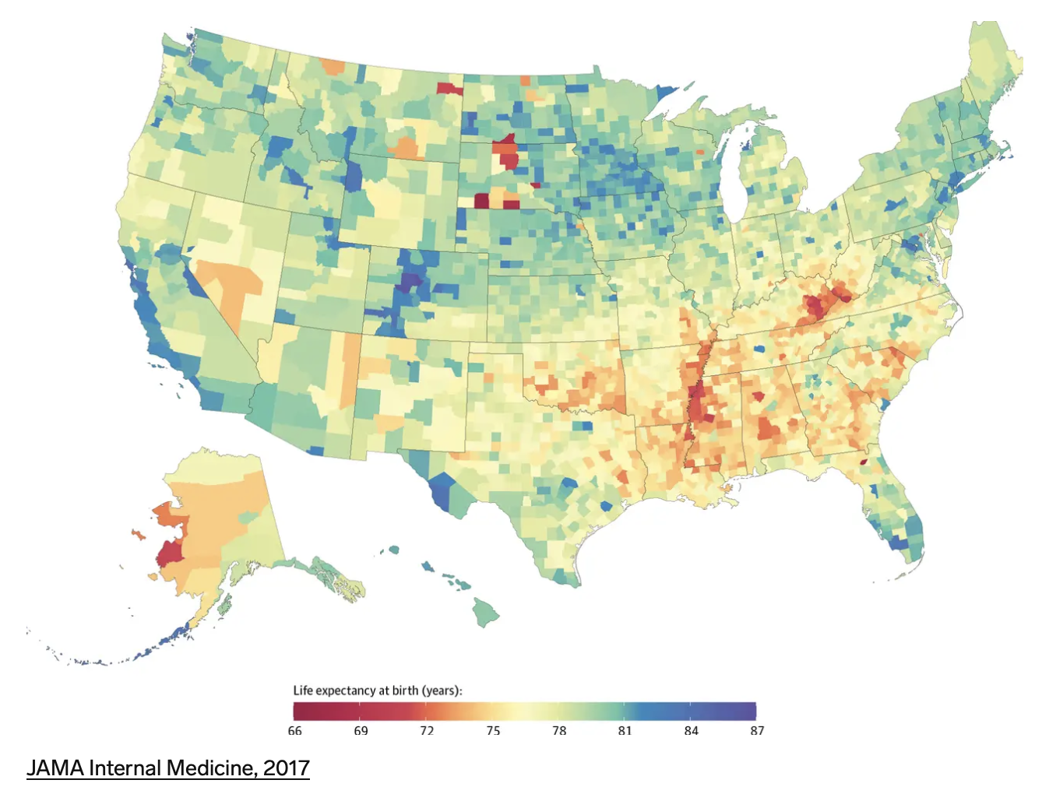
Life Expectancy of American Indians and Alaska Natives

Slide 7
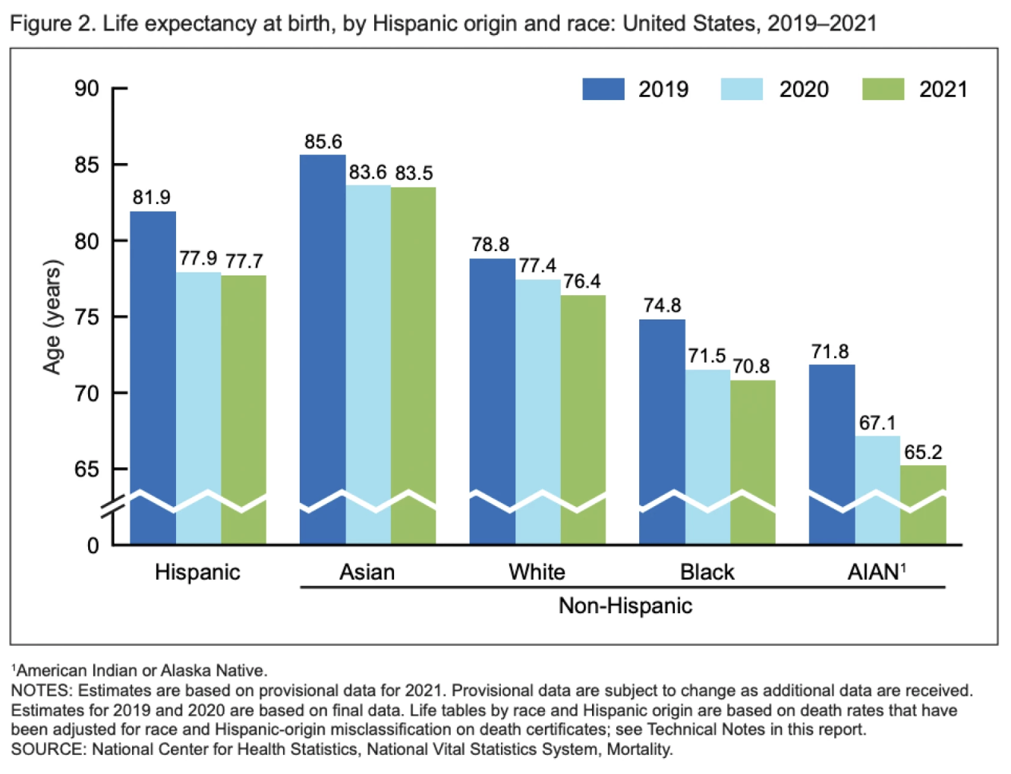
Life Expectancy of American Indians and Alaska Natives

Slide 8



Social Determinants of Health
Educational Attainment
  In 2020, 84.4% of AI/AN alone or in combination had at least a high school diploma compared to 93.3% of non-Hispanic Whites (NHW).
  20.8% of AI/AN age >25 had at least a bachelor's degree compared to 36.9% of NHW.
  7.6% of AI/AN held an advanced graduate or professional degree compared to 13.9% of NHW.

Slide 9
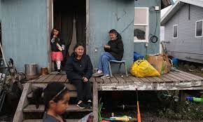

Social Determinants of Health
Economics
  Median household income for AI/AN was $49,906 compared to $71,664 NHW.
  7.9% of AI/AN were unemployed compared to 3.7% for NHW.
  Overall unemployment rate for AI/AN was 7.9% compared to 3.7% for NHW.
  32.0% of AI/AN >age 16 work in management and professional occupations compared to 44.8% of NHW.
  2019, 20.3% of this population live at the poverty level, as compared to 9.0% of NHW.

Slide 10
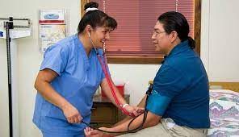

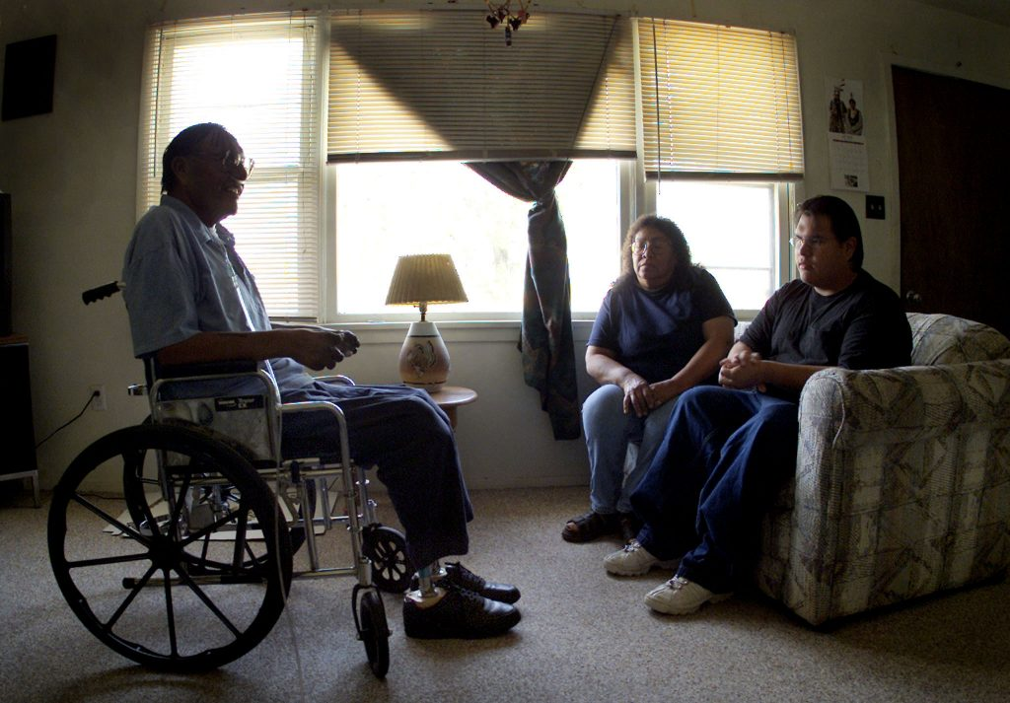
Social Determinants of Health
Insurance Coverage
51.9% of AI/AN alone or in combination had private health insurance coverage compared to 74.7% of NHW.
42.1% of AI/ANs relied on Medicaid or public health insurance coverage compared to 34.3% of NHW.
14.9% of AI/ANs had no health insurance coverage compared to 6.3% of NHW.
Causes of Death
Some of the leading diseases and causes of death among AI/AN are heart disease, cancer, unintentional injuries (accidents), diabetes, and stroke.

Slide 11

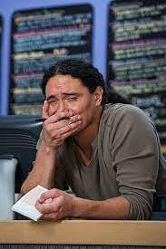
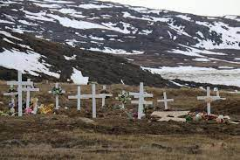
American Indians and Alaska Natives:
The Behavioral Health Landscape
AI/AN experience serious psychological distress 1.5 times more than the general population.
AI/AN experience PTSD more than twice as often as the general population.
The overall death rate from suicide AI/AN adults is about 20 percent higher compared to NHW.
Approximately 9% of AI/AN >ages 18 had co-occurring mental illness and substance use disorder in the past year—almost three times that of the general population.
Substantial disparities in social determinants of health contribute to their poorer mental health and employability.

Slide 12
The Opioid Epidemic in Indian Country
Opioids include:
    Prescription products such as oxycodone, hydrocodone, morphine, methadone, and fentanyl, and
    Illegal drugs including heroin and illicitly manufactured fentanyl.
American Indians and Alaska Natives had the second-highest rate of opioid overdose out of all U.S. racial and ethnic groups in 2019, and the second and third highest overdose death rates from heroin and synthetic opioids, respectively, according to the Centers for Disease Control and Prevention.
Johnson & Johnson and three major U.S. drug distributors agreed to pay nearly $590 million to Native American tribes heavily affected by the opioid crisis to resolve litigation against the companies.

Slide 13
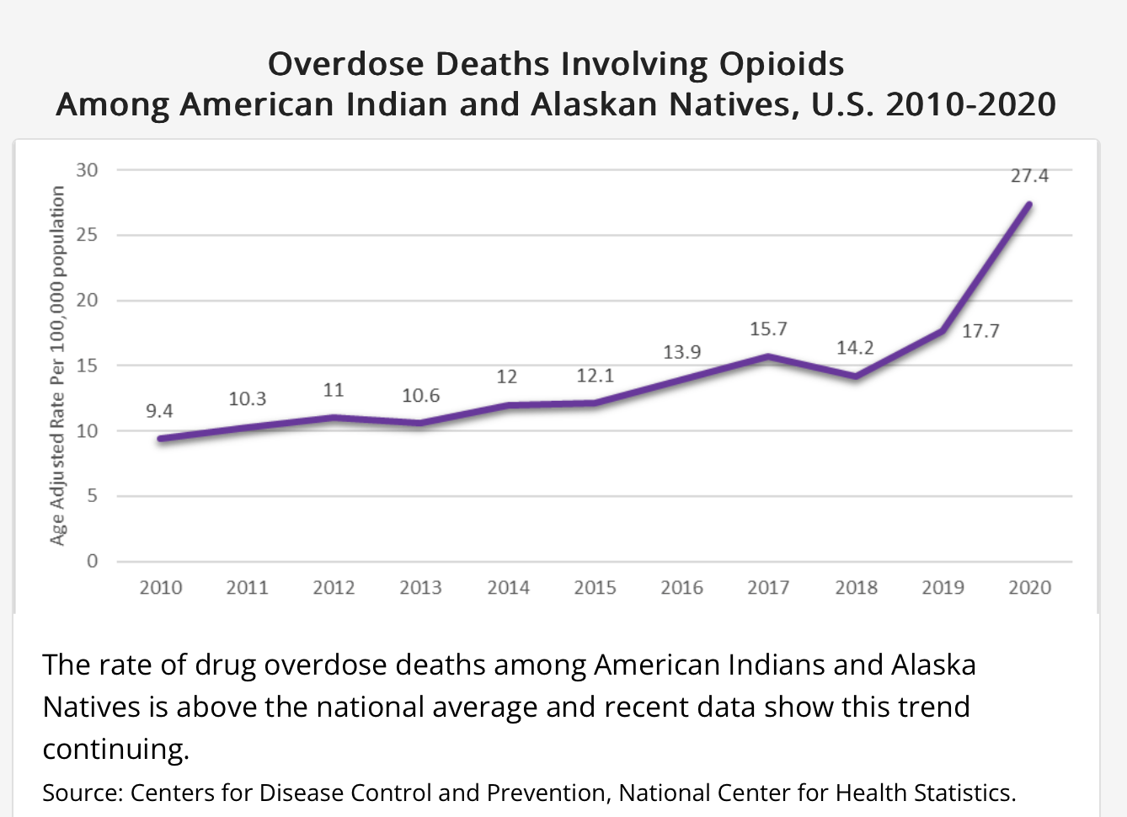
Opioid Overdose Deaths among Native People

Slide 14
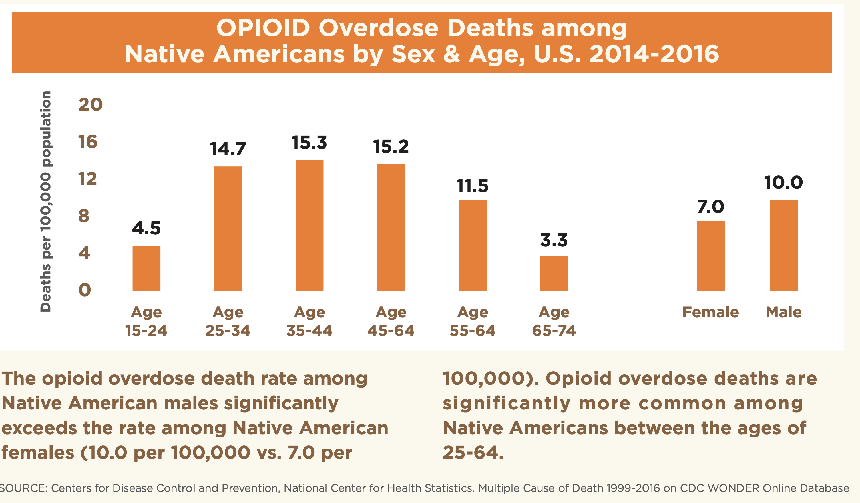
Opioid Overdose Deaths among Native People

Slide 15
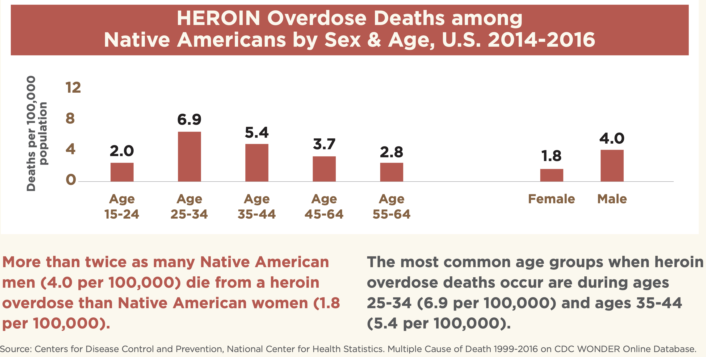
Heroin Overdose Deaths among Native People

Slide 16
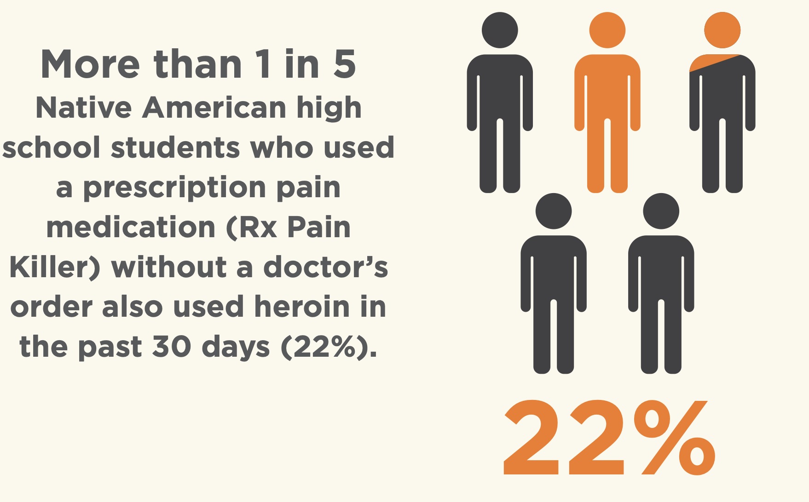
Opioid Use among Native Youth

Slide 17
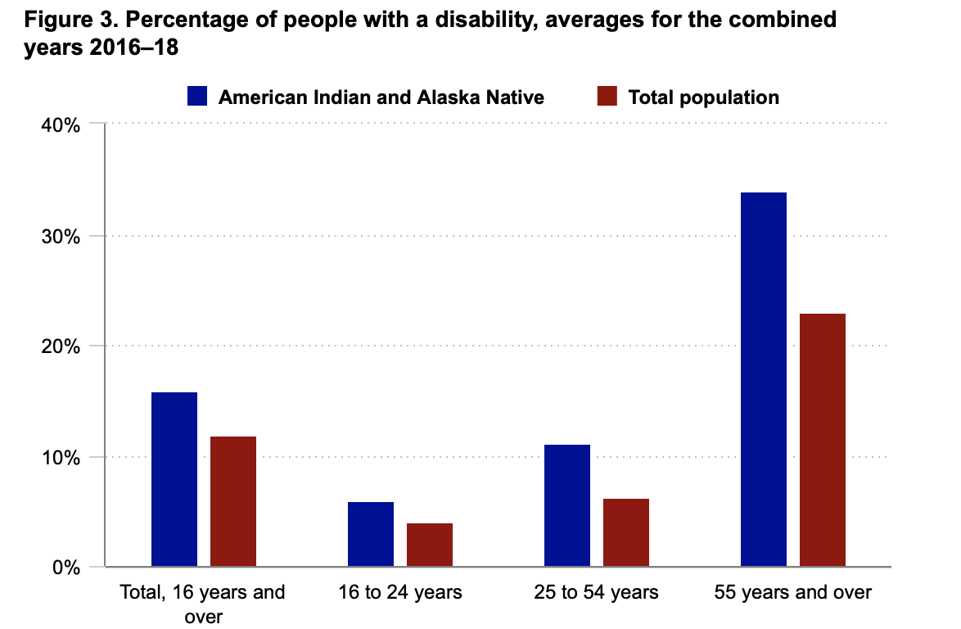
Disability among American Indians and Alaska Natives

Slide 18
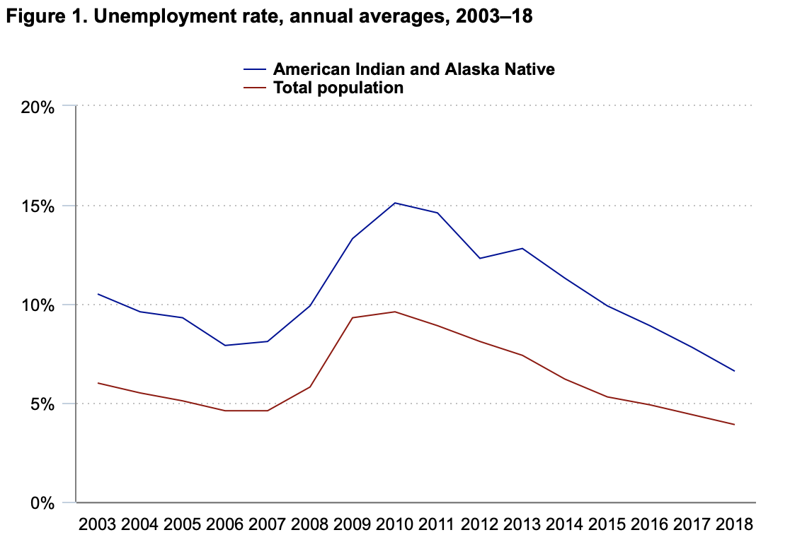
Disability Unemployment among Native People

Slide 19
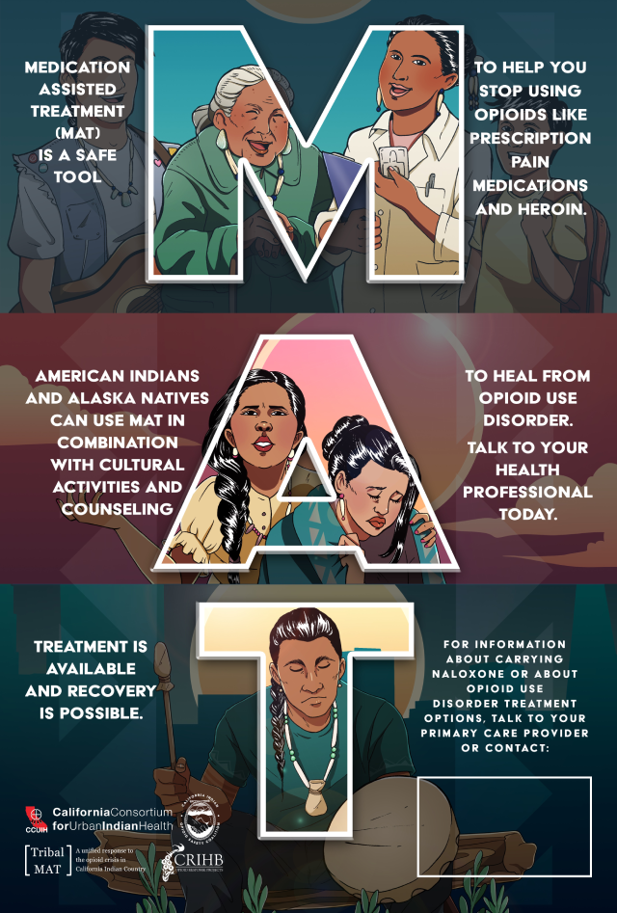
Treatment of Opioid Addiction among Native People
First national survey of tribal substance abuse treatment programs.¹
Clinicians or clinical administrators from 192 programs.
Cognitive Behavioral Therapy (82.2%), Motivational Interviewing (68.6%) and Relapse Prevention Therapy (66.8%) were most commonly implemented psychosocial evidence-based treatments (EBT).
Medications for psychiatric comorbidity was the most commonly implemented medication treatment (43.2%).
¹Novins DK, Croy CD, Moore LA, Rieckmann T. Use of evidence-based treatments in substance abuse treatment programs serving American Indian and Alaska Native communities. Drug Alcohol Depend. 2016 Apr 1;161:214-21. doi: 10.1016/j.drugalcdep.2016.02.007. Epub 2016 Feb 10. PMID: 26898185; PMCID: PMC4817996.

Slide 20


Treatment of Opioid Addiction among Native People
Greater evidence-based treatment knowledge and use were associated with both program (e.g., funding) and staff (e.g., educational attainment) characteristics.
Only two of the commonly implemented psychosocial EBTs -- Motivational Interviewing and Relapse Prevention Therapy --were endorsed as culturally appropriate by a majority of programs that had implemented them (55.9% and 58.1%, respectively).
Many users of these EBTs continue to have concerns about their cultural appropriateness, which likely limits their further dissemination.
¹Novins DK, Croy CD, Moore LA, Rieckmann T. Use of evidence-based treatments in substance abuse treatment programs serving American Indian and Alaska Native communities. Drug Alcohol Depend. 2016 Apr 1;161:214-21. doi: 10.1016/j.drugalcdep.2016.02.007. Epub 2016 Feb 10. PMID: 26898185; PMCID: PMC4817996.

Slide 21
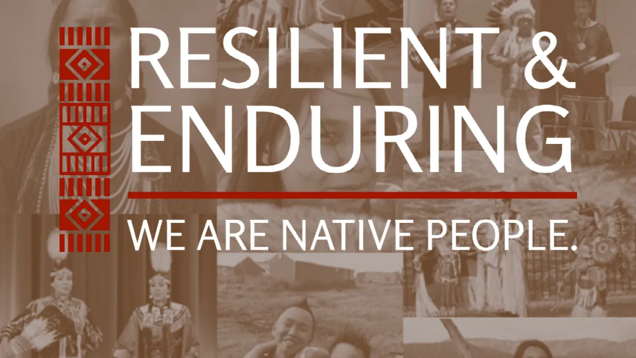

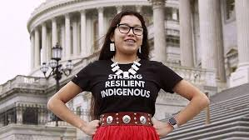

Slide 22
Cherokee Nation

Slide 23
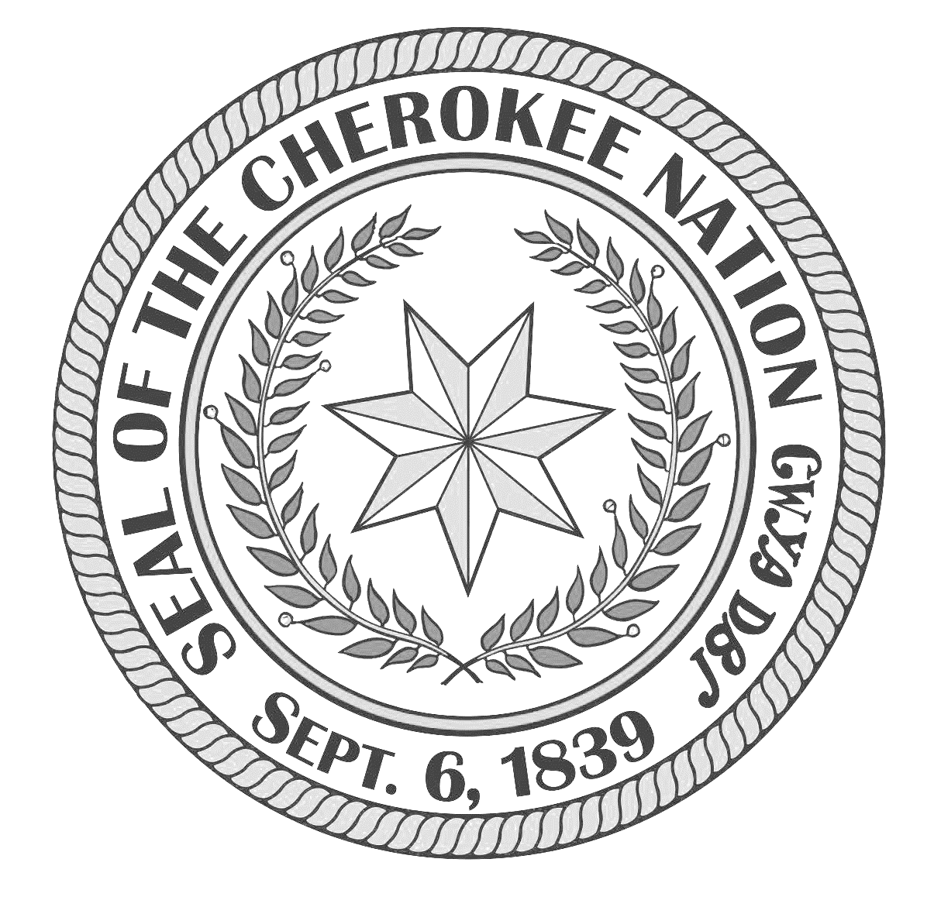
Cherokee Nation
Career Services Presenters:
Jacky England
Manager, Career Programs
Matt Lamont
Director of Reentry & Justice Involved Programs

Slide 24
2020 Dislocated Worker Demonstration Grant to address Opioid Crisis- Summarization
Introduction- focusing on the 14 county Cherokee Nation Reservation area, description of this area, and the type of populous within.
Impact/Need Statement- reviewing the impact the Opioid Crisis has had on Oklahoma and then highlighting how this number is even greater for Native American citizens- higher even than the general public-
Economic and Employment Conditions Demonstrate Additional Federal Support Needed- this covers how the services to address the Opioid crisis, and treatment is lacking in Oklahoma. Thus establishing our basis as to why this grant would make a huge impact- To establish services and increase access to assistance.
Death rates for drug poisoning and drug poisoning involving opioid analgesics and heroin for American Indian/Alaska Native by sex (Drug poisoning deaths per 100,000 resident population)
 | 1999 | 2000 | 2005 | 2010 | 2011 | 2012 | 2013 | 2014 | 2015
Male | 5.7 | 6.1 | 10.8 | 11.8 | 12.9 | 12.8 | 12.9 | 15.9 | 16.0
Female | 4.6 | 3.7 | 8.6 | 9.7 | 10.7 | 12.2 | 11.6 | 11.2 | 11.3

Slide 25
2020 Dislocated Worker Demonstration Grant to address Opioid Crisis- How we Started
Service Delivery: Community Partnerships- Identifying the community partnerships that were established, and highlighting why these connections are important for the overall evidence based treatment for opioid addiction, collaborating with Behavioral Health entities.
Service Strategies- How we incorporated Career Services staff and Behavioral Health staff to carry out services, establishing a baseline for treatment, and how to build a treatment plan upon intake with a participant.
Occupational Skills Training- How we concentrated on training programs that provided the participant with an industry-recognized credential or certificate through: On-the-Job Training, Work Experience, Direct placement, Supportive Services, Vocational Training and one-on-one services provided by Career Services and Behavioral Health Services.
Overall Goal- Establish a one-on-one support system through Career Services to enhance life skills, one-on-one support system through Behavioral Health to increase skills towards sobriety, and establish a healthy work experience to increase future employability.

Slide 26
Guest Speakers-
Jennifer Davis- Cherokee Nation
  Career Specialist I
Johnna Williams- Chickasaw Nation
  (PRSS) Peer Recovery Support Specialist

Slide 27
Dislocated Worker Demonstration Grant to address Opioid Crisis- Looking Ahead
Coming Home Reentry Program
  History
  Addition of “Justice Involved”
Moving Forward
Career Recovery Programs
  Reentry
  Justice Involved
  Vocational Rehabilitation
  Recovery & PRSS
  Partnerships – Behavioral Health, Employment & Training Sites
Focus on making sure that the individual is ready and worksites
are appropriate

Slide 28
Any Questions?

Slide 29
DOL’s Resources and Technical Assistance
National Dislocated Worker Grants Community of Practice
https://dwg.WorkforceGPS.org
Opioid Crisis Page -
Upcoming webinars
Related resource materials
Research
Case studies

Slide 30
Save the Dates: 2023 Spring Opioid Webinar Series
Recovery Ready Workplace Resource Hub ✔
    March 30, 2023
Trauma Informed Care – OVERVIEW ✔
    May 2, 2023
Native Americans and the Opioid Epidemic – Finding Solutions in the Workforce ✔
    May 8, 2023
Trauma Informed Care - SUD
    May 11, 2022
Combating Discrimination Against Individuals in Recovery
    May 23, 2023
Trauma Informed Care – YOUTH COMMUNITIES (Hosted by OWI’s Division of Youth Services)
    May 30, 2023
The Impacts of Opioid Addiction on the Rural Workforce
    May 31, 2023

Slide 31
US Department of Labor Contacts
Ashley Moore
  Workforce Analyst
    Office of Workforce Investment
    Employment and Training Administration
      Moore.Ashley.n@dol.gov
Amy Ambrose
  Workforce Analyst
    Office of Workforce Investment
    Employment and Training Administration
      Ambrose.Amy@dol.gov
Vivian Clarke
  Student Intern
    Office of Workforce Investment
    Employment and Training Administration
      vivianclarkeaz@gmail.com

Slide 32
Thank You!
Need help? Email: Support@workforceGPS.org

