Slide 1
Effective Community College-Workforce Development Board Partnerships Workshop
Strengthening Community Colleges Training Grants

Slide 2

Moderator
Dawn J. Murphy
  Workforce Development Specialist
    Division of Strategic Investments, Employment and Training Administration, U.S. Department of Labor

Slide 3
Polling Questions
1. From the perspective of your grant, please indicate where your college is at in terms of the relationship with your local workforce board(s ).
We have good relationship, are partnering effectively, and things are working well.
We would like help to improve our current relationship with our workforce board.
We do not have a relationship and would like to establish one with our local workforce board(s).
2. Please select a response to this statement:
I am clear on the purpose of a partnership with the workforce board, and why building a relationship is important to our local workforce ecosystem (outside of this being a requirement of the SCC grantee).
Yes
Somewhat
No

Slide 4
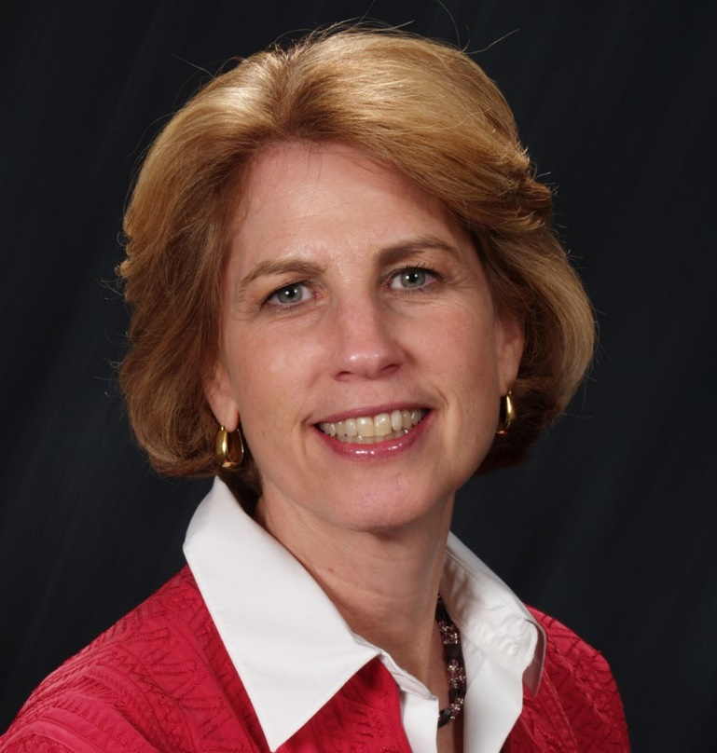

Speakers
Janet Bray
  Workforce Development Strategist
    Bray Strategies
Sheneui Weber
  Associate Superintendent, Workforce Innovations & Entrepreneurial Development,
  Chaffey Community College

Slide 5
Workforce Innovation and Opportunity Act (WIOA)

Slide 6
Workforce Innovation and Opportunity Act
Workforce Innovation and Opportunity Act (WIOA) was signed into law in July 2014.
The single largest source of federal funding for job training outside of higher ed and the GI Bill.
Also, funds ‘career services’ – helping workers find jobs, counseling, and basic job readiness.
Key themes:
  A streamlined workforce development system
  Better coordination within and across programs
  Improved outreach to disconnected youth
  Career pathways

Slide 7
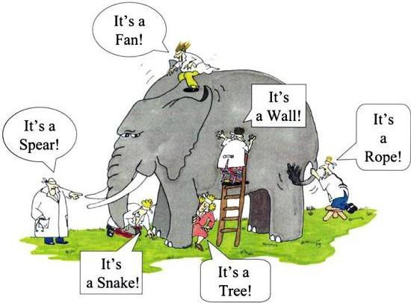
Workforce System Fast Facts
Nearly 550 local WDBs nationwide
Nearly 2,500 American Job centers
System serves some 20 million Americans every year
12,000 to 13,000 employers and employer representatives serve on WIBs
8 million people in the system – available to hire or train
Just 10% to 20% of adults served receive training
Training vouchers called Individual Training Accounts cover up to $2,000 to $8,000 per person
It can b e har d t o m ake sense o f t he sy st em – it ’s so com p lex and variab le r eg ion t o reg ion

Slide 8
Who Workforce Boards Touch
1 in 12
1.2 mil +
95,000
72%
American workers will touch our system
People received personalized services
Youth received career counseling and mentoring
of job seekers we work with will be employed within 6 months

Slide 9
What is a Workforce Board?
There are two types of workforce development boards (WDB): state boards and local boards.
The state WDB, appointed by the Governor, makes state workforce policy and ensures compliance with Federal mandates.
A local WDB makes workforce policy for its region and oversees local American Job Centers (one-stop centers) that provide training and employment services.
Board members represent employers, unions, community-based service providers, educational institutions, and government economic development agencies.
Local WDBs make decisions, including who should get priority for service, how much money is available for training, and what schools or other entities are qualified to receive funding for training.
Chairperson and 51% of members must come from the private sector (a key issue advanced by the National Association Workforce Board).
Local boards have 19 members.

Slide 10
What is a Workforce Board?
This is where employers and employer associations can have the most input.
Have labor market data as a core part of their data tools.
Provides analysis for businesses at free or competitive rates to help target recruitment and identify “market” wage rates.
Charged with convening and working with the education system to design career pathways that relate to in-demand occupations and skills aligned with industry.
Work to align skill development with a host of learning providers.
Set priorities for service, how much money is available for training and what schools or other entities are qualified to receive funds for training.

Slide 11
Powerhouse Partnership:
Community Colleges and Workforce Boards Working Together
Strategy and Planning
Funding
Align the work of the partnership with the goals and priorities of other large-scale statewide and regional initiatives.
Jointly and strategically engage employer partners.
Build leader-to-leader and staff-to-staff relationships.
Have a written agreement.
Look for opportunities to share costs.
Develop grant proposals together.
Source: Powerhouse Partnerships: Community Colleges and Workforce Boards Working Together
https://collegeconnection.workforcegps.org/resources/2018/04/09/17/11/Powerhouse_Partnerships_Community_Colleges_and_Workforce_Boards_Working_Together

Slide 12
Powerhouse Partnership:
Community Colleges and Workforce Boards Working Together (continued)
Systems and Processes
Communication
Develop staff knowledge of each other’s systems.
Co-enroll students when possible.
Continue to build and maintain systems of communication.
Recognize that a strong level of trust between the organizations is critical.
Source: Powerhouse Partnerships: Community Colleges and Workforce Boards Working Together
https://collegeconnection.workforcegps.org/resources/2018/04/09/17/11/Powerhouse_Partnerships_Community_Colleges_and_Workforce_Boards_Working_Together

Slide 13
Partnership Examples
Presidents of Grand Rapids WDB, Chamber of Commerce and Community College (MI) meet regularly every month to identify workforce gaps, new industries being secured for the region and underserved populations and develop a comprehensive, coordinated plan for meet the needs with each entity bringing to the solution the programs, people and experience required to address the challenges.
Workforce Solutions Greater Dallas and Dallas College have spent decades defining, refining, and realizing a unified mission with its local partner, Dallas College. The ongoing integration of education and workforce services consists of countless partnerships to provide adult education, literacy, childcare, training, and career services to thousands of job seekers.
Workforce Connections (Las Vegas, NV) and the local community colleges have worked together to strategically plan and implement training programs that meet local economic needs and placed an American Job Center at each college campus.
Pima Community College and the Pima County Workforce Investment Board (AZ) provide core services that include developing skilled workers for quality jobs, assisting employers to address workforce and recruitment needs, assisting households in financial crises, and helping persons with barriers, such as homelessness and lack of literacy, to transition into the community’s economic talent pool.

Slide 14
Any Questions?

Slide 15
Community Colleges and Workforce Boards:
Common Issues and Challenges

Slide 16
Common Issues
Workforce Boards
Colleges are not responsive to needs of employers
Developing curriculum takes too long
Lack of follow-through
Funding
Community Colleges
Community colleges are not included in planning process
Lack of interest to dialog or collaborate
Challenges with getting programs on ETPL
Compete on same grants

Slide 17
Workforce Ecosystem
Key areas to understand:
Each other’s role in the workforce ecosystem
Type of workforce board in your area (County/City)
Profiles of clients served
Required outcomes and deliverables of each party and common goals
Funding structure and priorities
Clarity in roles and boundaries

Slide 18
Workforce Ecosystem
Areas of Opportunities:
Include workforce boards in grant applications when possible
Develop an effective cross referral process
Mutual support of events
Identify complimentary services
Support Rapid response where applicable
Internships, apprenticeships, OJT collaboration
Engage with youth council activities where applicable

Slide 19
Breakout Room Discussions
Grantees and participants will be automatically assigned to a breakout room for peer-to-peer discussion.

Slide 20
Discussion Questions
Where do you see the workforce board as a partner in your workforce ecosystem?
Has working with the workforce board facilitated the building of a collaborative foundation with employers and community based organizations?
What would an ideal relationship with the workforce board and the college look like?

Slide 21
Breakout Room Report Out
Please share a highlight of what each group discussed.

Slide 22
Thank You!
Need help? Email: Support@workforceGPS.org

