Slide 1


Read Before You Proceed:
Instructions for Use & Legal Compliance
Legal Accessibility Requirements: 508 Compliance
Only use tables when standard content delivery is insufficient, and never merge table cells.
Do not use screenshots or images of text items. All text must be editable and not blur when the screen is zoomed in.
Avoid using “Smart Art” or the “Design Ideas” tool.
Do not repurpose slide title boxes for any other use.
Do not use multiple spaces, empty paragraphs, or strings of tabs to visually adjust your content, as every such repeated character must then be manually stripped from all slides before posting. Instead:
  Use soft returns to bump content to the next line in lieu of spaces (Shift + Enter)
  Manage paragraph spacing and tabs in the “Paragraph” panel.
Every image or visual element used must either have alternative “alt” text applied or be marked as “decorative”.
  Alt text translates visual information into verbal information, which is read aloud in screen readers, while items marked “decorative” are skipped.
  This step is required to deliver the full message provided by any graphics.
  The person who laid out the content should also provide
  that alternate information to ensure their
  message stays intact.
Learn about the new innovative features!
Please watch this webcast
before using this template.
https://vimeo.com/370983870/2afa9e8306
(Ctrl + Click to open link)
Duration: 6 minutes

Slide 2
Where Are You?
Please enter your location in the chat window
  (lower left of screen)

Slide 3
FY 2023 Community Project Grants
Training and Employment Guidance Letter (TEGL) 19-22 Technical Assistance Webinar

Slide 4
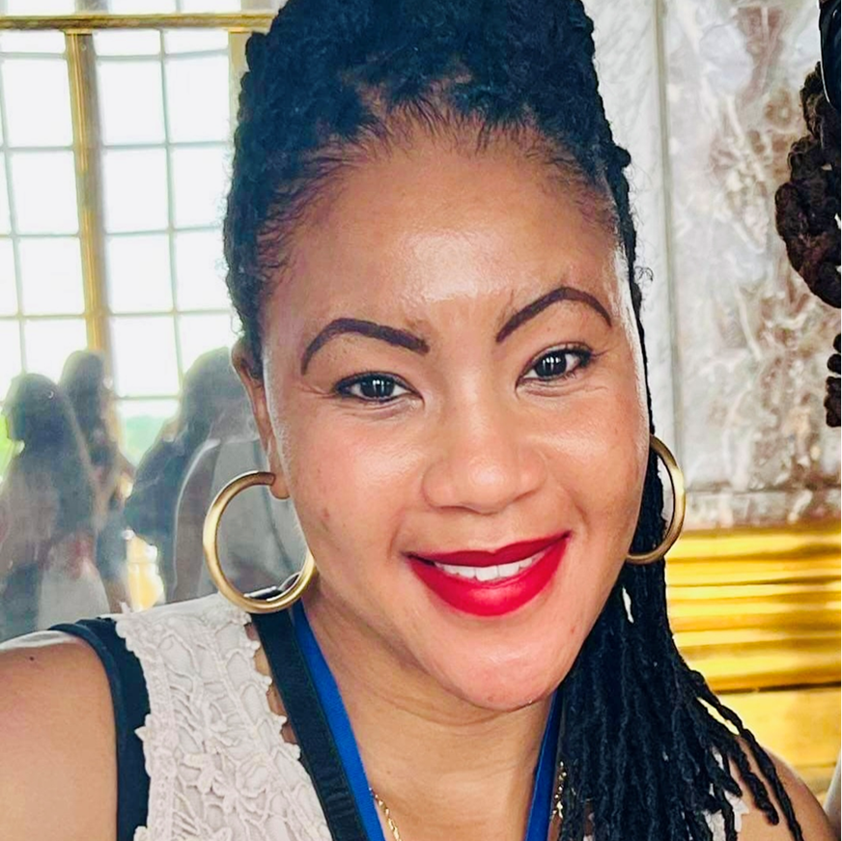
Today’s Speaker / Today’s Moderator
Britania Smith
  Regional Operations Analyst
    U.S. DOL, Employment and Training Administration
    Office of Regional Management

Slide 5
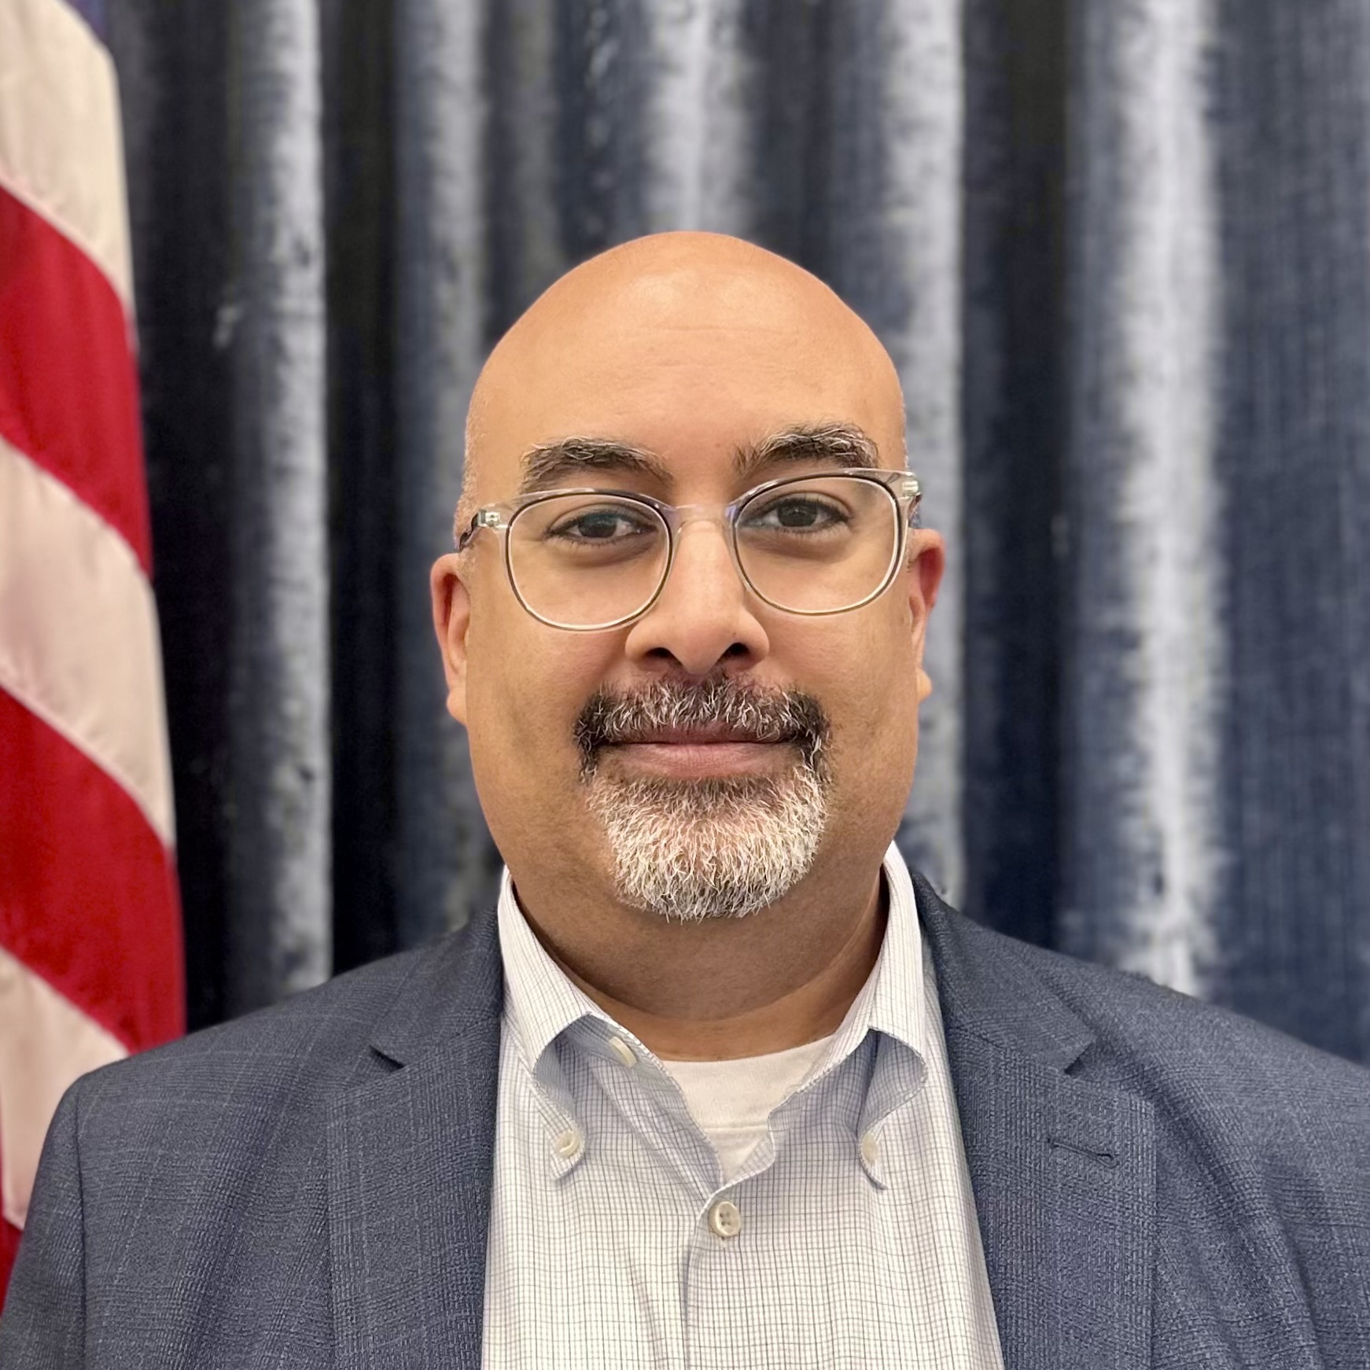
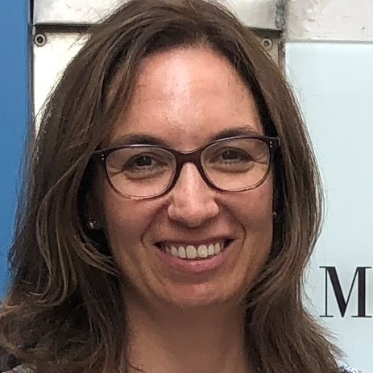

Today’s Speakers
Andres Ciriello
  Director
    Office of Regional Management
Aiyana Pucci
  Grant Officer
    Office of Grants Management
Ayreen Cadwallader
  Program Manager
    Office of Regional Management

Slide 6
Poll Question # 1
Using the poll, select the type of organization that you represent.
Community-based organization
School District
Technical School
Community College or University
Local/Regional Municipality
State/Local Workforce Boards
Other – type it in the chat window!
Select the best answer that reflect your organization.

Slide 7
Today’s Agenda
Welcome to ETA – Workforce Vision
Enter your questions in the Q&A; however, we will not address questions during the webinar.
TEGL 19-22 Overview
Developing Quality Applications
Technical Assistance: Abstract Reviews
Action Items and Next Steps
ETA Contacts

Slide 8




ETA Workforce Vision 2030
Building the Vision | Four Guiding Priorities for the Workforce Vision
Open Opportunities for Vulnerable Workers and Communities Ensure our programs focus on workers and communities who have been left behind—from reentry, to rural, to opportunity youth
New Industry Partnerships that Lead to Real, Good Jobs Broker and build partnerships with business and training providers and workers—including new entrants and youth, to ensure all training leads to good jobs across sectors (e.g., education, infrastructure, supply chain, manufacturing)
Building a Better Care Economy Support good jobs and protections for care workers—from nursing, early care, mental health, and more—with a focus on low-wage, BIPOC, young adult, and women workers
Action Today for the Future of Work Engage federal, state, and local leaders and the private sector now to prepare, support, and invest in workers and communities to prepare for jobs of the future and emerging industries

Slide 9
Training and Employment Guidance Letter (TEGL) 19-22
Application Instructions and Program Guidance for Department of Labor for FY 2023 Community Project Funding/Congressionally Directed Spending
Speaker: Aiyana Pucci, Grant Officer

Slide 10
Training and Employment Guidance Letter (TEGL) 19-22
Guidance for 2023 Community Project Funding/Congressionally Directed Spending Recipients
Consolidated Appropriations Act, 2023
Authorizes $217,324,000 in Congressionally Directed Funds
249 Demonstration and Pilot Projects
Specified in the Explanatory Statement for Division H – Departments of Labor, Health and Human Services, and Education, and Related Agencies Appropriations Act, 2023, Community Project Funding / Congressionally Directed Spending Table.
Community Project recipients must design their project to align with the descriptions and funding amounts approved by Congress.

Slide 11

Welcome Webcast for FY 23 CP Recipients
Review the Webcast
ETA Introductions
Grant Requirements
Timeline
Application Components
Link to Resources
Community Projects FY 23 Technical Assistance Page

Slide 12
Key Training Activities for All CP Recipients
Grants Application 101: Budgetary Forms - SF-424, 424A, 424B, and Budget Narrative: Budgets provide a financial blueprint and assist in complying with cost limitations, restrictions, and requirements outlined in the FOA. This webcast provides a brief introduction to the budget forms required to submit a grant application.
Grants Application 101: A Plain English Guide to DOL Competitive Grants: Grant applicants will understand DOL Federal Opportunity Announcements (FOAs) and learn how applications are evaluated.
ETA Grants Management Overview and Readiness Assessment: Learn about the requirements and standards applicable to the operation of a Federal grant funded by ETA, in order to avoid the common pitfalls experienced by new grantees and new staff.
SMART Approach to the 2020/2021 Uniform Guidance Revisions: Learn about OMB’s revisions to the Uniform Guidance that were published in the Federal Register on August 2020 and February 2021.
Financial Management: Procedures and Internal Controls: Learn about the core systems of financial management, like identifying policies and procedures required by the Uniform Guidance, providing suggestions for increased organization and efficiency, and describing financial areas that require internal controls.
Uniform Guidance: Cost Principles and Cost Classification: Learn about the general principles governing the allocability, allowability, and reasonableness of costs to the federal award. New definitions, significant changes to selected items of cost, and DOL’s exceptions to the Uniform Guidance (2 CFR Part 2900) will be reviewed.

Slide 13
Application Components
SF-424: Application for Federal Assistance
SF-424a: Budget Form
Budget Narrative
Project Narrative
Abstract
Project Organizational Chart
Work Plan
Letters of Commitment
Equipment Prior Approval Request, if Applicable
Negotiated Indirect Cost Rate Agreement, if applicable
Financial System Risk Assessment
TEGL 19-22: Appendix IV (pg. 25)
Application Submission
A. Required Documents

Slide 14
Polling Question: Are you ready?!
Select the answer that most reflect the activities that you have completed.
I read the TEGL back-to-back. Hooray!
I watched the welcome webinar. It was informative!
I already reviewed all the training webinars. I'm a superstar!
I'm still not sure. What is a TEGL?
Multiple Choice

Slide 15
Technical Assistance
Developing Quality Applications
Speaker: Ayreen Cadwallader, Program Manager

Slide 16
Purpose of Technical Assistance
Community Project grantees will receive technical assistance during the pre award and post award of your grants
Pre-award TA is to support you in the development of your applications
Post-award TA is to support you in managing and implementing your grant programs
Led by the regions and supported by the national Grant office and program office
Project Narrative
Abstract
Project Organizational Chart
Work Plan

Slide 17
Application Component: Project Program Design Elements
Project Narrative
Abstract, Work Plan, Org Chart
Comprehensive framework and description of the proposed project
Detailed description of the community issue or problem that the project will address
Demonstrate the organization’s capacity to implement the grant project
Limited to 10 double-spaced, single-sided, 8.5 x 11-inch pages with Times New Roman 12-point text font and 1-inch margins
Submitted as a separate document
The abstract a snapshot of your project
The work plan is used to track your grant funded activities throughout your period of performance
The org chart shows the grant’s projects management team, including any potential partners that are working on the project

Slide 18
Poll Question
Using the poll, select all of the other grants on which you have worked in the past or on which you currently work.
WIOA Formula - Adult and Youth Programs
Apprenticeship Grants
YouthBuild Grants
Reentry Employment Opportunities Grants
H-1B Technical Skills Training Grants
Dept. of Health and Human Services Grants
Dept. of Education Grants
Other Federal or State Agencies, philanthropic organizations, local grants
Choose the best answer(s) that reflect your work with the Department

Slide 19
Technical Assistance: Abstract Review
Speaker: Ayreen Cadwallader, Program Manager

Slide 20
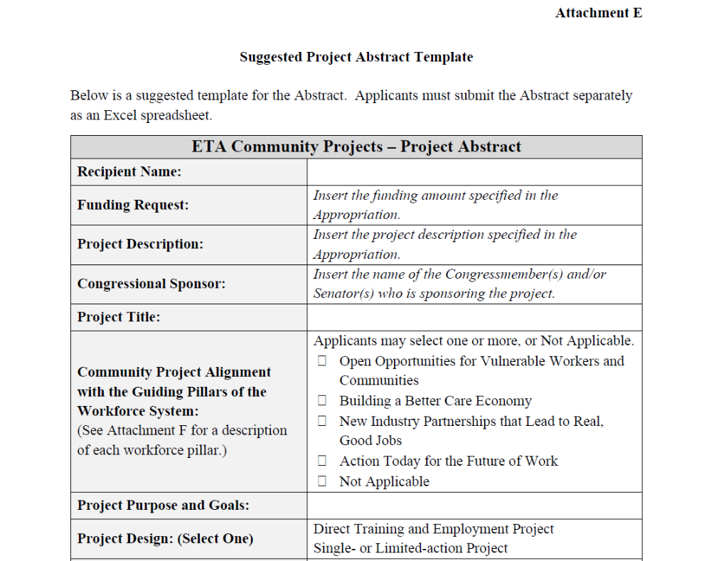
Technical Assistance Abstracts Review
Abstracts are an overview of your program design
Submit abstract by July 31, 2023
Excel spreadsheet with all the required sections from the “Suggested Project Abstract” Template (Attachment E)
Email to: CPGrants.ProgramOffice@dol.gov

Slide 21
Abstract Template – Key Information
Exact language specified in the FY 23 Appropriation.
  Recipient Name
  Funding Requested
  Project Description
  Congressional Sponsor
Project Title
  Name of the Community Project

Slide 22
Abstract Template – Workforce System Priorities
Select which of these workforce pillars align the most with your proposed project.

Slide 23

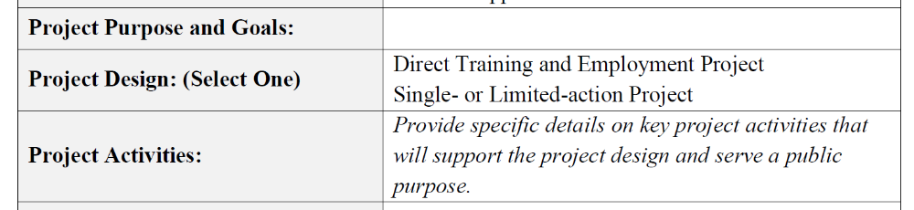
Abstract Template – Project Purpose and Goals
The [insert name of the project]
will empower youth and young adults [project purpose] to
[project goals] prepare them for achieve their full potential through career exploration , job training, and paid work experiences
to become productive members of our community. [public good]
Project Purpose and Goals
  Overarching purpose of your project
  specific goals that the project will achieve
  how it will serve the public good
TEGL 19-22: Project Narrative (pg. 48)
Section A. Community Project Workforce Program
1) Statement of Need and Project Purpose for Public Benefit

Slide 24
Abstract Template – Project Design
Serves a public purpose
Direct Training and Employment Project
Target population directly receives grant-funded services
Training activities
Employment, and supportive services
Single- or Limited-action Project
Capacity-building projects
  designing a new training and employment program and developing curriculum
  establishing sector strategies
Target population does not receive direct grant-funded services
TEGL 19-22: Project Narrative (pg. 49)
Section B. Project Design
(1) Description of Activities

Slide 25
Abstract Template – Project Activities
The [insert name of the project] will accomplish the following key activities:
  Provide professional development, career exploration, and other services
  Help youth complete their secondary education and prepare them for entry to apprenticeship programs, technical colleges, community-colleges, or four-year colleges.
  Provide pre-apprenticeship and apprenticeship training, including mentorship and paid work experiences.
  Engage local leadership, employer partners, and other community-based organizations.
How the project will achieve the intended public benefit based on the program design
Specific activities and services that will address the project’s workforce challenges
TEGL 19-22: Project Narrative (pg. 49)
Section B. Project Design
(1) Description of Activities

Slide 26
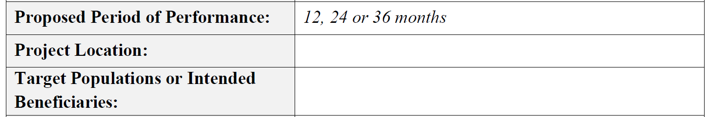
Abstract Template – Proposed Period of Performance Duration
Direct training and employment service program
  One-, two-, or three-year period of performance
  Appropriate to the amount of grant funds awarded and
  The number of projected individuals that will receive grant-funded services.
Period of performance will vary
  Amount of grant funds awarded
  Number of individuals receiving services
Grant start dates depend on when applications are submitted, reviewed by ETA and awarded
Grant agreement will specify the grant start and end dates
Single- or limited-action activity
  Shortest allowable timeframe for a Community Project is 12 months.
TEGL 19-22: Project Narrative (pg. 49)
Section B. Project Design
(2) Proposed Period of Performance

Slide 27
Abstract Template – Project Location, Target Population / Beneficiaries
Project Location
Target Population or Public Beneficiary
Propose the area where services will be provided
Congressional Sponsor’s intent
Local, Regional, Statewide or National
Target Population
  Identify the target population or individuals that will receive direct grant-funded services
Public Beneficiary
  Identify the target population or individuals that will benefit indirectly from the project.
TEGL 19-22: Project Narrative Section A (pg. 48)

Slide 28
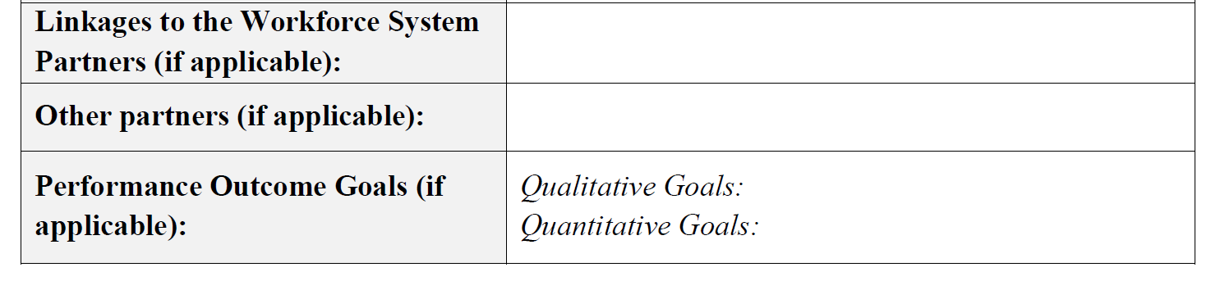
Abstract Template – Partnerships
Strongly suggested partnerships with state and local boards
Benefits of partnerships – all about access to existing resources
  Expertise on latest job trends, in-demand industries and occupations in your community
  Eligible training providers to support your program
  Support outreach and recruitment activities
  Access to employers that have job opportunities
Allowable, depending on the needs of the project
Consider organizations that has an expertise that your organization might not have
Determine services they can provide to support your program
Must include Letters of Commitment from ALL partners
TEGL 19-22: Project Narrative (pg. 49)
Section B. Project Design
(3) Linkages to the Workforce System and Other Partnerships

Slide 29
TEGL: Performance Reporting Requirements
Quarterly Performance Reporting
  Quarterly Performance Report (ETA-9173): Quantitative Outcomes
  Quarterly Narrative Report (ETA 9179): Qualitative Outcomes
Proposed performance measures and target outcome goals are strongly encouraged
Target goals should be attainable and achievable
  Funding amount
  Proposed program design and delivery of services
  Within the proposed period of performance
TEGL 19-22: Appendix VIII
Reporting Requirements (pg. 41)

Slide 30
Abstract: Performance Outcome Goals
Qualitative Performance Measures
Quantitative Performance Measures
Subjective insights
Illustrate the project’s success in achieving the goals and objectives of the grant
Outcomes are expressed as a narrative, although some data might support it
Usually, raw data that cannot be reported in the QPR ETA-9173
Numerical data and metrics used to measure performance
  participants that receive grant-funded services
  participants that begin training and complete training
  participants that earn credentials
  participants that enter employment
Propose raw numbers for the number of participants that receive grant-funded services.
TEGL 19-22: Appendix VIII
Reporting Requirements (pg. 41)

Slide 31
Action Items and Next Steps
Britania Smith, Aiyana Pucci, Ayreen Cadwallader

Slide 32


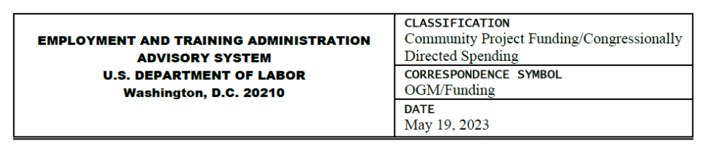



Action Items: Submitting Community Project Applications
Review TEGL 19-22
Watch the Welcome Webcast and Key Trainings
Submit Community Project Applications
Develop and Submit Abstracts
Please review the Welcome Webcast and Related Training webinars to support the development of your applications.

Slide 33
TEGL 19-22 Timeline
May 2023: TEGL 19-22 Published
TEGL 19-22 Technical Assistance Webinar
Key Dates & Technical Assistance Activities
Technical Assistance
July 31, 2023: Abstract Deadline
August 1, 2023: Recipients Begin to Submit Applications
Rolling Applications
Review and Award
Technical Assistance
Rolling Applications
Review and Award
January 31, 2024: Deadline to Submit Applications

Slide 34
Technical Assistance
We have some questions specific to the TEGL requirements (grants management assistance).
We will send an email with our questions about the TEGL (grants management assistance).
We have some questions on developing our project design (programmatic assistance).
We will request TA for our project design (programmatic assistance).
We’re all good, we have everything we need to submit!
Let us know if you have any specific questions that you’d like to address.
Select the response that most reflect your TA needs.

Slide 35
Next Steps – Submit TEGL Questions
Community Project Grants
Office of Grants Management
Community.Projects.ETA@dol.gov
Subject: FY 23 [CP Recipient Name] TEGL Question
SF-424: Application for Federal Assistance
SF-424a: Budget Form
Budget Narrative
Letters of Commitment
Equipment Prior Approval Request, if applicable
Negotiated Indirect Cost Rate Agreement, if applicable
Financial System Risk Assessment

Slide 36
Next Steps – Request for Technical Assistance
Community Project Grants
National Program Office
CPGrants.ProgramOffice@dol.gov
Subject: FY23 [CP Recipient Name] TA Request
Project Narrative
Abstract
Project Organizational Chart
Work Plan

Slide 37
Poll Question
Using the poll, let us know where you are in preparing for submitting your applications for your Community Project grant.
Super jazzed. We’re ready to submit our applications on August 1.
Pretty excited. We have our abstracts ready to submit on July 31.
Almost there. We are working on our abstract and application now.
Not quite. We are still clarifying our project goals and project design.
Choose the best answer(s) that reflect your application status

Slide 38
Resources:
Consolidated Appropriations Act of 2023 Explanatory Statement Division H
  Eligible grant award recipients
    https://www.appropriations.senate.gov/imo/media/doc/Division H - LHHS Statement FY23.pdf
TEGL 19-22: FY 2023 Community Project Funding/Congressionally Directed Spending
  Application Instructions and Program Guidance
    TEGL 19-22 | U.S. Department of Labor (dol.gov)
Submit Community Project Applications
  Submit applications using Grants.gov starting August 1
    Home | GRANTS.GOV
FY 23 Community Project Grants Resource Page on Workforce GPS
  Links to key resources, including recommended training for all CP recipients
    WorkforceGPS - Community Projects FY23
Coming Soon! Community Project Grants Community of Practice on Workforce GPS

Slide 39
Thank You!
Please stay on to provide feedback on today’s webinar.
Need help? Email: Support@workforceGPS.org

