Slide 1
Demystifying Disaster Recovery Dislocated Worker Grant (DWG) Applications
Part 2 – The Preliminary Project Implementation Plan, Enrollment and Expenditure Plan, Budget, and Budget Narrative

Slide 2
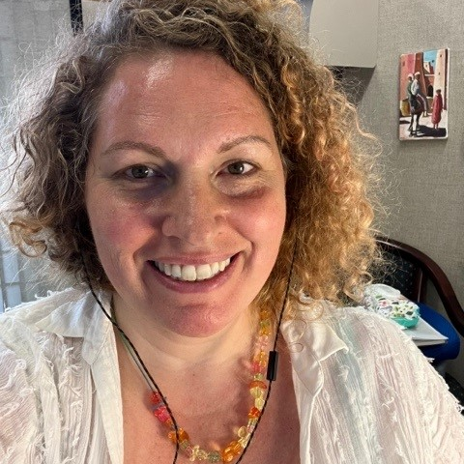


Today’s Moderator and Presenters
Ingrid Schonfield, Moderator
  Workforce Analyst, Office of Workforce Investment
    US DOL ETA
Jenifer McEnery, Presenter
  DWG Grant Officer, Office of Grants Management
    US DOL ETA
Jeff Ryan, Presenter
  Workforce Analyst, Office of Workforce Investment
    US DOL ETA

Slide 3
Welcome (1)
Purpose: Prepare eligible applicants to submit responsive Disaster Recovery National Dislocated Worker Grant (DR DWG) applications that
  leverage programmatic flexibilities to serve the greatest possible number of workers
  quickly respond to the declared disaster and its impacts on the community
  are fundable without grant terms and conditions
Why this training, now?

Slide 4
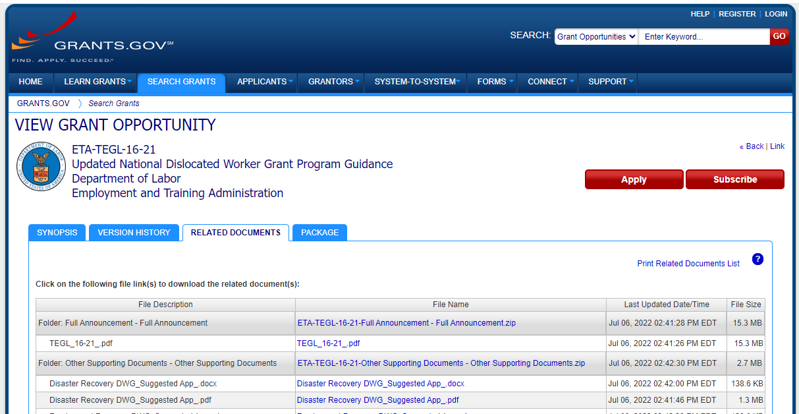
Welcome (2)
Agenda
  Getting to know you
  Recap: Demystifying DR DWG Applications - Part 2
  Crafting Your Disaster Recovery Dislocated Worker Grant (DR DWG) Application
    Overview: What Are Application Reviewers Looking For?
    Preliminary Project Implementation Plan
    Enrollment and Expenditure Plan
    SF-424A Budget and Budget Narrative
  Q & A
  Resources

Slide 5
Getting to Know You – Let’s Chat
Please share your name, your organization’s name, and where you’re located.
Please also note any Disaster Recovery DWG application-related questions you’ve brought with you today.
Please enter your responses to the two above questions into the chat

Slide 6
Recap: Demystifying DR DWG Applications Part 1 – Policy and Program

Slide 7
Recap: Demystifying DR DWG Applications Part 1
The most important thing you can do with a DR DWG is to get started ASAP!
A responsive DR DWG Application clearly connects the declared disaster and its impacts on the state, outlying area, or tribal community with the
amount of funds requested
number of participants to be served
proposed grant activities (and how disaster-relief employment addresses the impacts of the disaster)
project start date (which may be as early as the date of the qualifying event)

Slide 8
Crafting Your Disaster Recovery Dislocated Worker Grant (DR DWG) Application
Overview: What Are Application Reviewers Looking For?
Preliminary Project Implementation Plan
Enrollment and Expenditure Plan
Budget and Budget Narrative

Slide 9
Overview: What are we striving for?
Emergency Applications – Award as quickly as possible.
  Sections 1-3 of the Suggested Application
  No budget
  Justification supports immediate award with an abbreviated application
Full Applications – Award reasonably responsive applications as quickly as possible (with or without conditions).
  Sections 1-9 of the Suggested Application
  Fully developed statement of work
  Fully developed budget

Slide 10

Overview: What Are Application Reviewers Looking For?
Compliance
  Reasonably meets requirements under WIOA, UG, and relevant guidance
Justification
  Clearly states the disaster-related need and a plan to address that need
  Clearly explains how the funding request is determined
Documentation
  All requested information with data that supports the compliance and justification

Slide 11
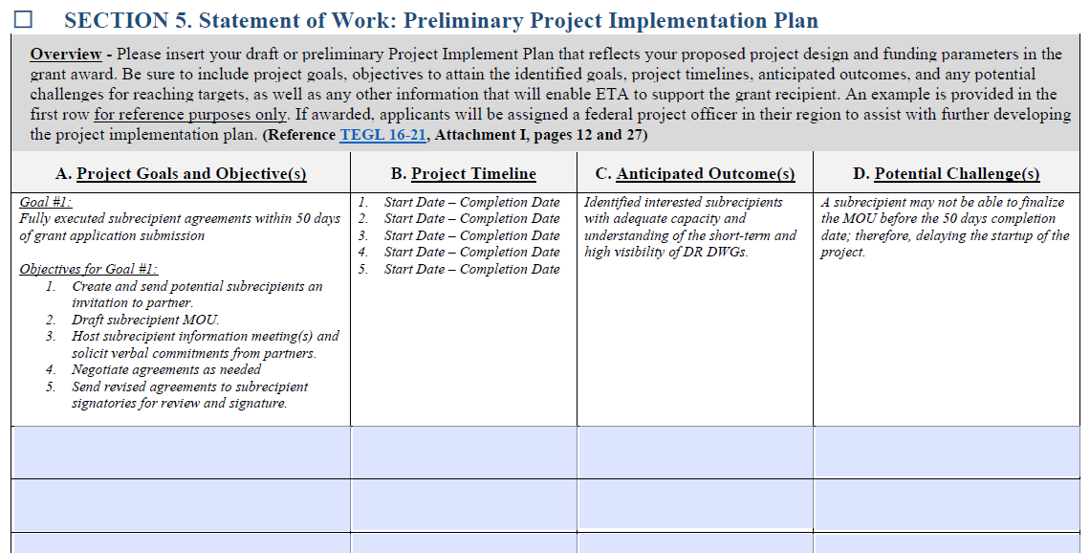
Application: Section 5 Statement of Work,
Preliminary Project Implementation Plan (PPIP)

Slide 12
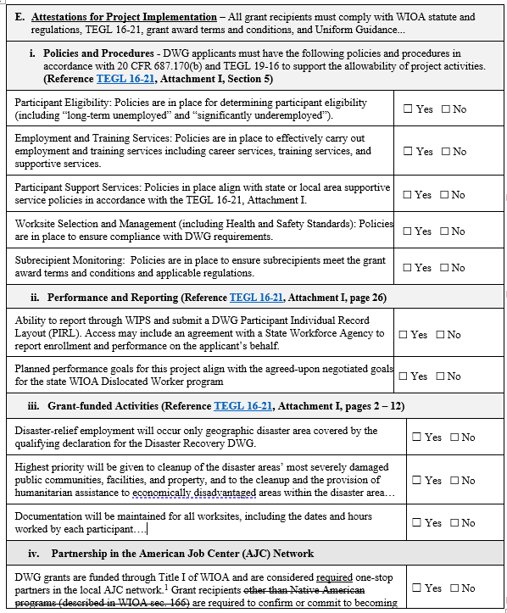
Application: Section 5 Statement of Work, PPIP, Attestations
Section E Attestations will be reviewed during monitoring
  i. Policies and Procedures
  ii. Performance Reporting
  iii. Grant Funded Activities
  iv. Participation in the AJCN

Slide 13
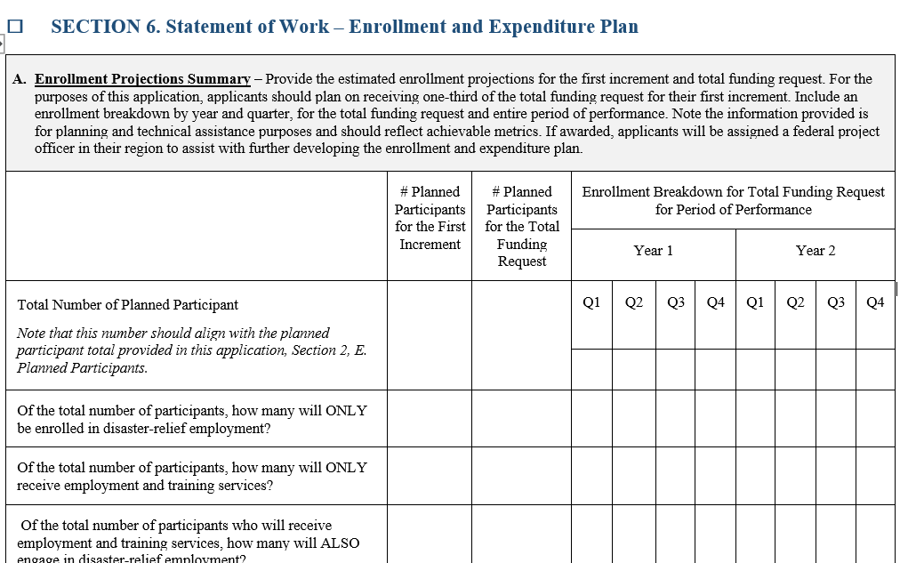
DR DWG Budgets: The Enrollment and Expenditure Plan (A)
Based upon up-to award amount threshold
Demonstrates plan to reach planned participant count with Incremental Funding (one-third increments)
Expected to fluctuate throughout the period of performance

Slide 14
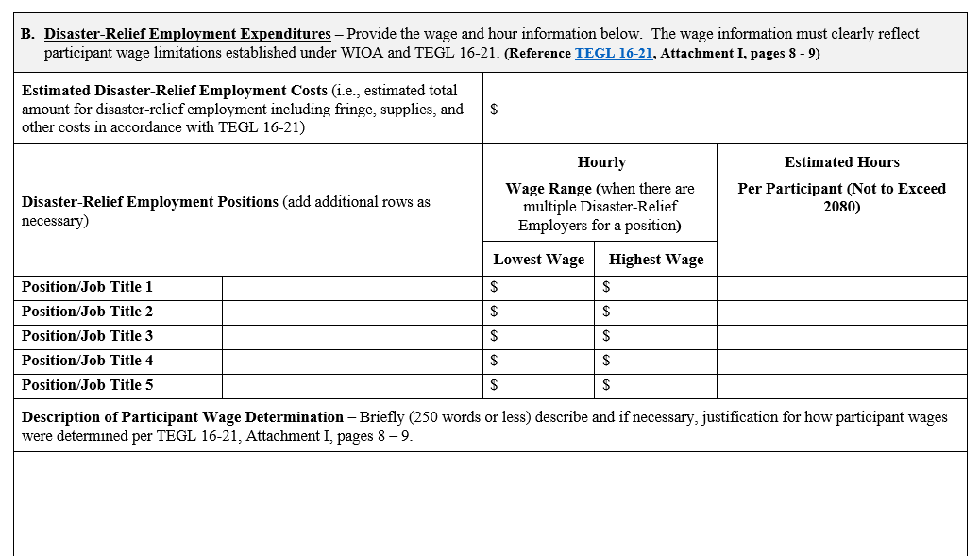
DR DWG Budgets: The Enrollment and Expenditure Plan (B)
Demonstrates wage requirements
Supports higher participant costs
Aligns with Section 4.A. Community Needs Assessment, Disaster-Relief Employment Needs and Jobs
Total Estimated Costs aligns with the Budget Narrative

Slide 15
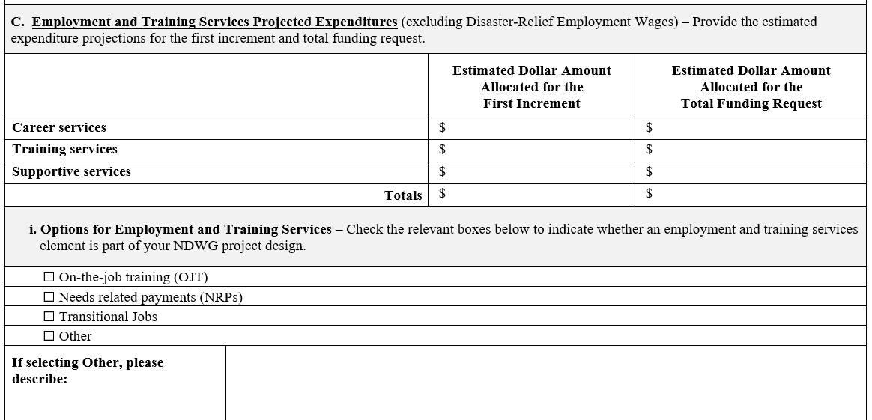
DR DWG Budgets: The Enrollment and Expenditure Plan (C)
Supports participant costs
Aligns with Section 4.B. Community Needs Assessment, Employment and Training Needs and Activities
Totals align with the Budget Narrative

Slide 16
Any Questions?
Please enter your questions in the chat. We’ll address as many as we can during this Q&A intermission.

Slide 17
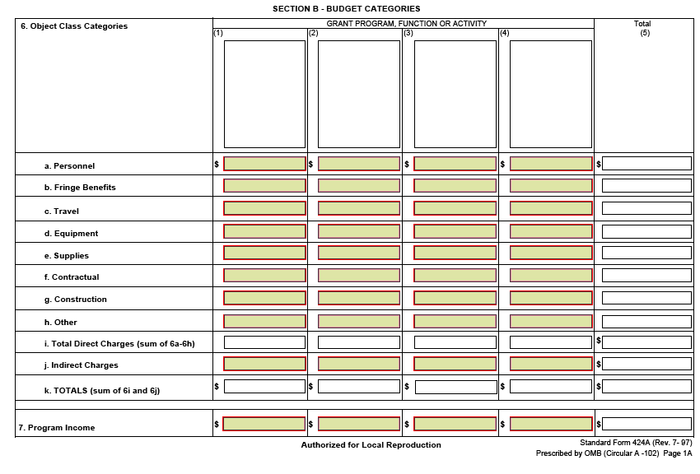
DR DWG Budgets: The SF-424A Budget – Section B
No Cents – round to the whole dollar ($500 not $500.53)
SF424A Cost category totals exactly match Budget Narrative cost category totals

Slide 18
DR DWG Budgets: Which cost goes where?
Other = Direct Costs that do not fit anywhere else.
  Disaster Relief Employment (if not subawarded)
  Training
  Career Services
  Supportive Services
Equipment
  Information Technology Systems w/Acquisition Cost > $5000 (prior approval required)
Contractual
  Subawards
  Contracts

Slide 19

DR DWG Budgets: The Budget Narrative - Overview
Must align exactly with SF424A
Must reasonably calculate (10 % flexibility)
Must provide sufficient information to determine allowability
Section 8 of the Suggested Application is submitted as the Budget Narrative, not in addition to.

Slide 20
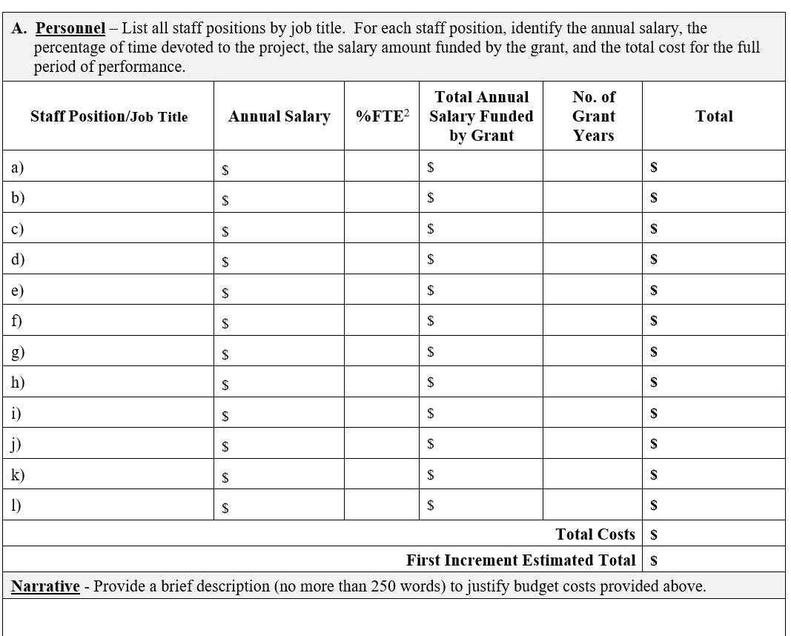
DR DWG Budgets: The Budget Narrative
Instructions for each cost category are provided in the grey boxes.
Cost Category Totals (and SF424A)
  Total Costs = Up-to-Award Amount
  First Increment Total = One-third Up-to-Award Amount
Narrative = Explains how you determined costs are allowable; and explains increment calculation.

Slide 21
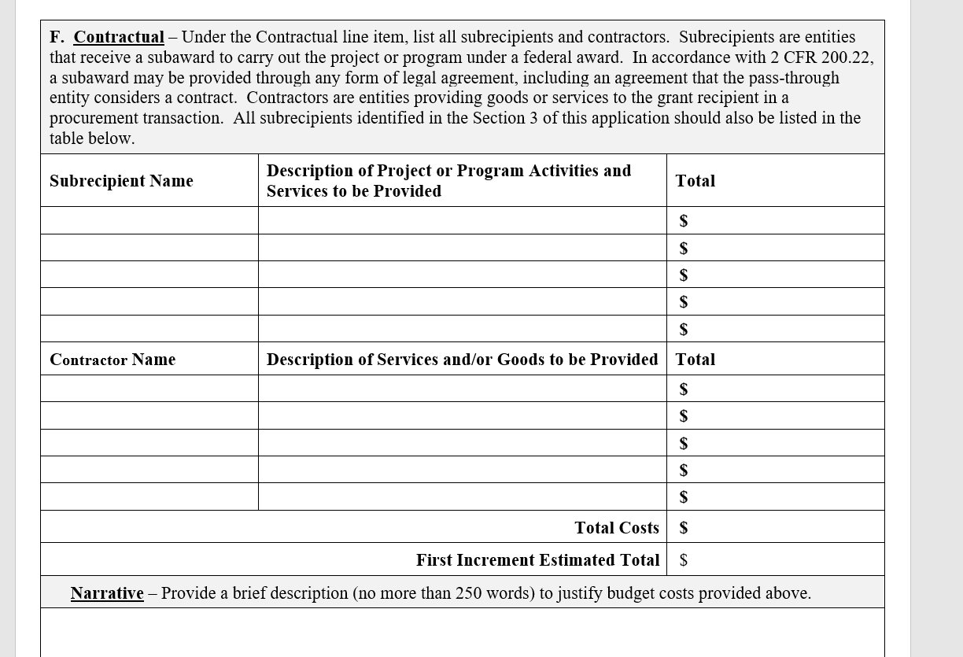
DR DWG Budgets: Contractual
Subrecipients are the entities carrying out the project
Subrecipient allocations flexible within cost category
No contingency funds allowed

Slide 22
Any Final Questions?
Please enter your questions in the chat. We’ll address as many as we can during this Q&A intermission.

Slide 23
Chat
What’s one word or phrase that you heard in today’s session that struck you?
What’s one thing you learned today?
What other Dislocated Worker Grant-related topics would you like to know more about?
Please enter your response(s) to the above questions into the chat!

Slide 24
What’s Next?
Office Hours Coming Next Month!
Let your Federal Project Officer know what themes or topics you’d like covered. A few proposed themes follow:
  Participant Eligibility Deep Dive
  DRE: Real-World Examples
  Ask the Grants Officer

Slide 25
Thank You!
Need help? Email: Support@workforceGPS.org

