Slide 1
Where Are You?
Please enter your location in the chat window
  (lower left of screen)

Slide 2
Serving Workers in a Large-Scale Multi-Language Layoff
Maine

Slide 3

Today’s Moderator
Timothy Theberge
  Division Director
    Office of Trade Adjustment Assistance

Slide 4
Today’s Speakers
Kate Fahey
  Project Director
    Peer Workforce Navigator project
Danielle McKinnon
  Team Leader
    Bureau of Unemployment Compensation- MDOL
Judy Pelletier
  Program Manager
    Bureau of Employment Services - MDOL
Robert Klaiber
  CareerCenter Manager
    Bureau of Employment Services - MDOL
Dave Wurm
  Director, Workforce Services
    Goodwill Northern New England

Slide 5
Today’s Objectives
To share our experiences and lessons learned in serving a large group of multi language laid off workers.
Multiple Providers will describe their services and approach
  Rapid Response
  Peer Navigator Project
  Unemployment Compensation
  WIOA Service Provider – Peer Support Worker Services
  CareerCenter
Provide time for questions and answers

Slide 6
Rapid Response

Slide 7
Multiple Temp Agency Layoffs
Second layoff from same employer for most workers
Some workers experienced prior short-term layoff – no UI and waited for call back
No severance or WARN pay was provided- immediate need for services
Over 1,000+ Workers who spoke multiple languages- 7-8
Lack of understanding of services or processes- Government programs- unemployment – training- job search assistance. Confusion over cash payment while looking for work- not a loan.
Culture differences – Concept of Time, lack of government trust, etc.

Slide 8
Rapid Response Experiences
Large Rapid Response event – Didn’t meet RR expectations
  Social event
  Parking
  Timing
Zoom sessions in multiple languages helpful but lower attendance.
Rumors- miscommunications- $500 in cash
During RR some signed up w/ WIOA provider and Peer Navigators
Some basic print info in multiple languages was provided
Strong need for collaboration

Slide 9
Rapid Response Take Aways
New website of Rapid Response information in multiple languages.
  www.mainecareercenter.com/laidoffinfo/
Stronger approach and connection of all parties to provide services in small groups.
Peer Support worker contract
Email blast announcing local, upcoming events – Job Fairs, training, etc.
Weekly statewide RR meetings- started with this group- now statewide
  Include CareerCenter Managers, Rapid Response staff, Local WIOA service providers and Peer Workforce Navigators.

Slide 10

Working together to support laid off workers from Maine’s immigrant community

Slide 11
Who is the Peer Workforce Navigator project?
The Peer Workforce Navigator project is made up of 6 community-based organizations built to support the advancement of economic security of all Mainers
Birth story of the Peer Workforce Navigator project
Our partner organizations include:
  Food AND Medicine
  Gateway Community Services Maine
  Maine AFL-CIO
  Maine Equal Justice
  Prosperity Maine
  Wabanaki Public Health & Wellness
Foundational in our work: relationships, trust, building bridges to resources
Working in partnership with the Maine Department of Labor
  (Bureau of Employment Services and the Bureau of Unemployment Compensation)

Slide 12
Our 3 buckets of work include
Connecting community members to good jobs, and the education and training opportunities that can help make those jobs possible
Supporting community members as they apply for and navigate the Unemployment Insurance system
Raise awareness of and connect people to critical public benefits to help make sure basic needs are met
And working with the Maine Department of Labor to inform systems that work for all of us

Slide 13
Learning about the Abbott layoffs
Initial day of layoffs
  Navigator receiving calls
  Connecting with MDOL’s Rapid Response
  Community-Based Organizations & Asylum Seekers Working Group
Directing people to Prosperity Maine for further information
  Collecting names, preferred languages and phone numbers
  Sharing information about upcoming Rapid Response session
Rapid Response session
Creation of clinics & coordination of Community-Based Organizations

Slide 14
Creation of the clinics
Stage 1
Stage 2
Stage 3
Holding space at Prosperity Maine weekly (consistency, a familiar & trusted space)
Collecting contact information (preferred language, preferred method of contact)
Initial Q&A re: UI, re-employment, public benefits
Collection and creation (when necessary) of multi-lingual one pagers informed by common questions received
Texting out clinic & weekly claim reminders
Welcoming in staff from MDOL’s BUC team (1-3 UI Claims reps present at each clinic)
  Hands-on UI claims support
Welcoming in staff from MDOL’s Greater Portland CareerCenter (Diane joining each week)
  Supporting with MaineJobLink, resumes, applications, education & training
Welcoming in staff from Goodwill’s Workforce Solutions (Djo Bobolibanda, Peer Support Worker)
  Supporting with resumes, job search, E&T
Bringing in peer “PWN Clinic Helpers”
  Later to create Volunteer Navigator opportunities
Welcoming in employers to the clinics
  Intentional choices of employers: no temp employers; employers with positions that can accommodate a variety of English proficiency; hiring on the spot
Bringing in Maine Equal Justice for public benefit questions
Beginning to incorporate educational opportunities

Slide 15
Impact of clinics – from the community’s perspective
From community advocates:
From community members:
“Since some people have started attending the clinics, they have begun receiving benefits. PWN has brought together a team of folks speaking different languages, employers, and folks who can help them get UI and jobs.” - Cadeau Assoumani, Immigrant Health Specialist at Cumberland County Public Health Dept
“More people are applying now than they used to – having information in people’s languages is making all the difference; also, having UI and job resources in one place, with language accessibility, this is bringing more people into the UI system. They come to the clinic for the options it provides…” – Guy Serge Makonda, Employment Case Manager at Catholic Charities
“Shortly after being laid off, I came to Prosperity Maine and there was someone here to help me apply [for UI].” – Community member laid off at Abbott Prosperity Maine
"During my appointment or meeting, the staff was very helpful about what I needed. A lot of options was giving to me about what I was looking for and some links were sending to me by email but to keep searching at home. Appreciate for the support and keep doing that.“ – Carlos C., community member laid off at Abbott

Slide 16
Coordination of Community-Based Organizations
Information & Resource Sharing
Training Opportunities
Sharing information about PWN clinics with community partners
Regular, weekly (then bi-weekly) meetings with CBO partners to hold space for sharing info, Q&A, resource asks/needs/highlights
Creation of shared Google Drive with resource materials
Creation of specific webpage to communicate info for laid off workers
Invite teams from MDOL to join recurring meetings with CBOs to offer space for Q&A and relationship building
Provide training opportunities in the following areas:
  UI 101
  Intro to Maine’s Workforce System
  Public benefits 101
  Housing – Tenant Rights & Evictions

Slide 17
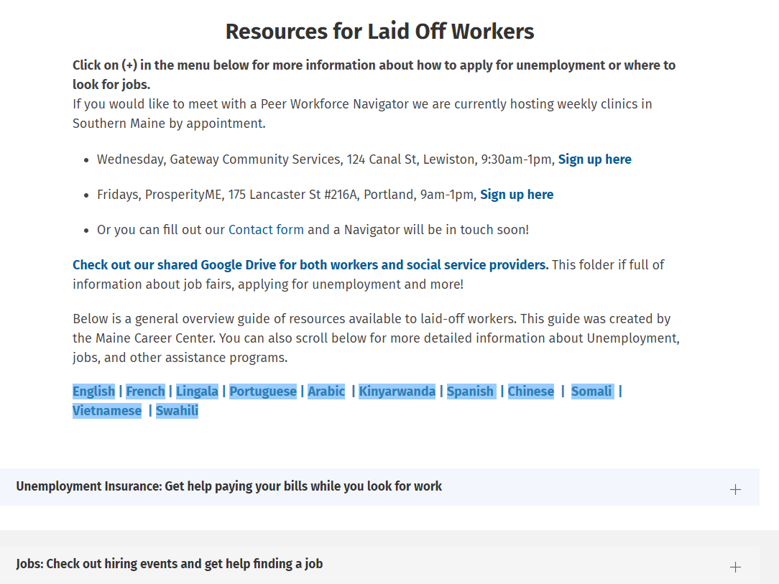

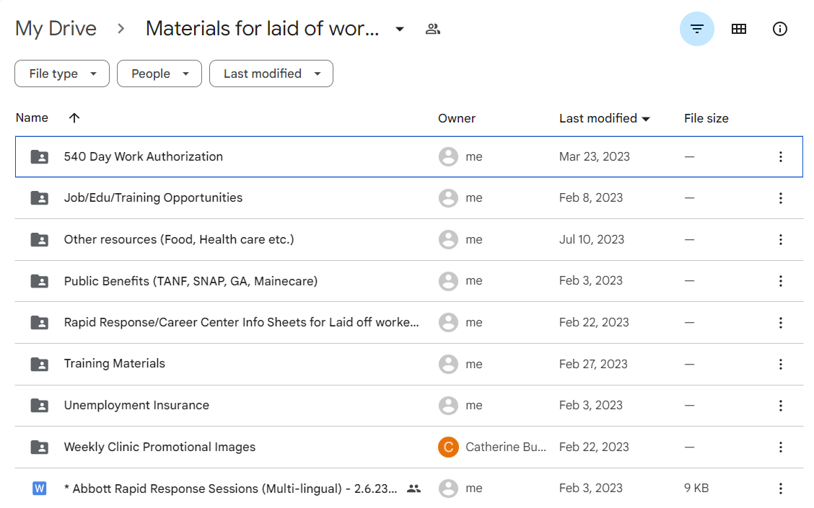
Best practices
Trusted messengers, trusted places
  Same place & space each week, consistency & in-person support
Coordination with MDOL/Workforce resources (BES & BUC)
  Rapid Response
  UI staff onsite!!!
  CareerCenter staff
  Peer Support Workers – Workforce Solutions
Texting and regular engagement, reminds and touch points with the project
Bringing resources to people
  and doing so in an integrated way (bringing multiple resources into one space)
  Connections to job fair opportunities
Regular reminders of the importance of notices, correspondence folders
Coordination with CBO partners – responsive information sharing, 1-pagers and resources, relationship building with MDOL, all centering cultural and language access
Within the project, the coordination and collaboration of 5 different organizations bringing their various areas of expertise (cultural competency, housing, legal aid and advocacy, etc)

Slide 18
Persisting challenges
Language access (and regional dialects)
  Translations, plain language of notices, etc
Familiarity and understanding of the UI system (what it is, how it operates)
  Misconceptions (i.e. the chilling effect of overpayments, public charge rule)
  Checking ReEmployME & correspondence with Maine Department of Labor
  Weekly worksearch requirements & expectations
  And from there… alternate base period; dislocated worker benefits; other opportunities
Work permit issues
  Automatic extensions for some work permit renewals
  Impact on UI eligibility AND re-employment opportunities
Identity verifications
The time required (for some) from start to finish
Amount provided and its ability to keep individuals and families afloat

Slide 19
Unemployment Compensation

Slide 20
Unemployment Insurance
Standard Process for layoffs
How we shifted
Claimant’s call 1-800-593-7660 for Agent support.
Online portal
Larger layoffs were supported with a dedicated small team and phone line.
In addition to the standard process:
In person support
  Cultural literacy
  Limited English Proficiency
  Education on Unemployment Insurance Processes.
  Filing Initial Claims and Weekly Claims
Video conference via Teams to continue to provide face-to-face support when volumes exceed on-site support team capacity.
Dedicated email address for Community Business Organizations to communicate complex inquiries.

Slide 21
Unemployment Insurance
Highlights
Increased claims filed in comparison to prior layoffs with similar cultural and language challenges.
Established trust
Lasting Community Partnerships
Meeting people in need where they are at.
Notable positive impact with on-site support team.
Increased understanding of underserved communities.

Slide 22
Unemployment Insurance
Take Aways
Needed website updates for plain language and translation.
Document updates for plain language and translation.
Impact of face-to-face communication to build trust.
Relationships with community partners to highlight the areas we could adapt.
Continue the relationships with community partners.
Playbook for future large layoffs with note of how to adapt to underserved community needs.

Slide 23
WIOA Title IB Provider

Slide 24
WIOA Title IB Provider
Standard Operations
How We Shifted
Three (3) FTE dedicated Dislocated Worker employment case manager staff responsible for providing Title IB Dislocated Worker services.
Staffing setup designed to support around 9-12 new enrollments per month
  based on unemployment rates in southern Maine and enrollment trends in recent program years
  Very difficult time to find Dislocated Workers – provider doing significant outreach to try to find eligible population
Flexed experienced, cross-trained employment case managers to offer Title IB Dislocated Worker services
Offered voluntary overtime to any experienced staff willing to expand caseloads
Frontline managers took on small caseloads
Multi-lingual employment case managers from other projects flexed to provide other types of support – basic interpretation, initial outreach/triage, etc.
Worked with Maine Department of Labor to bring on a multi-lingual Peer Support Worker/Peer Navigator to support activities.

Slide 25
WIOA Title IB Provider
Highlights
Increased Dislocated Worker new enrollments by 249% percent
  Average monthly new enrollments July 2022 – January 2023 = 6.87
  Average monthly new enrollments February 2023 – May 2023 = 24.0
Provided increased language supports through Peer Support Worker, Multi-Lingual Employment Case Managers, and paid or leveraged interpretation vendors
Outreached to every impacted employee through Peer Support Worker, attended all Rapid Response events, and integrated into partner providers offerings to ensure accessibility
Reprioritized wherever possible to keep focus on Rapid Response efforts

Slide 26
WIOA Title IB Provider
Take Aways
Build culture of flexibility within team – readiness to adapt and shift with sudden event
Create contingency plans in place to be agile when large scale events happen
Have pulse of team’s capacity – where there is excess capacity, who can stretch to serve bigger caseloads, who is cross-trained to serve multiple projects, language skills, etc.
Multi-lingual staff can be essential when serving limited English proficiency clients

Slide 27
CareerCenter

Slide 28
CareerCenter – Employment Services
Standard Services
M-F CareerCenter hours- open doors, no appointment, 8-5
CareerCenter Consultants – face to face support and guidance, referrals
CareerCenter resources – Computers, MJL, Re-EmployME, email, internet
Partners and Programs- Veteran Services, Vocational Rehabilitation, DHHS, Unemployment, CSSP, Apprenticeship, Healthcare Training for ME, Worker’s Fund, Employer Network, workshops, and Training Partner referrals
Job Search/Employment Services – Maine JobLink, technological supports, cover letter+resume writing, online applications, occupational research, workplace assessments, UI hotline, and referrals.

Slide 29
Career Center - Employment Services
Activated Services
Customized Job Fair –
Sector specific
Transferrable skills focused
Interpretation services
Employers and community resources
Hosting and promoting
Translated collateral
French, Lingala, Portuguese, Kinyarwanda
Individual Employer Events
Promoting hiring event (MJL active accounts)
Sponsor CareerCenter space

Slide 30
Career Center – Employment Services
Partner approach
Planning for unknown foot traffic
  Strategic planning with BUC
    Additional UI officers on-site
    Additional officers virtually
    Connecting language link resources into virtual service calls
    Finding alternative location to address capacity issues and maximizing outcomes
On-site at partner hosted unemployment clinics
  Dedicated CareerCenter staff in the community
  Mobile devices to enhance service delivery

Slide 31
Any Questions?

Slide 32
Contact Us
Judy Pelletier Dave Wurm
  Program Manager- Rapid Response Director, Workforce Services
    Maine Department of Labor Goodwill Northern New England
      Judith.a.pelletier@maine.gov David.Wurm@goodwillnne.org
        207-215-6677 207-615-7845
Kate Fahey Robert Klaiber
  Project Director CareerCenter Manager
    Peer Workforce Navigator Project Maine Department of Labor
      kate@workforcenavigator.org Robert.Klaiber@maine.gov
      978-761-4979 207-557-3274
Danielle McKinnon
  Team Leader- Unemployment Compensation
    Maine Department of Labor
      Danielle.m.McKinnon@maine.gov
        207-626-6211

Slide 33
Save the Date:
Webinar – Tennessee
  Co-enrollment WIOA-TAA
    Event Date
Webinar – Minnesota
  Work-Based Learning
    Event Date
Convening – Philadelphia
  Regional Convening
    Event Date

Slide 34
Thank You!

