Slide 1
On-the-Job Training:
A Different View

Slide 2



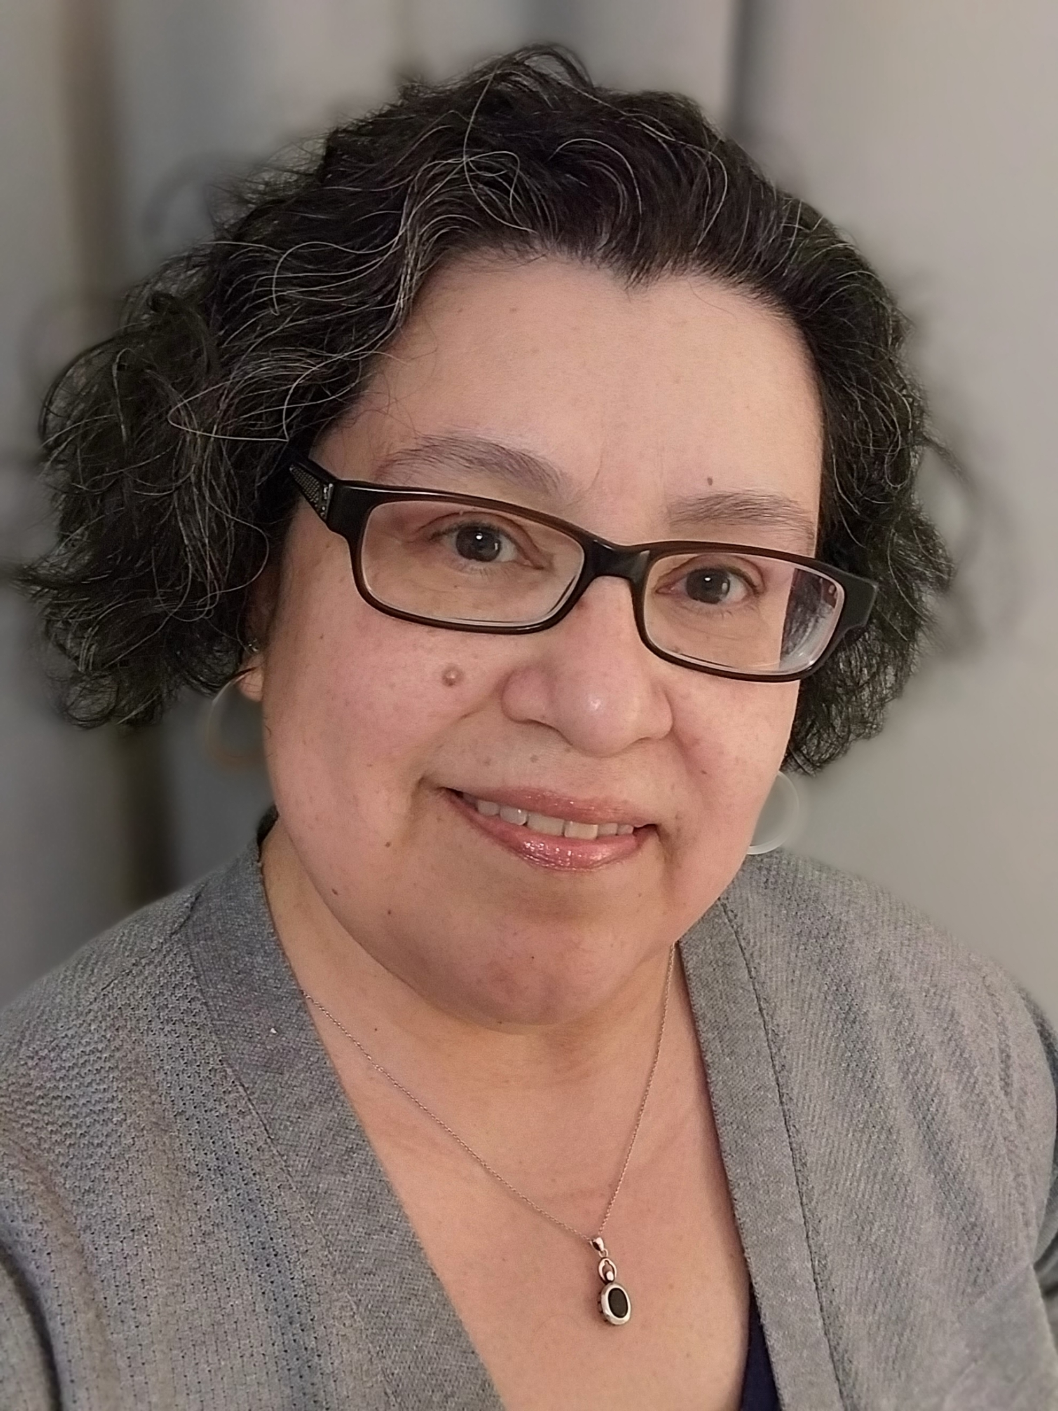
Today’s Speakers
Sarah Saito
  TAA Supervisor
    DEED
Hony Yang
  TAA Specialist
    DEED
M. Estela Hernandez
  TAA Specialist
    DEED
Thomas Sommer
  TAA Performance
  and Financial Specialist
    DEED

Slide 3
Today’s Agenda
MN OJT History review with Performance Data
Panelist Segment
Retrospective view & Program Improvements
Question/Answer Segment

Slide 4
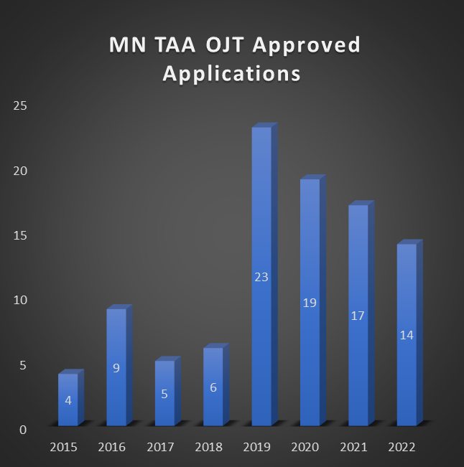
MN TAA On-The-Job-Training
Since 2019-
86% of MN TAA OJT participants have successfully completed their OJT (does not include participants currently in training)
MN TAA OJT participants have averaged a starting wage of $24.36/hour
MN TAA OJT Approved Applications
  2015: 4
  2016: 9
  2017: 5
  2018: 6
  2019: 23
  2020: 19
  2021: 17
  2022: 14

Slide 5


Our Panelists
Deb Holleman
Career Counselor
City of Duluth,
Workforce Development
Laura Molter
Human Resources Lead
ST Paper 1, LLC
Cory Peterson
Lead Recycle Operator
ST Paper 1, LLC

Slide 6


Slide 7
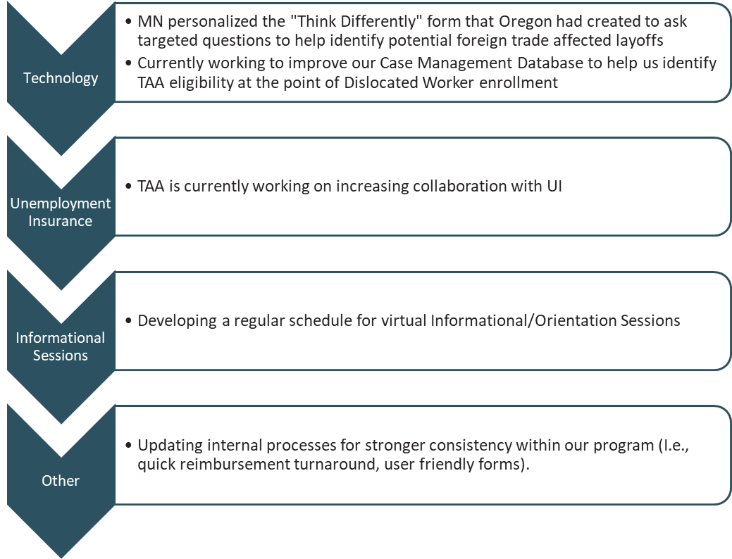
Program Improvements
Technology
  MN personalized the "Think Differently" form that Oregon had created to ask targeted questions to help identify potential foreign trade affected layoffs
  Currently working to improve our Case Management Database to help us identify TAA eligibility at the point of Dislocated Worker enrollment
Unemployment Insurance
  TAA is currently working on increasing collaboration with UI
Informational Sessions
  Developing a regular schedule for virtual Informational/Orientation Sessions
Other
  Updating internal processes for stronger consistency within our program (I.e., quick reimbursement turnaround, user friendly forms).
"Default towards action"
Steve Grove,
former Commissioner, DEED

Slide 8
Thank You!
Need help? Email: Support@workforceGPS.org
Notes:
<

