Slide 1




Youth Apprenticeship Week
May 5-11, 2024
Office of Apprenticeship
Employment and Training Administration
U.S. Department of Labor

Slide 2
Poll Question #1
What is your primary role in the apprenticeship ecosystem?
Employer
Parent
Educator/Education Institution
Policymaker
Student/Apprentice
Other

Slide 3


SPECIAL WELCOME FROM AN APPRENTICE TRAILBLAZER
Courtney Driscoll
Apprentice Trailblazer & Craft Instructor
The Apprentice School

Slide 4
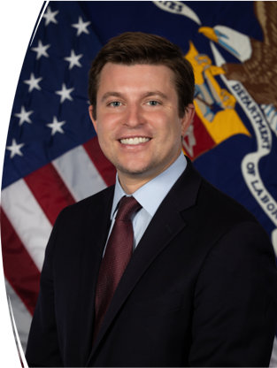
WELCOME
Brent Parton
Principal Deputy Assistant Secretary
Employment and Training Administration (ETA)
We are excited to announce the first
Youth Apprenticeship Week!

Slide 5
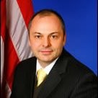
WELCOME
John Ladd
Administrator, Office of Apprenticeship
Employment and Training Administration (ETA)
Thank you for joining us today to learn about
Youth Apprenticeship Week!

Slide 6

AGENDA OVERVIEW
U.S. Department of Labor Welcoming Remarks:
Courtney Driscoll, Apprentice Trailblazer & Craft Instructor, The Apprenticeship School
Brent Parton, Principal Deputy Assistant Secretary, ETA
John Ladd, Administrator, Office of Apprenticeship, Education and Training Administration (ETA)
Cierra Mitchell, Division Director, Office of Apprenticeship, ETA
Gemma Thomas, Strategic Partnerships Team Lead, Office of Apprenticeship, ETA
Speaker Panel:
Gabriela Caballero, Apprentice Trailblazer & Outsourcing Delivery Specialist, Aon Business Services
Lateefah Durant, Vice President, Innovation, CityWorks DC
Latitia McCane, Director of Education, The Apprenticeship School
Philip Minardi, Vice President, Strategic Engagement, BuildWithin
Moderator:
Randy Copeland, Youth Lead and Program Analyst, Office of Apprenticeship, ETA

Slide 7

JOIN THE CELEBRATION
Youth Apprenticeship Week (YAW) is a nationwide celebration that highlights the benefits and value of Registered Apprenticeship programs for youth, ages 16–24. Employers, educators, labor unions, and workforce professionals across the country are launching Registered Apprenticeship programs that allow youth to earn competitive wages while obtaining the relevant training and experience to start their careers. YAW is an opportunity for these stakeholders to host events to showcase how Registered Apprenticeship creates a sustainable pipeline of skilled and diverse talent across multiple high-demand industries such as:
Advanced Manufacturing
Artificial Intelligence
Arts and Entertainment
Clean Energy
Cybersecurity
Engineering
Gaming and Graphic Design
Healthcare
Transportation
Robotics

Slide 8
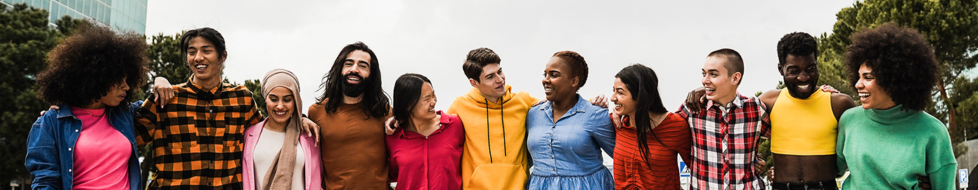
INCREASE AWARENESS
YAW is designed to increase awareness of apprenticeships among youth, educators, parents, state agencies, and workforce and industry partners to highlight the benefits of apprenticeships as a pathway to high-paying careers. In 2023, over 1/3 of apprentices were youth ages 16-24 (over 264,406).
YAW gives apprenticeship sponsors, career, and technical education (CTE) programs, employers, labor unions, workforce agencies and other diverse partners the opportunity to showcase the value of Registered Apprenticeship programs for youth and gives youth apprentices a platform to highlight their apprenticeship experience.

Slide 9
CAPITALIZING ON MOMENTUM
YAW builds on the success of NAW and is a key part of the Department's Youth Employment Works strategy.
  In March 2023, DOL launched a Youth Employer Works strategy, to center young people at the heart of workforce and economic development conversations. It challenges us to deepen partnerships across sectors and provide “no wrong door” to quality career pathways, paid work, and wrap-around services, and hire young workers through youth apprenticeship, summer youth employment, and beyond. Learn more at DOL.gov/YEW.
In the last 10 years, the number of active youth apprentices increased by 118% from 119,996
to 264,406.
The DOL awarded funding to four Youth Apprenticeship Intermediaries, and 14 youth apprenticeship readiness grantees, and 7 youth focused Apprenticeship Building America grantees to expand and support RA opportunities for youth throughout the United States.

Slide 10

DAILY THEMES
Monday:
“Parents and Guardians are a Priority” in Registered Apprenticeship
Tuesday:
Youth Apprenticeships: Building Awareness, Myth Busting, Partnering with Educational Providers, and Creating Pathways through Pre-Apprenticeship
Wednesday:
Expanding Youth Apprenticeship Opportunities for Underserved Populations
Thursday:
National Youth Apprenticeship Signing Day
Friday:
Federal Partners Day and Call to Action

Slide 11
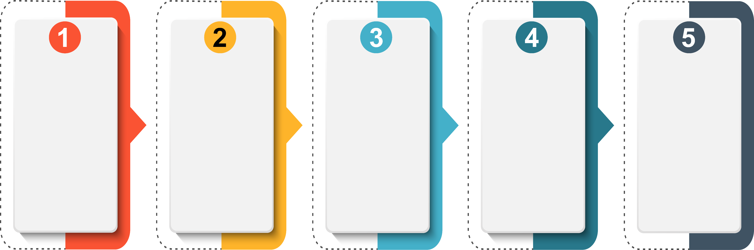
HERE’S HOW YOU CAN GET INVOLVED
Spread
The Word
Find An Event
Near You
Host
An Event
Submit Proclamations
Share Your Event Highlights
Share information about YAW and encourage your stakeholders to get involved.
Use our
interactive
YAW map
to find an event near you to participate in.
Help plan and promote YAW events, and
don’t forget to submit details
on the
YAW website.
Connect with local and state government, industry and educators
and encourage them to support Youth Apprenticeship Week.
Share photos, videos, blogs and more
on social media with hashtags
#YAW2024 and
#ApprenticeshipUSA.

Slide 12
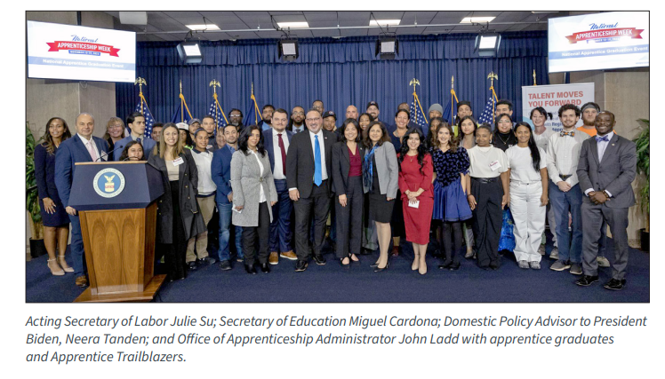
TYPES OF EVENTS
Examples of YAW related events may include:
Apprenticeship recruitment fairs
Apprenticeship open houses
Career discovery boot camps
Hackathon competitions
Social media challenges and amplification activities
Apprenticeship graduations
Signing ceremonies for new and exisiting programs
Virtual tours for students
Podcasts
Be creative, celebrate, and recruit Youth Apprentices!

Slide 13
POLL QUESTION #2
What is your main goal in participating in Youth Apprenticeship Week? ​
To learn about staring an apprenticeship program​
To find apprenticeship opportunities for youth​
To network with other stakeholders​
To advocate for apprenticeship programs​
Other​

Slide 14

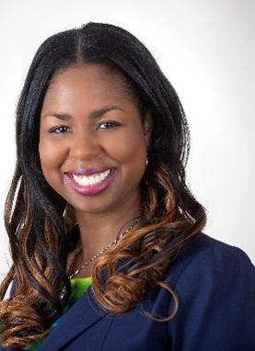
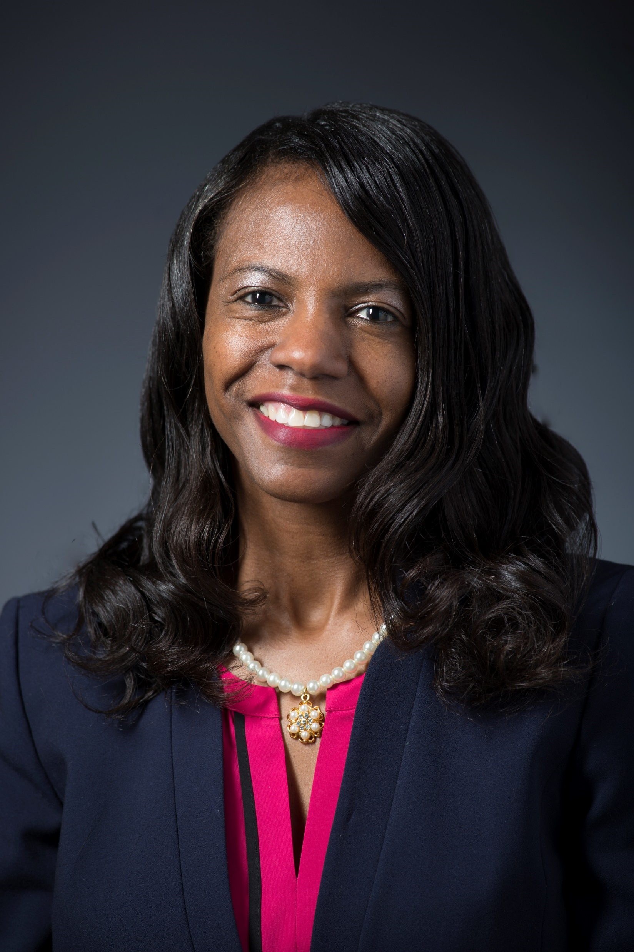

YAW SPOTLIGHT
Gabriela Caballero
Outsourcing Delivery Specialist,
Aon Business Services
Lateefah Durant
Vice President, Innovation
CityWorks DC
Dr. Latitia McCane
Director of Education
The Apprentice School
Philip Minardi
Vice President, Strategic Engagement
BuildWithin

Slide 15
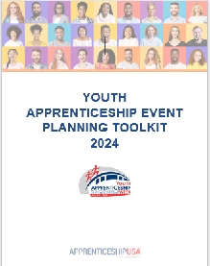


RESOURCES
Youth Apprenticeship Week Resources
The materials below can help you plan events and to gather proclamations!
Planning YAW Events Resources
YAW 2024 Event Planning Toolkit
Guide to Hosting a Virtual Event
Proclamation Resources
Download templates to encourage city, state and tribal leaders, educators, industry leaders and sponsors to support YAW 2024!
City Template
State Template
Education Template
Industry Template
YAW Tribal Nations Template

Slide 16

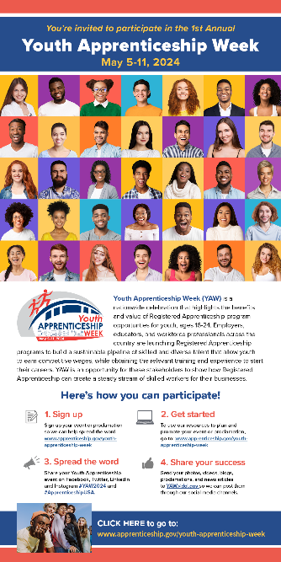
MORE RESOURCES
Youth Apprenticeship Week Resources
These materials below will help you further promote and enhance your event for Youth Apprenticeship Week (YAW).
Promote YAW
Download and share the Youth Apprenticeship Week Mailer and editable flyers with your stakeholders, so they too can learn about apprenticeship and get involved.
YAW 2024 Promotion Toolkit
YAW Event Mailer
YAW Event Promotion Flyers (editable)
Graphics and Marketing Materials
Download logos to help promote your event and utilize the Youth Apprenticeship Week fact sheet to share with event attendees.
2023 YAW logo JPG | PNG
YAW factsheet

Slide 17
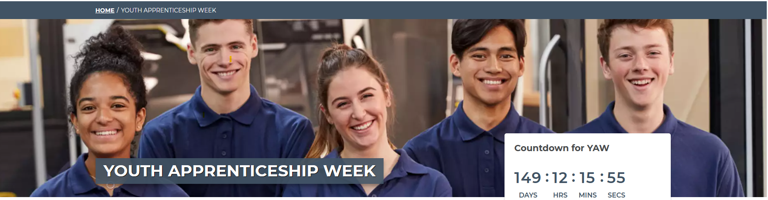

NOT SURE WHERE TO BEGIN?
Visit Youth Apprenticeship Week | Apprenticeship.gov or contact us at YouthApprenticeshipWeek@dol.gov
  Promote YAW 2024 and share your success stories through social media using hashtags #YAW2024 #ApprenticeshipUSA!

Slide 18
POLL QUESTION #3
Would you be interested in webinars or workshops on how to create and manage youth apprenticeship programs? ​
Yes​
No​
Maybe​

Slide 19
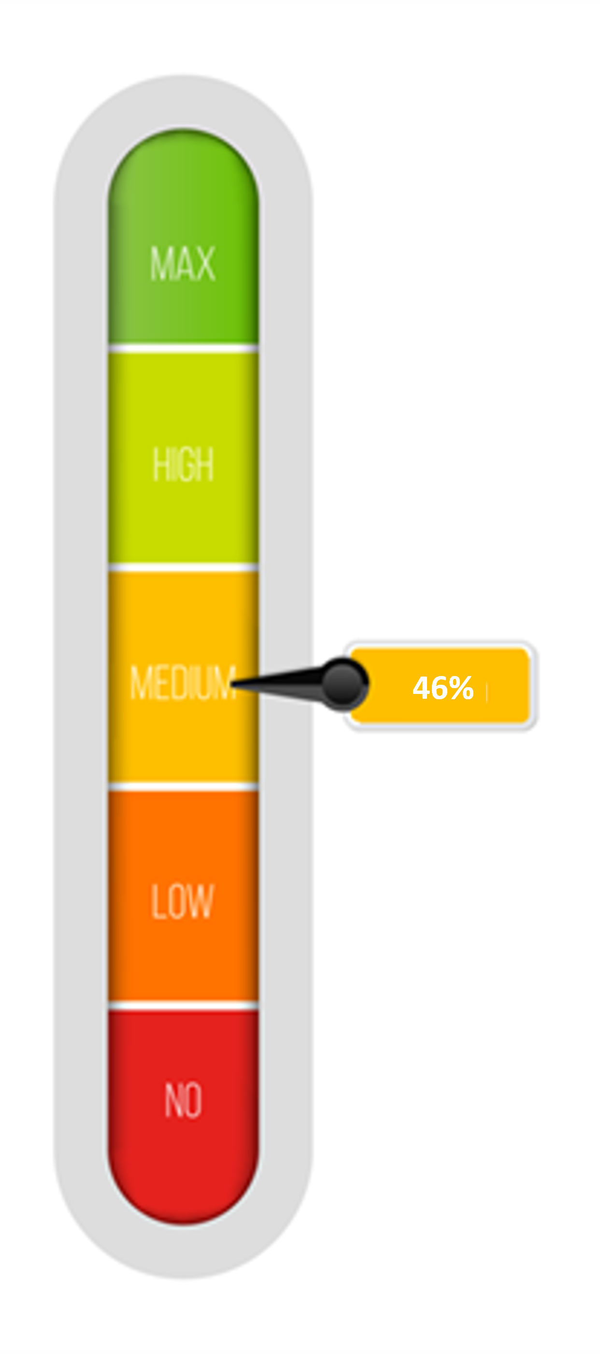
YAW STATUS UPDATE AND CALL TO ACTION
Events Registered to Date: 50 (of 100)
Time to Launch: T-Minus 59 Days
Call to Action! We need to register an average of at least ONE EVENT PER DAY to reach our goal!
Hosting a related event before/during/after YAW? Just register it! JUST YAW IT! Registering a YAW event is easy and takes 60 seconds!

Slide 20

Q&A
Questions?
What activities do you plan to organize or attend?​

Slide 21
CONTACT US
YouthApprenticeshipWeek@dol.gov
EMAIL:
VISIT:
Apprenticeship.gov Homepage: www.apprenticeship.gov
Youth Apprenticeship Week: https://www.apprenticeship.gov/youth-apprenticeship-week
Resources: https://www.apprenticeship.gov/youth-apprenticeship-week/resources
Submit an Event: https://www.apprenticeship.gov/youth-apprenticeship-week/yaw-submit-event
Submit a Proclamation:
https://www.apprenticeship.gov/youth-apprenticeship-week/yaw-submit-your-proclamation

