Slide 1
Job Quality Academy
Starter Guide – Part 2

Slide 2

Today’s Speaker / Today’s Moderator
Cheryl Martin
  Manager, Community College Investments Unit
    U.S. Department of Labor Employment and Training Administration

Slide 3
Agenda
Welcome
  U.S. DOL priorities
Job Quality Academy Overview
Starter Guide Deep Dive
Panel Discussion
Q&A

Slide 4
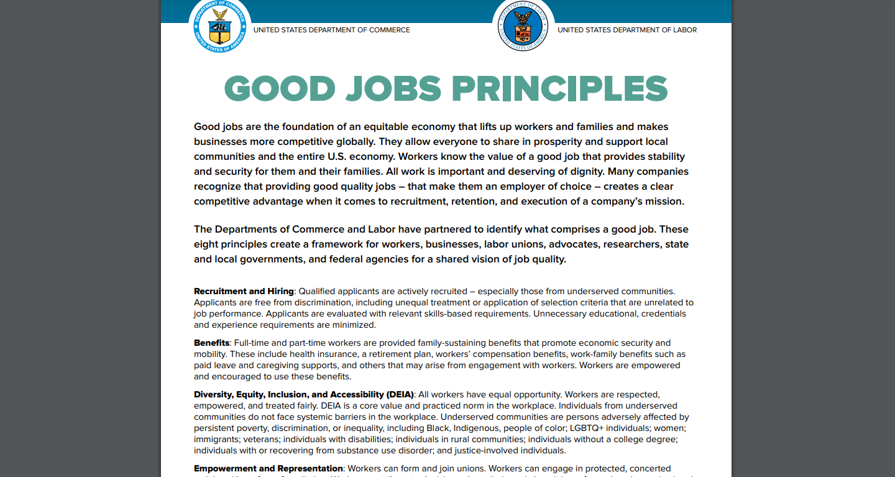
Good Jobs Principles
Good jobs help workers achieve economic stability and mobility, while prioritizing diversity and worker voice. The principles of a good job are:
  Recruitment and hiring – Free of discrimination, skills-based hiring
  Benefits
  Diversity, Equity, Inclusion, and Accessibility (DEIA)
  Empowerment and representation
  Job security and working conditions
  Organizational culture
  Pay - Stable and predictable living wage. Fair, transparent, and equitable
  Skills and career advancement
Want to read more? The Principles can be found at: https://www.dol.gov/general/good-jobs/principles

Slide 5
ETA Job Quality Activities
    RFI on Sector Strategies – gathered information on worker-centric sector strategies aimed at improving job quality. (January 2023)
    Training and Employment Guidance Letter 7-22, Increasing Employer and Workforce System Customer Access to Good Jobs outlines how the workforce system should integrate good jobs strategies into its employer partnerships and workforce training. (Published Jan 2023) and webinar
    Quality Jobs, Equity, Strategy, and Training (QUEST) DWGs awarded in September 2022.
    New Demo for Critical Sector Job Quality Grants to improve job quality in Care Economy, Clean Energy and Hospitality sectors. (Awarded in September 2023)
    Job Quality Academy TA for 16 teams in developing job quality plans during 2023
    Tools –Job Quality Starter Guide

Slide 6
Job Quality Academy Overview

Slide 7



Today’s Speakers
Ben Sommer
  Director
    Jobs For the Future
Genna Petrolla
  Senior Manager
    Jobs For the Future
Jonathan Osei
  Manager
    Jobs For the Future

Slide 8
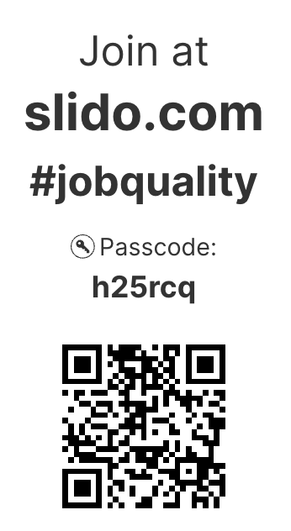
How do you define Job Quality?
POLL
Please enter your answer/ answers in the chat
OR
Scan the QR code to share your answer/ answers

Slide 9
Where is your organization on your job quality journey?
POLL
Just getting started
Defining Job Quality in our region
Employer/ Partner Engagement
Developing a strategic plan
Implementing a number of job quality initiatives at scale
Something else- please share in chat

Slide 10
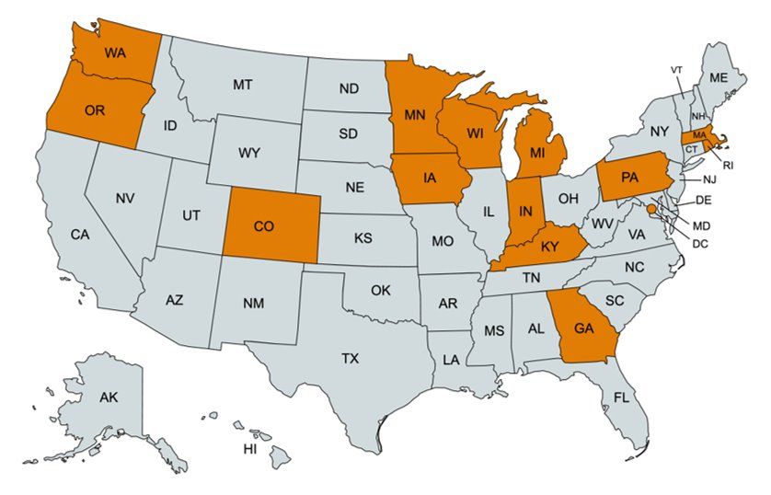
Job Quality Academy Teams
16 teams from 14 states

Slide 11
Job Quality Academy Teams
Team Structure
Lead Organizations represented one of the following types of organizations: state workforce board, state workforce agency, local workforce board, or tribal entity.
Teams were required to include a worker voice-focused organization such as a labor union or worker center representative.
Teams could also include any community-based organization, employer or employer representative, or any other organization committed to improving job quality in their community.

Slide 12
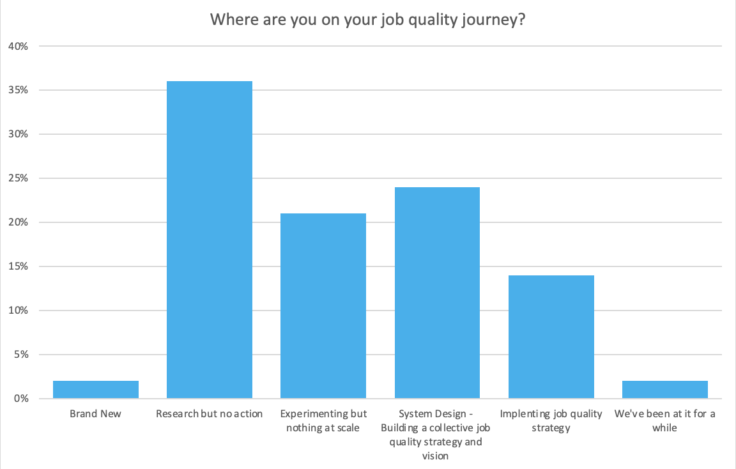
Where teams were in their JQ journey

Slide 13

Partners

Slide 14




Academy Structure
In-person intensives
Coaching Support
Design-thinking activities
Ecosystem-wide approach

Slide 15




Coaching
Coach as resource
TA Intake form
2 Group Coaching Sessions
Office Hours

Slide 16
Job Quality Starter Guide

Slide 17
Job Quality Starter Guide – Key Components
Defining Job Quality
How to use the starter guide
Finding your focus
Setting Your Foundations
Developing Your Job Quality Action Plan
Additional Resources
Case Examples

Slide 18
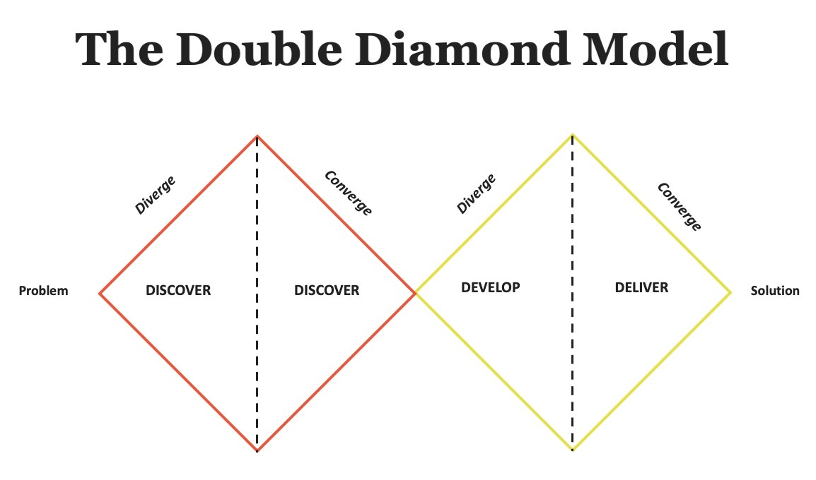
How to Use the Starter Guide
Guiding Principles
Iteration and Prototyping
Stakeholder Engagement

Slide 19
Setting Your Foundations
Understanding your environment and context
Assembling a team
Consensus on Job Quality Definition
Leadership Support for Job Quality
Grant Funding for Job Quality Initiatives
Stakeholder Engagement for Job Quality Metrics
Diverse Organizational Representation
Foundational Team as a Starting Point

Slide 20
Assembling Your Team
The Powerbroker
This organization has access to your region’s permission structures and can give cover to new ideas.
The Advocate
This person or organization knows how to bring important issues to the forefront. They can help with incorporating worker voice as well as dissemination of the final action plan.
The Connector
This person or organization knows everyone and everything that’s going on in the region. Rely on them to bring in important stakeholders for feedback and alignment
The Convener
This organization is best situated for bringing team members together. This could also be called the team lead. They may already be leading similar cross-sector partnerships and have the infrastructure and the model to host.

Slide 21



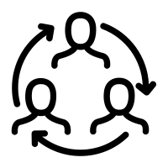


Finding Your Focus
Procurement
KEY LEVERS FOR CHANGE
Empowerment
Policy
HR Practices
Education and Enforcement

Slide 22
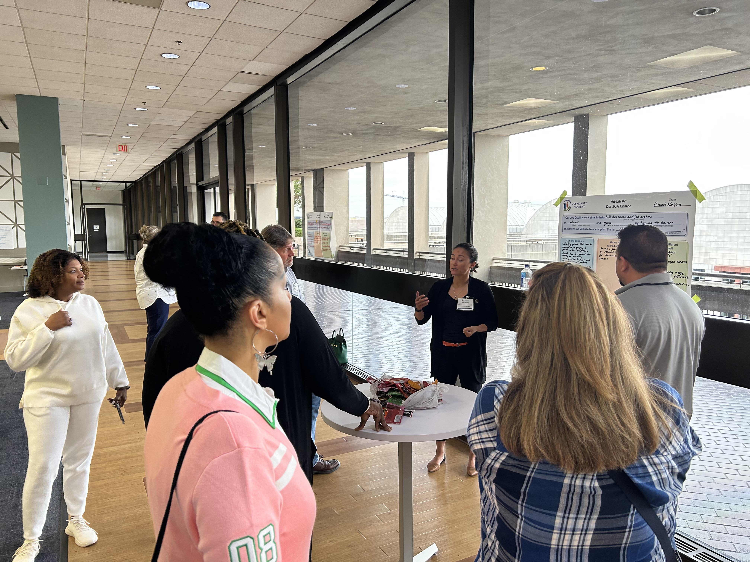
Developing Your Job Quality Action Plan
Defining Success
Action Planning
Pitch to Stakeholders
Success Measurement
Strategy Identification

Slide 23
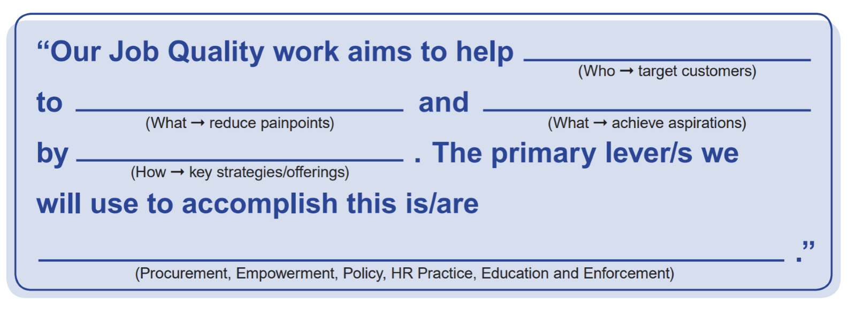
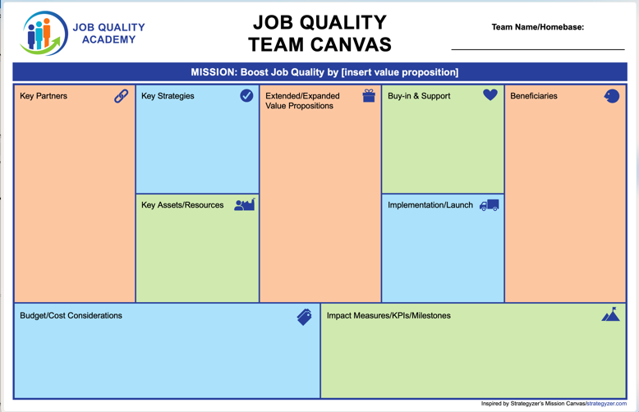
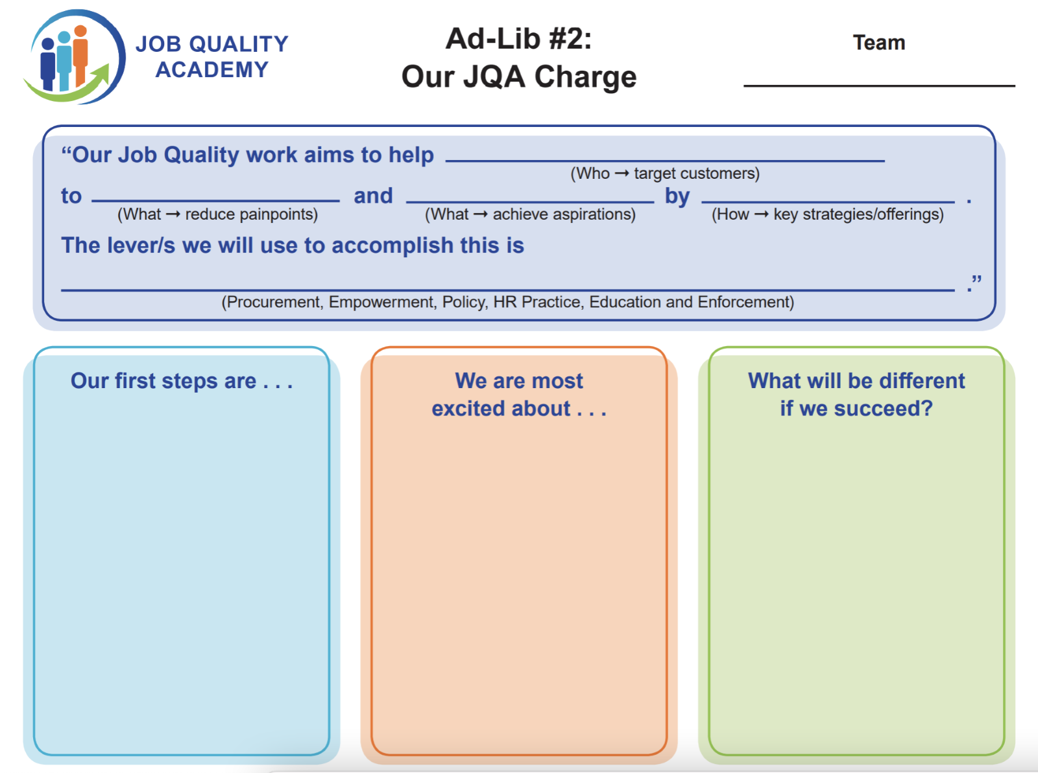
Developing Your Job Quality Action Plan
Strategy: (identified goal you are addressing with this strategy)
Action steps | Person(s)/ partners responsible | Resources needed internal/ external | Progress indicators/ milestones | Target completion date | Other
What you’ll need to do to implement the strategy. | Who is responsible for carrying out each action step. | What resources you’ll need to complete each action step. | How you know that you have made progress on each action step. | When you expect to complete each action step. | Additional needs, resources or information

Slide 24
Developing Your Job Quality Action Plan

Slide 25
Developing Your Job Quality Action Plan
Mission
Key Partners
Key Strategies
Key Assets/Resources
Extended/Expanded Value Proposition
Buy-in & Support
Implementation/Launch
Beneficiaries
Budget/Cost Considerations
Impact Measures/KPIs/Milestones

Slide 26
Developing Your Job Quality Action Plan
Value Proposition
First Steps
What we are most excited about
What will be different if we succeed?

Slide 27
Developing Your Job Quality Action Plan
Strategy: (identified goal you are addressing with this strategy)
Action steps | Person(s)/ partners responsible | Resources needed internal/ external | Progress indicators/ milestones | Target completion date | Other
What you’ll need to do to implement the strategy. | Who is responsible for carrying out each action step. | What resources you’ll need to complete each action step. | How you know that you have made progress on each action step. | When you expect to complete each action step. | Additional needs, resources or information

Slide 28
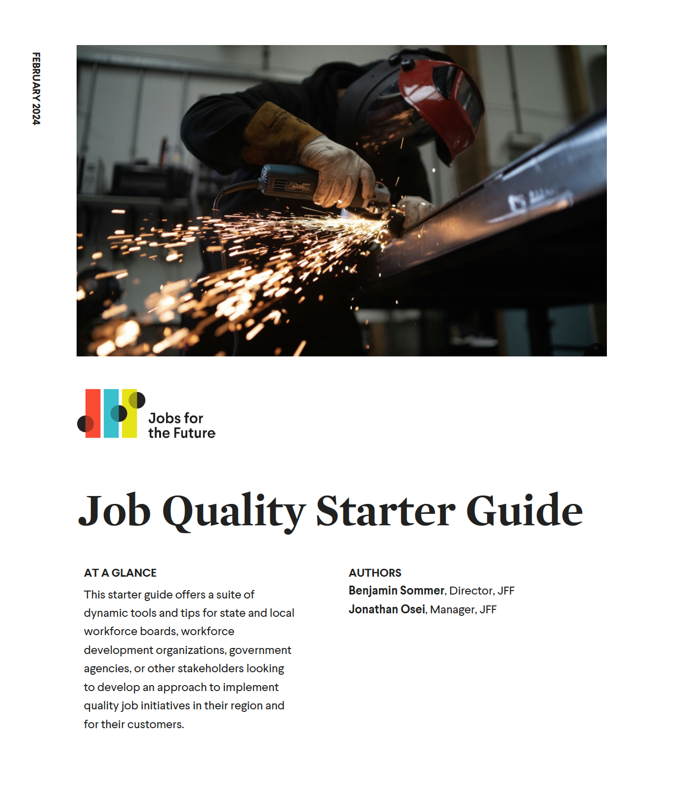
Using the Starter Guide!
Workforce GPS https://dwg.workforcegps.org/resources/2024/02/01/21/01/Job-Quality-Academy
Your feedback matters! Tell us how you're using the starter guide in your work.

Slide 29
Panel Discussion
How did we embark on our job quality journey together?

Slide 30



Job Quality Academy “Alumni”
Bonny Yeager
  Senior Manager of Industry Solutions
    Partner4Work
Miranda Swafford
  Executive Director
    Mississippi Valley Workforce Development Board
Tyler Lanz
  Strategic Partnership Specialist
    Mississippi Valley Workforce Development Board

Slide 31
Value Proposition
Empowering the workforce of tomorrow! Our Job Quality initiative is dedicated to creating a balanced workplace environment where worker expectations and employer practices seamlessly align, championing the widespread adoption of the Good Job Principles.
- Mississippi Valley Workforce Development Board

Slide 32
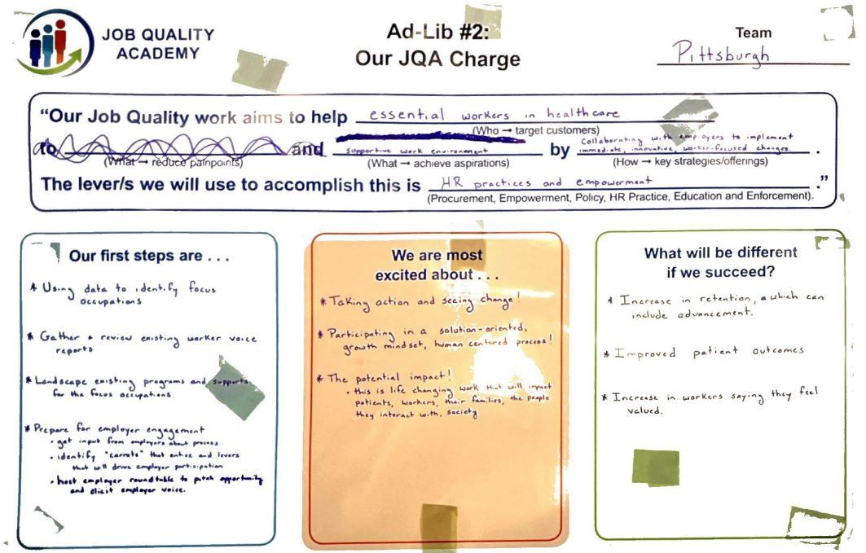
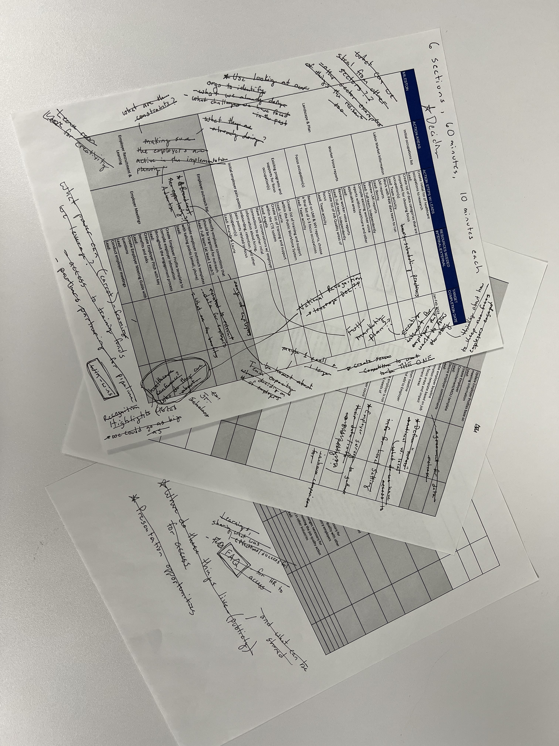
The Process in Real Life

Slide 33
What's Next?
Download the Starter Guide: https://dwg.workforcegps.org/resources/2024/02/01/21/01/Job-Quality-Academy
Join us on Tuesday, March 26 at 11:15am - 12:15pm ET NAWB Forum
Questions on how to use the Starter Guide in your community? Contact Ben Sommer at bsommer@jff.org. We'd be happy to hear from you!
Question on the Job Quality Academy? Contact Heather Fleck at fleck.heather@dol.gov
Missed webinar #1? Check it out: https://www.workforcegps.org/events/2024/01/21/13/04/Job-Quality-Academy-Starter-Pack-Part-1

Slide 34
Any Questions?
Please type your questions in the chat.

Slide 35
Thank You!
Need help? Email: Support@workforceGPS.org

