Slide 1
Program Retention: Strategies to Keep
Pre-Apprentices and Apprentices Engaged, Empowered, and Involved

Slide 2
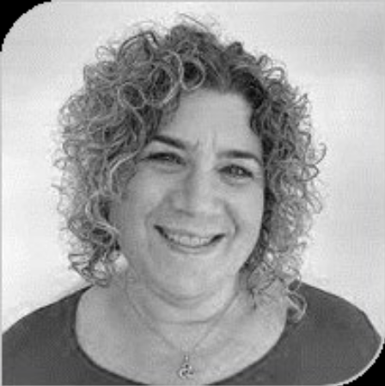
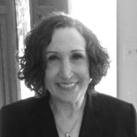
Today’s Speakers
Amy Landesman, ICF
Apprenticeship Building America (ABA) Coach
Valerie Taylor, ICF
Apprenticeship Building America (ABA) Coach

Slide 3
Quick Poll – We value your input!
The ICF technical assistance team will be adopting a cloud-based communication tool to enable ABA grantees to connect with each other.
Microsoft Teams
Slack
I use another tool (Please drop the name in the Chat)
I do not currently use a cloud-based communication tool
Do you currently use any of the following tools for communicating with your colleagues or other professional contacts?

Slide 4
Today’s Agenda
The Retention Dilemma
How Did This Happen?
Engagement, Empowerment, and Retention Strategies
  Program Development
  Messaging
  Incentives/Employment Supports
ABA Updates and Publications

Slide 5
Pulse Check
Not an issue for us
A challenge, but we have a plan
A challenge, but we are not quite sure how to address it
I can’t talk about it right now!
Pre-apprenticeship or Apprenticeship engagement and retention is:

Slide 6

The Retention Dilemma
Push-Pull Challenge – AKA Tug of War!

Slide 7

Keeping Pre-Apprentices and Apprentices Engaged
Are we experiencing challenges in keeping connected with participants after the start of their pre-apprenticeship or Registered Apprenticeship (RA)?
What are some of our challenges?
What are some of our hunches as to why?

Slide 8
The Retention Dilemma 2
For many, retention and follow-up with the pre-apprenticeship/RA Program are equated only with employment verification
Or the pre-apprentice/apprentice identifies the “program” as the worksite and not us
Or the program is unable to retain the pre-apprentice while waiting for/transitioning to a RA
All of these are a problem because there is no apparent benefit for the
pre-apprentice or apprentice to stay connected.

Slide 9
How Did This Happen?

Slide 10
How Did This Happen? 2
Faulty messaging during orientation
  Ex. – “And after you get placed, we will continue to meet to talk about how it is going and to make sure you are still working” - implies nothing more than employment verification
Lack of services between a pre-apprenticeship and a RA
  No touch points or communication
Lack of follow-up services once in a pre-apprenticeship or RA
  Often there isn’t much for pre-apprentices/apprentices to stay connected to beyond 1-1 check-ins

Slide 11
How Did This Happen? 3
No clear benefits
  If they can’t see the “what is in it for them,” they won’t continue to engage
Uninspiring outreach
  If the message doesn’t motivate or resonate, they won’t come
Inappropriate use of incentives/ employment supports
  Incentives that don’t speak to people or aren’t necessary anymore won’t work
  Incentives alone after time will not work

Slide 12
Engagement, Empowerment, and Retention Strategies
What can we do about this?

Slide 13
Retention Intervention
Program Development
Messaging
Incentives/Employment Supports

Slide 14
Program Development
What services do you currently offer?
  For a pre-apprenticeship
  RA
  Pre-apprenticeship to RA transition
What can be developed?

Slide 15
Program Development: Activities
Speaker series
Hot topics
Alumni events
Recognition events
Career pathway planning
Community speakers
Job retention activities/topics
Peer activities
Socializing opportunities
Opportunities to mentor
Guest lecture/speaker
Networking events
What else????

Slide 16
Program Development: Environment
What is your site like when you walk into it?
  Is it welcoming?
  Are there places to sit or hang out and build connections?
  What is the “vibe”?
Visuals
  Career posters or motivational sayings
  Wall of Success
Class/Training room set-up
  What is the seating like?

Slide 17
Program Development: Empowerment
Solicit feedback
  Informal or formal
  Focus groups, surveys, interviews, etc.
Create opportunities for ownership of pre-apprenticeship or RA
  Co-designers of programming
  Planning activities or events
  Naming rights/agenda setters

Slide 18
Program Development: Empowerment (2)
Program recognition opportunities
  Shout-outs of partners or each other
  Newsletters/announcements
Build team/cohorts and create champions
  Alumni events
  Cohort events
  Recruiting assistance
  Speakers on behalf of programs
  Peer competition
    Work site vs. work site or cohort vs. cohort

Slide 19
Program Development: Other Considerations
Remember orientations
  Think about how follow-up is described
  Live the mantra “Retention starts on Day One”
Will activities be group, 1-1, or both?
Staff capacity – who will develop and implement the ideas?
Can you articulate the benefit for the alumni?
Will the activity be of interest?

Slide 20
Messaging
How are you reaching out?
What is the message?
  Is it positive – assuming the best and not the worst (i.e., unemployment)?
Is the focus something besides employment verification?
Do you have something to offer and are you offering it in a way that appeals to your target audience?
How do you address your audience - do you use apprentice and alumni and not participants?

Slide 21
Messaging Techniques
Do you use general marketing techniques?
  Engaging and inspirational
  Articulates the benefits
  Answers WIIFM
  Shares results

Slide 22
Pulse Check 2
Incentives
Rewards
Both
I am not sure the difference
We use incentives and/or rewards for our pre-apprentices and apprentices:

Slide 23
Incentives/Employment Supports
What is the difference between incentives and rewards?
Incentives – used to motivate participants to commit to, participate in, and accomplish tasks, goals or specific behaviors
Rewards – given to participants because they earned it based on performance, a specific behavior or achievement
Link incentives and rewards to performance
as much as possible.

Slide 24
What Type of Recognition Works best?
Money (or equivalents like gift cards) improves performance for a short period. Money quickly becomes seen as a right rather than a reward.
Public recognition creates good feelings, empowerment and a sense of attachment to a program.
Personal connection with staff and other pre-apprentices/apprentices produces the greatest results.

Slide 25
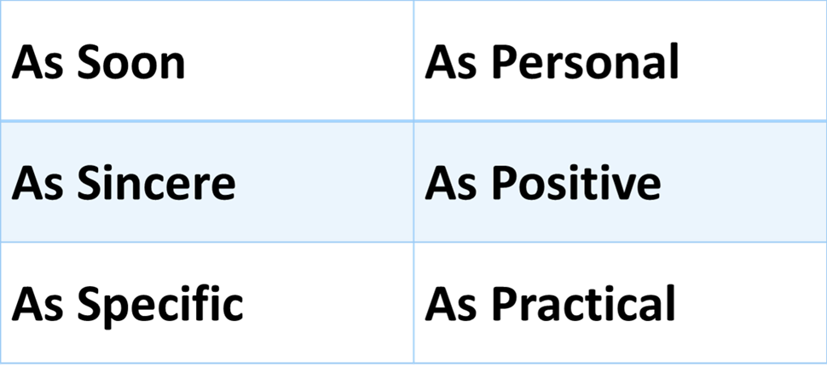
Maximizing Recognition
Follow Dr. Bob Nelson’s ASAP3 (“ASAP cubed”) Model of Recognition:
www.drbobnelson.com

Slide 26

Let’s Hear From You
Share some of your
Retention Interventions

Slide 27
ABA Program Retention Publications
ABA Tip Sheet: Apprentice Retention
Solutions to Address Common Challenges in Serving Opportunity Youth in Registered Apprenticeship
We will be adding publications on this topic this summer/fall!

Slide 28
Apprenticeship Building America Evaluation
Please complete this brief questionnaire to indicate your satisfaction with this webinar and your ability to apply the information to your programs. Your responses will allow ETA to improve its TA offerings and webinars to meet the needs of grant recipients. Webinar poll participation is confidential and voluntary, and all answers will be used for internal planning purposes only.
According to the Paperwork Reduction Act of 1995, no persons are required to respond to a collection of information unless it displays a valid OMB control number. The OMB control number for this collection is 1225-0059 and expires on February 29, 2024. Public reporting burden for this collection of information is estimated to average 2 minutes per response including time for reviewing instructions, searching existing data sources, gathering the data needed, and completing and reviewing the collection of information. Your response is voluntary. Send comments regarding the burden estimate or any other aspect of this collection of information to DOL_PRA_PUBLIC@dol.gov and reference the OMB control number.

Slide 29
Contact us
Amy Landesman - amy.landesman@gmail.com
Valerie Taylor – valerie.taylor@icf.com
All grant inquiries - ABA.Grant@dol.gov

Slide 30
Thank you!!!

