Slide 1
Consumer Protection: Job Searching Strategies to Protect Against Scams, Fraud, and Identity Theft
United States Department of Labor Employment and Training Administrations and the Federal Trade Commission
March 11, 2026
02:00 - 03:00 PM ET

Slide 2


Moderators
Maisha Meminger
Nimisha Timsina
Manpower Development Specialist
Workforce Analyst
Department of Labor, Employment and Training Administration Office of Workforce Investment’s Division of Youth Services
Department of Labor, Employment and Training Administration Office of Workforce Investment’s Division of Youth Services

Slide 3

Agenda
Moderator Introductions
Review WIOA Adult and Dislocated Worker Financial Literacy Definition
Review WIOA Youth Program Element Financial Literacy Education
Presenter Introductions
FTC Presentation
Q&A Discussion
Closeout

Slide 4
National Consumer Protection Week
March 01-07, 2026

Slide 5
Financial Literacy for Adult and Dislocated Workers

Slide 6
Financial Literacy for Adults and Dislocated Workers
Financial literacy education can be offered as a career service in WIOA Adult and Dislocated Workers programs. Benefits of financial literacy education may include the following:
    Improved financial stability and resilience
    Create household budgets
    Enhanced decision making and knowledge (spending, credit, and debt)
    Access to resources and support with managing finances

Slide 7
Financial Literacy Education Resources for Adults and Dislocated Workers
TEGL 19-16 Guidance on Services provided through the Adult and Dislocated Worker Programs under the Workforce Innovation and Opportunity Act (WIOA) and the Wagner-Peyser Act Employment Service (ES), as amended by title III of WIOA, and for Implementation of the WIOA Final Rules
  Career Services pages 2-3.
    https://www.dol.gov/agencies/eta/advisories/training-and-employment-guidance-letter-no-19-16
TEGL 16-16 One-Stop Operating Guidance for the Workforce Innovation and Opportunity Act
  Career Services pages 12-16.
    https://www.dol.gov/agencies/eta/advisories/training-and-employment-guidance-letter-no-16-16

Slide 8
Financial Literacy for Youth and Young Adults

Slide 9
§ 681.500 What is financial literacy education?
The financial literacy education program element may include activities which:
Support the ability of participants to create budgets, initiate checking and savings accounts at banks, and make informed financial decisions;
Support participants in learning how to effectively manage spending, credit, and debt, including student loans, consumer credit, and credit cards;
Teach participants about the significance of credit reports and credit scores; what their rights are regarding their credit and financial information; how to determine the accuracy of a credit report and how to correct inaccuracies; and how to improve or maintain good credit;

Slide 10
§ 681.500 What is financial literacy education? cont. 2
The financial literacy education program element may include activities which:
Support a participant's ability to understand, evaluate, and compare financial products, services, and opportunities and to make informed financial decisions;
Educate participants about identity theft, ways to protect themselves from identify theft, and how to resolve cases of identity theft and in other ways understand their rights and protections related to personal identity and financial data;
Support activities that address the particular financial literacy needs of non-English speakers, including providing the support through the development and distribution of multilingual financial literacy and education materials;

Slide 11
§ 681.500 What is financial literacy education? cont. 3
The financial literacy education program element may include activities which:
Support activities that address the particular financial literacy needs of youth with disabilities, including connecting them to benefits planning and work incentives counseling;
Provide financial education that is age appropriate, timely, and provides opportunities to put lessons into practice, such as by access to safe and affordable financial products that enable money management and savings; and
Implement other approaches to help participants gain the knowledge, skills, and confidence to make informed financial decisions that enable them to attain greater financial health and stability by using high quality, age-appropriate, and relevant strategies and channels, including, where possible, timely and customized information, guidance, tools, and instruction.

Slide 12
Identity Theft is a part of Financial Literacy Education Definition
The financial literacy education program element may include activities which…
(e) Educate participants about identity theft, ways to protect themselves from identify theft, and how to resolve cases of identity theft and in other ways understand their rights and protections related to personal identity and financial data
§ 681.500 What is financial literacy education?

Slide 13
WIOA Youth Financial Literacy Education Resources
WIOA Youth Program Element Brief: Financial Literacy Education
  This brief includes related information in the Act, the regulations, and guidance for this program element.
    https://d2leuf3vilid4d.cloudfront.net/-/media/D7D017E73E3E46B0AA2717CFDFD2F447.ashx?rev=366349CAE4B46FAA539295E847817FD5
§ 681.500 What is financial literacy education?
  The financial literacy education program element may include this list of activities
    https://www.ecfr.gov/current/title-20/section-681.500

Slide 14
WIOA Youth Financial Literacy Education Resources cont.
Financial Literacy Education WorkforceGPS Resources
  Information and ideas on providing financial literacy education to youth.
    https://youth.workforcegps.org/resources/2017/01/27/12/40/Financial-Literacy-Education
Financial Literacy Tools
  For tools including calculators, budget templates, and activities.
    https://youth.workforcegps.org/resources/2023/06/23/17/14/Financial-Literacy-Tools

Slide 15


Federal Trade Commission (FTC) Presenters
Kira Krown
James Kreidler
Consumer Education Specialist
Consumer Education Specialist
Federal Trade Commission
Federal Trade Commission

Slide 16
How to Avoid Job Scams
Kira Krown | Jim Kreidler
March 11, 2026

Slide 17
What the Federal Trade Commission Does
Enforcement
Consumer and Business Education
Building Partnerships and Coalitions
Hello

Slide 18

What We’ll Cover Today
Top Frauds 2025
How to Avoid Scams
Deep Dive: Job Scams
How to Report Scams
How to Recover from Scams
Free FTC Resources

Slide 19
Top Frauds

Slide 20
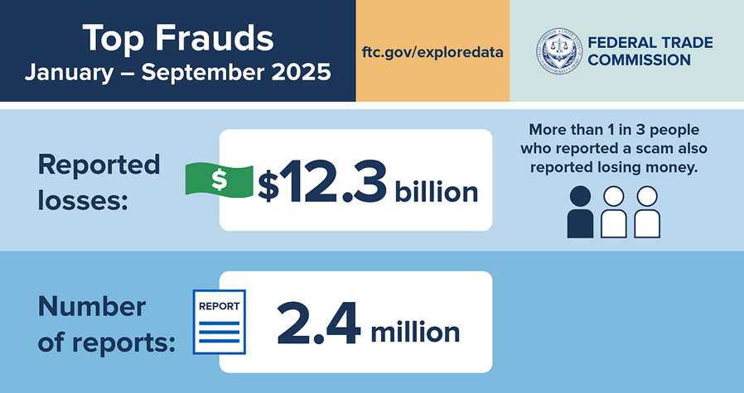
Top Fraud trends January through September 2025 1
Top Frauds

Slide 21
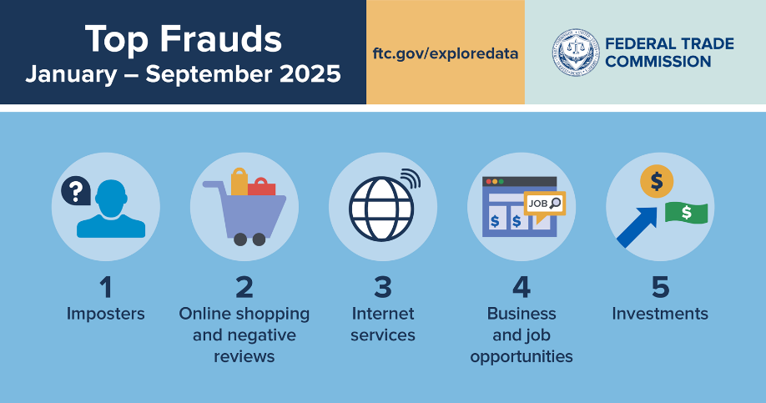
Top 5 Frauds January through September 2025 2
Top Frauds

Slide 22
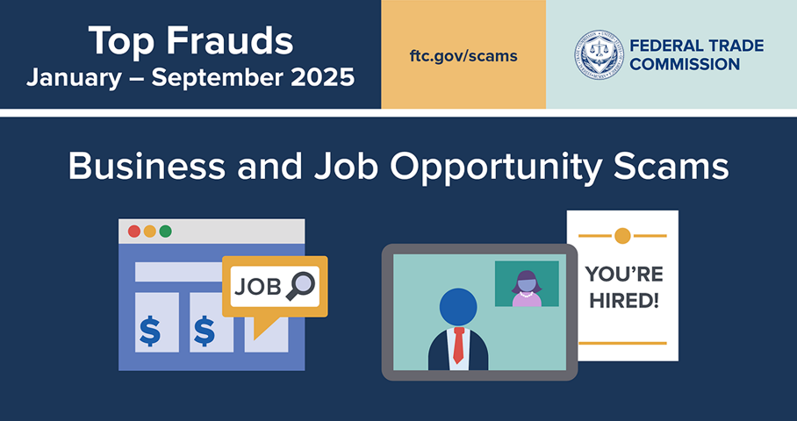
Top Frauds January through September 2025 3
Top Frauds

Slide 23
How to Avoid Scams

Slide 24
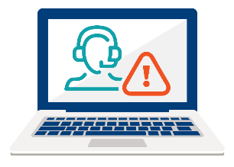
Four Signs it’s a Scam: Pretend
Four Signs It’s a Scam
#1: Scammers PRETEND to be from an organization you know.

Slide 25

Four Signs it’s a Scam: Problem or Prize
Four Signs It’s a Scam
#2: Scammers say there’s a PROBLEM or a PRIZE.

Slide 26

Four Signs it’s a Scam: Pressure
Four Signs It’s a Scam
#3: Scammers PRESSURE you to act immediately.

Slide 27

Four Signs it’s a Scam: Pay
Four Signs It’s a Scam
#4: Scammers tell you to PAY in a specific way.

Slide 28

How to Avoid Scams
Block unwanted calls and texts
Verify the story
Don’t be rushed
Know how scammers tell you to pay

Slide 29
Job Scams

Slide 30
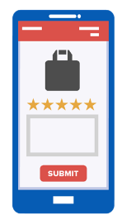
Job Scams: Task Scams
Simple tasks, like rating product images
The supposed “job” is “earn money” for each click
“Earnings” are fake

Slide 31

Job Scams: Fake Recruiters
Call or text offer for remote job
Set up an interview but first…
Ask for personal or financial info

Slide 32
Job Scams: Boss Imposter Scams
New “boss” tells you to buy gift cards
Promises to pay you back
Once you give gift card number and PIN, money is gone

Slide 33

Business Opportunity Scams
Promise "expert coaches"
No such thing as "proven method"​
Glowing stories of success – fake

Slide 34
Job Scams: Fake Checks
Did someone send you a check and ask you to send some money back?
That’s a scam.

Slide 35
Job Scams: How to Avoid
Do an online search
Talk to someone you trust
Don't pay for the promise of a job
Never bank on a “cleared” check

Slide 36
How to Report Scams

Slide 37
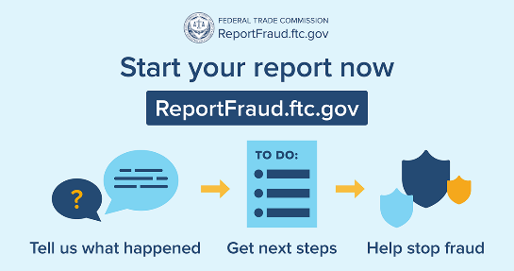
FTC Website Demonstration

Slide 38
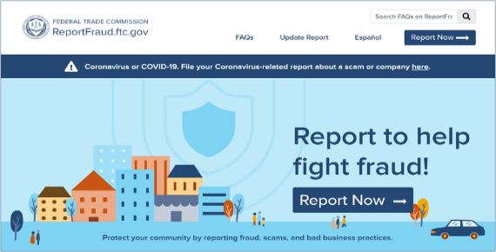
ReportFraud.ftc.gov Website Demonstration

Slide 39
How to Recover from Scams

Slide 40

If You Paid a Scammer
You paid by | Contact
Credit Card | Your card issuer
Wire transfer | Wire transfer company
Gift card | Company that issued the gift card
Money transfer app | Company behind the money transfer app
Cryptocurrency | Company you used to send the crypto

Slide 41
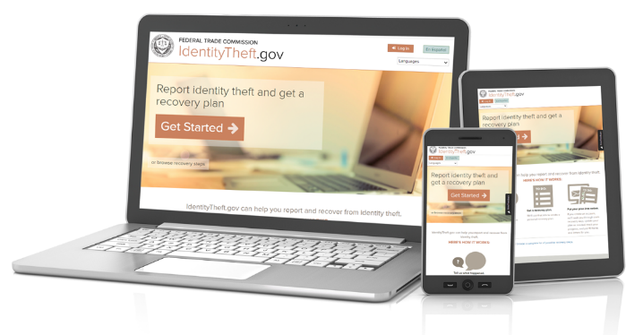
If You Gave a Scammer Your
Personal Information
Did someone use your information?
If Yes, Report it at IdentityTheft.gov.
If No, take steps to protect your information.

Slide 42
Free FTC Resources

Slide 43
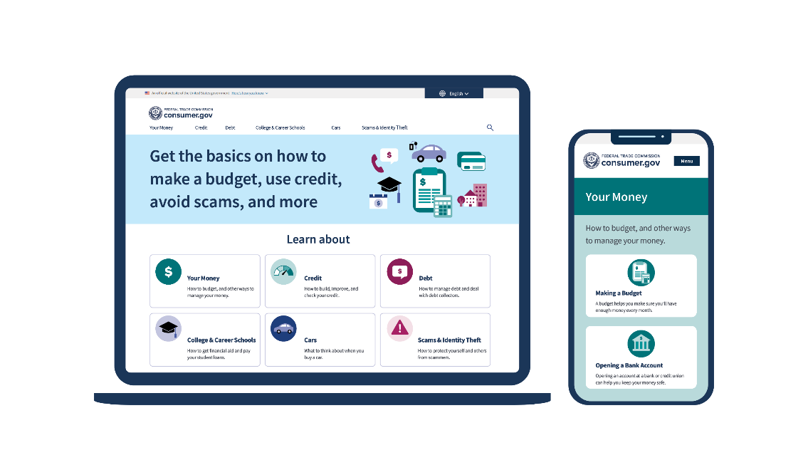
consumer.gov

Slide 44
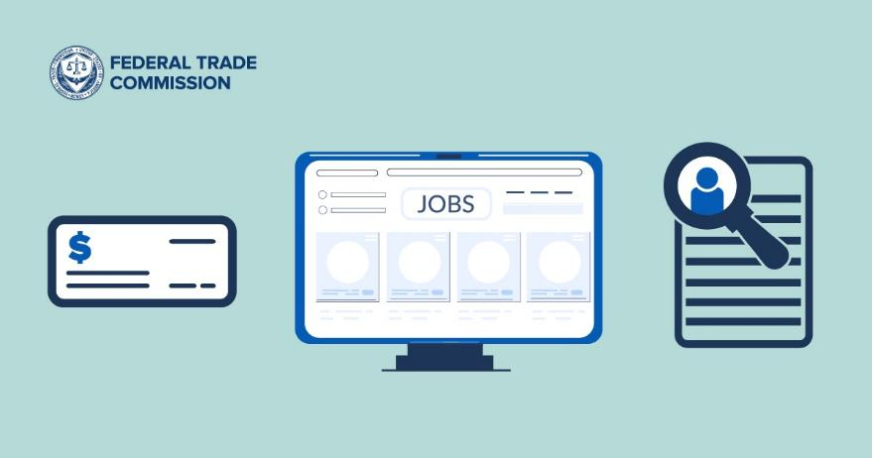
Learn More About Job Scams
ftc.gov/
jobscams

Slide 45
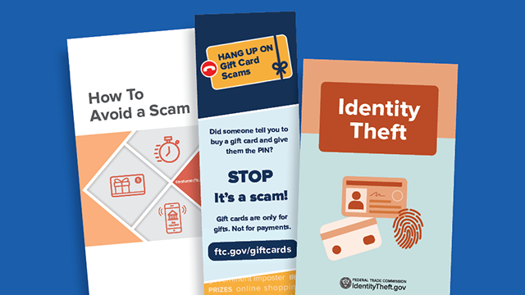
Free Print Materials at BulkOrder.ftc.gov

Slide 46

Stay Connected
Sign up for Consumer Alerts
English: ftc.gov/ConsumerAlerts
Spanish: ftc.gov/AlertasdeConsumidor

Slide 47
Your
Technology and Accessibility Experience

Slide 48
Questions

Slide 49
Thank You kkrown@ftc.gov jkreidler@ftc.gov

Slide 50
We want your feedback!
What additional topics would you like to see covered?

Slide 51
Division of Youth Services Contact Information
Division of Youth Services: youth.services@dol.gov
Additional Resources:
Youth Connections on WorkforceGPS

Slide 52
Your
Event Experience

Slide 53

Thank You!
We look forward to seeing you on WorkforceGPS.
Need Help? Email: Support@WorkforceGPS.org

