Slide 1
Reemployment Services and Eligibility Assessment (RESEA) 2022 State Plan Webcast Series
December 9, 2021
Reemployment Services and Eligibility Assessment (RESEA)

Slide 2
Ellen Wright
  Workforce Development Specialist
    USDOL - ETA
Gloria Salas-Kos
  Program Analyst
    USDOL - ETA

Slide 3
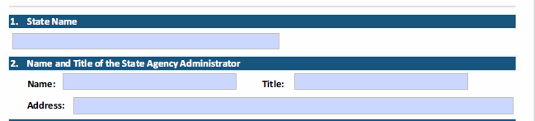
State Plan Elements 1 and 2
Verify that information matches SF-424
  State Name – SF-424 Section 8. Applicant Information, part a. Legal Name
  Name – SF-424 Section 21.
  Address – SF-424 Section 8. Applicant Information, part d. Address
Keep contact information up to date

Slide 4
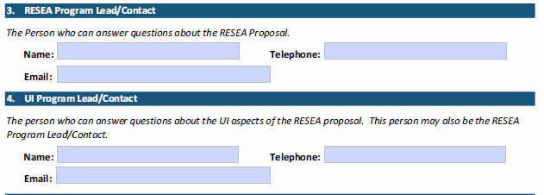
State Plan Elements 3 and 4
Possible that RESEA Program Lead/Contact is same person as UI Program Lead/Contact
Keep contact information up to date

Slide 5
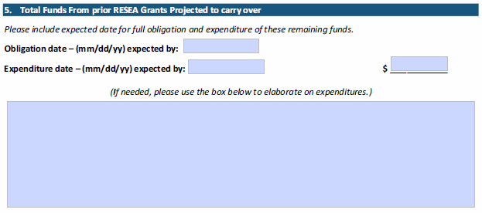
State Plan Elements 5
Verify carry-over limit for specific Fiscal Year
Use the blank text box to explain timeline for expenditure of carry-over funds

Slide 6
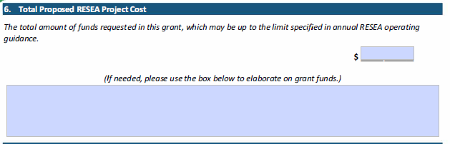
State Plan Elements 6
Verify that information matches SF-424 and SF-424A
  Total Funding – SF-424 Section 18, Estimated Funding ($) part (a) Federal and (g) TOTAL.
  Total Funding – SF-424A Section 1 and 5’s part (e) and (g); Section 6 part (k)
Use the blank text box to explain how amount calculated
Indicate if requesting maximum amount

Slide 7
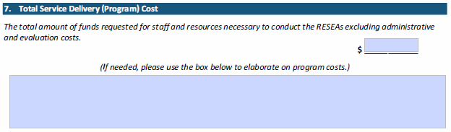
State Plan Elements 7
Use the blank text box to provide a break out narrative listing program costs
For example, Salary and Fringe; Contractor costs; Program costs; Other costs
Verify amount by Element 6 (Minus) Element 8

Slide 8
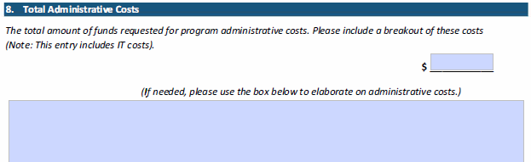
State Plan Elements 8
Provide all costs (direct and indirect)
Refer to 20 CFR Section 683.215 WIOA Title I
Verify amount by Element 7 (plus) Element 8 equals Element 6

Slide 9
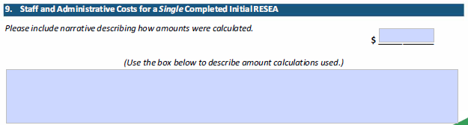
State Plan Elements 9
Verify amount by sum of the total staff costs and admin costs divided by the number of initial RESEAs the state projects shown in Element 18
Use blank text box to explain how staff and administrative costs calculated
If there is a significant cost difference between current and previous year, provide an explanation

Slide 10
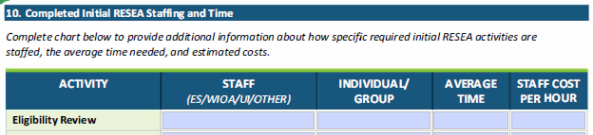

State Plan Elements 10
Chart reflects 5 activities required as part of RESEA session
Provide Time in minutes and Cost in dollars per hour
Items with “Zero” or decrease/increase compared to previous year are to be explained in Element 11 text box. Label “Notes on Initial RESEA Staffing and Time:”
Error check is Element 9 will be greater than Element 10

Slide 11
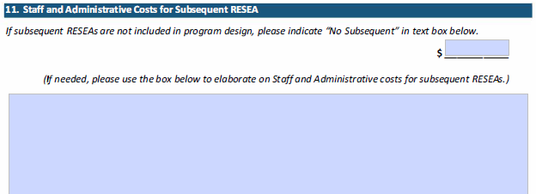
State Plan Elements 11
Use text box to provide cost breakout and explain how subsequent costs were determined
Indicate subsequent activities performed
If there are no subsequent, enter $0 and state “No Subsequent”
Error check is Element 11 will be less than Element 9

Slide 12
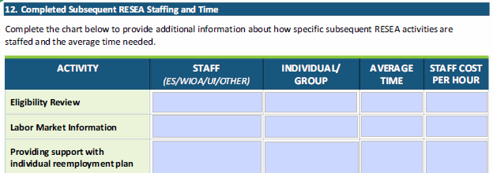
State Plan Elements 12
Similar to chart in Element 10, provide Time in minutes and Cost in dollars per hour
Fields requiring explanation, use the Element 11 text box. Label “Notes on Subsequent RESEA Staffing and Time:”
Error check is Element 12 will be less than Element 10

Slide 13

State Plan Elements 13
If there are automated services that would account for speed and efficiency, use Element 15 text box and explain
Error check is Element 13 will be greater than Element 10

Slide 14

State Plan Elements 14
Use Element 15 text box to discuss/list subsequent paperwork activities
Error check is Element 14 will be greater than Element 12
If no subsequent RESEA, type ‘No subsequent’ or ‘N/A’

Slide 15
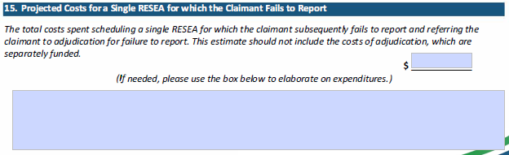
State Plan Elements 15
Provide projected cost in financial text box, excluding adjudication costs
Use blank text box to explain expenditures, including costs associated with Failure to Report (FTR) and its calculation
If FTR costs noticeable different than previous year, use blank text box to explain why

Slide 16

State Plan Elements 16
If noticeable increase or decrease than previous year, provide an explanation how target was determined
Error check is Element 18 (plus) Element 19 equals Element 16

Slide 17
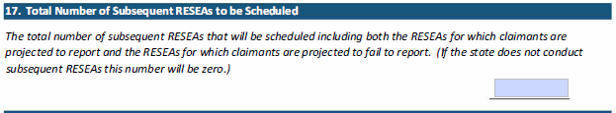
State Plan Elements 17
Include both number of Subsequent to be scheduled and projected claimants fail to report
If total subsequent scheduled is unchanged or notable increase/decrease than previous year, provide an explanation in Element 20
If no subsequent, put “0” in text field

Slide 18

State Plan Elements 18
For states conducting subsequent RESEAs, include this number in Element 18 text field
For example, state estimates it will complete 2500 initial RESEAs and 100 subsequent RESEAs, then Element 18 will read “2500/100”
Error check is Element 19 (minus) Element 16 equals Element 18
If goals remain unchanged or notable difference than previous year, explain in Element 20’s text field

Slide 19

State Plan Elements 19
Use text field to breakout number of initial and subsequent
Error check is Element 18 (minus) Element 16 equals Element 19
If notable fail to report rate or unchanged, explain how rate and number determined. Include information on mitigating factors being taken or planned action to reduce rate and obstacles creating the rate

Slide 20
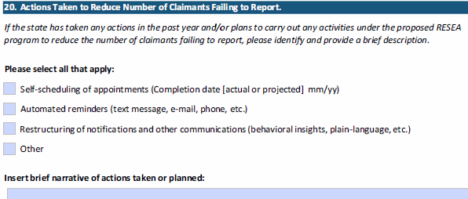
State Plan Elements 20
Use tick-boxes for all action taken or planned
Provide a details about actions taken/planned with a timeline
Actions must demonstrate that aid in reducing no-show rates

Slide 21
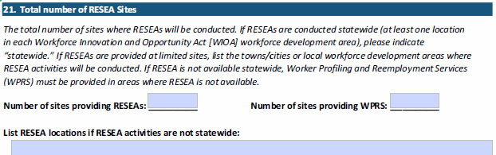
State Plan Elements 21
If RESEA Statewide enter “Statewide”
If RESEA NOT statewide, enter number of RESEA sites, list RESEA locations and enter number of WPRS sites, list WPRS locations

Slide 22
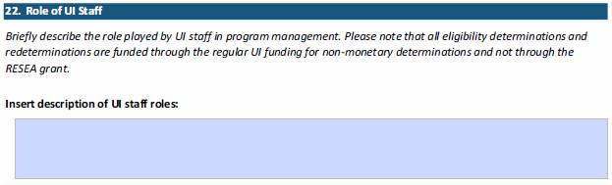
State Plan Elements 22
Provide information on: what UI staff role in the RESEA program management; who provides UI training to staff; RESEA and Employee Services staff trained on how to detect UI eligibility issues?; What is the UI adjudication process for RESEA
Establish that UI approved training in compliance with WIOA Section 134(c)(A) and WIOA 20 CFR 678.430(a)(10)
Staff providing RESEA services must receive sufficient training from UI staff

Slide 23
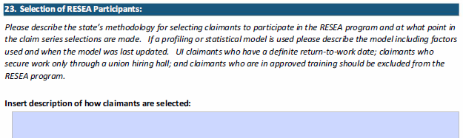
State Plan Elements 23
Provide information on:
  The actual selection process of participants;
  Description of the statistical model used;
  When model last updated and plans for update;
  Statement about targeted population and how it was determined.

Slide 24
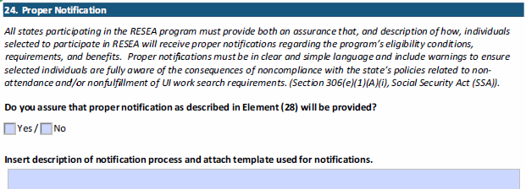
State Plan Elements 24
Provide information on notification process
Discuss mitigating instances of an RESEA participant failing to report, e.g., what type and how often reminders are sent
If “No” to proper notification, explain
Include a copy of notice with state plan

Slide 25
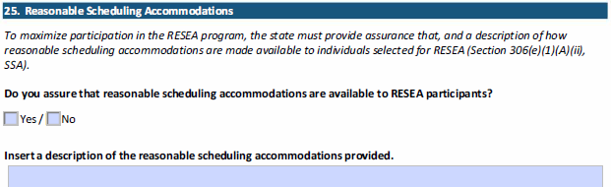
State Plan Elements 25
Provide a description of reasonable scheduling accommodations:
  Rescheduling process, policies, and procedures;
  How many times a claimant can reschedule;
  Timeline for appointments, e.g., how far out appointments are scheduled;
  Is there a scheduling process in place for subsequent RESEA?
If “No” to proper notification, explain
Include a copy of notice with state plan

Slide 26
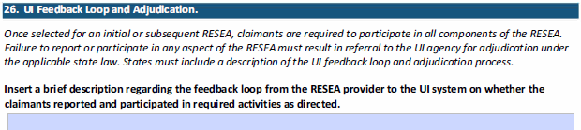
State Plan Elements 26
Part 1 - provide information on RESEA to UI System:
  Feedback process and are there follow ups;
  Staff involved and roles/responsibilities;
  What happens when claimant fails to report and or never reschedules?
Part 2 - provide information on UI eligibility issues:
  How are claimant eligibility issues referred? When non-UI staff?;
  How long does the issue remain open with the claimant?

Slide 27
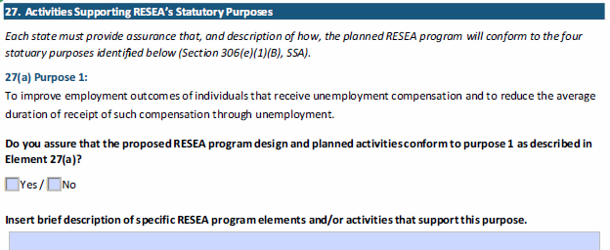
State Plan Elements 27
These four responses are to provide specific information to assure the planned activities
  1) fulfill each purpose and
  2) support each of the other purposes.

Slide 28
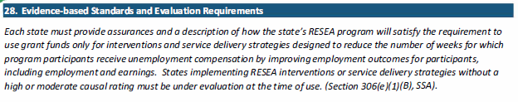
State Plan Elements 28
Use the FY 2020 RESEA State Plan Plain Language tool to complete Elements 28a – 28d
https://rc.workforcegps.org/resources/2019/07/30/17/32/RESEA_Evaluation_Evidence_Resources

Slide 29
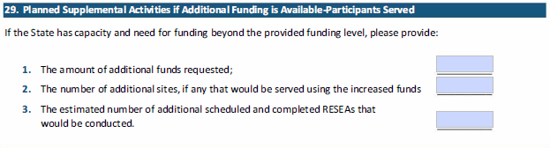
State Plan Elements 29
If a state does not wish to request additional funds, then enter “Zero” in the fields

Slide 30
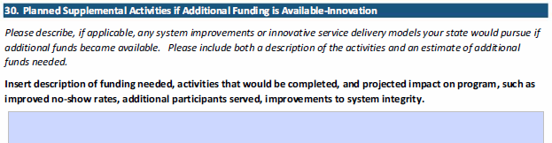
State Plan Elements 30
Provide a description of how the state will use the additional funds requested in Element 29
Response to include description of activities, the funds needed, projected timeline, and overall projected impact on RESEA program

