Slide 1
TAA Reporting Overview

Slide 2

Today’s Speaker / Today’s Moderator
Robert Hoekstra
  Program Analyst
    Office of Trade Adjustment Assistance

Slide 3
Today’s Objectives
What reports does TAA use?
What are their purposes?
When do the reports need to be submitted?
Where can I find resources?

Slide 4
TAA Reporting Parts
Participant Reporting
Participant Individual Record Layout (PIRL)
Financial Reporting
State Practices
Efforts to Improve Outcomes
TAA Administrative Collection (TAAACS)
TAA Data Integrity (TAADI)
Petition Data
Program (TaOA)
ETA-9130(M)
Benefits (TRA/RTAA)
ETA-9130
TAADI Self-Check
Quarterly Sheets
Annual Review
Data Validation
(State Operated)

Slide 5
TAA Reporting Parts
Why do we collect so much data?
Statutory requirements
Ensuring proper program administration
Identifying good state practices
Most importantly… Telling our story

Slide 6
TAA Participant Reporting

Slide 7
TAA Participant Reporting
Participant Reporting
Participant Individual Record Layout (PIRL)
TAA Data Integrity (TAADI)
TAADI Self-Check
Quarterly Sheets
Annual Review
Data Validation
(State Operated)
Participant Individual Record Layout (PIRL)
Submitted every quarter through the Workforce Integrated Performance System (WIPS) on the 15th day of the second month of the next quarter
Includes a record for every participation
Tracks all participants being served and through 10 quarters after exit
Can be submitted jointly with other programs
  Large overlap with WIOA programs

Slide 8
TAA Participant Reporting
Participant Reporting
Participant Individual Record Layout (PIRL)
TAA Data Integrity (TAADI)
TAADI Self-Check
Quarterly Sheets
Annual Review
Data Validation
(State Operated)
PIRL Differences for TAA
Petition and eligibility information
TAA-specific benefits and services
  TAA case management
  Trade Adjustment Allowances (TRA)
  Reemployment Trade Adjustment Assistance (RTAA)
  Job search and relocation allowances
Expenditure data
Fiscal Year instead of Program Year

Slide 9
TAA Participant Reporting
Participant Reporting
Participant Individual Record Layout (PIRL)
TAA Data Integrity (TAADI)
TAADI Self-Check
Quarterly Sheets
Annual Review
Data Validation
(State Operated)
PIRL Reporting Resources
TAA Participant Reporting Practitioner Resources
  TAA reporting materials by topic, FAQ sheets, and webinars
    https://www.dol.gov/agencies/eta/tradeact/practitioners/participant-reporting
Joint PIRL Online Learning Resource
  Learn all about PIRL reporting, who uses the PIRL, and basic requirements
    https://performancereporting.workforcegps.org/resources/2019/10/01/13/32/PIRL-Reporting-Online-Resource
WIOA Performance Site
  Basic information, WIPS Access
    https://www.dol.gov/agencies/eta/performance
WIOA Performance Reporting WorkforceGPS Site
  Additional information about this resource
    https://performancereporting.workforcegps.org/
Reporting Ask Me Anything Sessions

Slide 10
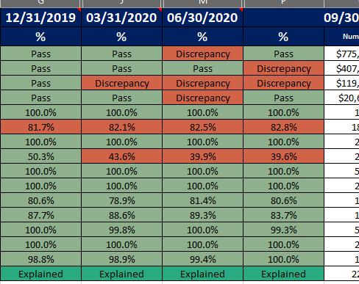
TAA Participant Reporting
Participant Reporting
Participant Individual Record Layout (PIRL)
TAA Data Integrity (TAADI)
TAADI Self-Check
Quarterly Sheets
Annual Review
Data Validation
(State Operated)
TAA Data Integrity (TAADI)
Quarterly review of data submitted
Uses aggregate measures to flag where states may be struggling on reporting or programmatic issues
Some measures compare PIRL data to Financial Data
States are required to look into issues and respond
Looks for continuous improvement

Slide 11
TAA Participant Reporting
Participant Reporting
Participant Individual Record Layout (PIRL)
TAA Data Integrity (TAADI)
TAADI Self-Check
Quarterly Sheets
Annual Review
Data Validation
(State Operated)
TAA Data Integrity (TAADI)
TAADI Self-Check
PIRL Submission
TAADI Results to States
TAADI Responses to Regions/Natl
Technical Assistance?
TAADI Self-Check allows states to check data before submissions
Annual review after 4th quarter (9/30) responses which can result in areas of concern or findings
Annual changes in measures and targets as necessary

Slide 12
TAA Participant Reporting
Participant Reporting
Participant Individual Record Layout (PIRL)
TAA Data Integrity (TAADI)
TAADI Self-Check
Quarterly Sheets
Annual Review
Data Validation
(State Operated)
TAADI Resources
Today’s TAADI Webcast
  A full discussion of TAADI including measures, processes, etc.
    https://performancereporting.workforcegps.org/resources/2018/10/11/14/48/Today-s-TAADI-Webcast
TAA Participant Reporting Practitioner Resources
  Self-Check files, annual review processes, and more!
    https://www.dol.gov/agencies/eta/tradeact/practitioners/participant-reporting
TAADI TEGL 01-19
  Guidance on TAADI, the timeline, and the requirements
    https://wdr.doleta.gov/directives/corr_doc.cfm?docn=7478
TAADI Ask Me Anything Sessions

Slide 13
TAA Participant Reporting
Participant Reporting
Participant Individual Record Layout (PIRL)
TAA Data Integrity (TAADI)
TAADI Self-Check
Quarterly Sheets
Annual Review
Data Validation
(State Operated)
TAA Data Validation
States are required to have a process to check that the data they submit is accurate
States have flexibility in their process
Nothing needs to be submitted, but subject to monitoring
Specific elements and their validation can be found in TEGL 23-19 and its attachments

Slide 14
TAA Financial Reporting

Slide 15
TAA Financial Reporting
Benefits (TRA/RTAA)
ETA-9130
Program (TaOA)
ETA-9130(M)
Financial Reporting
TAA Program (TaOA) Financial Reporting
Training and Other Activities (TaOA) funds
  Training
  Case management
  Job search and relocation
  Administration
Aggregate quarterly reports
Three year funds
Used in TAADI

Slide 16
TAA Financial Reporting
Financial Reporting
Program (TaOA)
ETA-9130(M)
Benefits (TRA/RTAA)
ETA-9130
TAA Benefit (TRA and RTAA) Benefit Reporting
Aggregate quarterly reports
One-year funds
Used in TAADI

Slide 17
TAA Financial Reporting
Financial Reporting
Program (TaOA)
ETA-9130(m)
Benefits (TRA/RTAA)
ETA-9130
Financial Reporting Resources
TEGL 18-20: TAA Financial Reporting Alignment and Clarifications
  Provides guidance to address major financial reporting requirements and how to address specific situations
    https://wdr.doleta.gov/directives/corr_doc.cfm?DOCN=9318
TAA Financial Overview
  Financial discussion of TAA including common issues
    https://www.workforcegps.org/events/2019/12/04/15/26/Trade-Adjustment-Assistance-TAA-Financial-Overview
TAA Financial Reporting Practitioner Resources
  Fiscal Self-Check files, webinars, reserve funding requests
    https://www.dol.gov/agencies/eta/tradeact/practitioners/financial-reporting
Department Financial Reporting Page
  Deadlines, form instructions, and copies of forms
    https://www.dol.gov/agencies/eta/grants/management/reporting
TAADI and Fiscal Ask Me Anything Sessions

Slide 18
TAA Petition Data

Slide 19
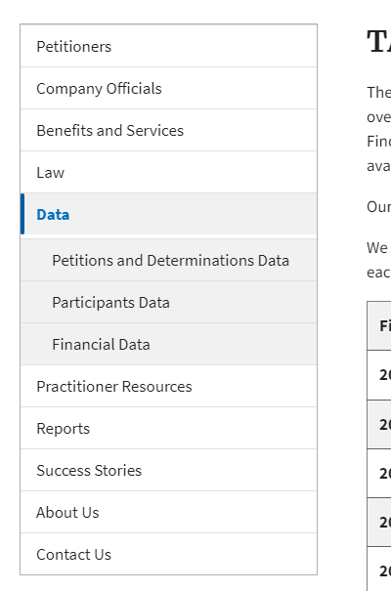
TAA Petition Data
Petition Data
TAA Petition Data
No data to be submitted!
Provides information on what groups of workers can be served by TAA
Includes criteria such as when a layoff needs to occur for a participant to be eligible.
Data files available at:
https://www.dol.gov/agencies/eta/tradeact/data/petitions-determinations

Slide 20
TAA State Practices

Slide 21
TAA State Practices
State Practices
Efforts to Improve Outcomes
TAA Administrative Collection (TAAACS)
TAA Efforts to Improve Outcomes
Quarterly narrative on state efforts
Provides us information on what you are working on
Short and focused on highlights
Entered as a comment on the QPR (when submitting PIRL)
Posted publicly on the website

Slide 22
TAA Participant Reporting
State Practices
Efforts to Improve Outcomes
TAA Administrative Collection (TAAACS)
Efforts to Improve Outcomes Resources
Reporting “Efforts to Improve Outcomes” Webinar
  Discussed how to write good narratives, how to submit, and what kind of information should be included
    https://www.workforcegps.org/events/2018/12/10/17/52/Reporting-Efforts-to-Improve-Outcomes-in-PIRL-for-the-TAA-Program
Efforts to Improve Outcomes FAQ
  Or a short FAQ that gives you all the information you need to submit
    https://www.dol.gov/sites/dolgov/files/ETA/tradeact/pdfs/PIRL_Efforts_to_Improve_Outcomes_FAQ.pdf
TAA Participant Reporting Practitioner Resources
  Efforts to Improve Outcomes resources are also here!
    https://www.dol.gov/agencies/eta/tradeact/practitioners/participant-reporting

Slide 23
TAA State Practices
State Practices
Efforts to Improve Outcomes
TAA Administrative Collection (TAAACS)
TAA Administrative Collection of States (TAAACS)
States submit annually in October/November
Emailed, Fillable Excel Sheet
Collect discrete data across 8 categories
  State Organization
  Outreach
  Eligibility and Program Benefits and Services
  Integration
  IT Systems and Reporting
  Training for TAA Staff
  Barriers and Technical Assistance
  Worker List Collection

Slide 24
TAA Participant Reporting
State Practices
Efforts to Improve Outcomes
TAA Administrative Collection (TAAACS)
TAAACS Resources
TAAACS: Filling out the 2021 Version
  About the collection, how to fill it out, and how we use it
    https://www.workforcegps.org/events/2021/08/25/13/14/TAAACS-Filling-out-the-2021-Version
TAAACS Review of Initial Results
  A whirlwind tour of some of the insights from our first collection
    https://www.workforcegps.org/events/2020/01/02/18/33/TAA-Administrative-Collection-of-States-Review-of-Initial-Results

Slide 25
Understanding the TAA Timeline

Slide 26
TAA Reporting Obligations
Quarterly
Due On Report Deadline
PIRL
ETA-9130s
Quarterly
After Reporting Deadline
TAADI Responses
Annual
TAADI Annual Review (early February)
TAAACS Collection (Oct/Nov)
Efforts to Improve Outcomes
TAADI Self-Check (Highly Recommended)
Ongoing
Data Validation

Slide 27
TAA Reporting Deadlines
January
Mid-Jan: Semi-Annual Fiscal AMA 1/18: DOL TAADI Assistance to States Deadline
February
Feb: TAADI Annual Review Results to States 2/15: PIRL, 9130s, and Efforts to Improve Due*
March
3/11: TAADI results to states 3/31: States provide TAADI Responses*
April
4/20: DOL TAADI Assistance to States Deadline
May
5/15: PIRL, 9130s, and Efforts to Improve Due*
June
6/9: TAADI results to states 6/29: States provide TAADI Responses*
July
Mid-July: Semi-Annual Fiscal AMA 7/19: DOL TAADI Assistance to States Deadline
August
8/15: PIRL, 9130s, and Efforts to Improve Due*
September
9/8: TAADI results to states 9/28: States provide TAADI Responses*
October
10/1: TAAACS Period Opens 10/18: DOL TAADI Assistance to States Deadline
November
11/15: PIRL, 9130s, and Efforts to Improve Due* 11/30: TAAACS Deadline
December
12/9: TAADI results to states 12/29: States provide TAADI Responses*
*Two Ask Me Anything (AMA) sessions will precede this deadline
PIRL, Efforts to Improve, and ETA-9130s always are due on the 15th irrelevantly of holidays and weekends.

Slide 28
What Don’t We Do?

Slide 29
Obligations We DON’T Have
No separate annual participant report
No annual narrative report
No negotiation of performance outcomes
No reports on training providers

Slide 30
Contact Us
Regional Contact
  https://www.dol.gov/agencies/eta/tradeact/contact/regional-office
Robert Hoekstra
  Program Analyst
    Office of Trade Adjustment Assistance
      hoekstra.robert@dol.gov
        202-693-3522
Susan Manikowski
  Program Analyst
    Office of Trade Adjustment Assistance
      manikowski.susan@dol.gov
        202-693-3545

